Slide 1

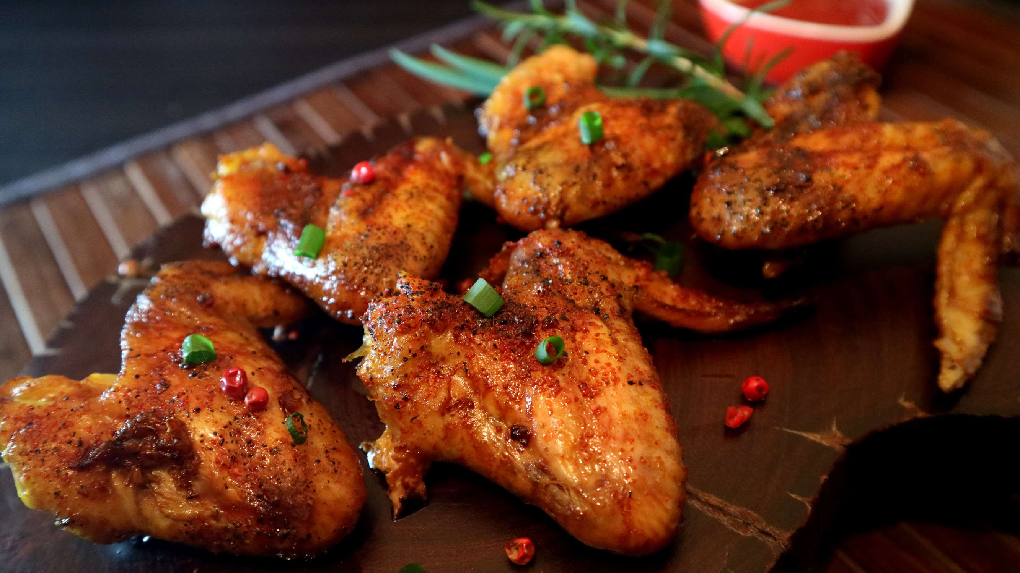
GLOBAL
CHICKEN
MARKET REPORT
2024
Global,Regional,CountryAnalysis

Slide 2
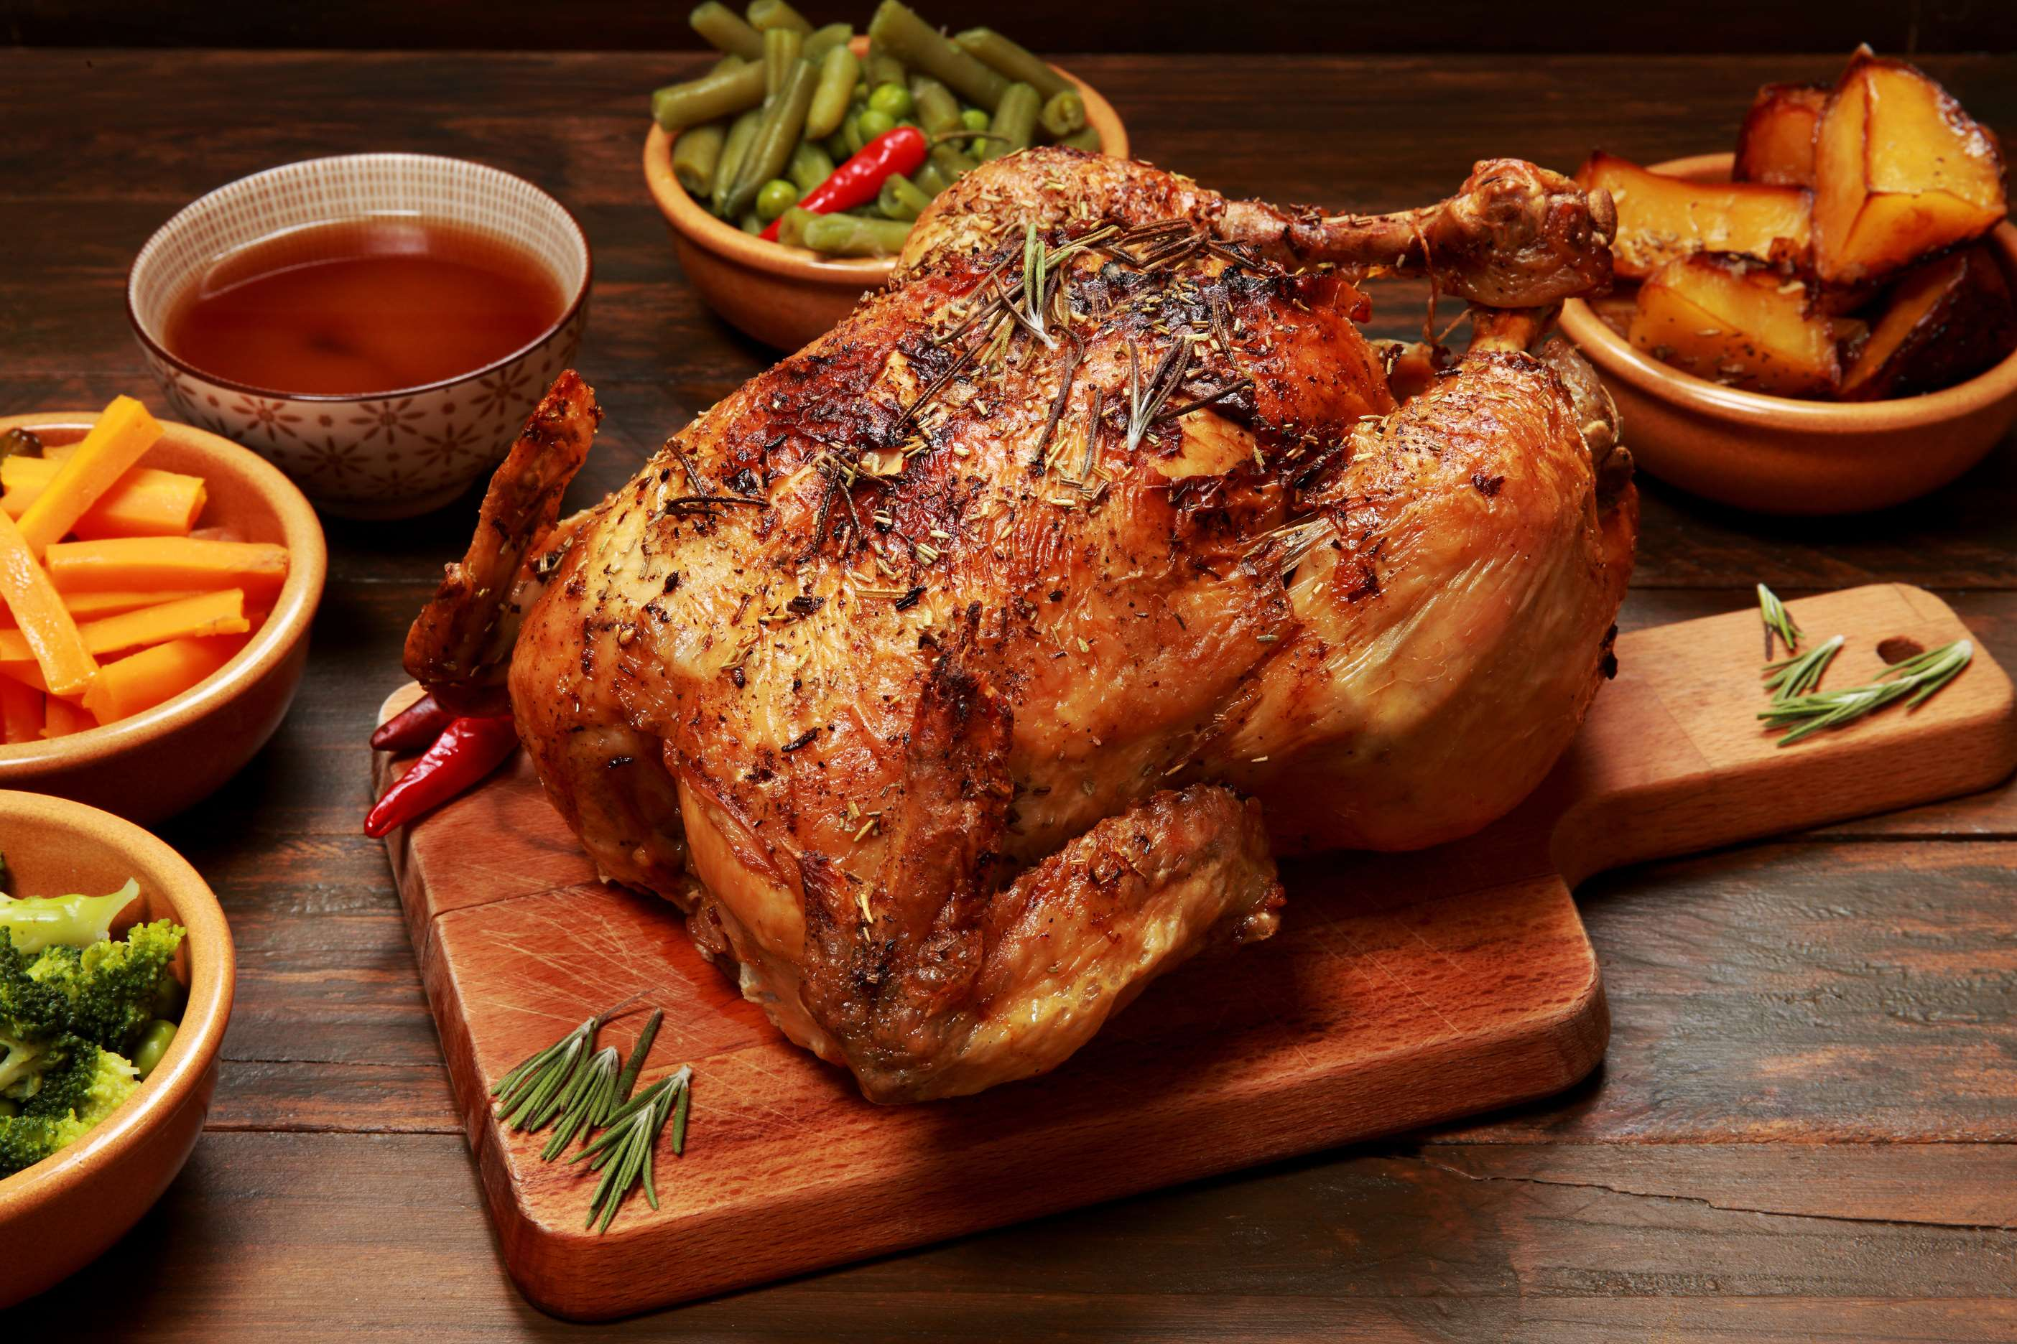
INTRODUCTION
The chicken market refers to the global trade and consumption of poultry products, primarily derived from domesticated chickens. Chicken is one of the most widely consumed meats worldwide, valued for its affordability, versatility, and nutritional value. It encompasses various products such as whole chickens, chicken parts (e.g., breasts, thighs, wings), processed chicken (e.g., nuggets, sausages), and value-added products (e.g., marinated chicken, pre-cooked meals).One of the key drivers propelling the chicken market is the growing global population and changing dietary preferences. As the world's population continues to expand, particularly in emerging economies, there is an increasing demand for affordable protein sources.

Slide 3
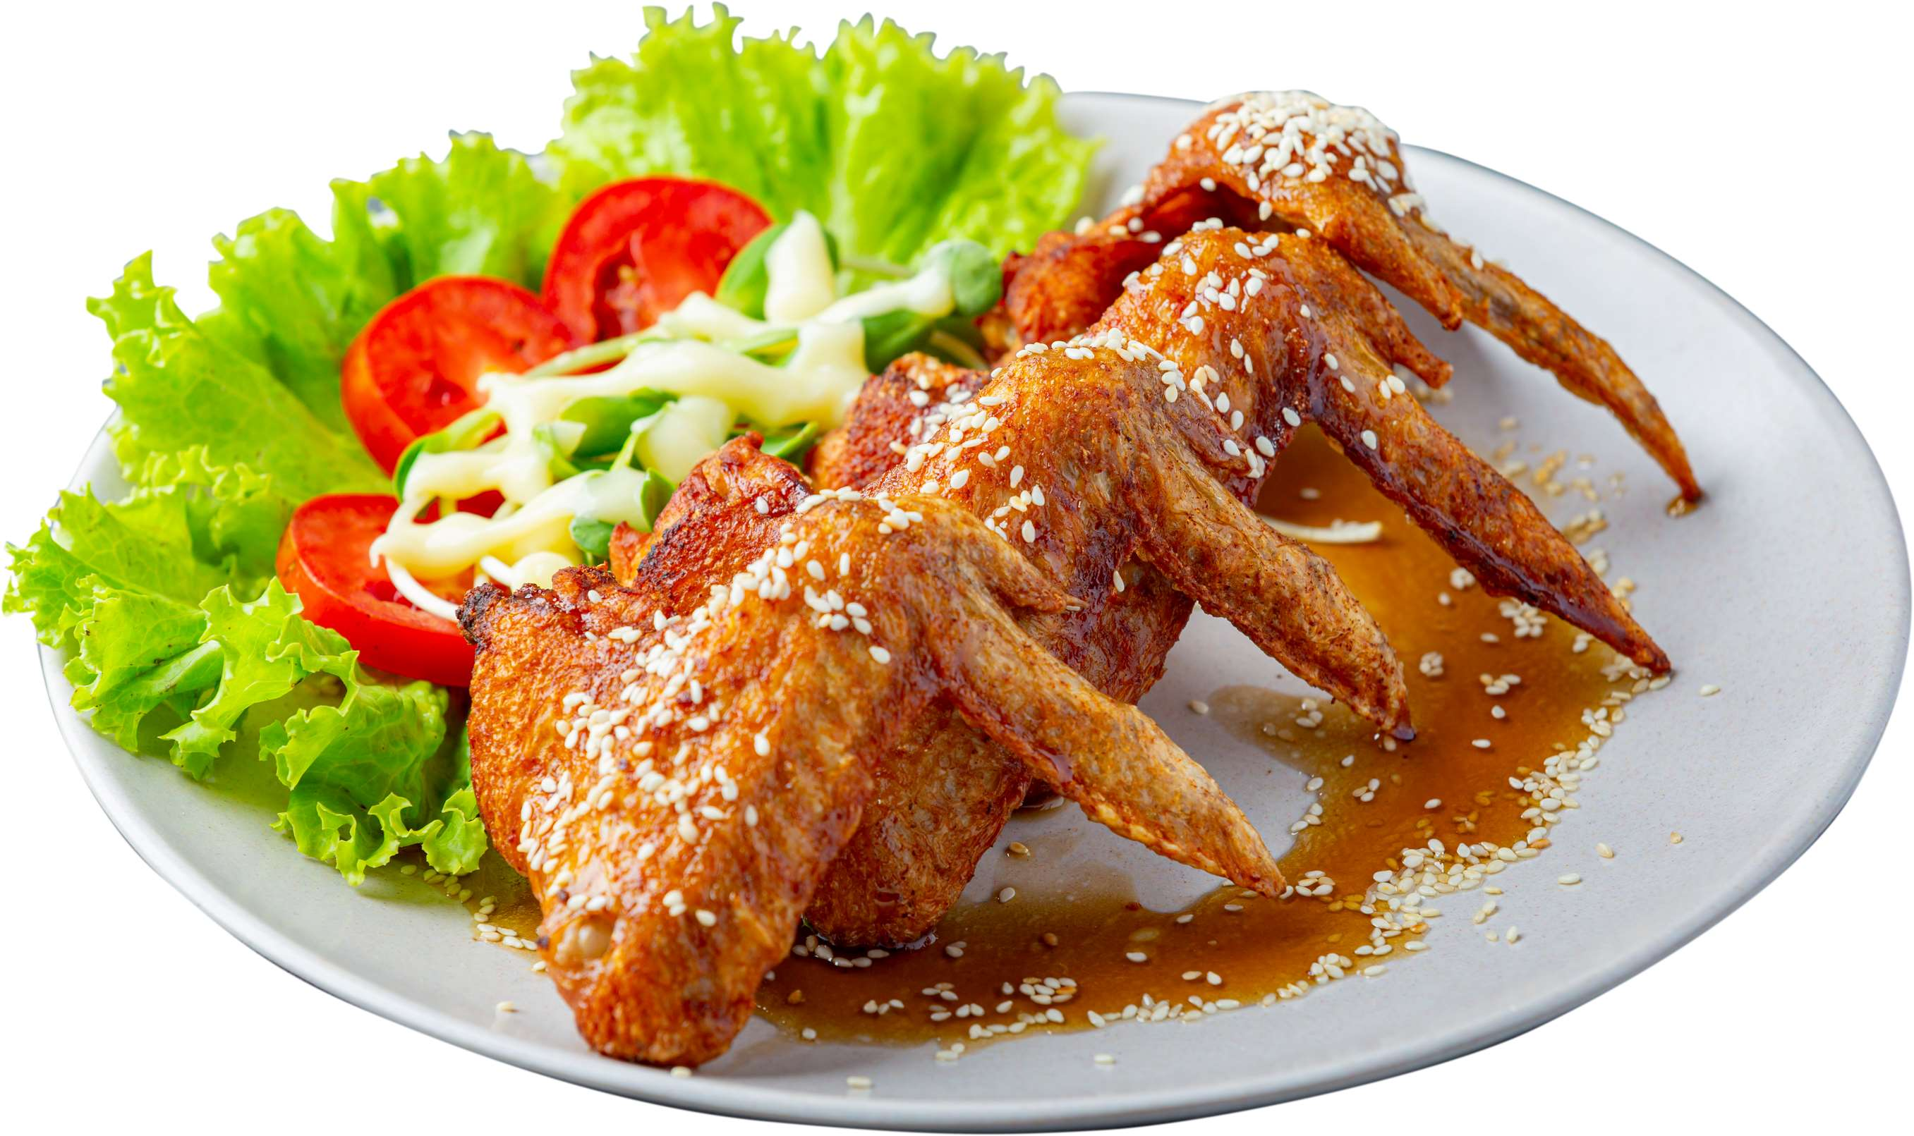

KEY INSIGHTS
MARKET SIZE
USD 369154.2 million
2024
CAGR
6.00%
2024- 2031

Slide 4
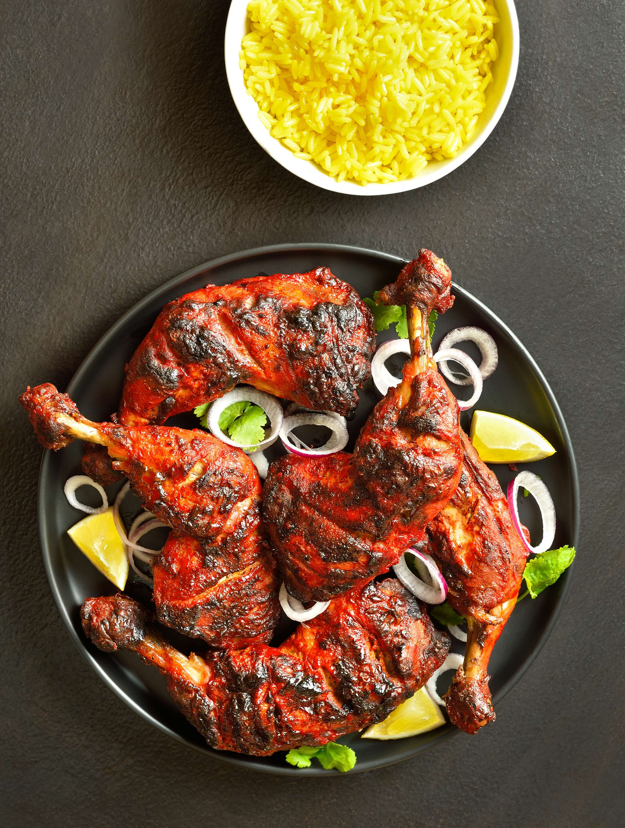
REVENUE MARKET SHARE BY SEGMENTS 2022
  Frozen Chicken
  Fresh Chicken
Type Segment
  Retail Stores
  Business to Business (B2B)
Distribution channel
  Food Services
  Households
End Use Segment

Slide 5

Global Chicken Market Revenue share for 2024
North America
40%

Slide 6
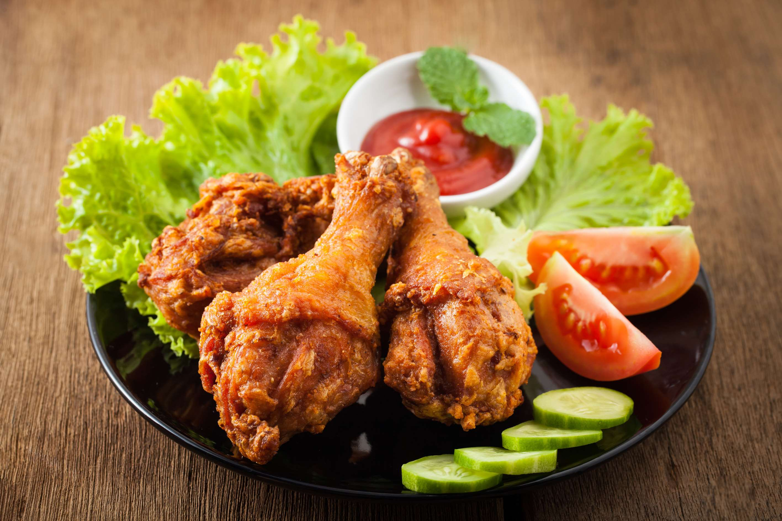
  Rising Consumer Demand for Poultry Products to Increase the Demand Globally
  Technological Advancements in Poultry Farming to Propel Market Growth
Drivers
Disease Outbreaks and Health Concerns to Limit the Sales
Restraints

Slide 7
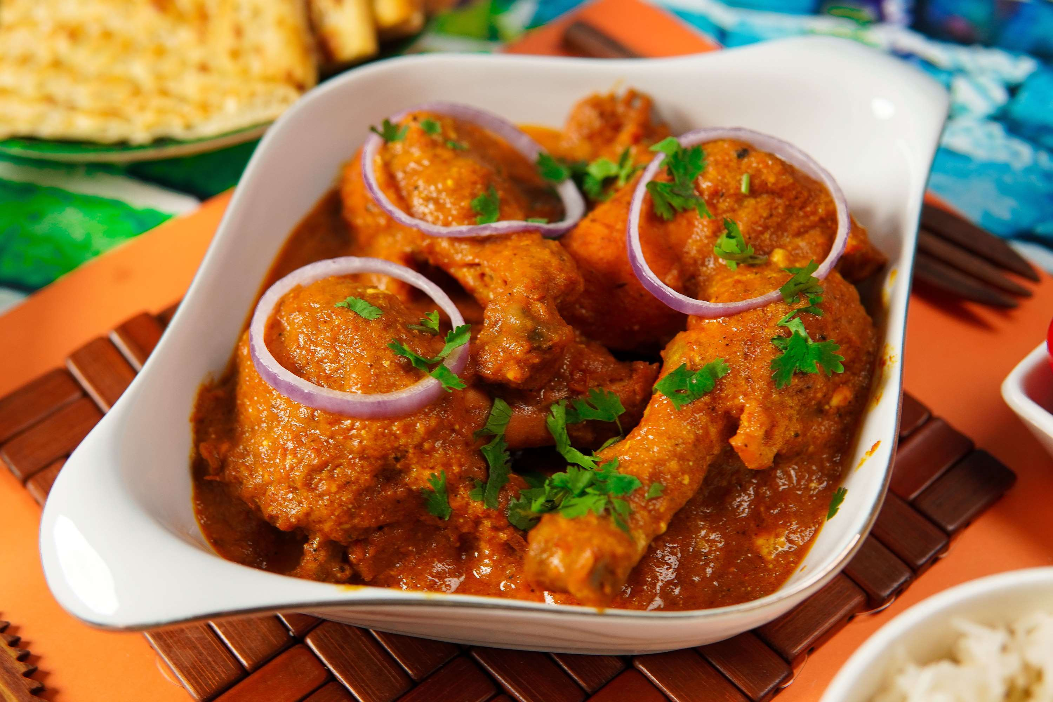
AUTHOR'S PERSPECTIVE
  The global Chicken market will expand significantly by 6.00% CAGR between 2024 to 2031.
  Frozen chicken offers longer shelf life and greater convenience in storage, handling, and distribution, making it an attractive option for consumers seeking extended product durability and ease of use.
  The rising popularity of chicken-centric cuisines, such as fried chicken, chicken sandwiches, and chicken salads, has driven the demand for chicken in the food services sector.
  The dominating category is often fresh chicken. Fresh chicken holds a prominent position due to several factors.
  The dominating category is often households. This is primarily due to the widespread consumption of chicken as a staple food item in households worldwide.

Slide 8


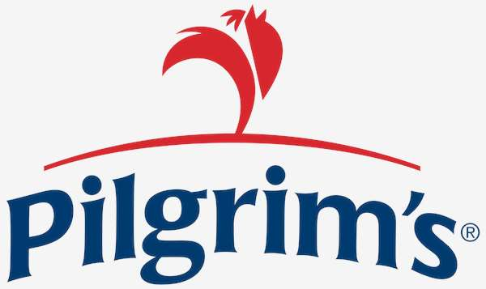


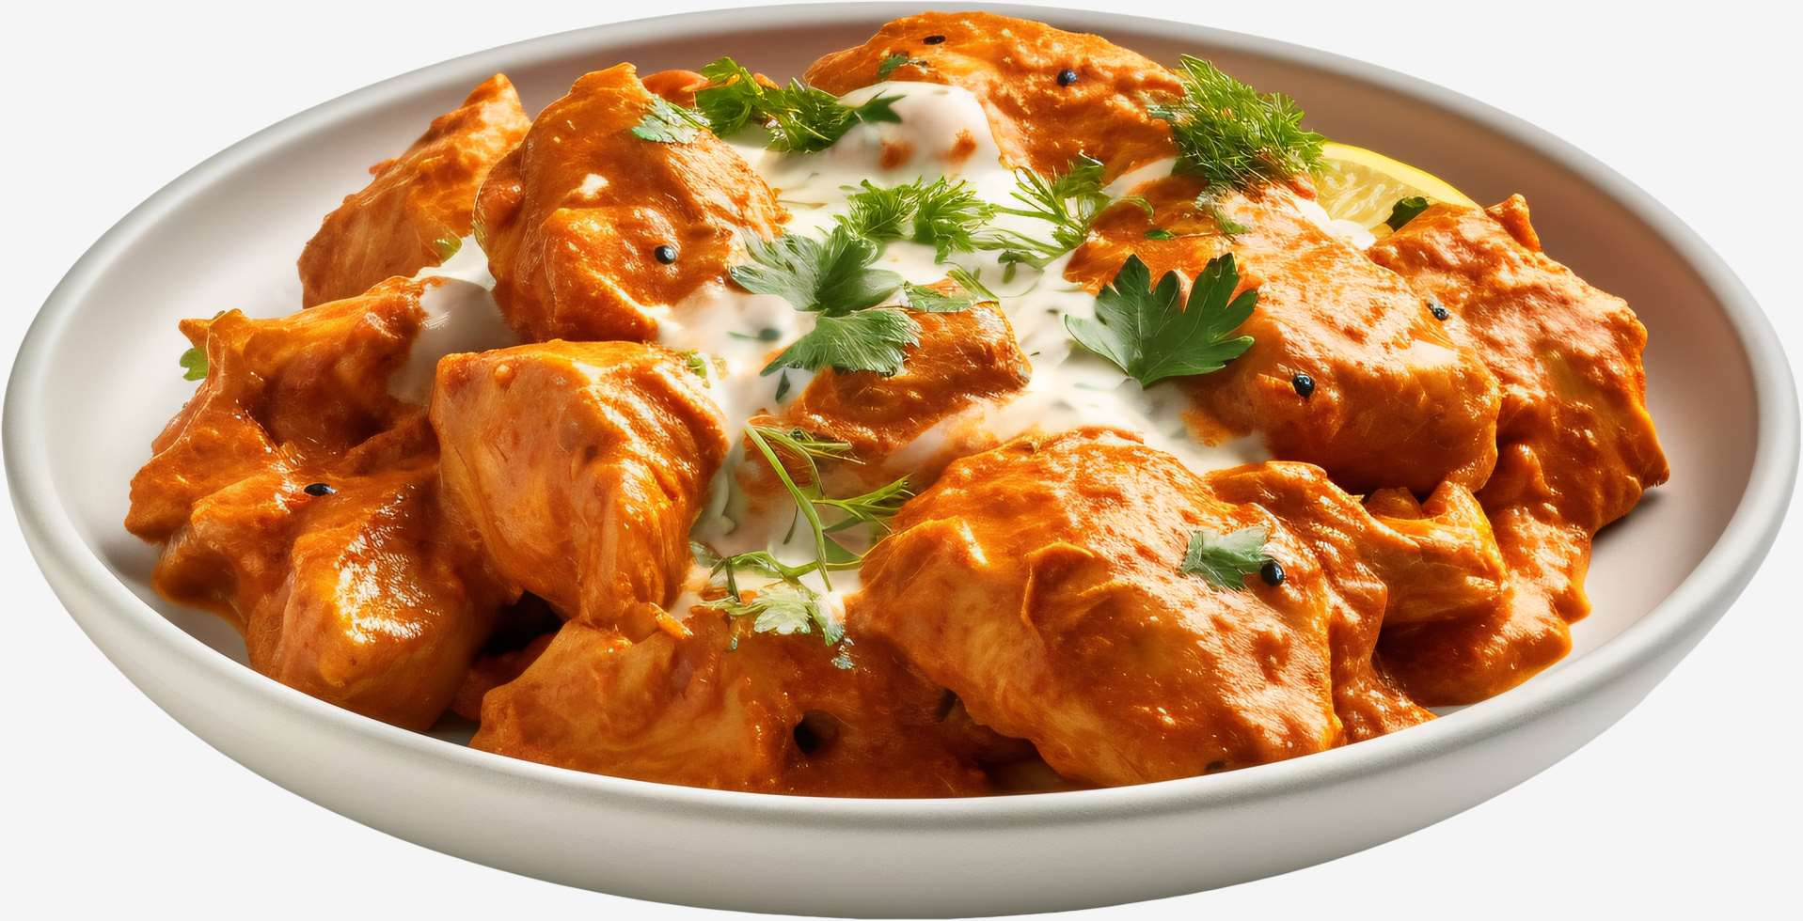



KEY PLAYERS

Slide 9


For Full Report
Contact us
COGNITIVE MARKET RESEARCH
Tel: +1 312-376-8303 | +44 020-8123-0732
India: (+91) 983-496-8611
sales@cognitivemarketresearch.com
Access the Full Report : https://tinyurl.com/54hp844r
Please visit our website:
https://www.cognitivemarketresearch.com

