Slide 1

GLOBAL
Ceramic Tableware
MARKET REPORT 2024
Global,Regional,CountryAnalysis

Slide 2

INTRODUCTION
Ceramic tableware, typically crafted from clay materials like bone china, porcelain, melamine, and stoneware, contributes a distinct and individualized element to dining establishments, hotels, and residences alike.
These ceramics, encompassing dinnerware and beverageware, showcase effortless cleaning properties and exhibit staining resistance. The widespread utilization of ceramic tableware fuels its expansion and offers an array of advantages.

Slide 3


KEY INSIGHTS
MARKET SIZE
USD 68.3 billion
2023
20₋23
CAGR 6.50%
2030

Slide 4
REVENUE MARKET SHARE BY SEGMENTS 2022
Sun Spray
Sun Protection Lotion
Type Segment
Infant
Children
Adult
Application Segment

Slide 5
Global Ceramic Tableware Market Revenue share for 2022
North America 30%

Slide 6
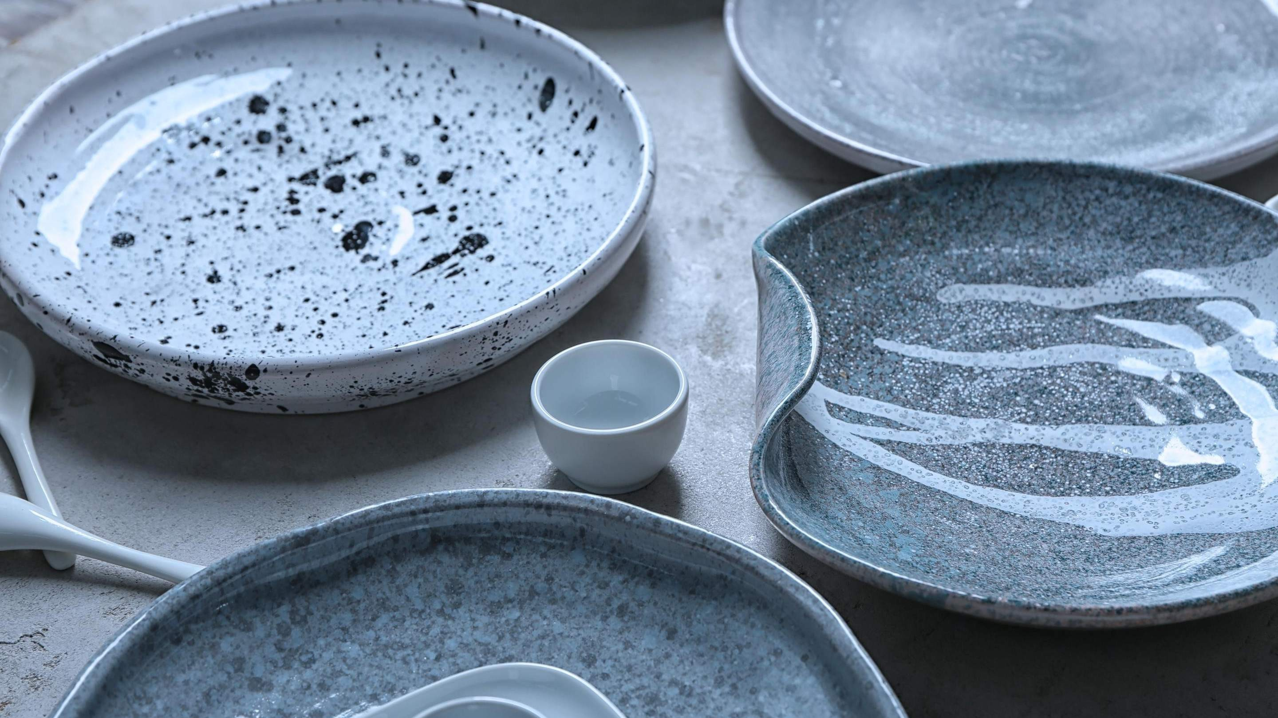



Slide 7

AUTHOR'S PERSPECTIVE
The Global Ceramic Tableware Market is
witnessing significant growth in the near future.
Stoneware tableware i tems are f i red at high
temperatures, making them highly resistant to cracks and breakage.
Restaurants, hotels, and households often prefer
porcelain tableware for i ts ability to enhance the dining experience, elevating the presentation of gourmet dishes.
Ceramic tableware is preferred in commercial settings due to i ts durability, versatility, and
ability to withstand the r igors of daily use and frequent washing.

Slide 8
KEY PLAYERS

Slide 9


Contact us
For Full Report
COGNITIVE MARKET RESEARCH
Tel: + 1 312 - 376 - 8303 | + 44 020 - 8123 - 0732
India: ( + 91 ) 983 - 496 - 8611
sales@ cognitivemarketresearch. com
Access the Full Report : http://tinyurl.com/5xe5kud8
Please visit our website:
https://www.cognitivemarketresearch.com

