Slide 1
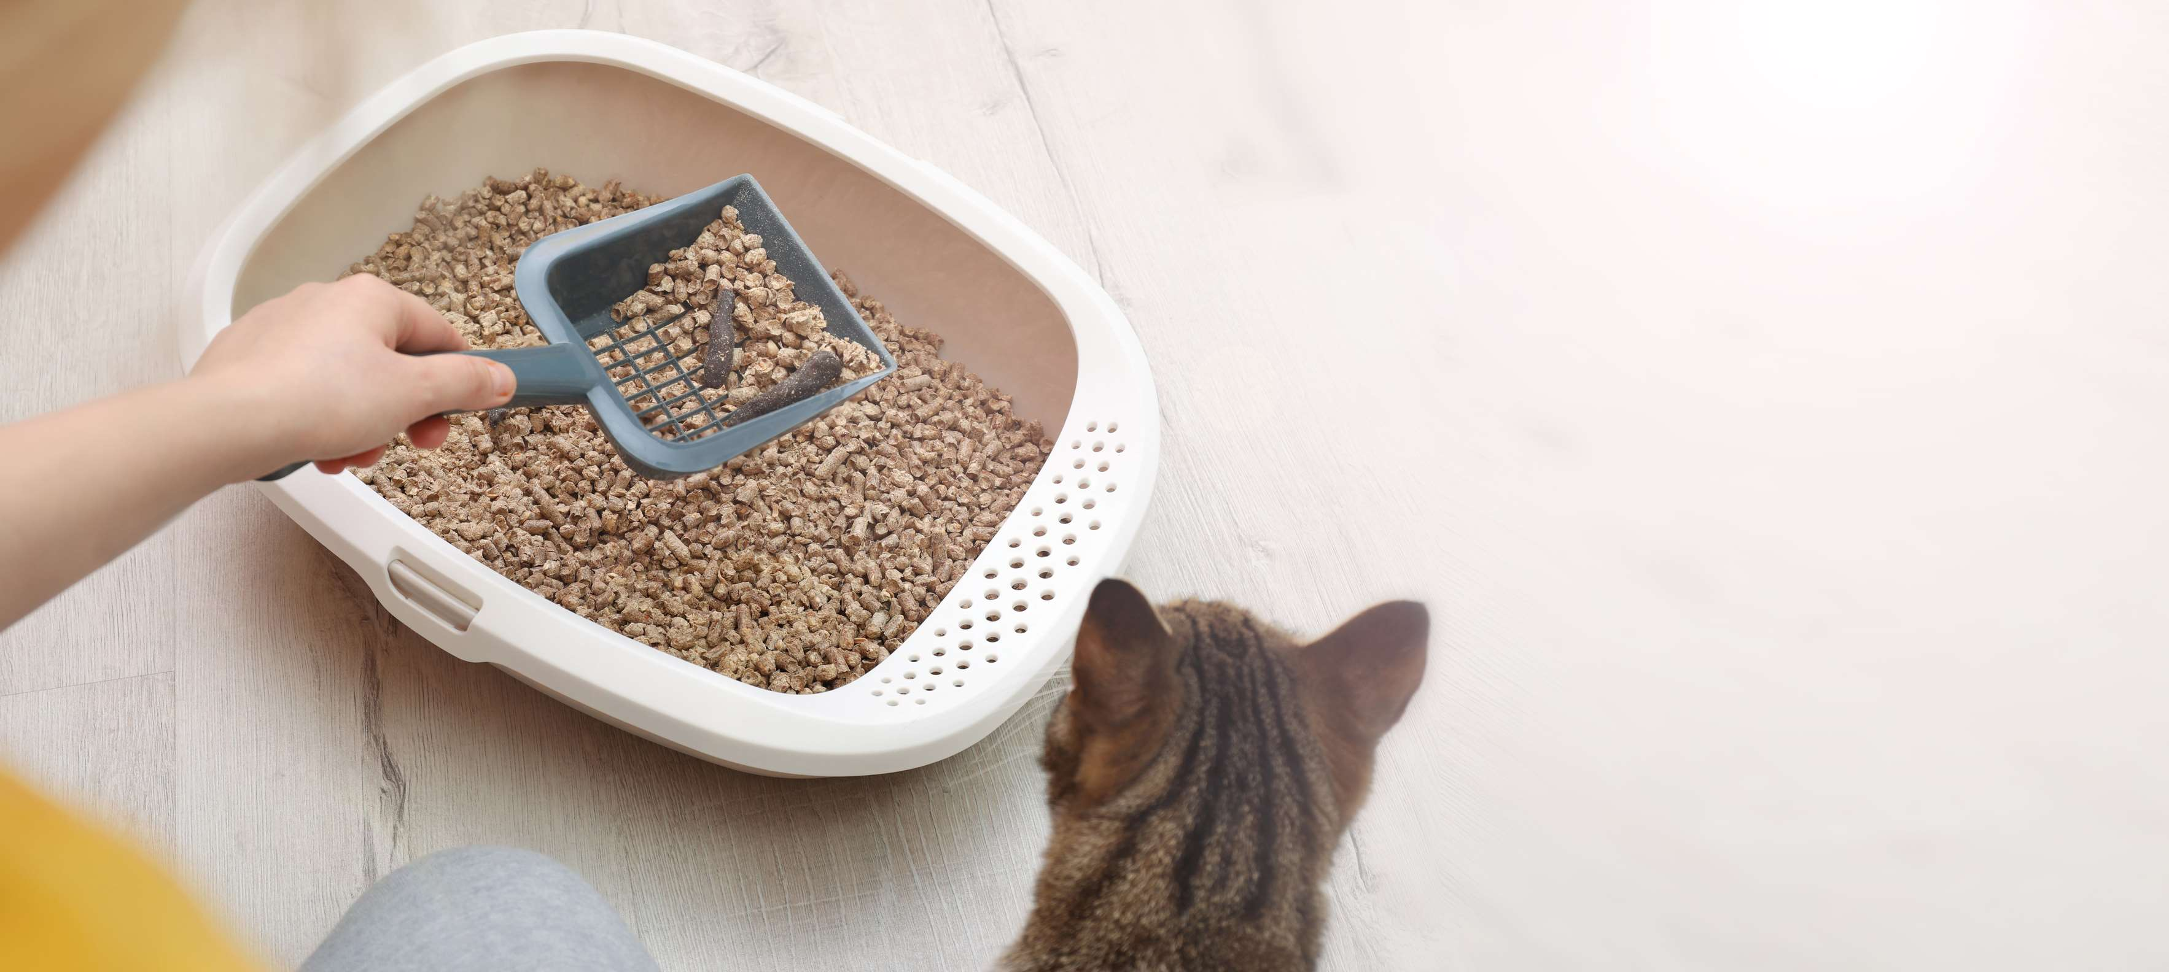
GLOBAL
CAT LITTER
MARKET REPORT
2024
Global,Regional,CountryAnalysis

Slide 2
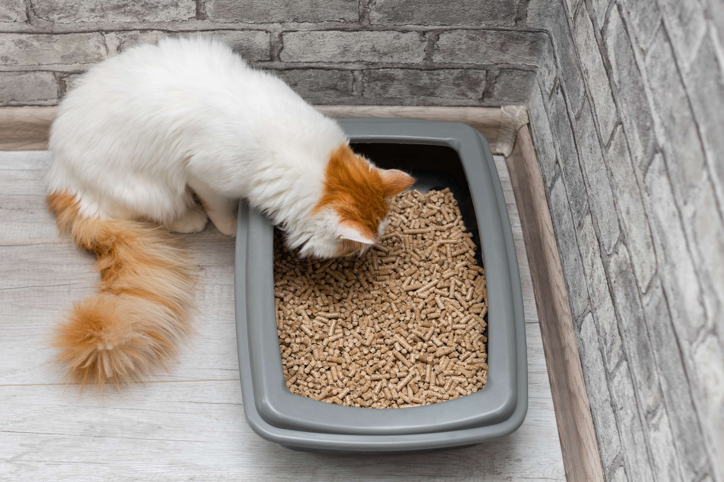
INTRODUCTION
The Cat Litter market encompasses products designed to provide a sanitary and convenient solution for managing feline waste. Primarily made from materials like clay, silica gel, plant-based substances, or recycled materials, cat litter absorbs moisture and traps odors to maintain cleanliness in homes with cats. With the steady growth in pet ownership globally, particularly in urban areas, the demand for cat litter has surged.

Slide 3
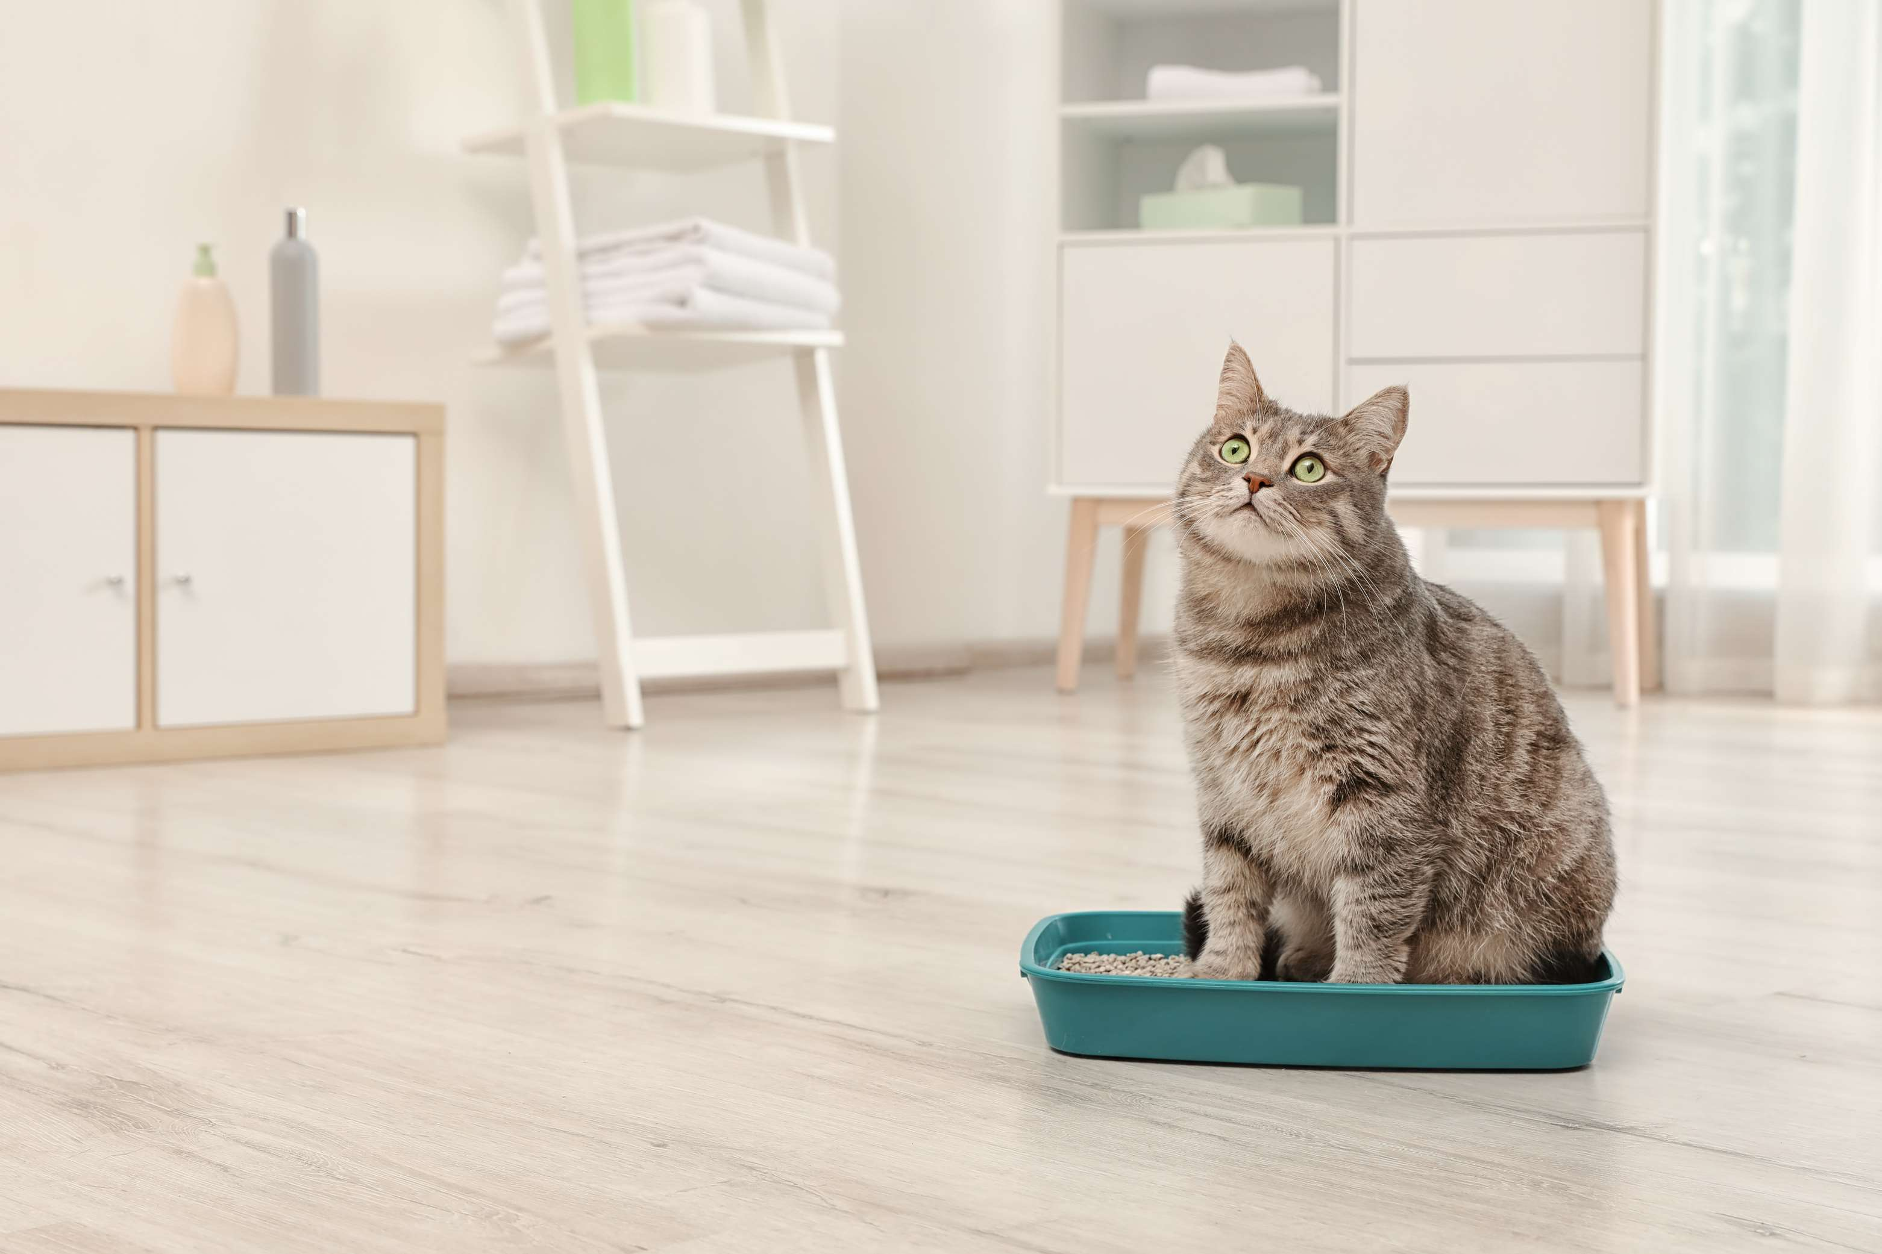

KEY INSIGHTS
MARKET SIZE
USD 15514.2 million
2024
CAGR
5.50%
2024- 2031

Slide 4
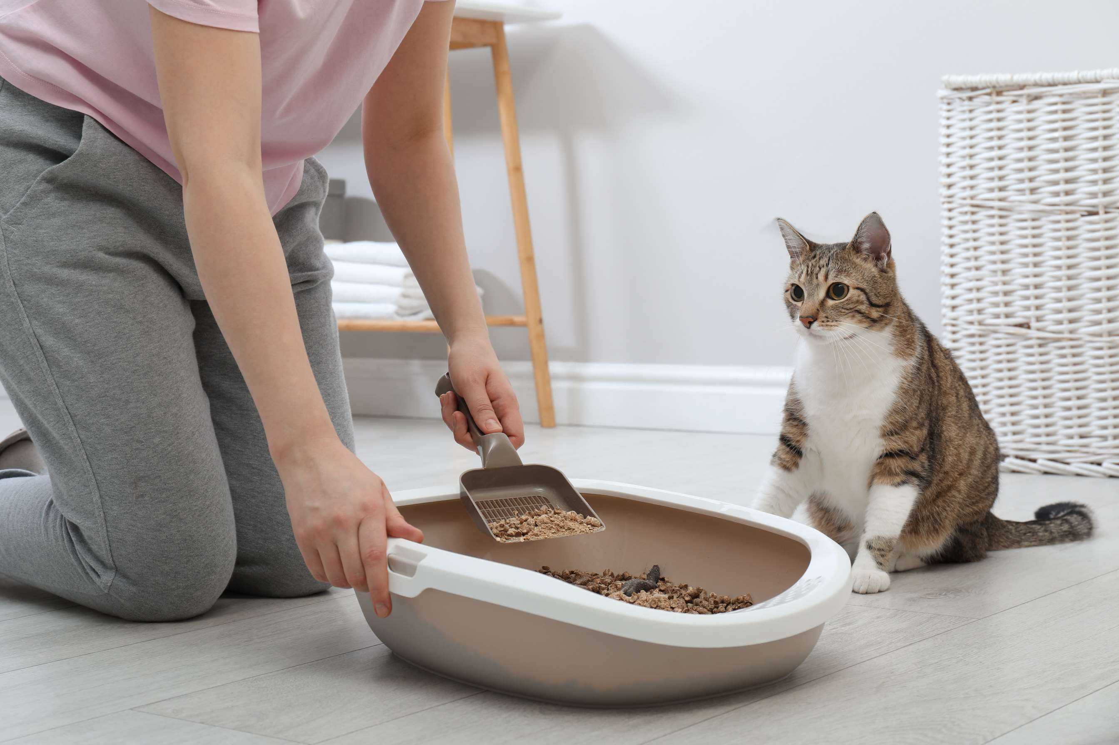
REVENUE MARKET SHARE BY SEGMENTS 2022
  Clumping
  Non-Clumping
Product Type Segment
  Natural
  Conventional
Nature Segment
  Clay
  Silica
  Plant Fibers
Material Type Segment
  Scented
  Unscented
Type Segment
  Adult
  Kitten
Life Stage Segment

Slide 5

Global Cat Litter Market Revenue share for 2024
North America
40%

Slide 6
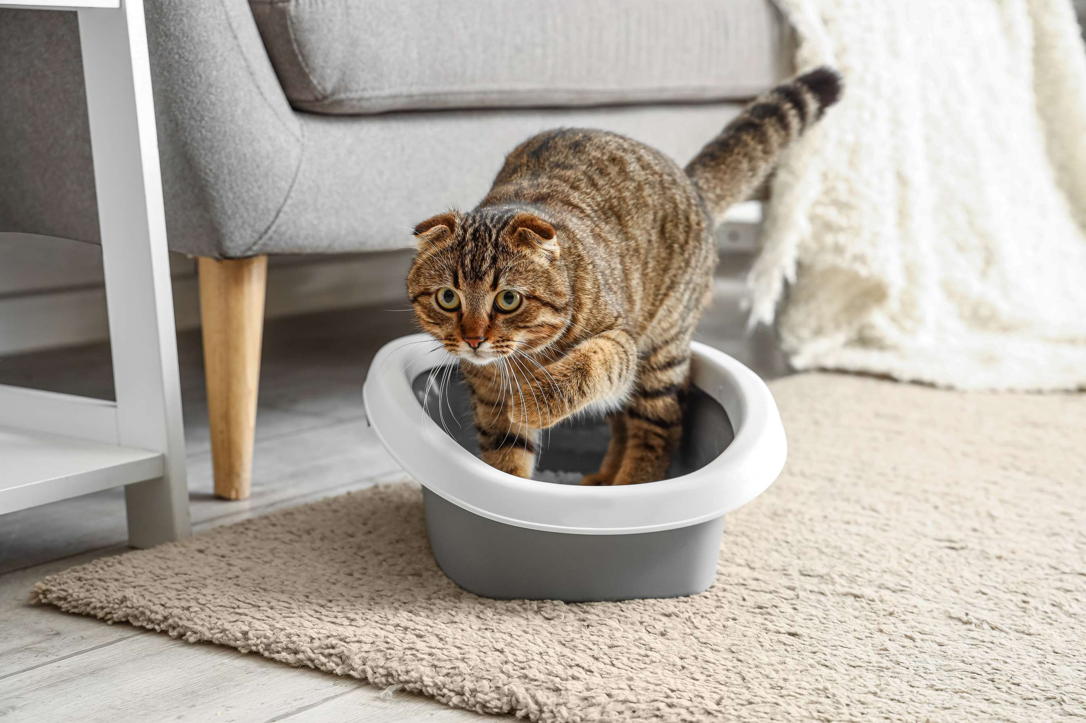
Technological Advancements In Cat Litter Products Are Increasing Consumer Interest And Market Growth
Drivers
Limited Consumer Awareness About Eco-Friendly Options Can Lead To Environmental Pollution And Concerns About Sustainability To Limit Market Growth
Restraints

Slide 7
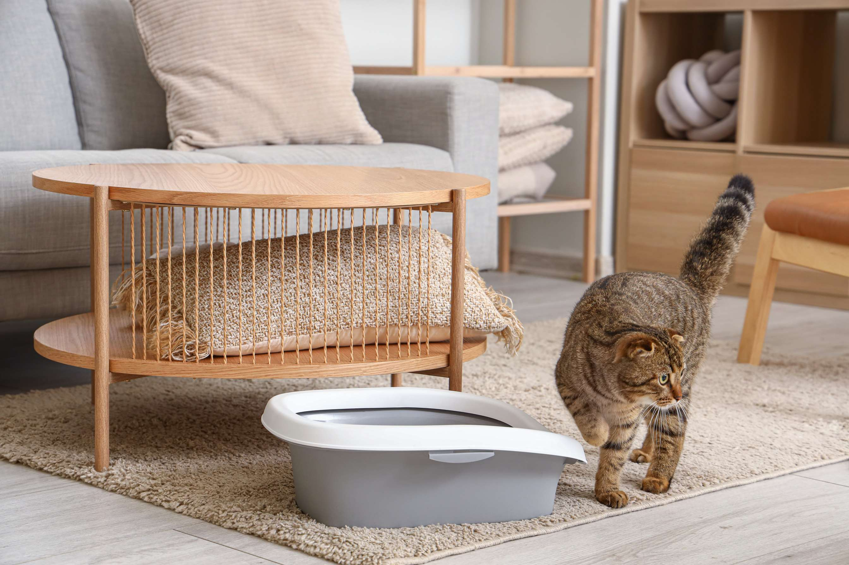
AUTHOR'S PERSPECTIVE
  The global Cat Litter market will expand significantly by 5.50% CAGR between 2024 to 2031.
  The clumping cat litter market segment offers convenient waste management, forming solid clumps upon contact with liquid waste for easy removal. Targeting pet owners seeking hassle-free cleaning solutions, it emphasizes odor control, moisture absorption, and ease of disposal. Brands compete by offering varying clumping strengths and natural ingredient options to meet consumer preferences.
  Increasing pet ownership rates, growing awareness of hygiene among cat owners, rising demand for eco-friendly and natural products, technological advancements leading to improved litter materials

Slide 8
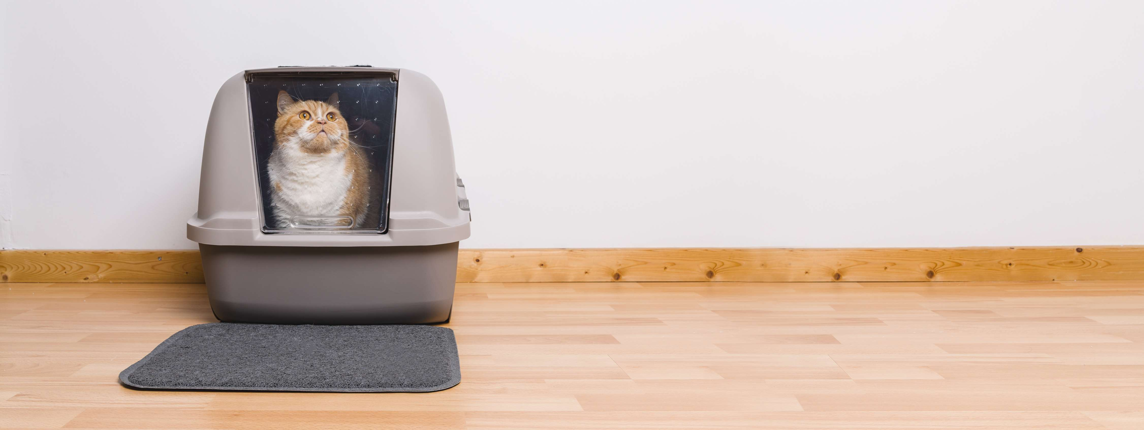








KEY PLAYERS

Slide 9


For Full Report
Contact us
COGNITIVE MARKET RESEARCH
Tel: +1 312-376-8303 | +44 020-8123-0732
India: (+91) 983-496-8611
sales@cognitivemarketresearch.com
Access the Full Report : https://tinyurl.com/mrxtn7jn
Please visit our website:
https://www.cognitivemarketresearch.com

