Slide 1

GLOBAL
CAST IRON COOKWARE
MARKET REPORT 2024
Global,Regional,CountryAnalysis

Slide 2

INTRODUCTION
A subset of cast-iron cookware is heavy-duty cast-iron cookware. Most cast iron cookware is produced using low-tech or traditional methods. It is recognized for its capacity to endure extremely high temperatures while cooking with little to no oil. It is ideal for slow cooking due to its ability to retain heat. One can make many foods because cast iron cookware is inexpensive and adaptable. Recent years have seen a significant shift in consumer behavior, with people now preferring to do their product research online on e-commerce websites and buy a variety of cookware, including electric, nonstick, and cast iron cookware. As a result, the market is being strengthened by rising consumer awareness of the health dangers associated with nonstick cookware and aluminum products and a burgeoning online retail industry.

Slide 3


KEY INSIGHTS
MARKET SIZE
USD 2.5 billion
2022
CAGR
4.20%.
2023- 2030

Slide 4

REVENUE MARKET SHARE BY SEGMENTS 2022
  Enamel Coated
  Unseasoned
  Seasoned
Type Segment
Application Segment
  Residential
  Commercial
  Pots
  Dutch Ovens
  Woks
  Skillets
Style Segment

Slide 5

Global Cast Iron Cookware Market Revenue share for 2022
Asia Pacific

Slide 6

Expansion of Food Service Industry to Provide Viable Market Output
Drivers
Price Volatility for Raw Materials to Restrict Market Growth
Restraints

Slide 7
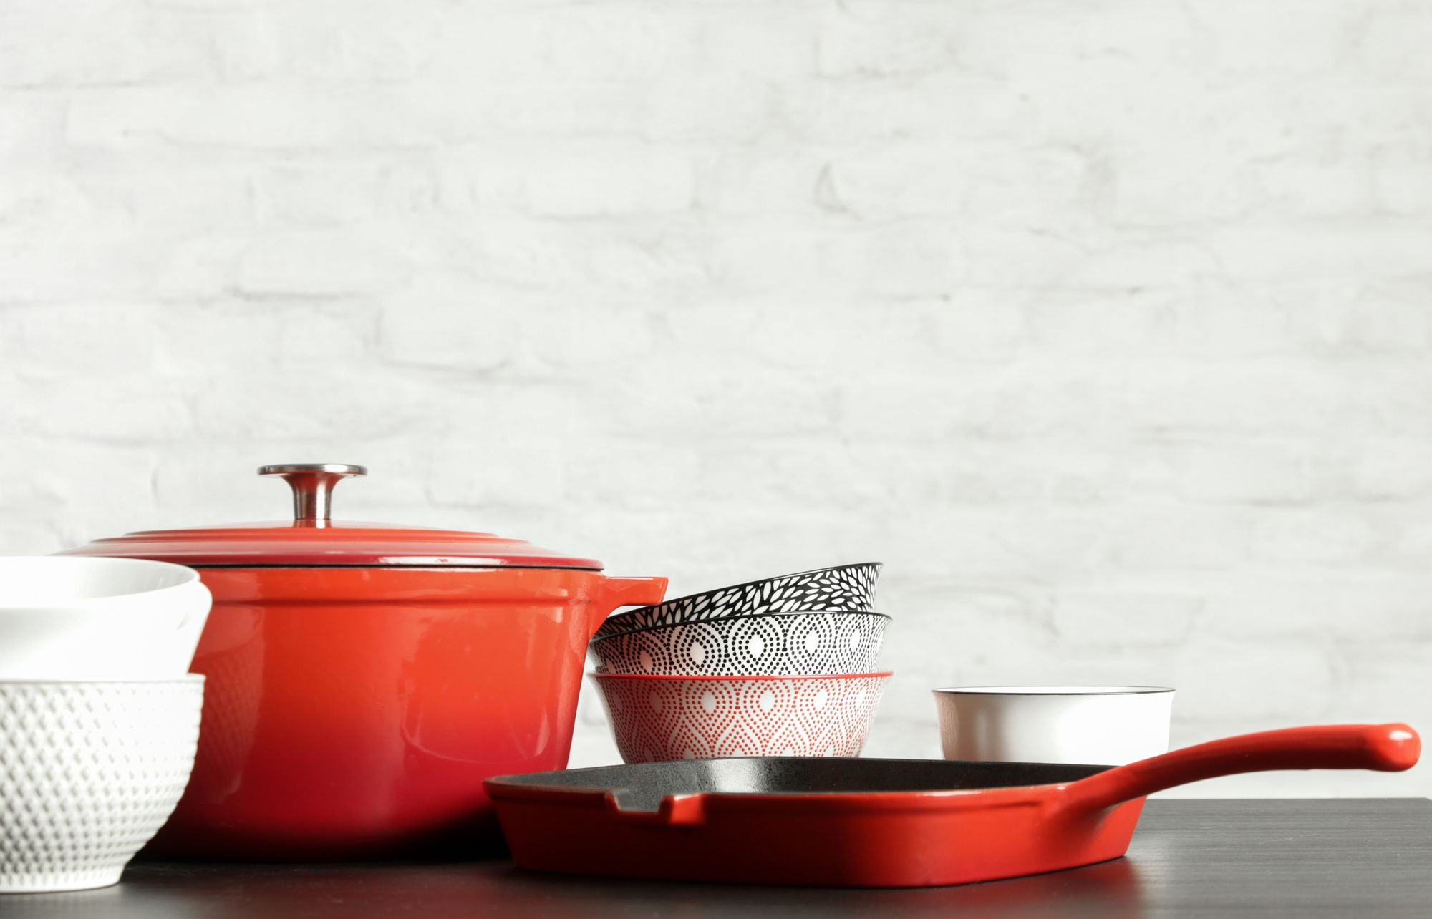
AUTHOR'S PERSPECTIVE
  The Global Cast Iron Cookware Market is witnessing significant growth in the near future.
  Seasoned cast iron cookware was the second most popular type. Cast iron is shielded from rust and given a naturally non-stick surface by "seasoning."
  Cast iron cookware is becoming more popular among consumers due to growing fitness consciousness and concerns over nutrient-dense meals, accelerating this industry's expansion.
  In 2023, the Enamel Coated segment accounted for noticeable share of global Cast Iron Cookware Market and is projected to experience significant growth in the near future.
  The Residential segment is expected to expand at the significant CAGR retaining position throughout the forecast period.

Slide 8











KEY PLAYERS

Slide 9


For Full Report
Contact us
COGNITIVE MARKET RESEARCH
Tel: +1 312-376-8303 | +44 020-8123-0732
India: (+91) 983-496-8611
sales@cognitivemarketresearch.com
Access the Full Report : http://tinyurl.com/nhb9uya8
Please visit our website:
https://www.cognitivemarketresearch.com

