Slide 1
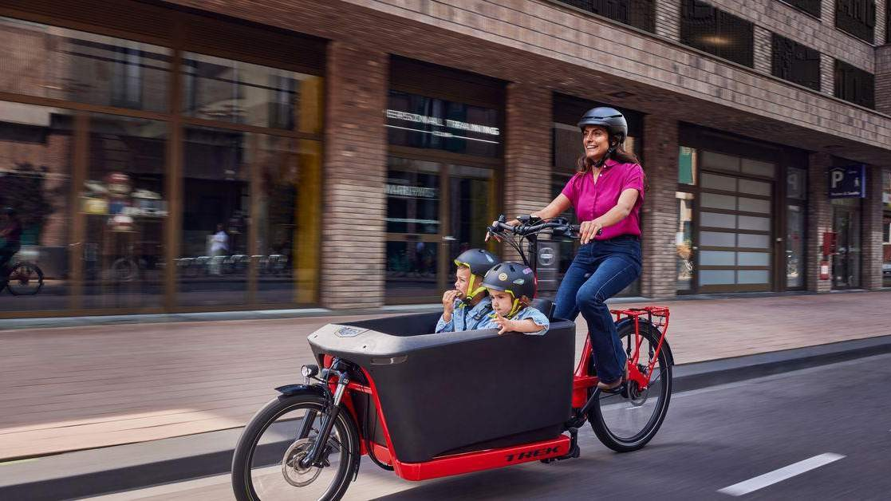
CARGO BIKE MARKET REPORT

Slide 2

INTRODUCTION
A cargo bike is called as box bike, carrier cycle, freight bicycle, cycle truck, or freight tricycle. It is simply a bike that is designed for carrying heavy loads. Cargo bicycles can be developed for a wide range of applications, including delivering specific loads, operating in difficult terrain, and even serving as mobile grocery shops.

Slide 3
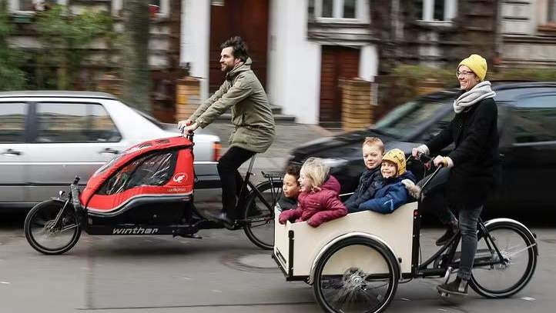

KEY INSIGHTS
MARKET SIZE
USD 5,308.60 Million
2028
2023-
2030
CAGR 7.90%

Slide 4

REVENUE MARKET SHARE BY SEGMENTS 2022
by Product
Propulsion Segment
End Use
Two Wheeled
USD 1,659.07
Million
Conventional
USD 1,303.18
Million
Courier & Parcel Service Provider
USD 1,534.30
Million
Size Segment
Price Segment
Below 20”
USD 625.57
Million
Below USD 1,500
USD 1,063.0
Million

Slide 5


GLOBAL CARGO BIKE MARKET REVENUE SHARE FOR 2022
North America USD 1,276.19 Million

Slide 6
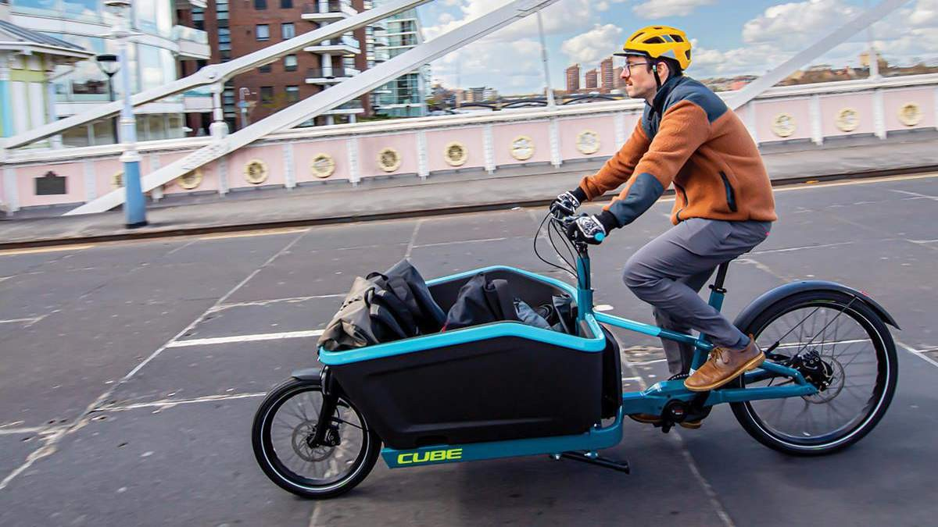


Mounting of E- commerce platform
High costs and limited infrastructure for cargo bikes

Slide 7

AUTHOR'S PERSPECTIVE
The Global Cargo Bike Market is witnessing significant growth in the near future.
In 2023, the Two Wheeled segment accounted for noticeable share of global Cargo Bike Market and is projected to experience significant growth in the near future.
The Conventional segment is expected to expand at the significant CAGR retaining position throughout the forecast period.

Slide 8

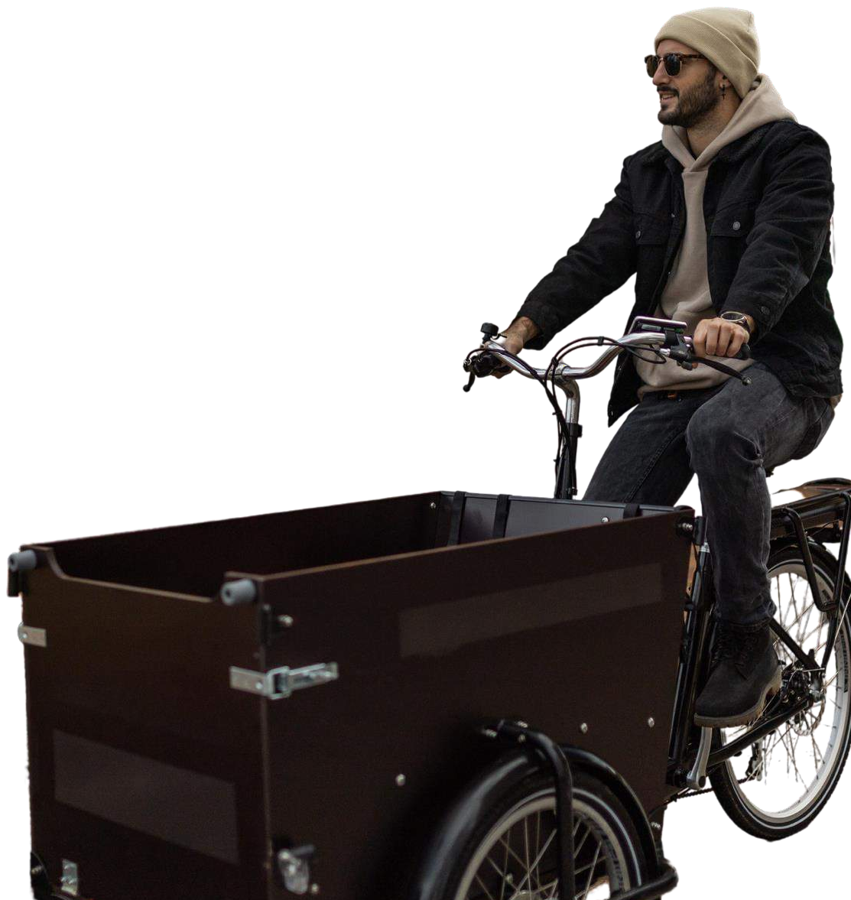









KEY PLAYERS

Slide 9


Contact us
For Full Report
COGNITIVE MARKET RESEARCH
Tel: + 1 312 - 376 - 8303 | + 44 020 - 8123 - 0732
India: ( + 91 ) 983 - 496 - 8611
sales@ cognitivemarketresearch. com
Access the Full Report : https://rb.gy/zqw28
Please visit our website:
https://www.cognitivemarketresearch.com

