Slide 1
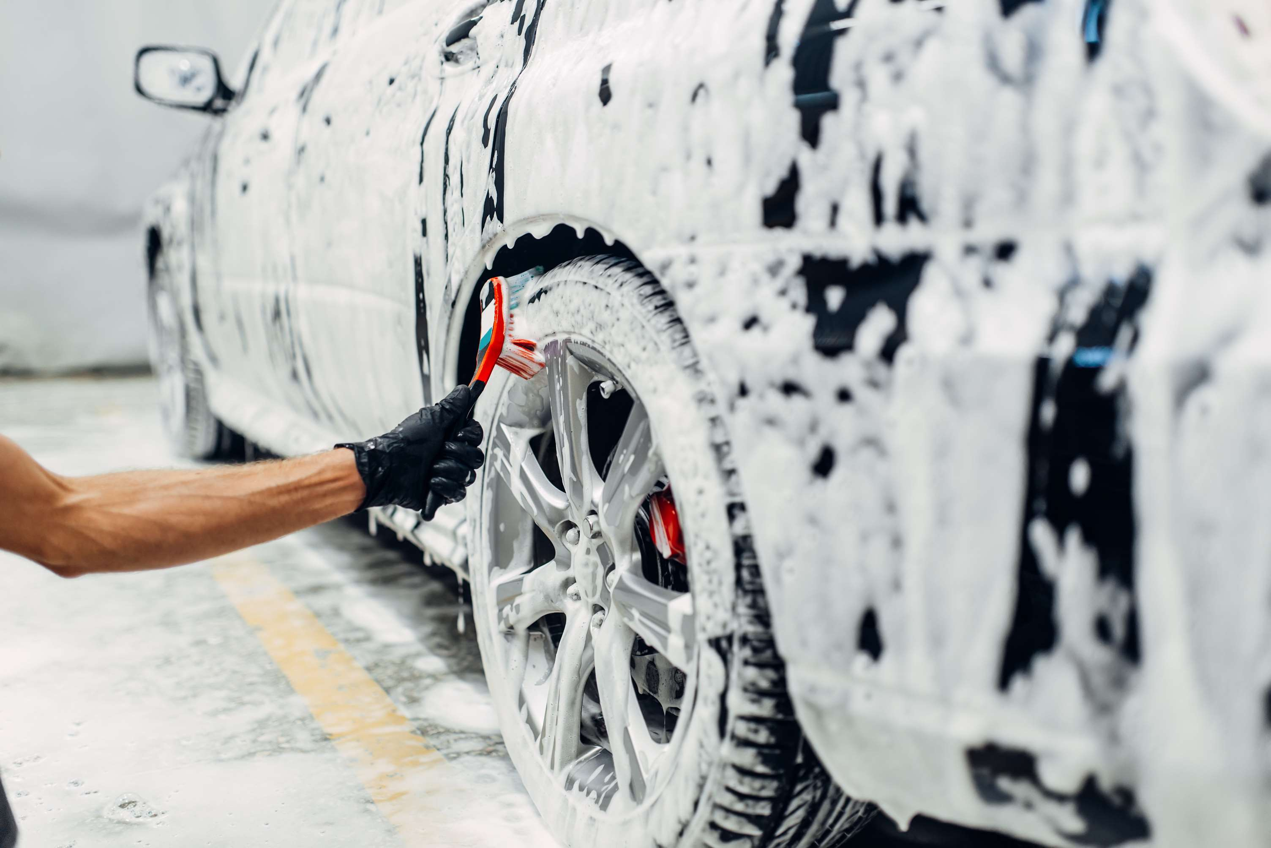
GLOBAL
CAR WASH SERVICE
MARKET REPORT
2024
Global,Regional,CountryAnalysis

Slide 2

INTRODUCTION
Improved efficiency, easier leadership, time savings, and increased safety are projected to boost the Car Wash Market in the next years. Furthermore, technical advances in the industry, such as hybrid and touch-free washing technologies, enhanced water recycling methods, and cost-cutting innovations, are expected to increase the market in the future. Furthermore, the growing customer preference for speed, convenience, and car maintenance is expected to boost the market throughout the predicted years. Furthermore, growing demand for skilled and dependable cleaning, rising new car enrolments, and increasing consumer environmental awareness are expected to drive market expansion.

Slide 3
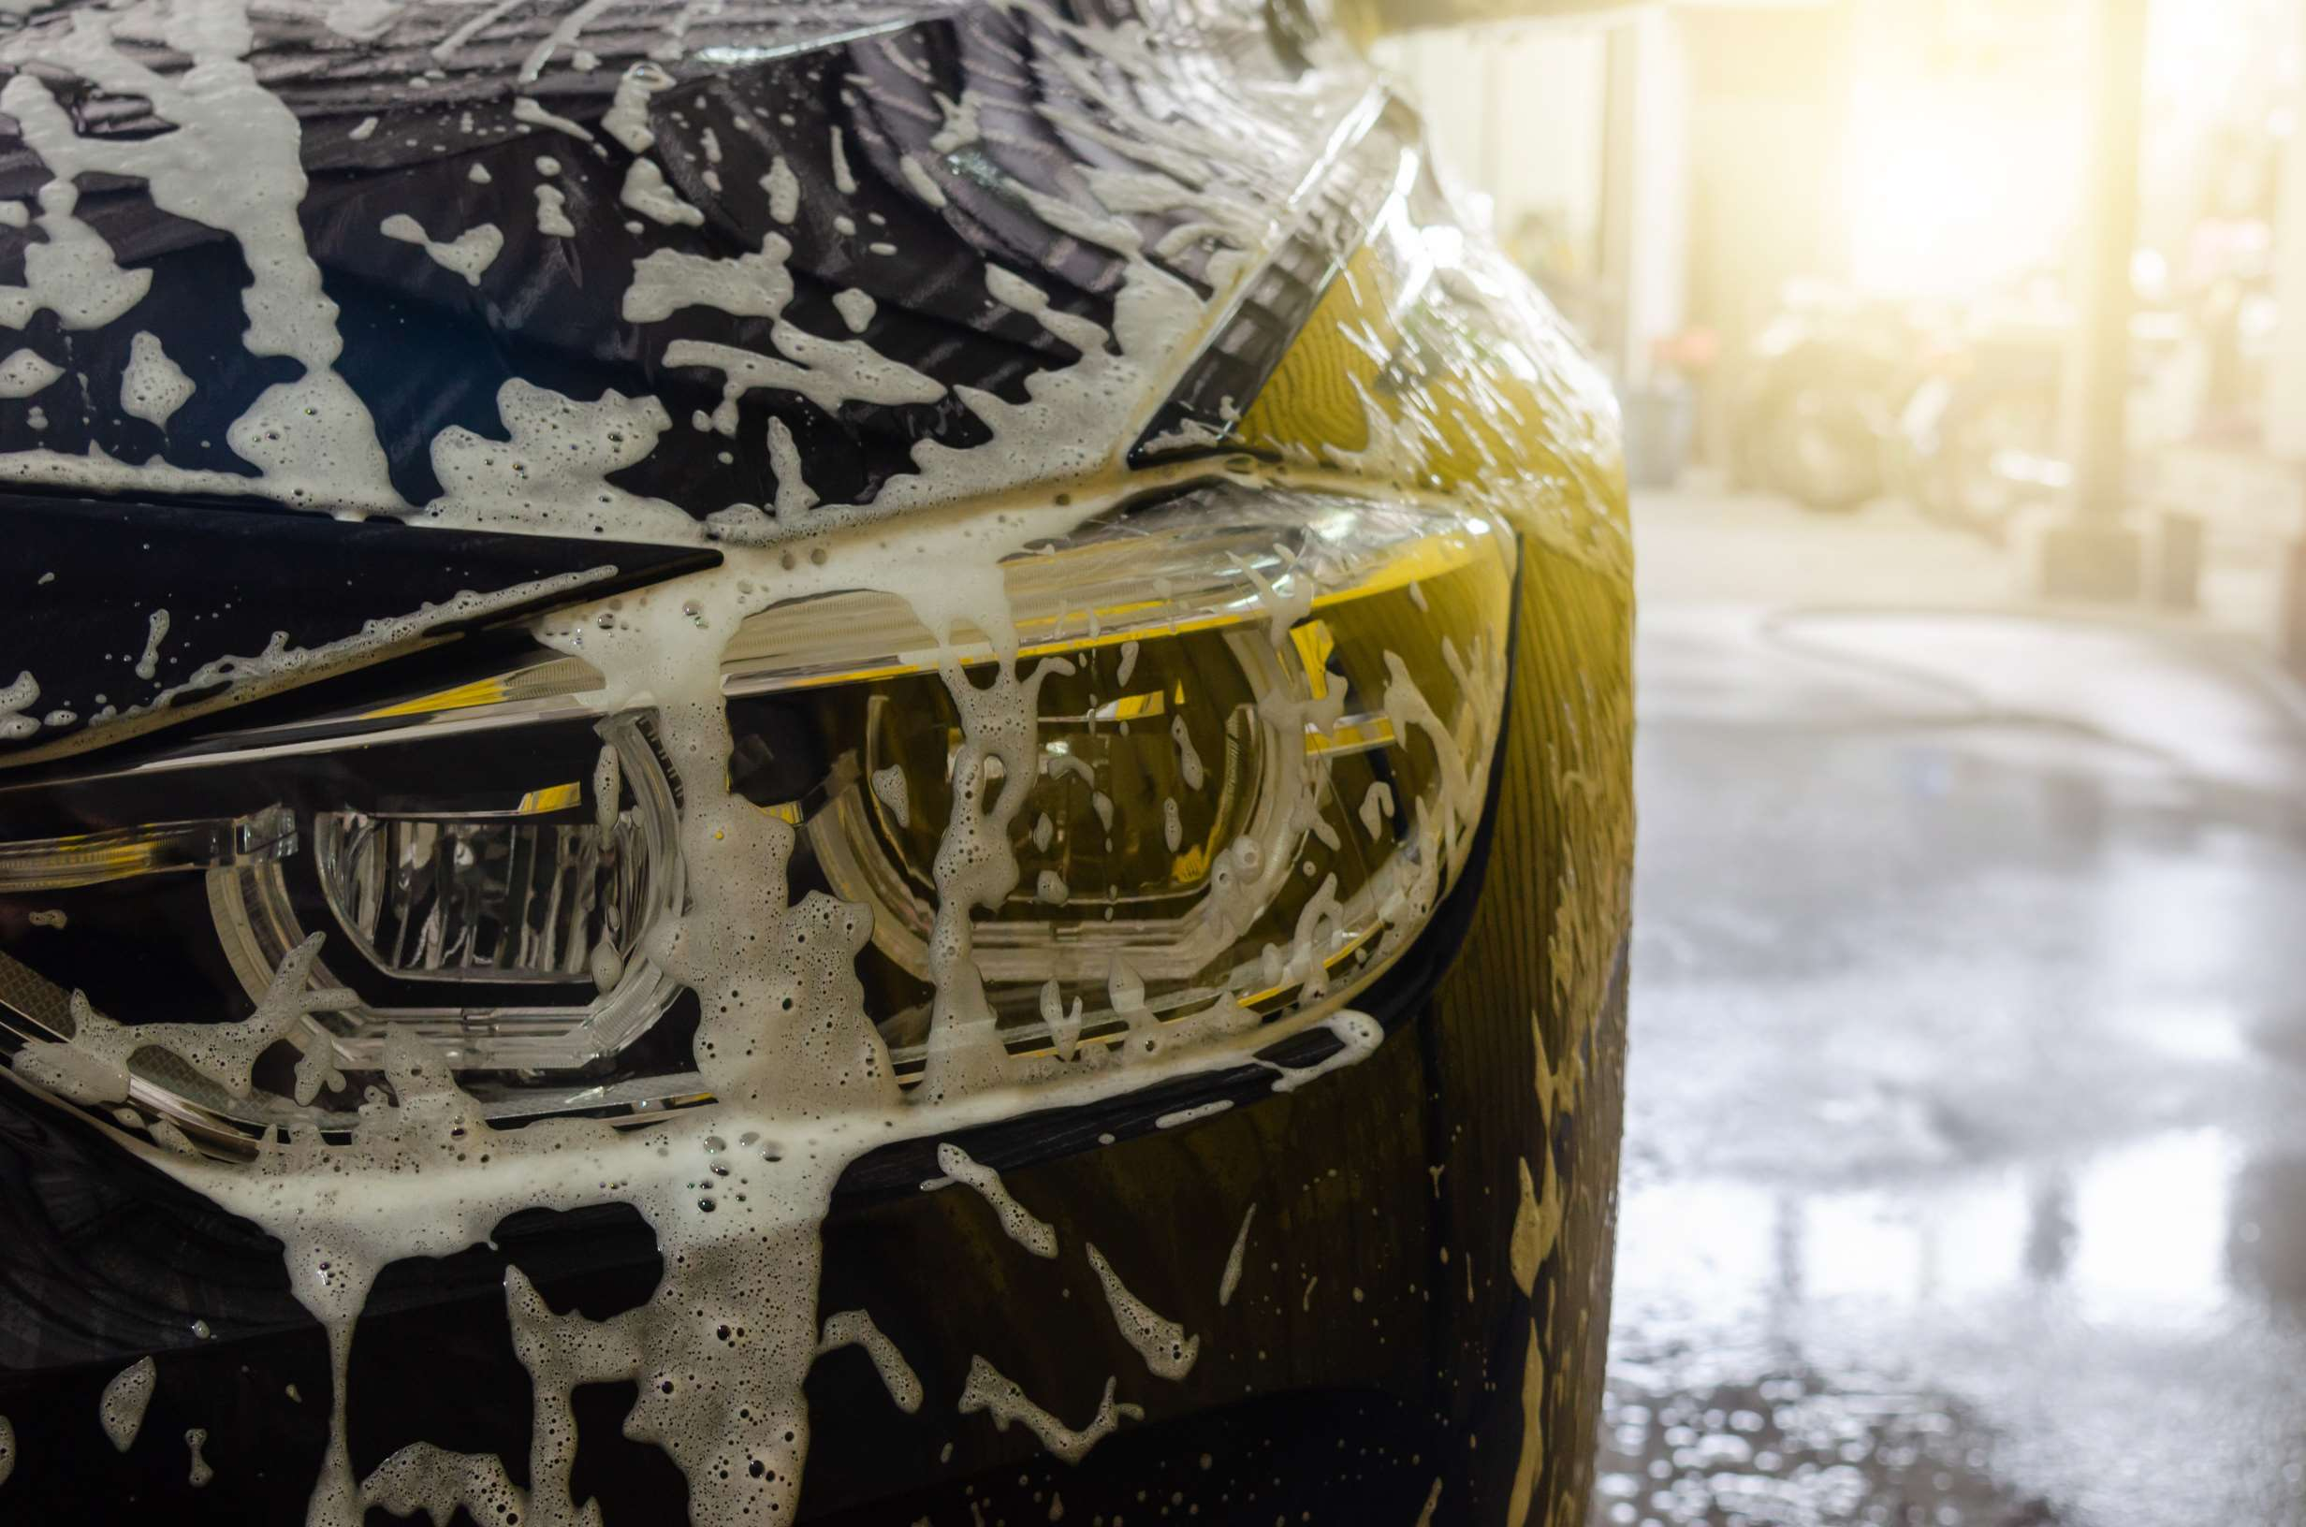

KEY INSIGHTS
MARKET SIZE
USD 33.1 billion
2022
CAGR
3.85%
2023- 2030

Slide 4
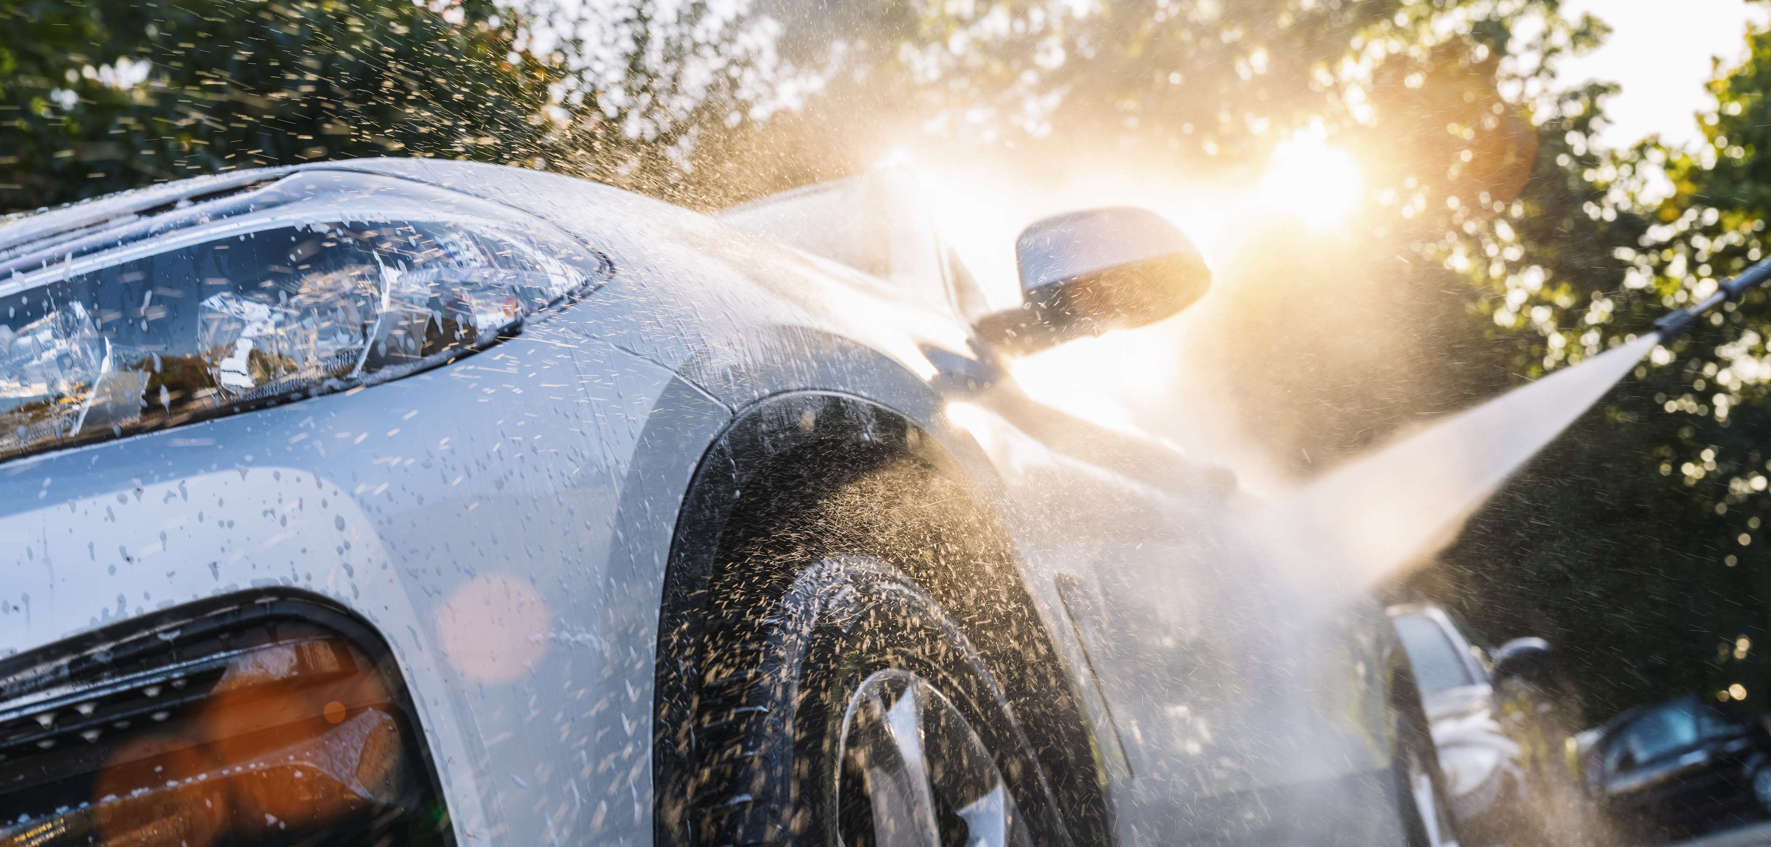
REVENUE MARKET SHARE BY SEGMENTS 2022
  Tunnels
  Roll-over/In-bay
  Self-service
Type Segment
  Cash Payment
  Cashless Payment
Mode of Payment

Slide 5

Global Car Wash Service Market Revenue share for 2024
North America
50%

Slide 6

Growing Demand for Vehicle Washes Due to their Numerous Benefits to Boost Market Growth
Drivers
The Variables Restraining the Development and Growth of the Car Wash Services Market
Restraints

Slide 7

AUTHOR'S PERSPECTIVE
  The Global Car Wash Service Market is witnessing significant growth in the near future.
  Clients in the millennial age want to be able to pay in the most comfortable way, whether through coins, bank cards, rewards programs, EMV-enabled credit card transactions, or smartphone payments.
  In 2023, the Tunnels segment accounted for noticeable share of global Car Wash Service Market and is projected to experience significant growth in the near future.
  The Cash Payment segment is expected to expand at the significant CAGR retaining position throughout the forecast period.

Slide 8






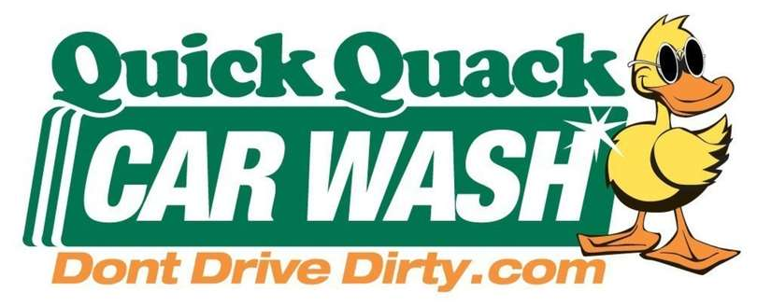



KEY PLAYERS

Slide 9


For Full Report
Contact us
COGNITIVE MARKET RESEARCH
Tel: +1 312-376-8303 | +44 020-8123-0732
India: (+91) 983-496-8611
sales@cognitivemarketresearch.com
Access the Full Report : https://tinyurl.com/4mhd9znj
Please visit our website:
https://www.cognitivemarketresearch.com

