Slide 1
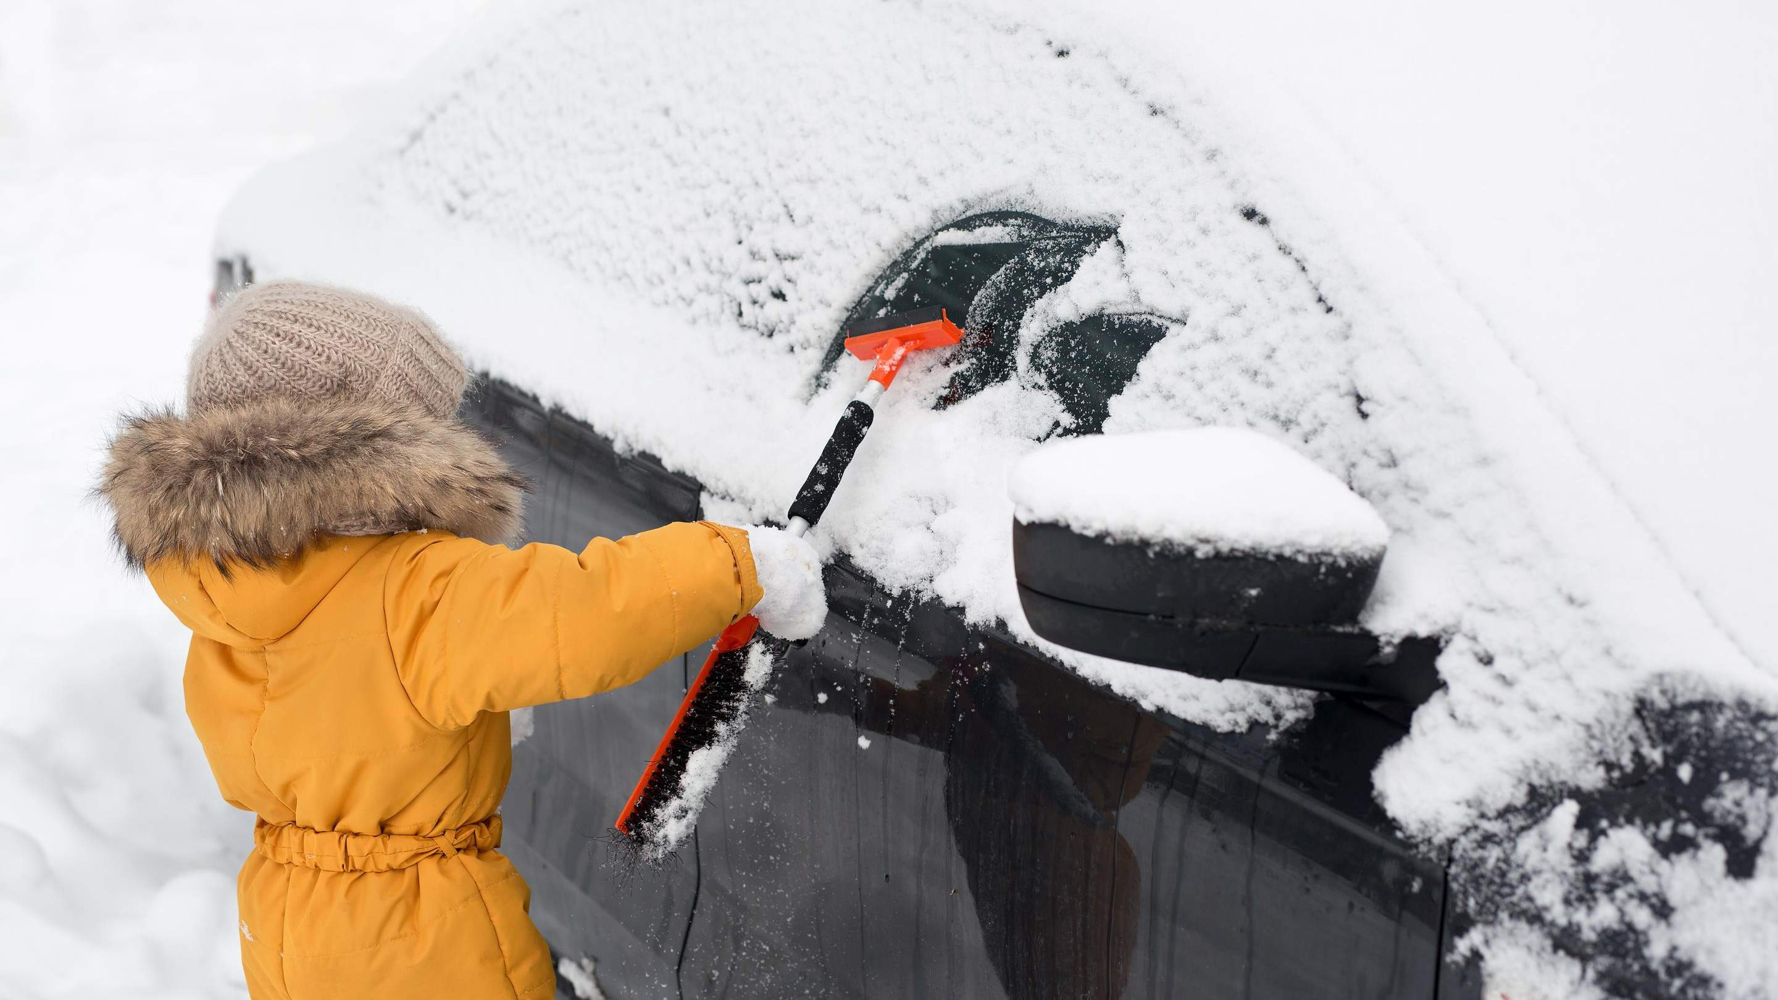
CAR ICE SCRAPERS MARKET REPORT

Slide 2
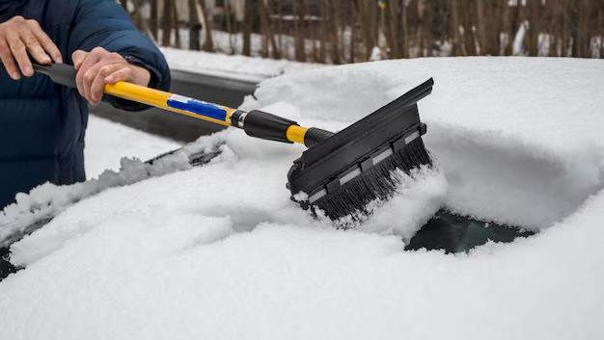
INTRODUCTION
An ice scraper is an ice-removable tool that can brush off snow from door handles to get into a car. It can easily scrape thick or thin ice off the windshield without leaving any scrapes. The car ice scrapers can efficiently create divots in the ice to break it apart and hence ice can be scraped away from the surface. These scrapers are mostly made up of plastic but can also be obtained from metal material.
However, a metal scraper can damage a car’s surface, it doesn’t use often especially since a car under a load of snow doesn’t have much visibility.

Slide 3
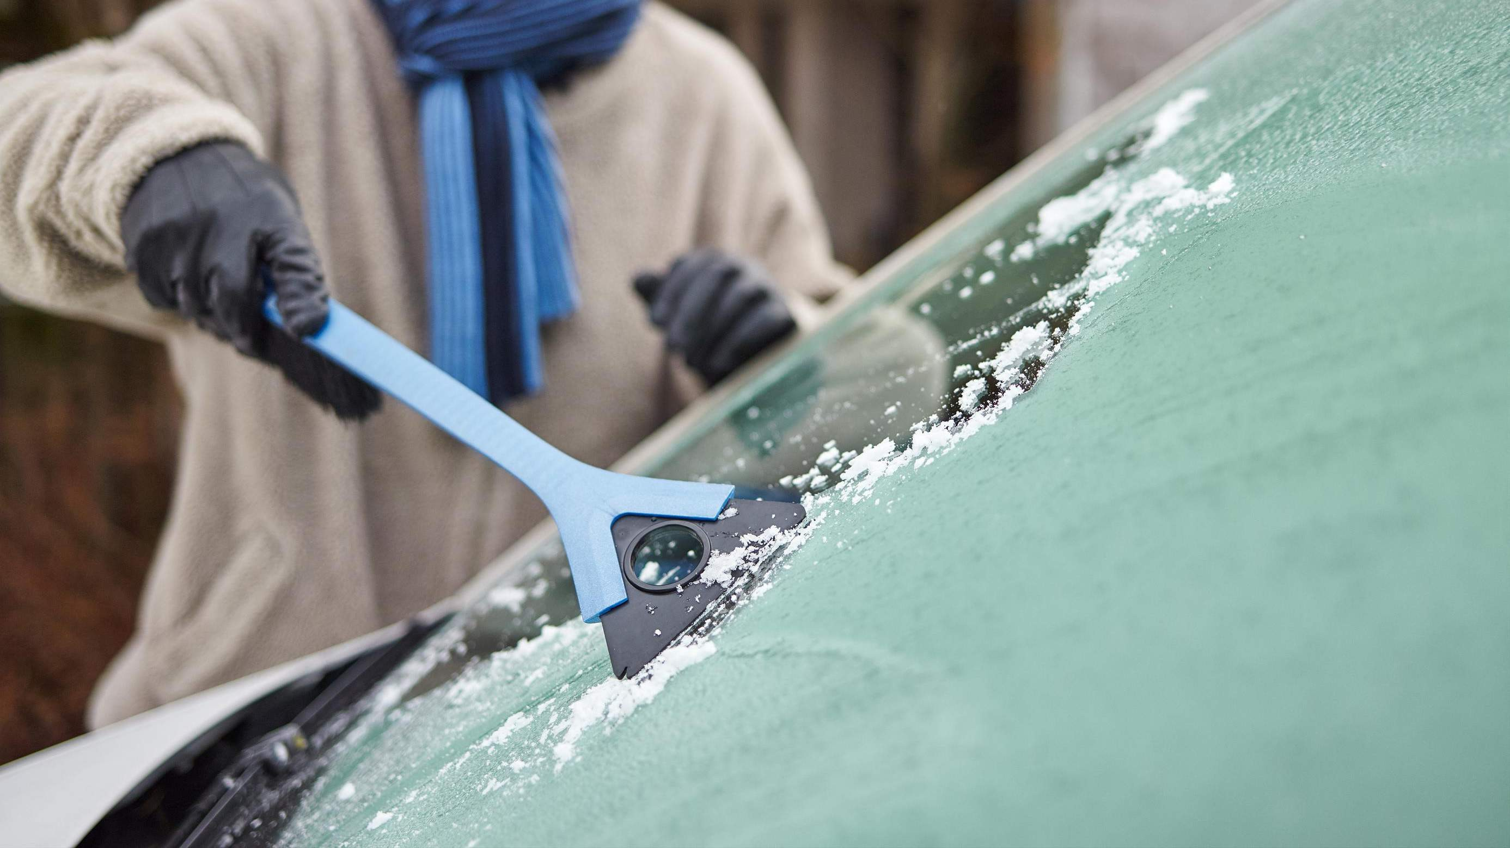
KEY INSIGHTS
MARKET SIZE
s2,313.28 Million
2029
2023-
2030
CAGR 5.58%

Slide 4
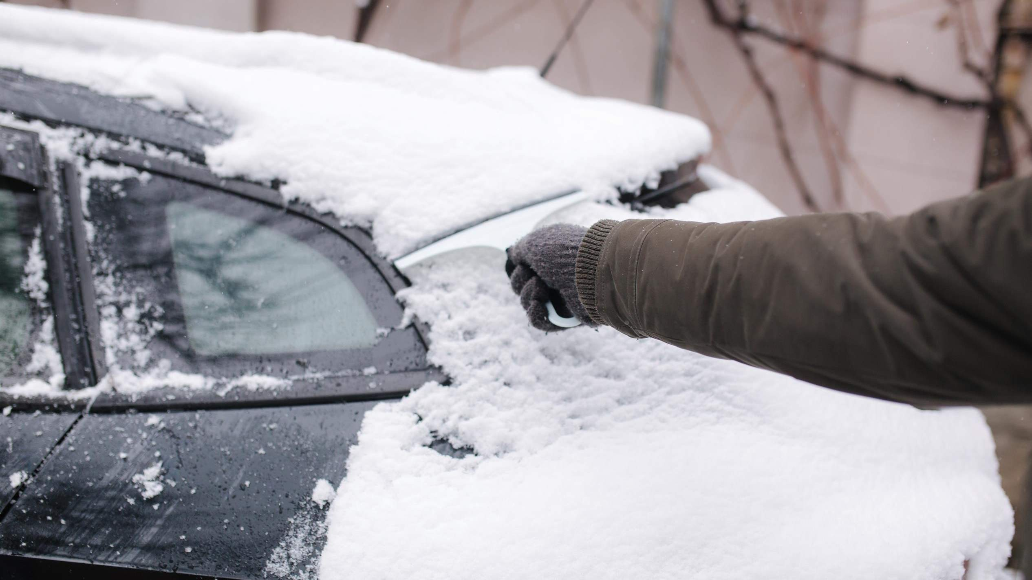
REVENUE MARKET SHARE BY SEGMENTS 2022
by type
Heated Car Ice Scrapers
USD 486.29 Million
Application Segment
Residential USD 486.29 Million
Distribution channel
Online
USD 841.15 Million

Slide 5
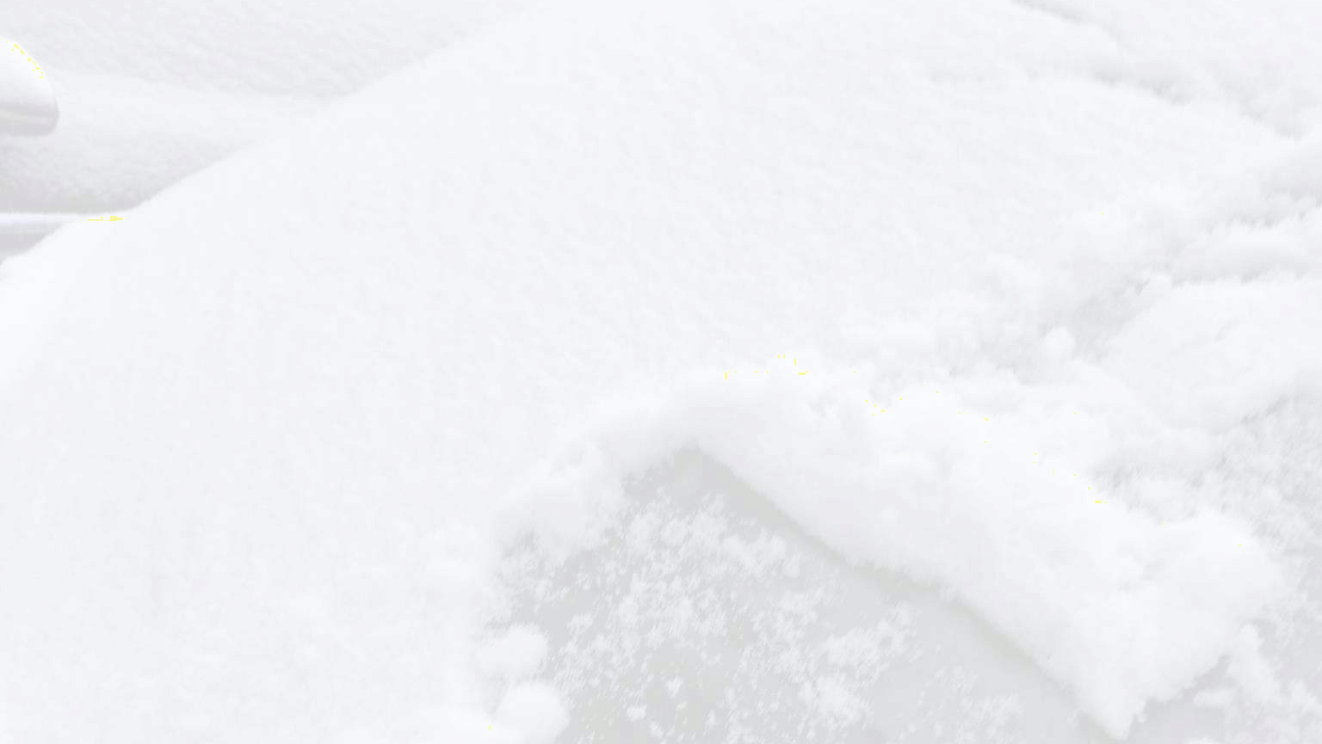
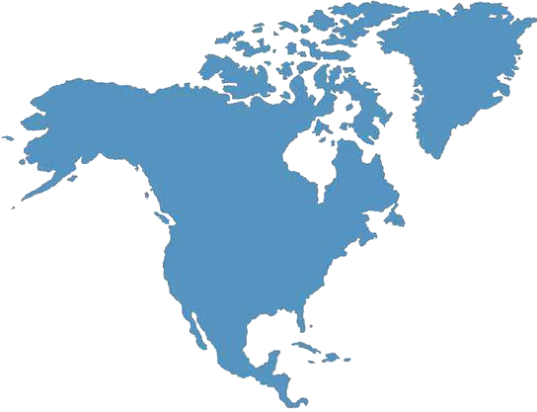
Global Car Ice Scrapers Market Revenue share for 2022
North America
USD 1,103.44 Million

Slide 6
Swelling in car sales across the globe
Presence of alternative options and volatile raw material price

Slide 7
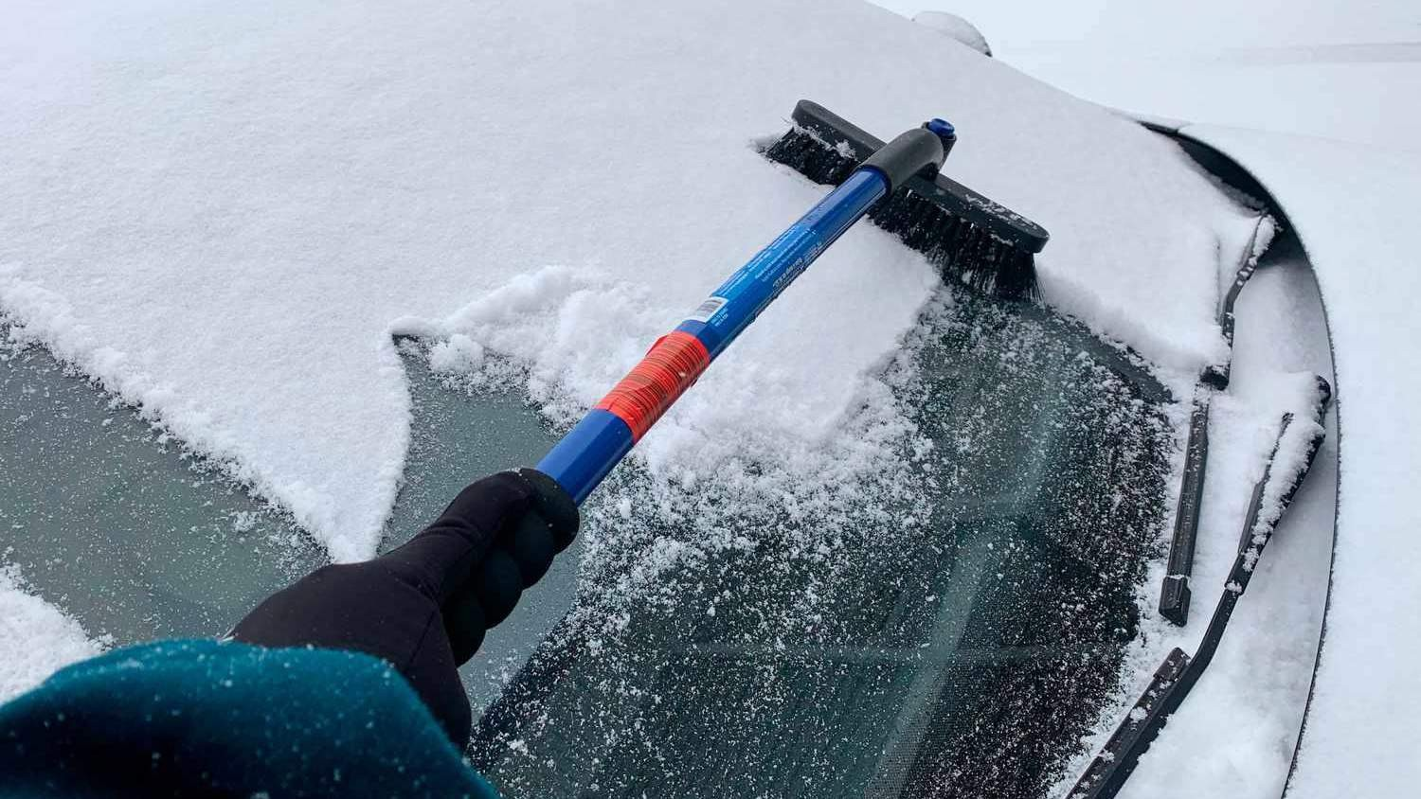
AUTHOR'S PERSPECTIVE
The Global Car Ice Scrapers Market revenue in 2017: USD 1,398.14 Million
General Ice Scrapers held for largest share of total revenue generated in 2020
Offline held maximum share of Car Ice Scrapers market in 2020
Residential held maximum share of Car Ice Scrapers market in 2020
Rising sales of cars and snowfall in several parts of the world coupled with the emergence of an e-commerce platform are driving the growth of the car ice scrapers market
The presence of alternative options and volatile raw material prices may hinder the growth of the car ice scrapper market
The increased snowfall due to climate change may increase the demand for ice scrappers
in the future

Slide 8
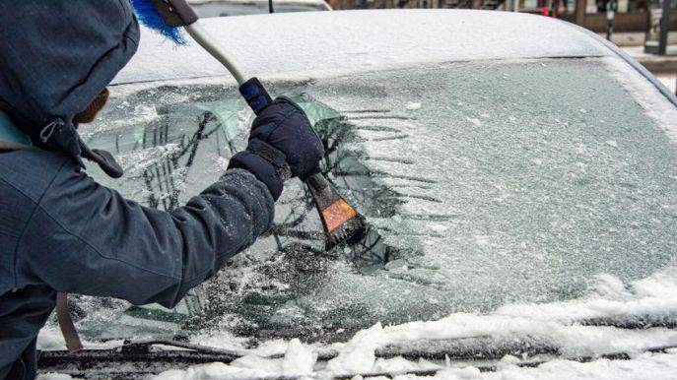




KEY PLAYERS

Slide 9


Contact us
For Full Report
COGNITIVE MARKET RESEARCH
Tel: + 1 312 - 376 - 8303 | + 44 020 - 8123 - 0732
India: ( + 91 ) 983 - 496 - 8611
sales@ cognitivemarketresearch. com
Access the Full Report : https://tinyurl.com/ynpy9mxm
Please visit our website:
https://www.cognitivemarketresearch.com

