Slide 1
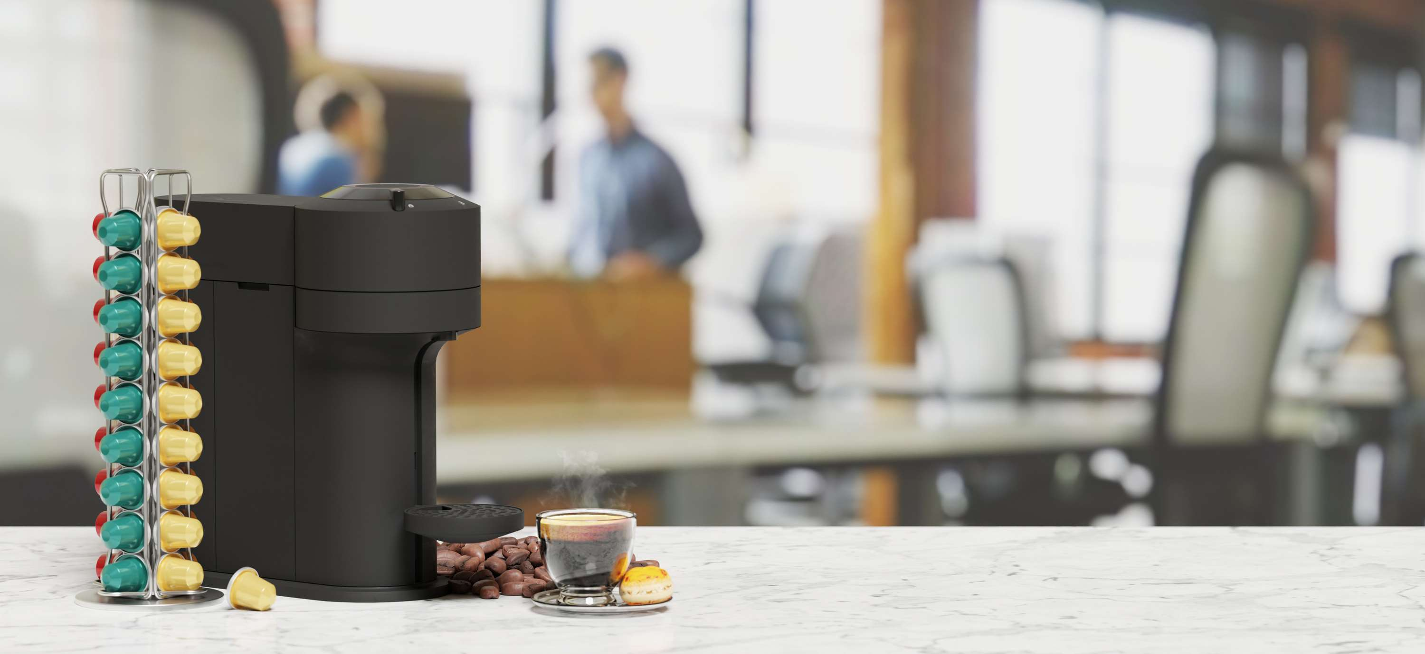
GLOBAL
CAPSULE COFFEE MACHINES
MARKET REPORT 2024
Global,Regional,CountryAnalysis

Slide 2
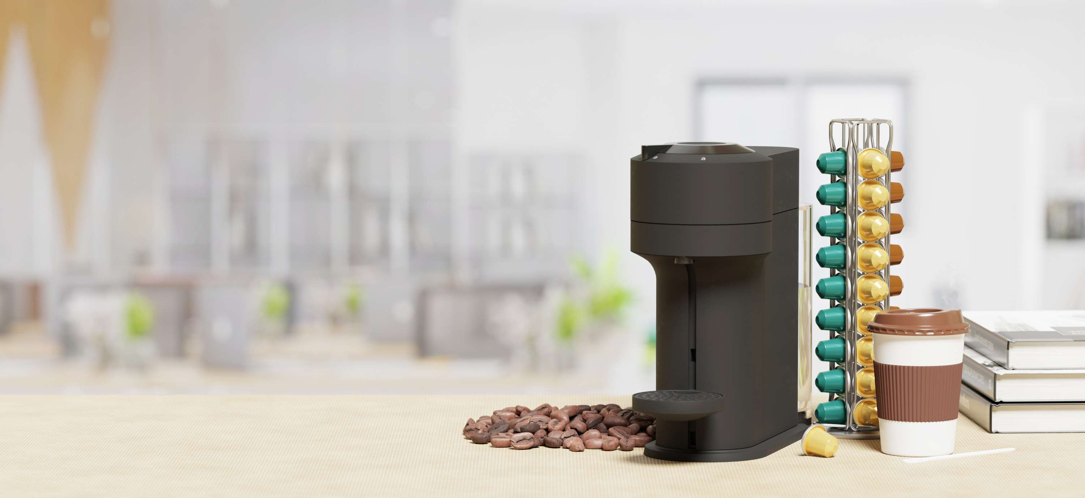
INTRODUCTION
Inside the capsule coffee makers is a pressure pump that makes it simple and quick to obtain full-bodied coffee. The coffee capsule's upper portion is drilled when it is put into the coffee maker, and the maker then starts heating the hot water that is fed to the coffee capsule under high pressure, making coffee. The resulting coffee capsules are single-dose products.

Slide 3


KEY INSIGHTS
MARKET SIZE
USD 1.5 billion
2023
CAGR
5.50%
2023- 2030

Slide 4
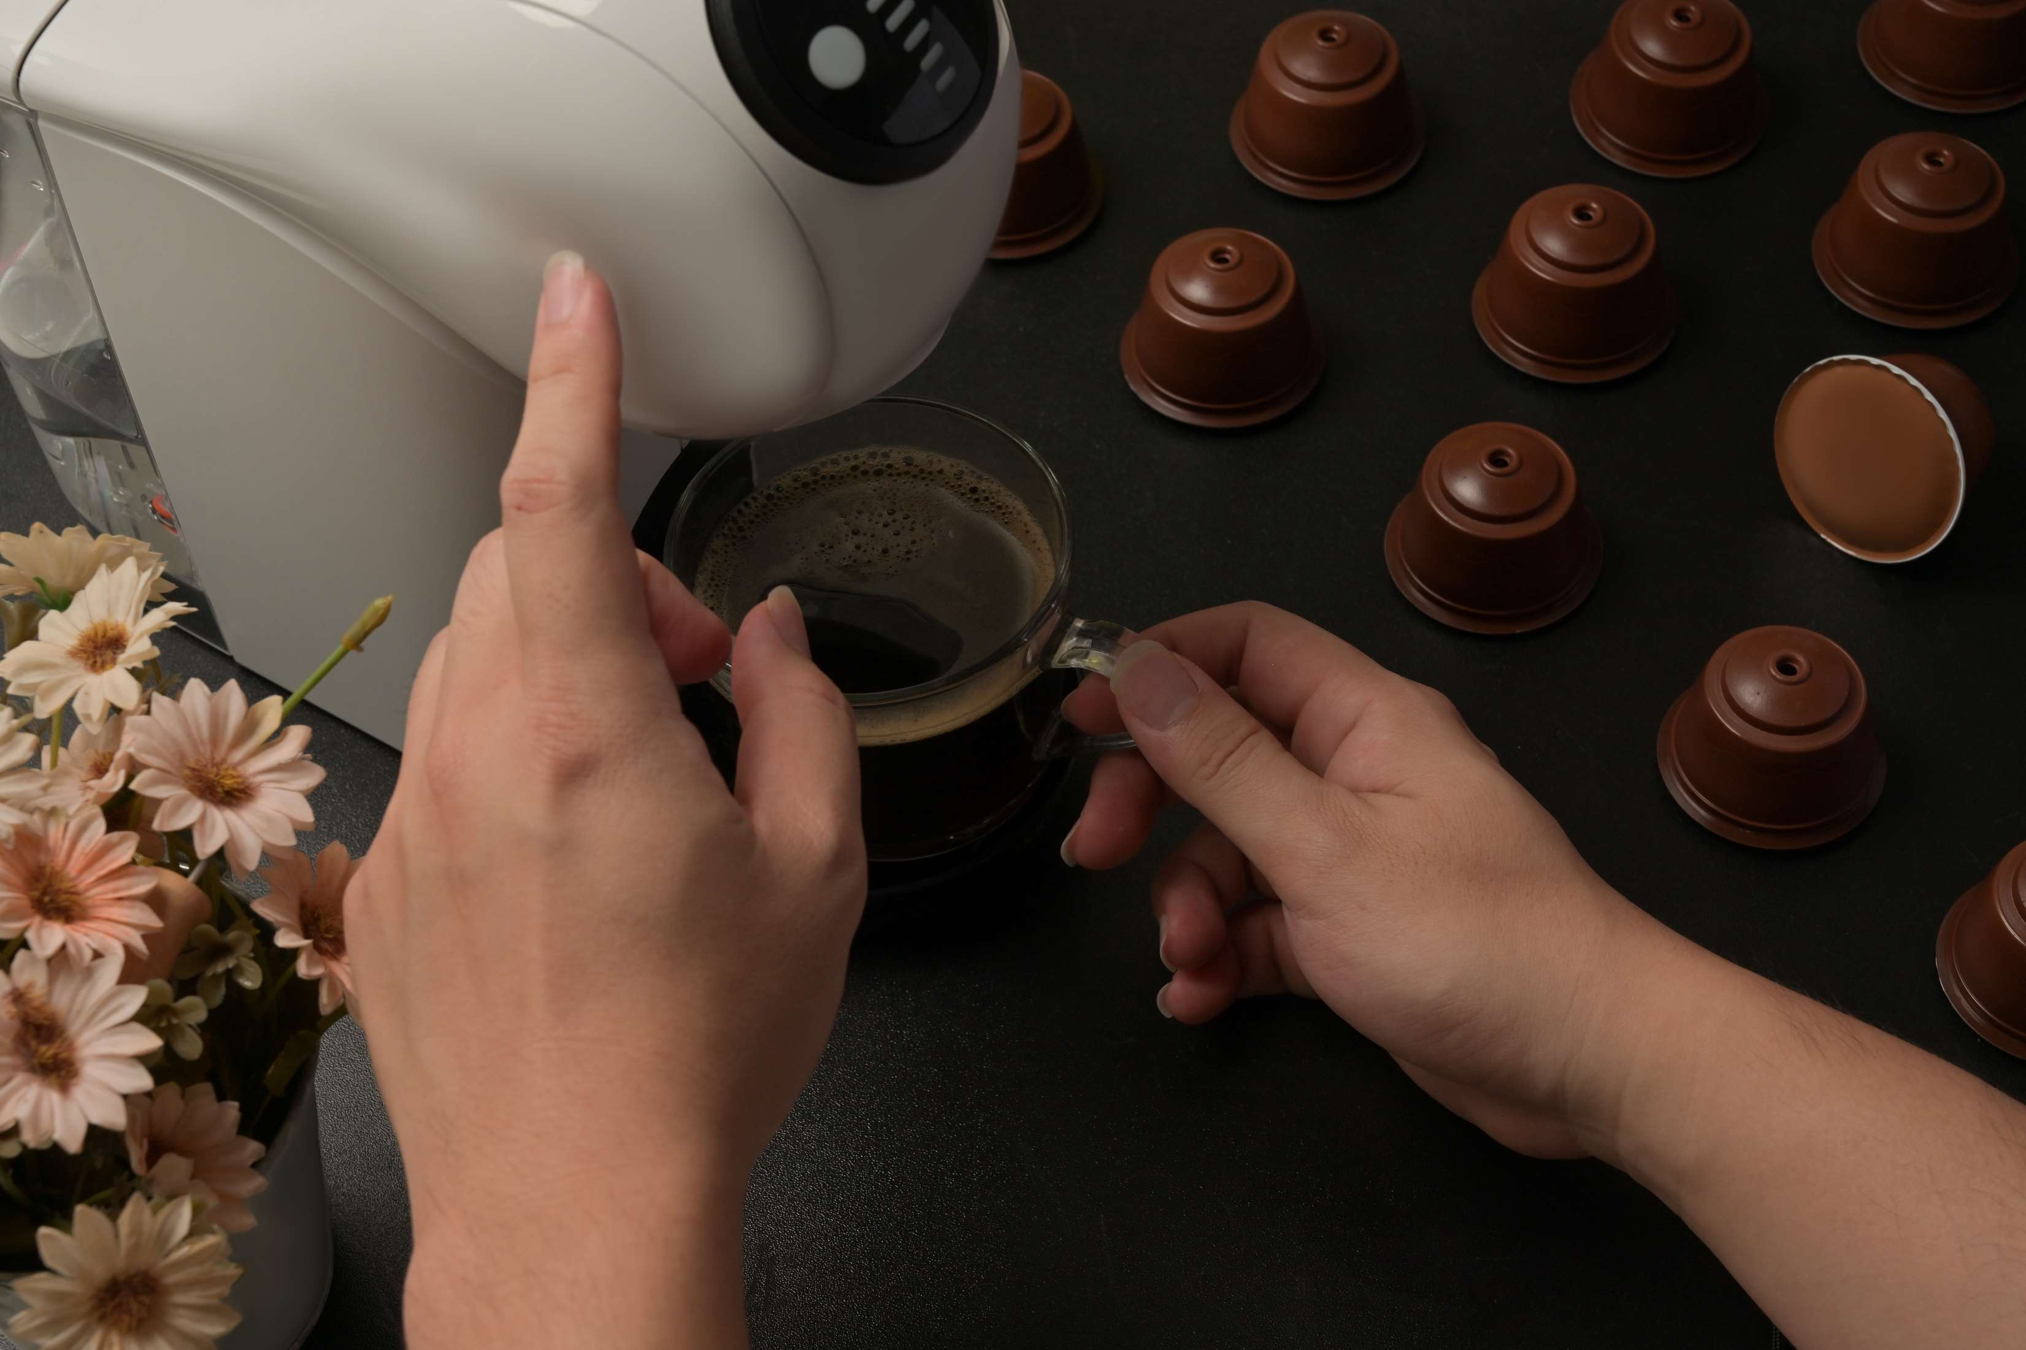
REVENUE MARKET SHARE BY SEGMENTS 2022
  Closed Source System
  Open Source System
Type Segment
Application segment
  Household
  Commercial
  Satellite Brewers
  Decanter Brewers
  Airpot Brewers
  Coffee Urns
Machines Product

Slide 5

Global Capsule Coffee Machines Market Revenue share for 2022
North America
35%

Slide 6
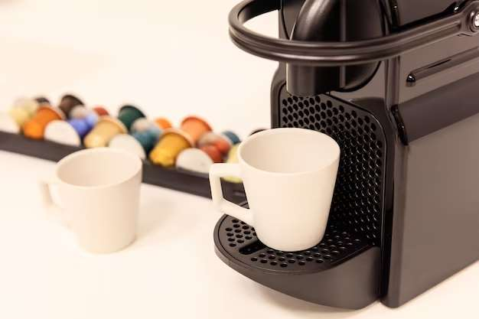
Market Expansion through the Introduction of New Products
Drivers
Geographical and Industrial Limitations are Impeding Market Expansion
Restraints

Slide 7

AUTHOR'S PERSPECTIVE
  The Global Capsule Coffee Machines Market is witnessing significant growth in the near future.
  In 2023, the Closed Source System segment accounted for noticeable share of global Capsule Coffee Machines Market and is projected to experience significant growth in the near future.
  The Household segment is expected to expand at the significant CAGR retaining position throughout the forecast period.

Slide 8














KEY PLAYERS

Slide 9


For Full Report
Contact us
COGNITIVE MARKET RESEARCH
Tel: +1 312-376-8303 | +44 020-8123-0732
India: (+91) 983-496-8611
sales@cognitivemarketresearch.com
Access the Full Report : http://tinyurl.com/yc3yuejd
Please visit our website:
https://www.cognitivemarketresearch.com

