Slide 1
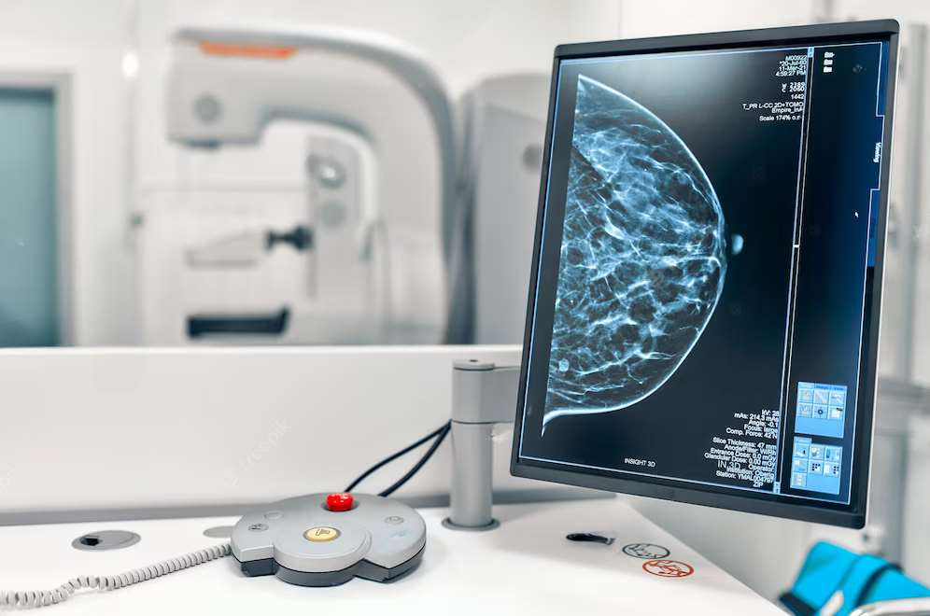

GLOBAL
CANCER DIAGNOSTICS
MARKET REPORT

Slide 2
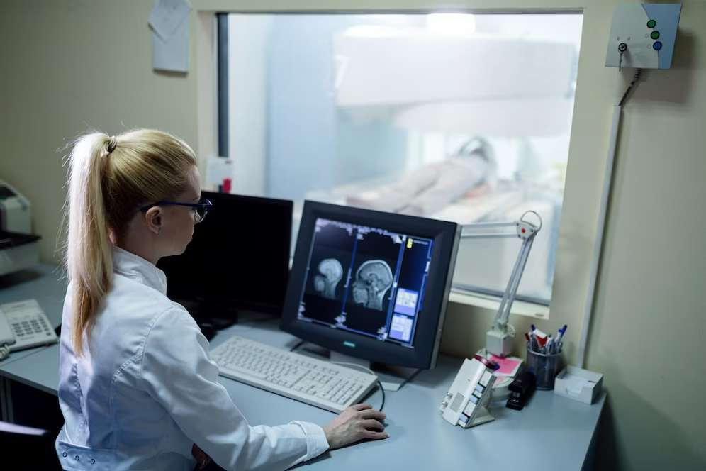
INTRODUCTION
Cancer diagnostics is a process for identifying various proteins, biomarkers, and other symptoms that point to the presence of a cancerous tumor. Effective diagnostic testing is employed to confirm or exclude the presence of illness, track the development of the disease, and plan and evaluate treatment outcomes.

Slide 3

MARKET SIZE
18.31 Billion
2022
KEY INSIGHTS
FORECAST
36.72 Billion
2030
2023-
2030
CAGR
10.3%

Slide 4
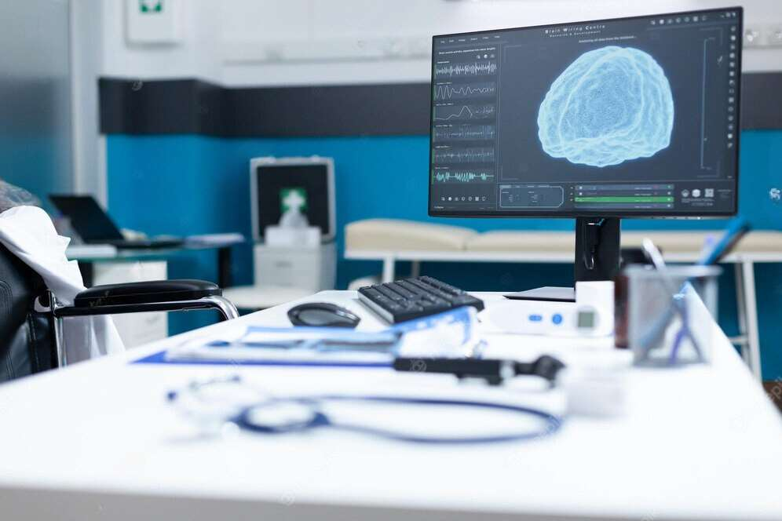
REVENUE MARKET SHARE BY SEGMENTS 2022
By Type
By Application
By End Users
Breast Cancer, Skin Cancer, Colorectal Cancer, Cervical Cancer, Lung Cancer, Prostate Cancer, Blood Cancer, Kidney Cancer, Liver Cancer,
Hospitals and Clinics, Diagnostic Laboratories, Research Institutes, and Diagnostic Imaging Centers (Dominated end user: Hospitals and Clinics)
Genetic Tests, Laboratory Tests, Biopsy, Imaging, Endoscopy, and Others (dominated type: laboratory tests: 24.6%)

Slide 5


GLOBAL CANCER DIAGNOSTICS MARKET REVENUE SHARE FOR 2022
North America Regional Share
24%

Slide 6
  Increasing developments in diagnostic testing techniques
  Growing Strategic Collaborations Associated with Cancer Diagnostics
Drivers
Restraints
High cost of cancer diagnostic imaging

Slide 7
AUTHOR'S PERSPECTIVE
  The market for cancer diagnostics is expected to boost in upcoming years due to technological advancements in diagnostic testing.
  Cancer Diagnostics market analysis helps to understand key industry segments, and their global, regional, and country-level insights
  The conducting of samples of urine, laboratory tests for cancer, blood, or other body tissues or fluids studied in the laboratory during testing for cancer to abnormal cells can help identify whether a person has precancerous or cancer disease.

Slide 8

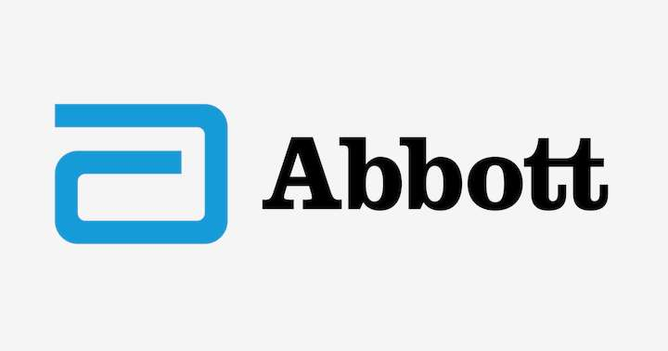


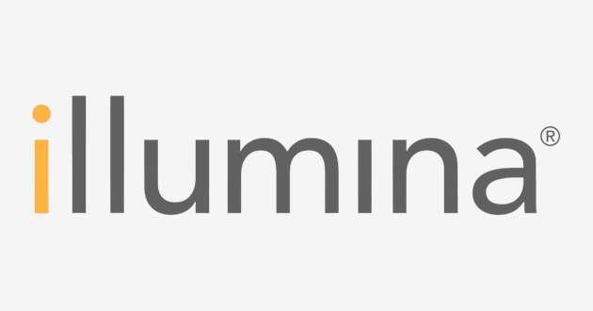




KEY PLAYERS

Slide 9


For Full Report
Contact us
COGNITIVE MARKET RESEARCH
Tel: +1 312-376-8303 | +44 020-8123-0732
India: (+91) 983-496-8611
sales@cognitivemarketresearch.com
Access the Full Report : https://shorturl.at/anAIN
Please visit our website:
https://www.cognitivemarketresearch.com

