Slide 1

GLOBAL
CAFFEINE
MARKET REPORT
2024
Global,Regional,CountryAnalysis

Slide 2

INTRODUCTION
Caffeine is a popular psychoactive drug, which stimulates the Central Nervous System. Caffeine is naturally found in cocoa beans, tea leaves, kola nuts, and coffee beans. This is white crystalline purine, a methylxanthine alkaloid with a bitter taste. Caffeine is used as an ingredient in several supplements such as dietary supplements and health supplements which include pre-workout powders, protein supplements, pills, and others.

Slide 3
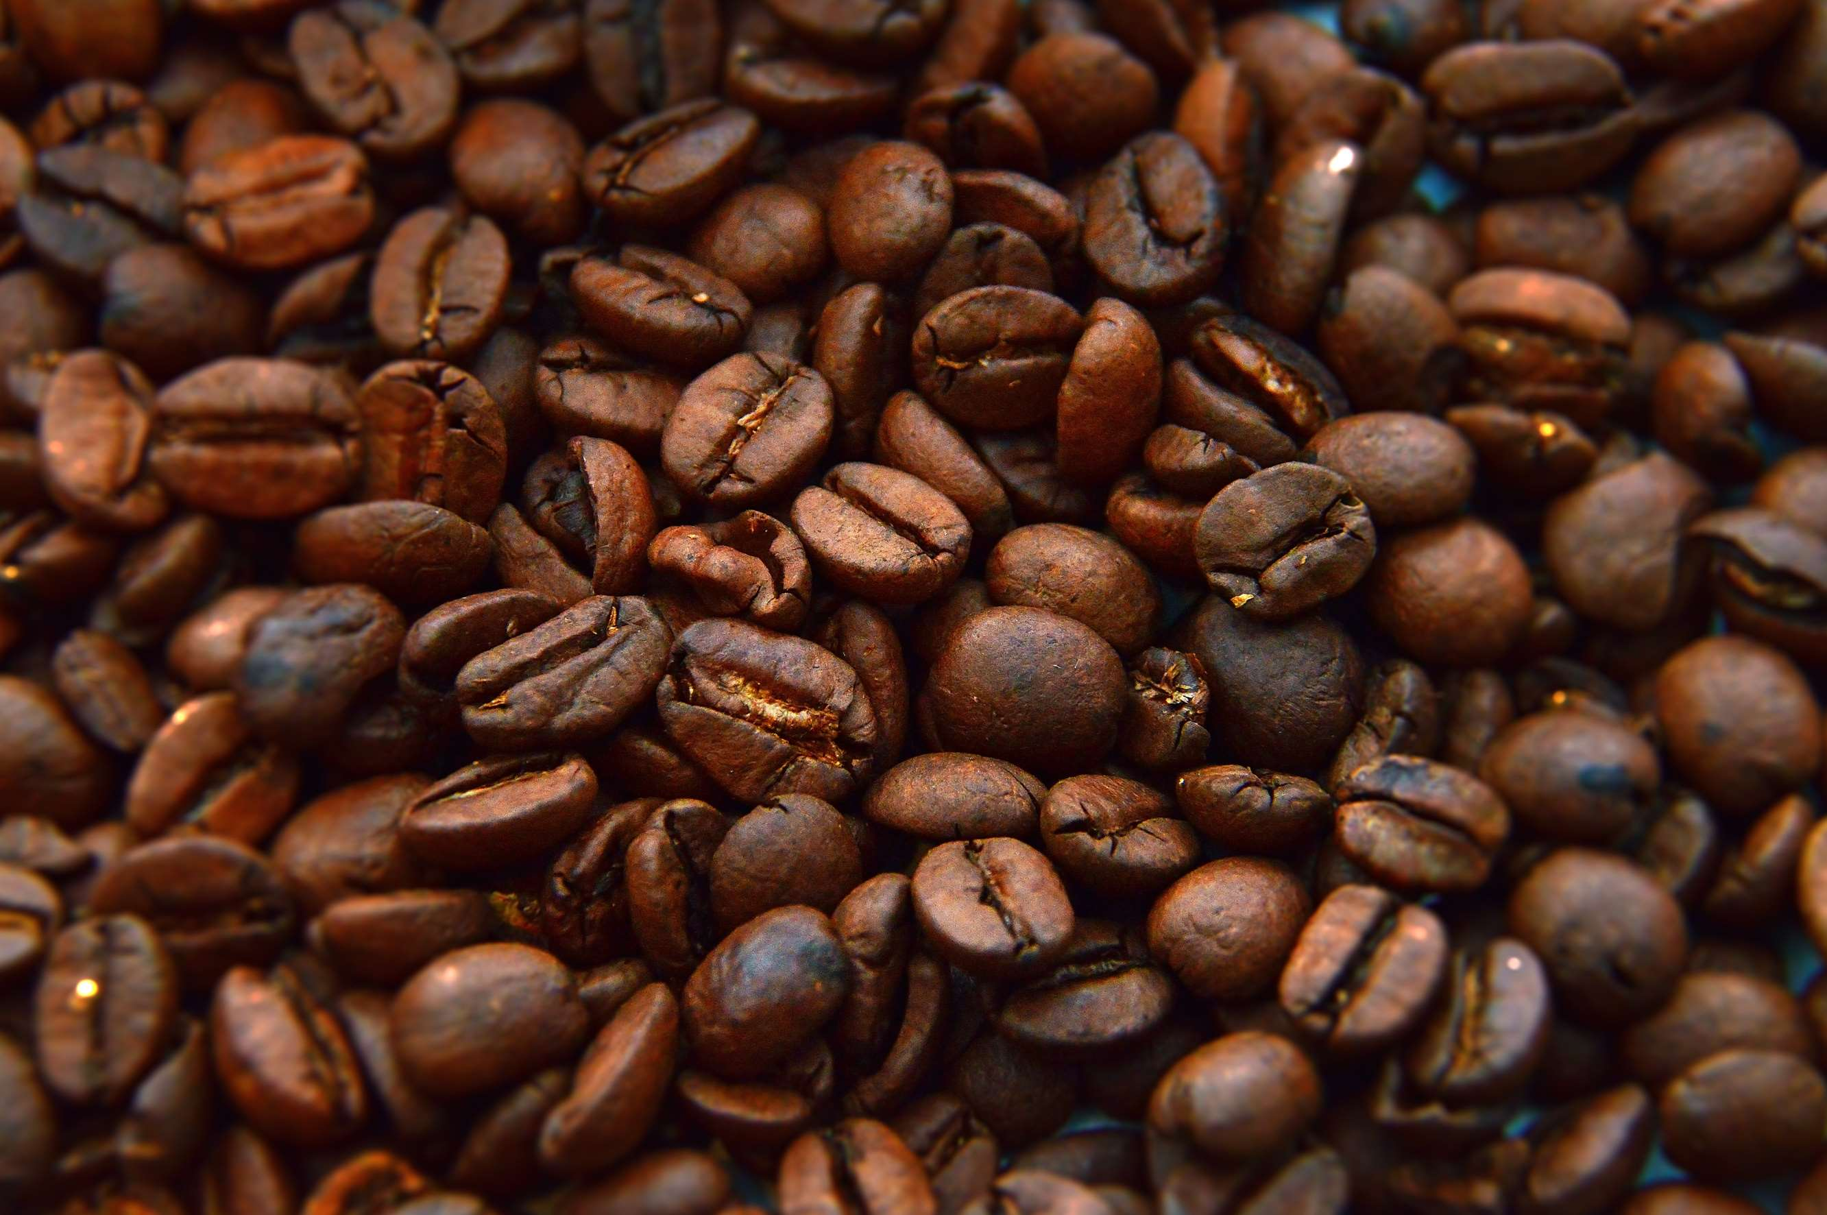

KEY INSIGHTS
MARKET SIZE
USD 815.20 Million
2022
FORECAST
USD 1.16 Billion
2030
CAGR
6.21 %
2023- 2030

Slide 4
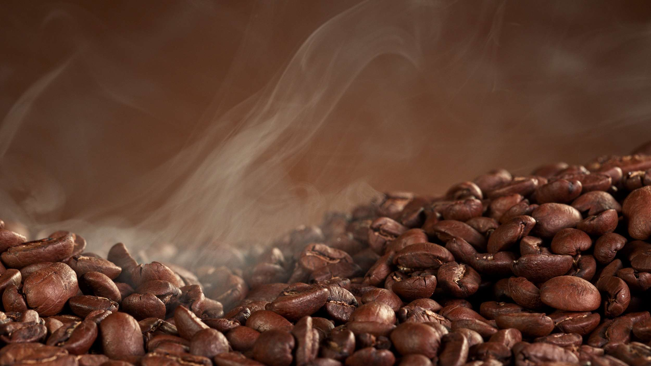
REVENUE MARKET SHARE BY SEGMENTS 2022
  Synthesis Caffeine
  Natural Caffeine
Type Segment
  Food & Beverage
  Pharmaceutical
  Flavor & Fragrance
Application Segment
  Online Stores
  Supermarket/Hypermarket
  Convenience Stores
Distribution Channel

Slide 5
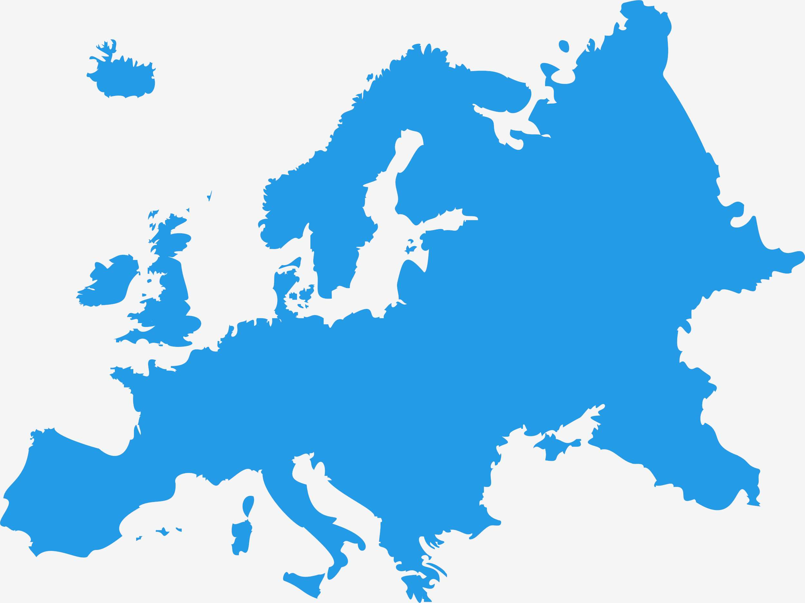
Global Caffeine Market Revenue share for 2022
Europe

Slide 6

Increasing preference for caffeine beverages and the number of people choosing an active lifestyle is the key factor expected to drive the growth of the caffeine market.
Drivers

Slide 7

AUTHOR'S PERSPECTIVE
  The Global Caffeine Market is witnessing significant growth in the near future.
  This is due to increasing consumer preferences for instant energy drinks and synthetic caffeine is high in antioxidants is projected to drive the growth of the synthesized caffeine segment.
  In 2023, the Synthesis Caffeine segment accounted for noticeable share of global Caffeine Market and is projected to experience significant growth in the near future.
  The Food & Beverage segment is expected to expand at the significant CAGR retaining position throughout the forecast period.

Slide 8









KEY PLAYERS

Slide 9


For Full Report
Contact us
COGNITIVE MARKET RESEARCH
Tel: +1 312-376-8303 | +44 020-8123-0732
India: (+91) 983-496-8611
sales@cognitivemarketresearch.com
Access the Full Report : http://tinyurl.com/4vwu8cxd
Please visit our website:
https://www.cognitivemarketresearch.com

