Slide 1

GLOBAL
CABLE CARS
MARKET REPORT 2024
Global,Regional,CountryAnalysis

Slide 2
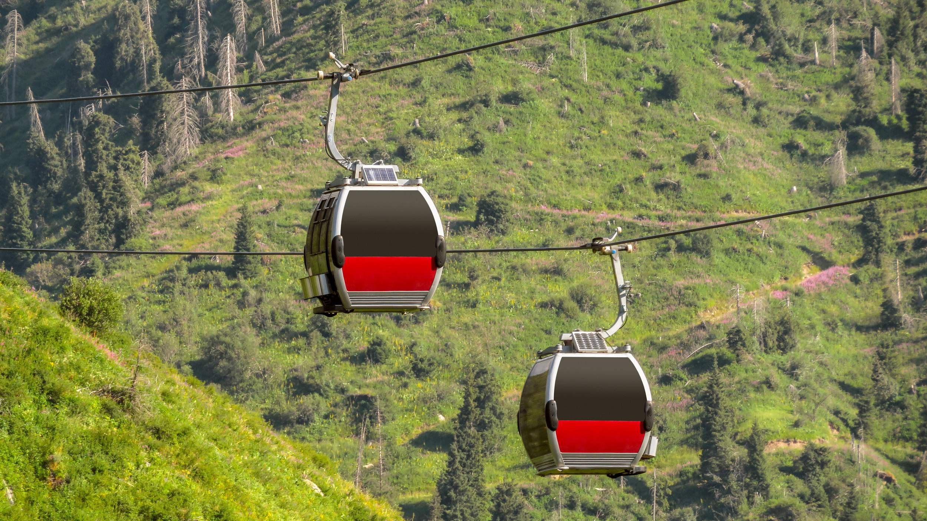
INTRODUCTION
Cable cars, which are also referred to as aerial tramways or ropeways, are a transportation method involving cabins or gondolas suspended from a constantly moving cable. These systems are frequently utilized to transport individuals or goods across challenging terrains, like mountains or urban areas with complex topography. The expansion is being driven by the growing tourism and recreation sectors, as well as urban transportation needs

Slide 3
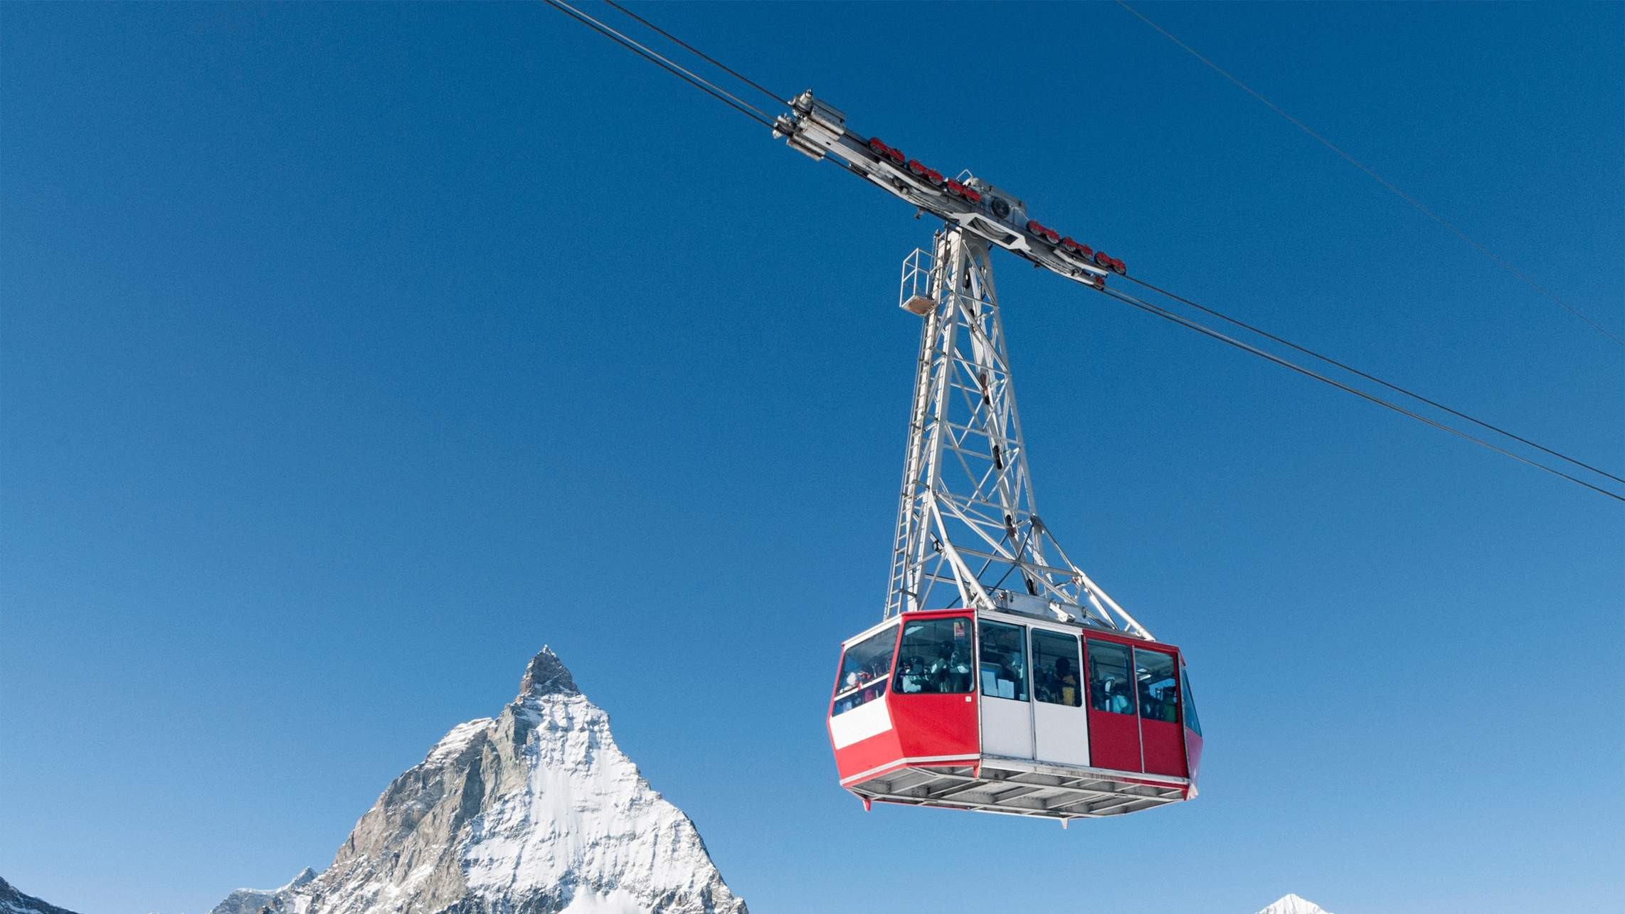

KEY INSIGHTS
MARKET SIZE
USD 0.048 billion
2023
20₋23
CAGR 11.80%
2030

Slide 4
REVENUE MARKET SHARE BY SEGMENTS 2022
Vertical Lifts Surface Lifts Inclined Lifts
Type Segment
Tourism
Public Transport Others
Application Segment

Slide 5
Global Cable Cars Market Revenue share for 2022
North America

Slide 6
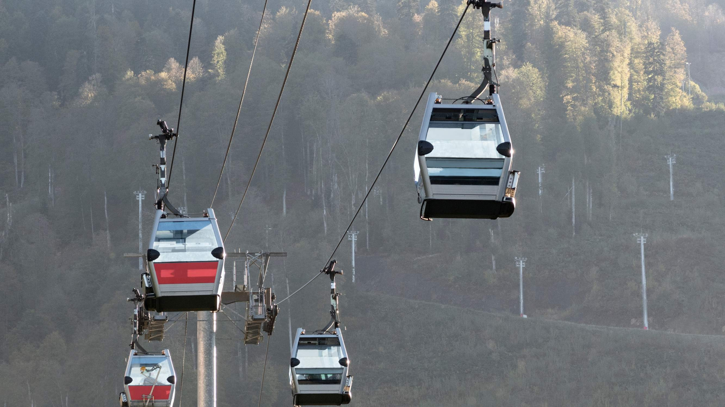
Urban Mobility Solutions and Traffic Decongestion to Propel Market Growth
Drivers
Environmental and Regulatory Challenges to Restrict Market Growth
Restraints

Slide 7
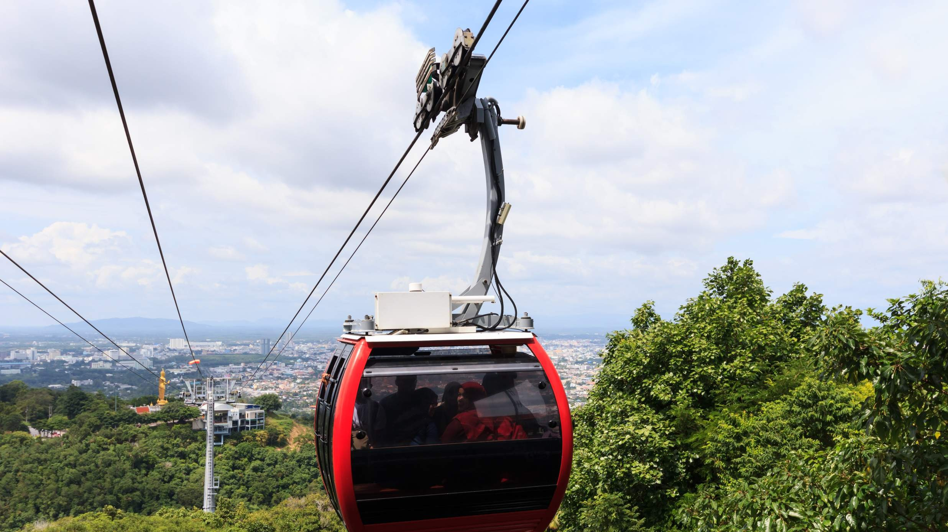
AUTHOR'S PERSPECTIVE
The Global Cable Cars Market is witnessing significant growth in the near future. Vertical lifts are versatile, capable of transporting passengers and cargo over steep terrains or urban landscapes, offering a solution for both recreational and urban transportation needs.
Cable cars play a pivotal role in enhancing the tourist experience by offering breathtaking panoramic views and convenient transportation to scenic locations Governments and urban planners worldwide are recognizing the value of cable cars in enhancing public transport networks, making this category the fastest- growing segment as cities embrace innovative and eco-friendly mobility solutions..

Slide 8
KEY PLAYERS

Slide 9


Contact us
For Full Report
COGNITIVE MARKET RESEARCH
Tel: + 1 312 - 376 - 8303 | + 44 020 - 8123 - 0732
India: ( + 91 ) 983 - 496 - 8611
sales@ cognitivemarketresearch. com
Access the Full Report : http://tinyurl.com/5bph75kp
Please visit our website:
https://www.cognitivemarketresearch.com

