Slide 1




Slide 2




INTRODUCTION

Slide 3
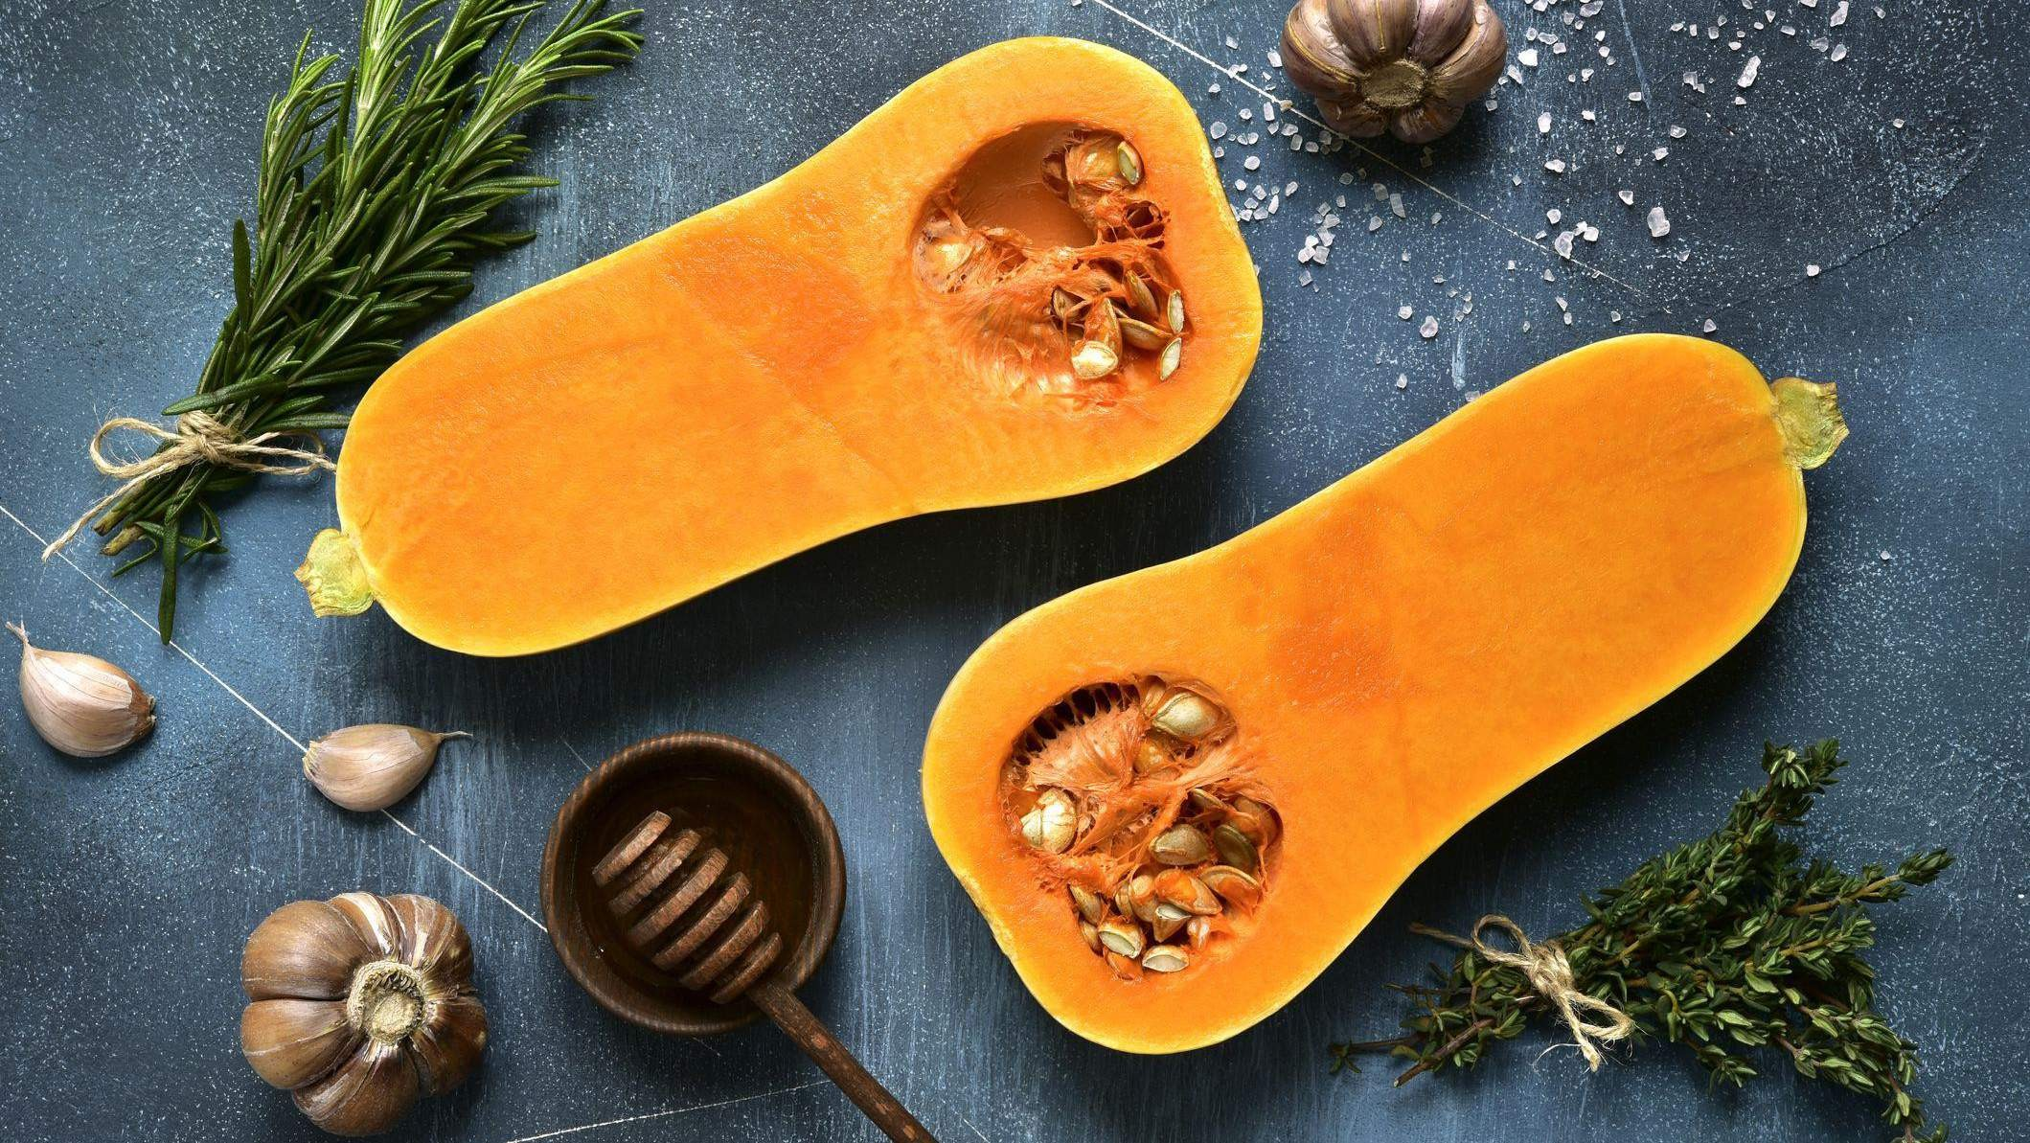

KEY INSIGHTS
MARKET SIZE
USD 4,142.67 Million
2016
FORECAST
USD 6,874.24 Million
2028
2023-
2030
CAGR 5.32%

Slide 4
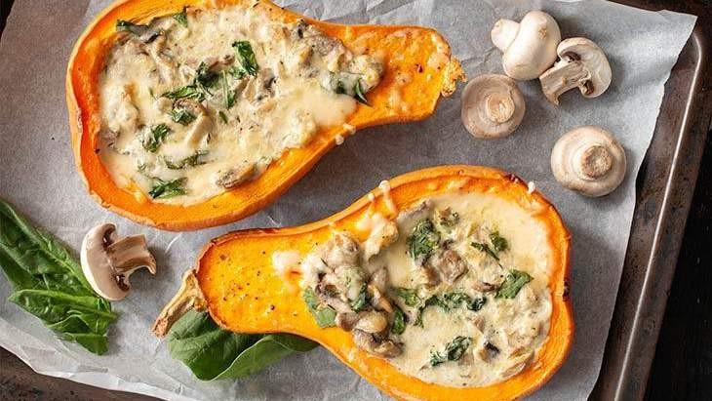
REVENUE MARKET SHARE BY SEGMENTS 2022
FORM SEGMENT
PACKAGING SEGMENT
Bottles & Tetra Pack USD 1,348.43 Million
DISTRIBUTION CHANNEL
Direct
USD 1,434.25 Million
Fresh Form USD 2,499.40 Million

Slide 5

GLOBAL BUTTERNUT SQUASH MARKET REVENUE SHARE FOR 2022
Europe
USD 1,994.91 Million

Slide 6
Rising health consciousness and increase in food and beverage industry
Disruption of the supply chain

Slide 7

AUTHOR'S PERSPECTIVE
The Global Butternut Squash Market is witnessing significant growth in the near future.
In 2023, the Fresh Form segment accounted for noticeable share of global Butternut Squash Market and is projected to experience significant growth in the near future.
The Bottles & Tetra Pack segment is expected to expand at the significant CAGR retaining position throughout the forecast period.

Slide 8
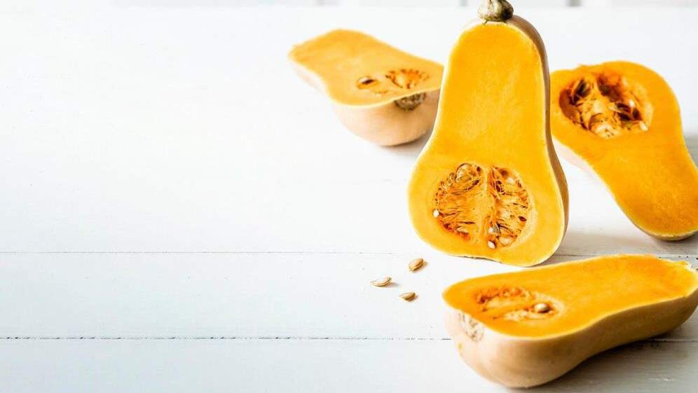






KEY PLAYERS

Slide 9


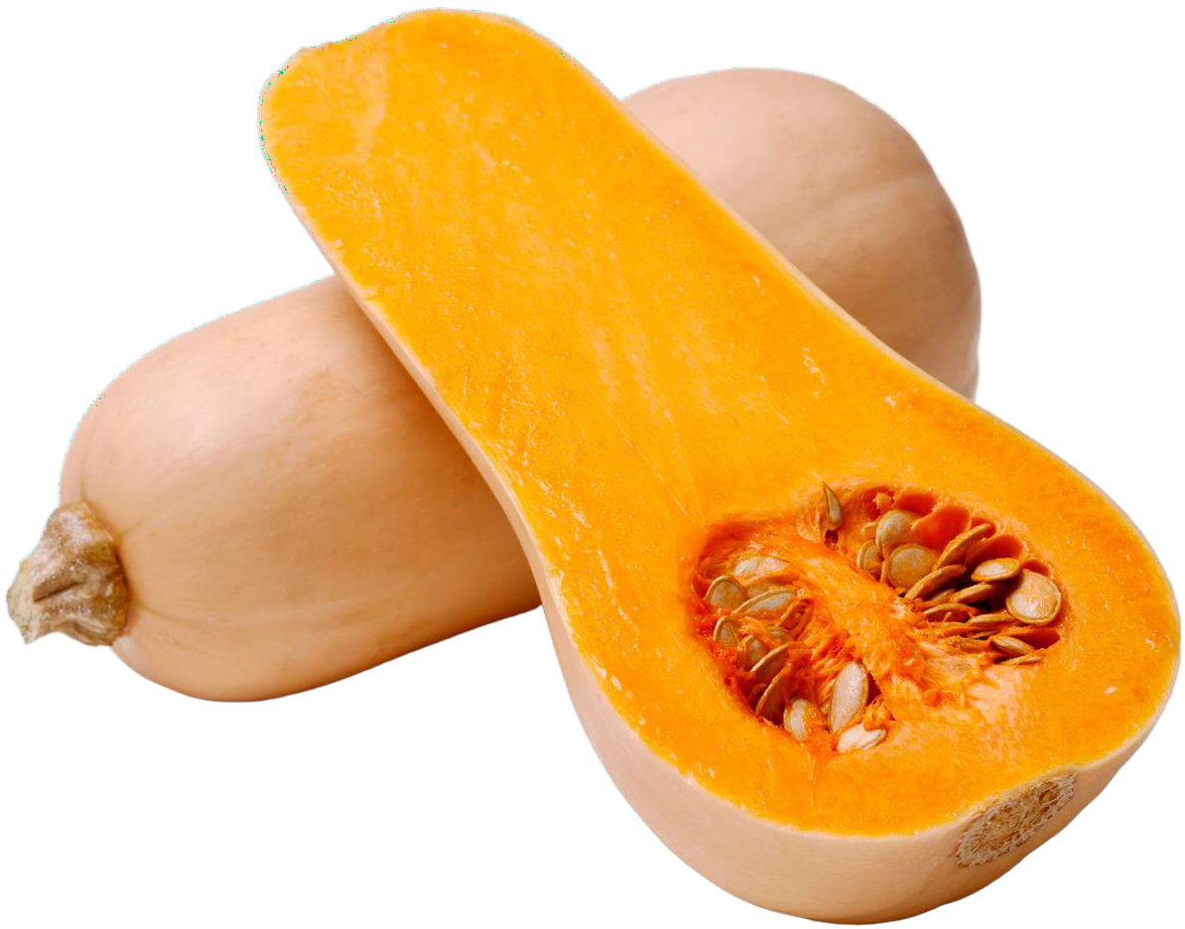
Contact us
For Full Report
COGNITIVE MARKET RESEARCH
Tel: + 1 312 - 376 - 8303 | + 44 020 - 8123 - 0732
India: ( + 91 ) 983 - 496 - 8611
sales@ cognitivemarketresearch. com
Access the Full Report : https://shorturl.at/iwX59
Please visit our website:
https://www.cognitivemarketresearch.com

