Slide 1
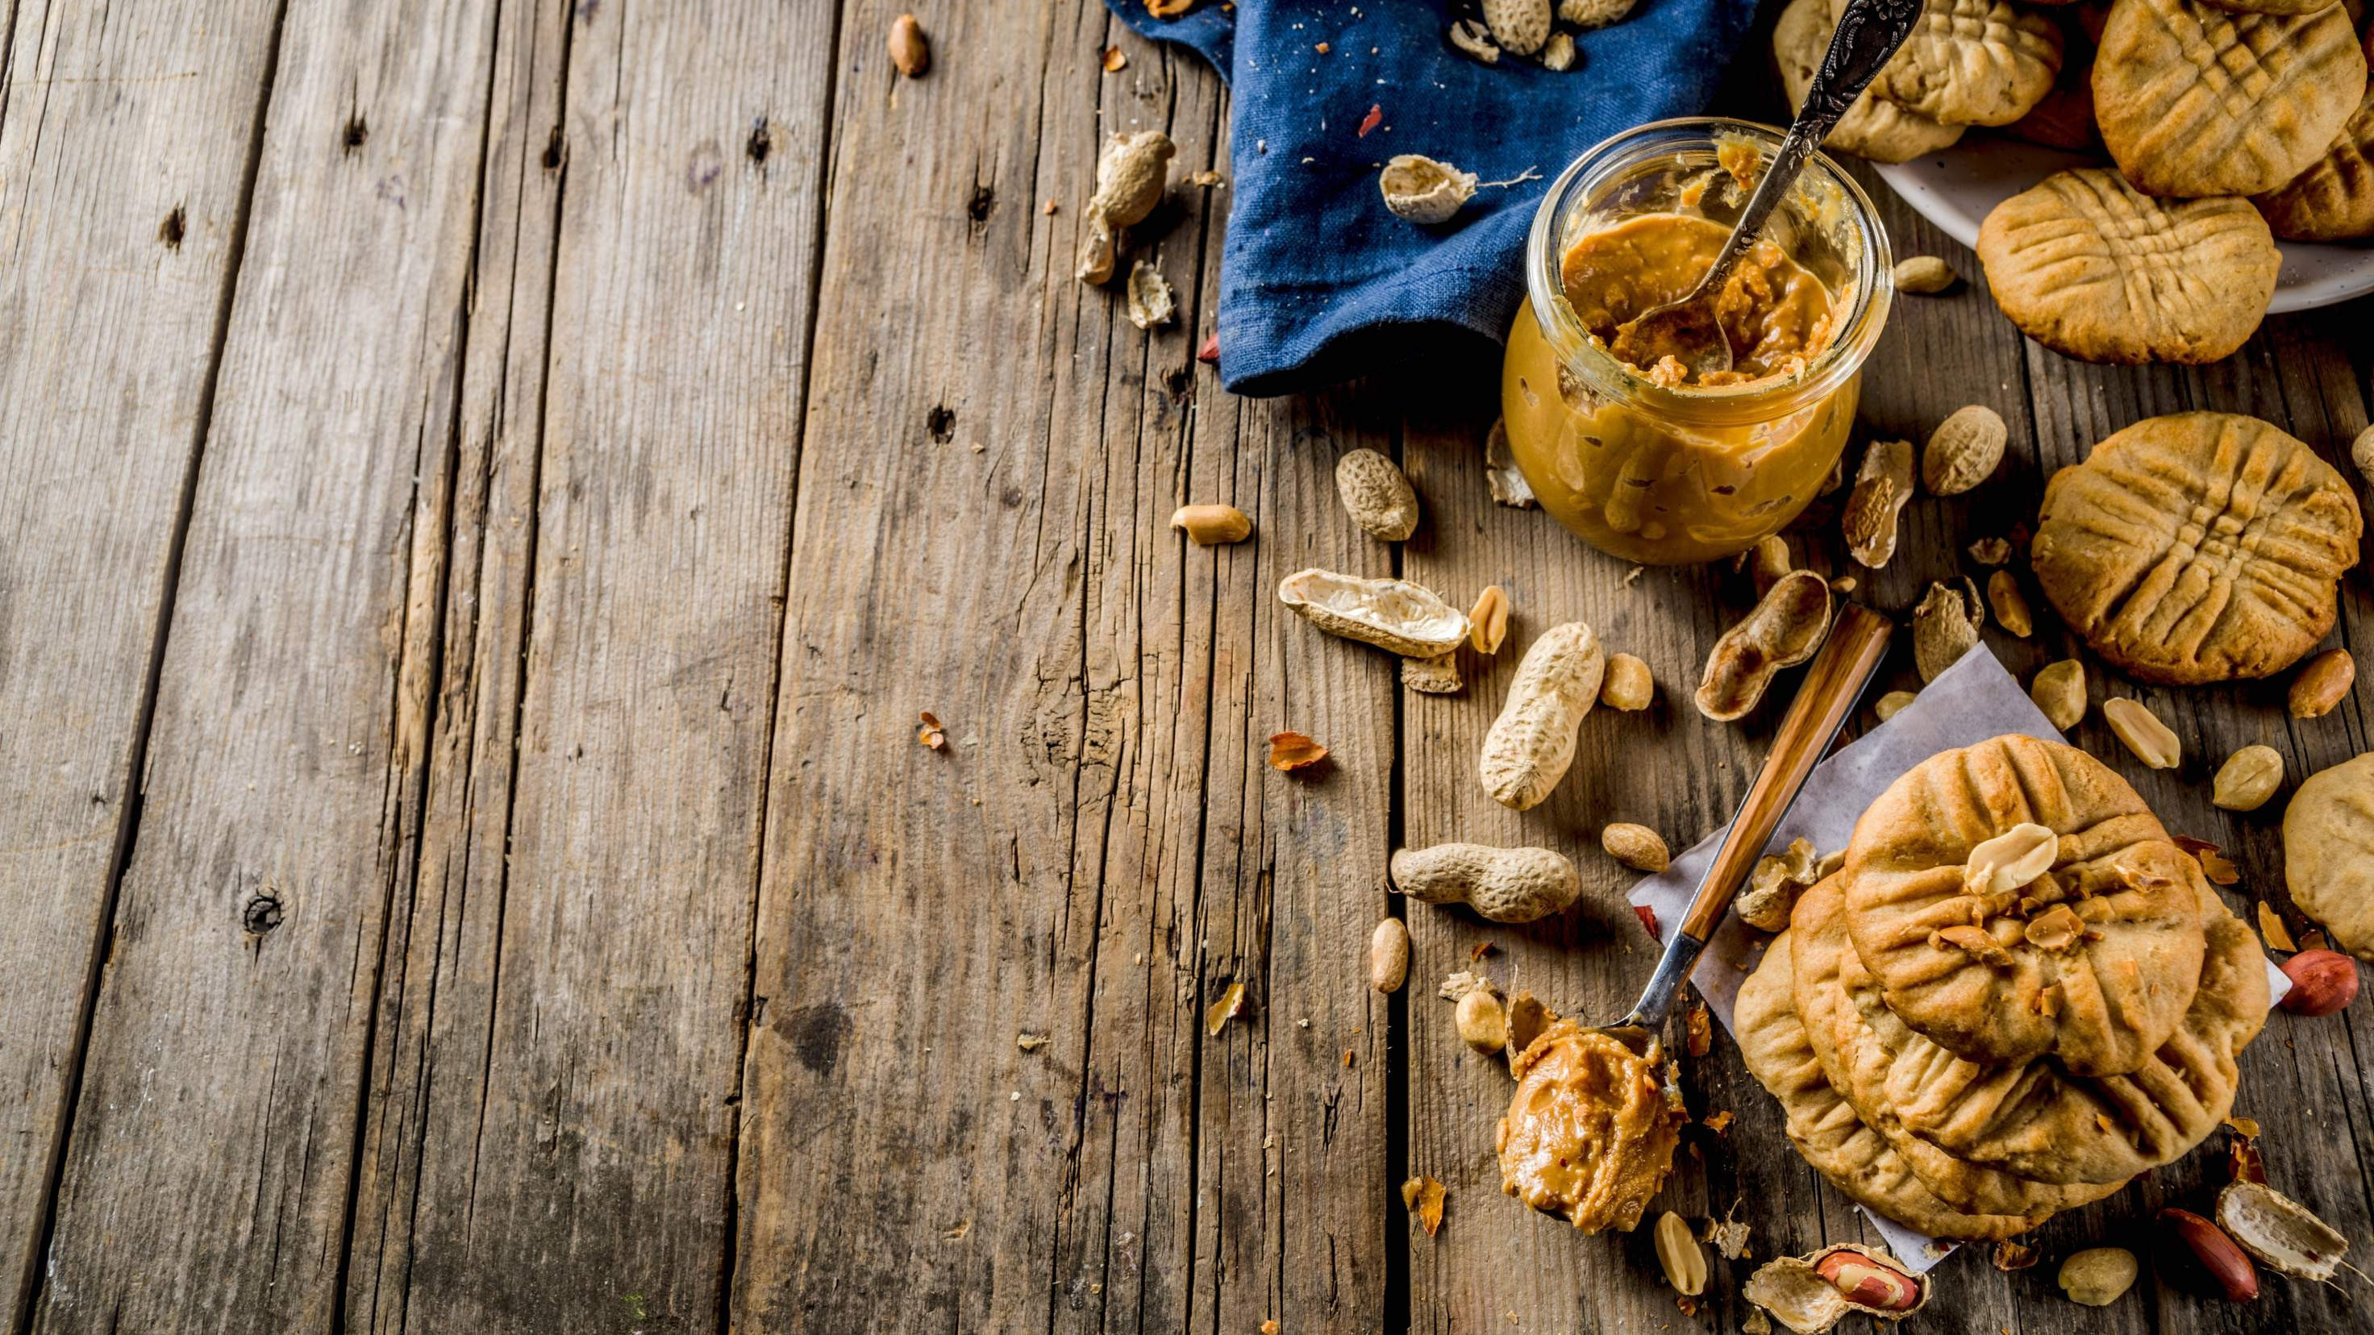
GLOBAL
BUTTER COOKIES
MARKET REPORT 2024
Global,Regional,CountryAnalysis

Slide 2
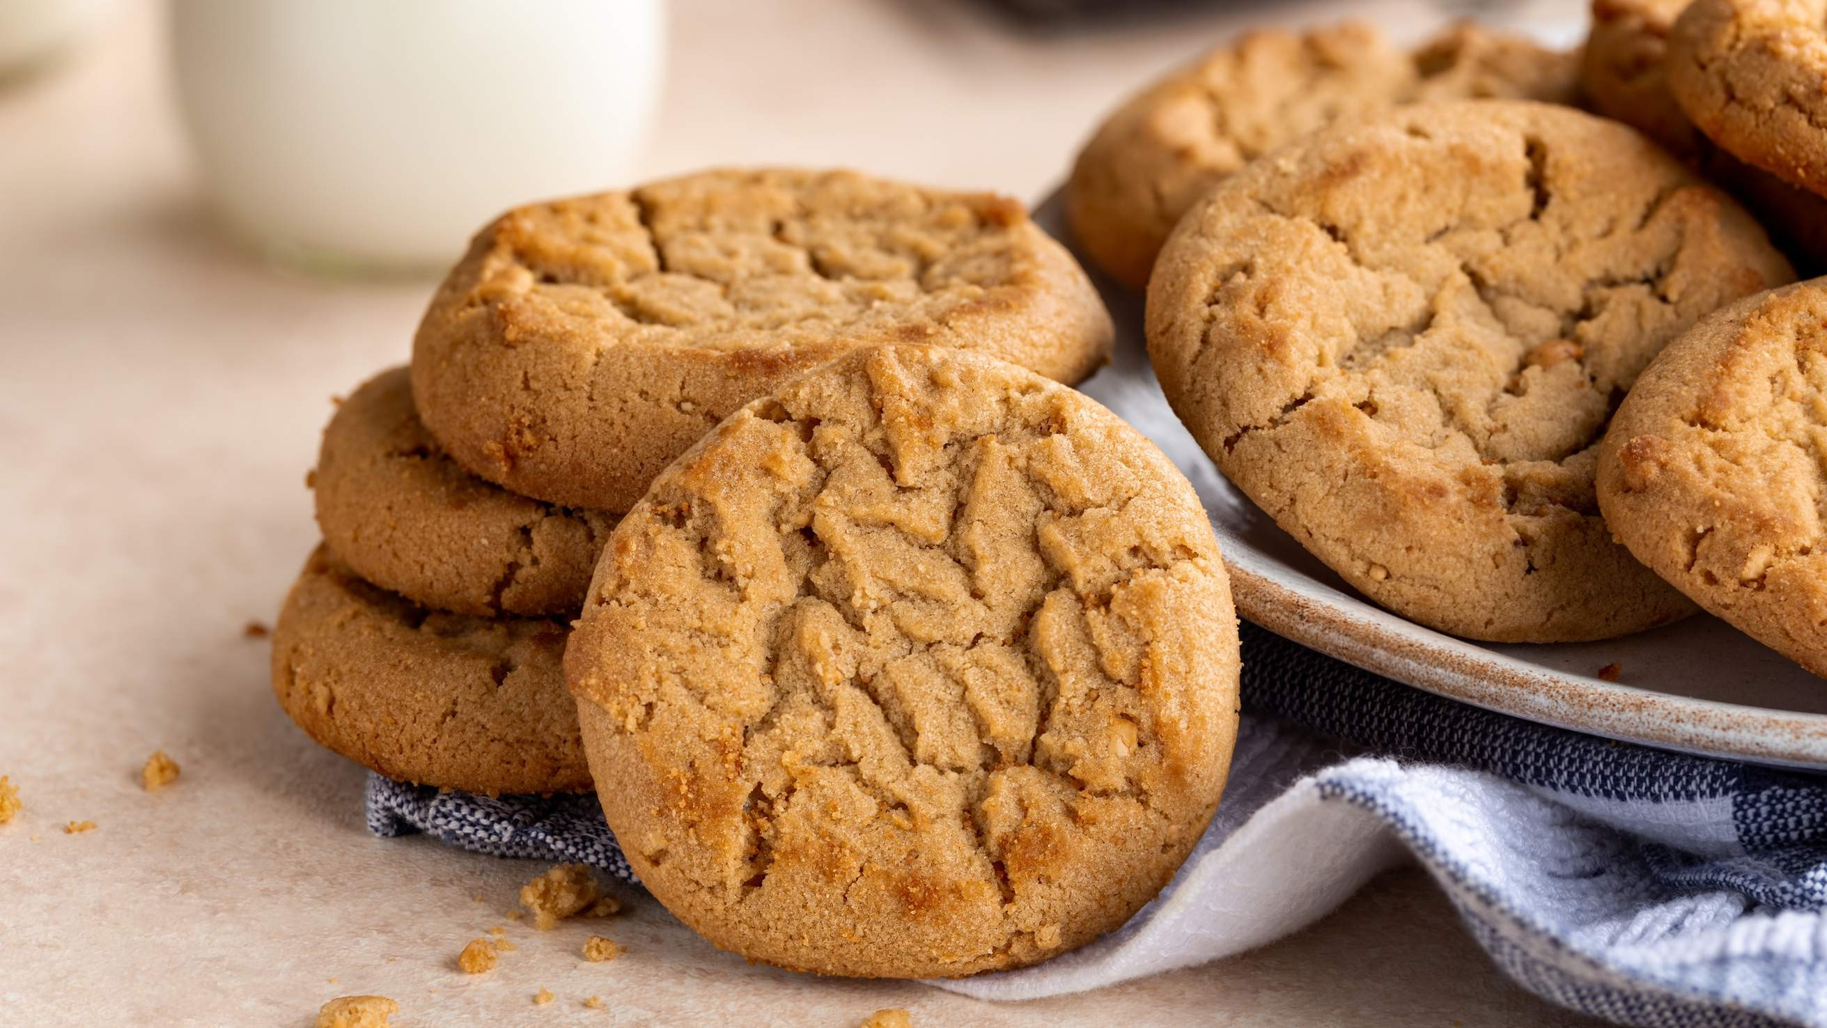
INTRODUCTION
This development is primarily ascribed to three factors: rising knowledge of butter cookies' health advantages, expanding desire for convenience food in busy lifestyles, and rising disposable income. As manufacturers release new goods to satisfy the expectations of health-conscious customers, the market is anticipated to continue expanding in the years to come. The increased demand from customers for easily packed snacks has led to tremendous expansion in the global market for butter cookies over the past several years. The global market for butter cookies is expanding as a result of increasing urbanization and increased consumer disposable income. A significant number of regional producers are being drawn to the market by various regional preferences for the flavor and texture of products, which is boosting market demand.

Slide 3
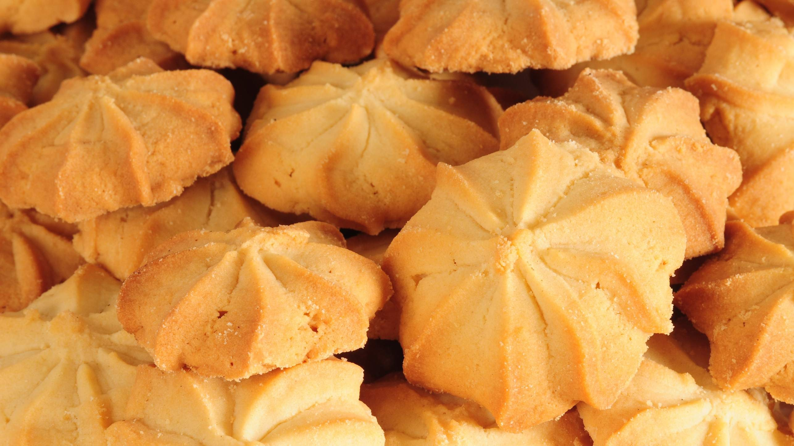

KEY INSIGHTS
CAGR 6%
20₋23
2030

Slide 4
REVENUE MARKET SHARE BY SEGMENTS 2022
Peanut Butter Cookies Almond Butter Cookies
Box Packaging Plastic Packaging
Packaging Segment
Type Segment
Domestic Use Commercial Use
Premium Economical
Price Range Segment
End User Segment

Slide 5
Global Butter Cookies Market Revenue share for 2022
Europe 35%

Slide 6
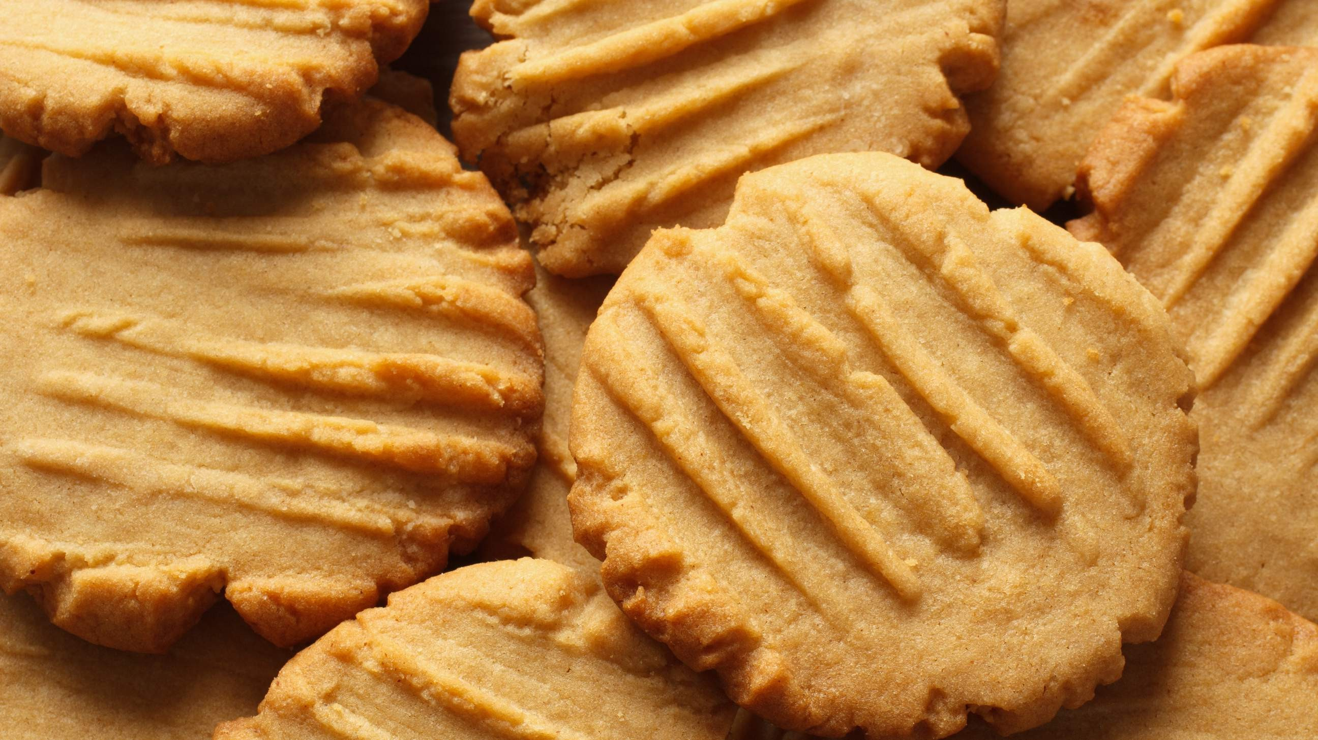
Rising Desire for Things that Make Life Easier to Propel Market Growth
Drivers
Presence of Alternative Food Items to Hinder Market Growth
Restraints

Slide 7
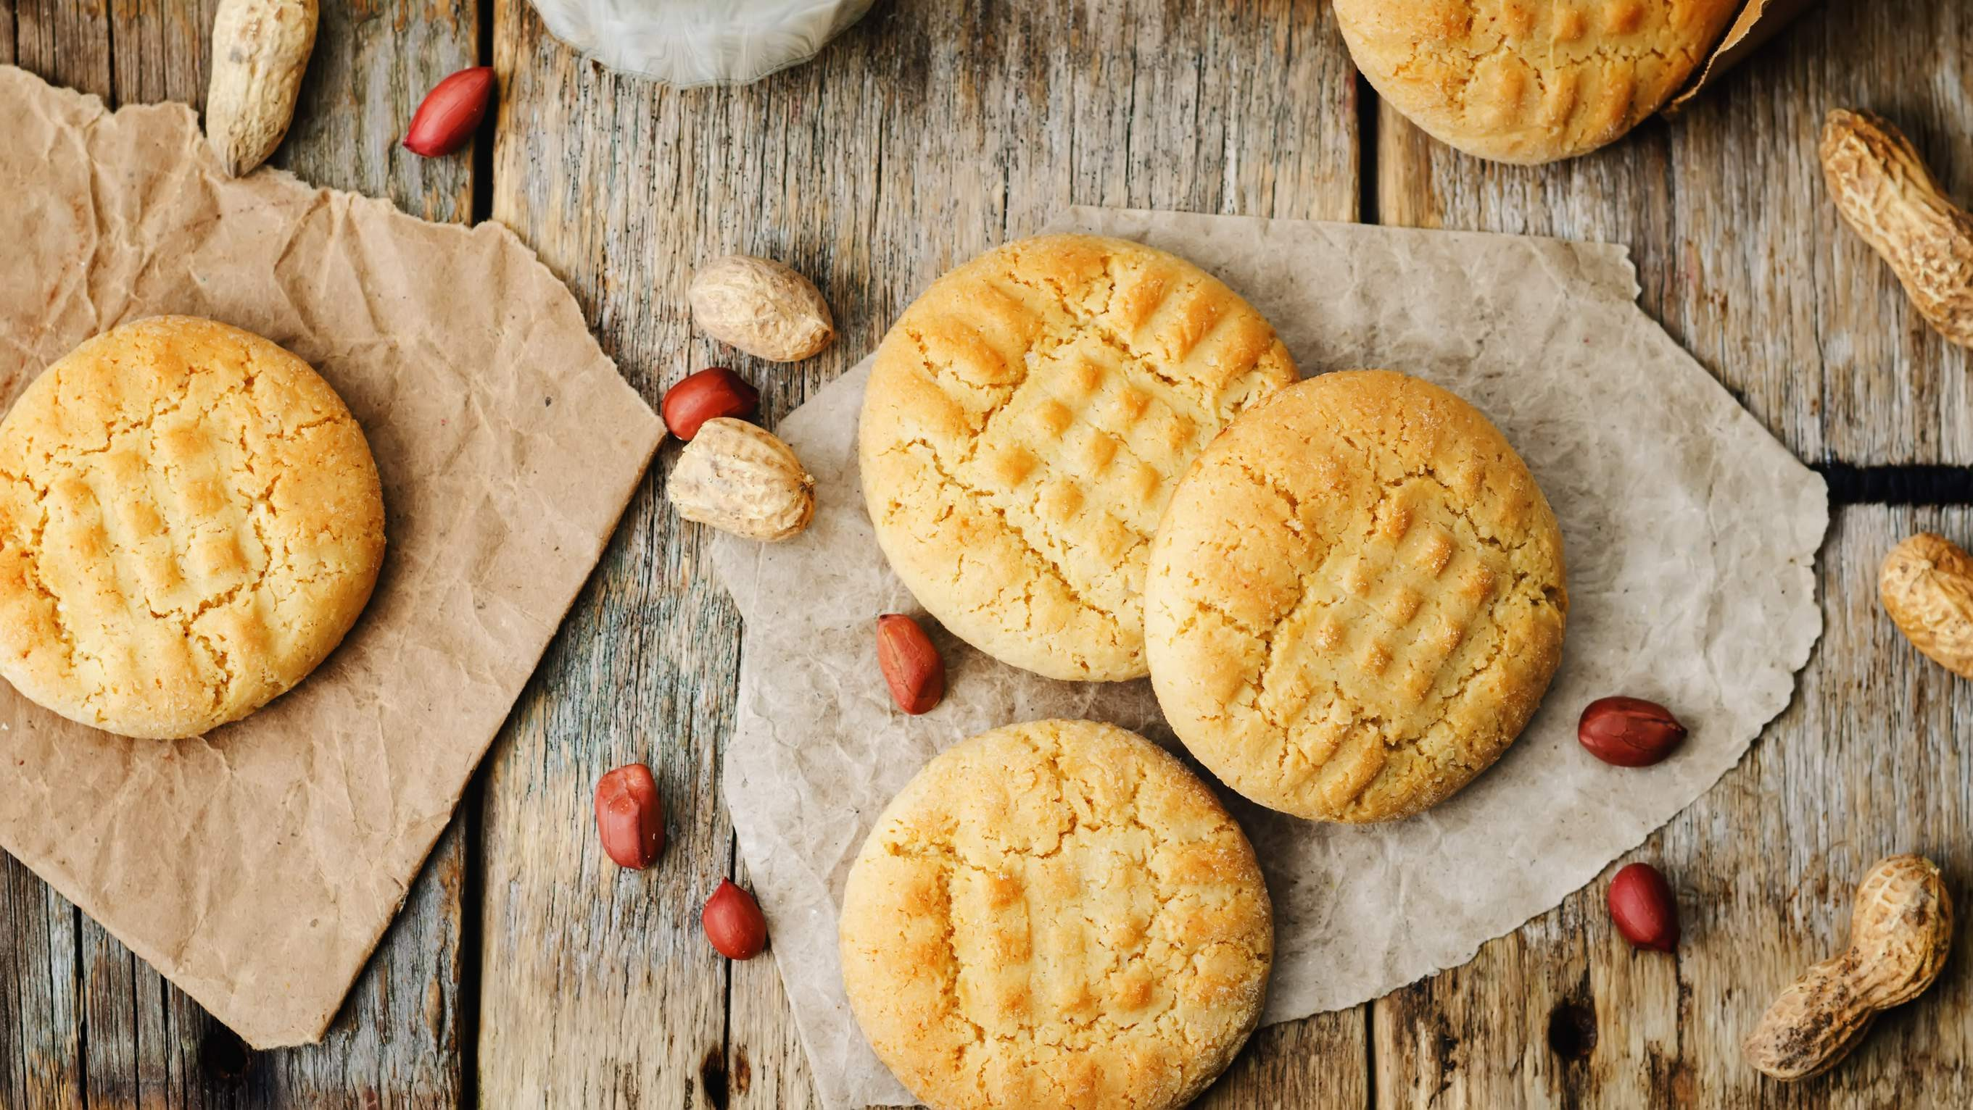
AUTHOR'S PERSPECTIVE
The Global Butter Cookies Market is witnessing significant growth in the near future. Cookies made with peanut butter are a beautifully tasty and buttery delicacy.
These snacks have a smooth texture and delicious flavor since they are produced with freshly ground almonds that have been combined with butter and milk.
Butter demand has eventually grown across the market as a result of manufacturers' rising investments in research and development of innovative confectionary items.
Customers may access a wider variety of goods, as well as compare prices and buy butter cookies at fantastic prices, with exclusive offers and discounts.
Boxes are frequently used, especially during special occasions like Christmas, to share a variety of cookies with others.

Slide 8
KEY PLAYERS

Slide 9


Contact us
For Full Report
COGNITIVE MARKET RESEARCH
Tel: + 1 312 - 376 - 8303 | + 44 020 - 8123 - 0732
India: ( + 91 ) 983 - 496 - 8611
sales@ cognitivemarketresearch. com
Access the Full Report : http://tinyurl.com/5f8fyppu
Please visit our website:
https://www.cognitivemarketresearch.com

