Slide 1



BURGERS
MARKET REPORT
2024
Qualitative Analysis + Quantitative Analysis

Slide 2
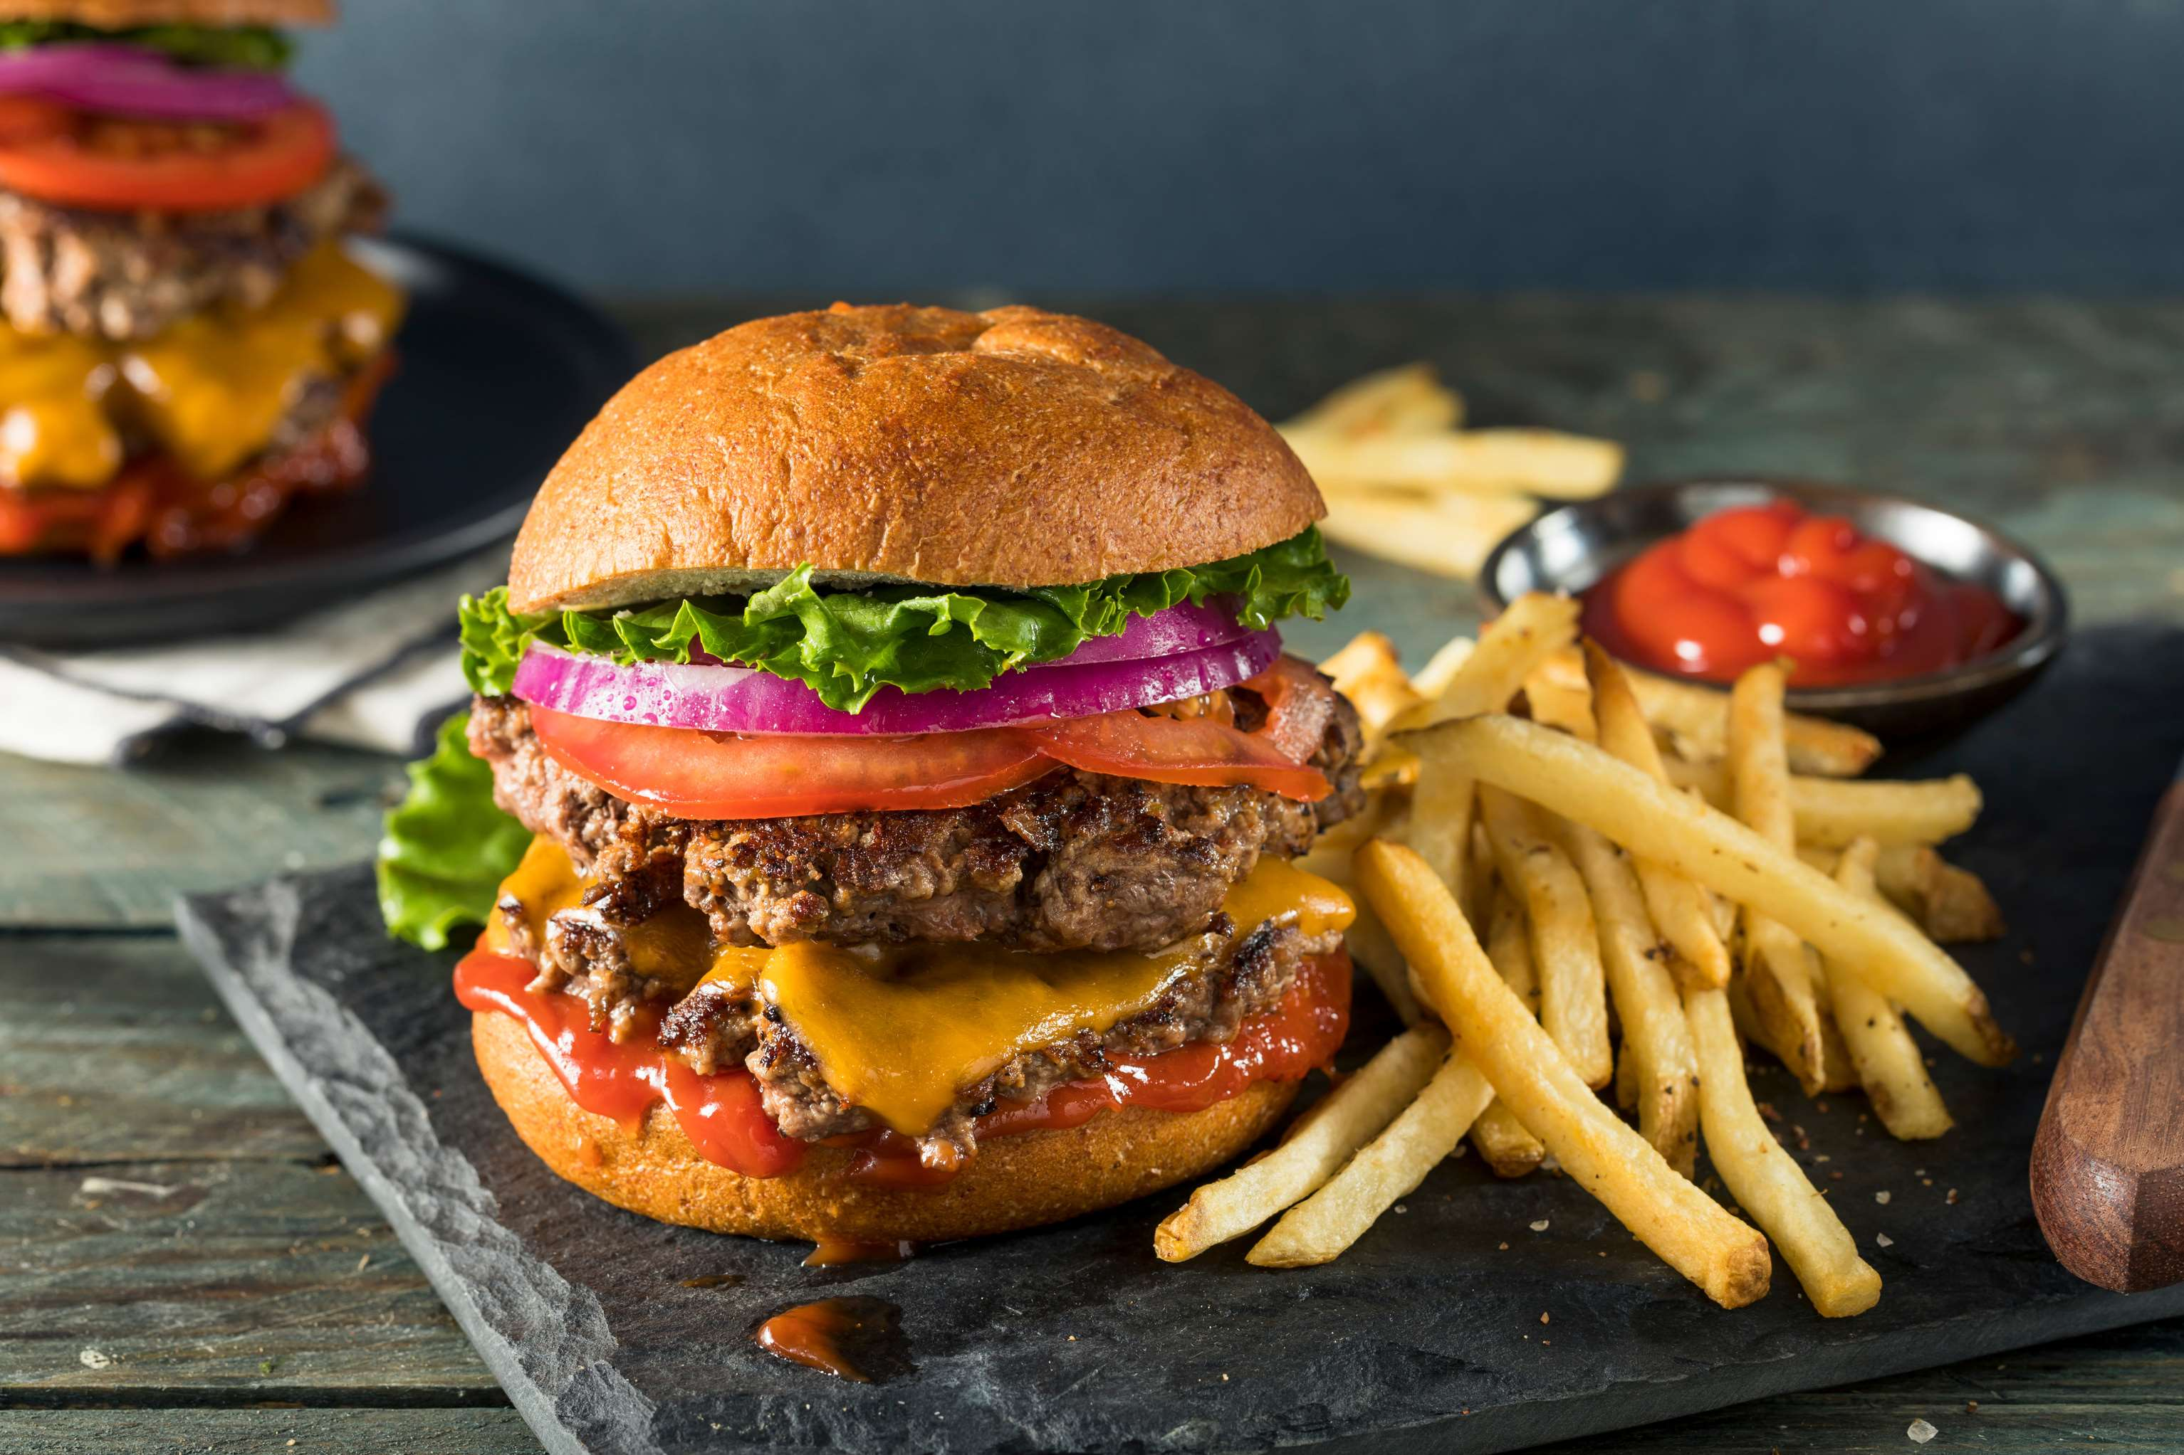
INTRODUCTION
The burger market continues with innovation and growth, fueled by evolving consumer tastes and preferences. As an ideal comfort food, burgers have maintained their popularity while also adapting to accommodate health-conscious and adventurous eaters alike. Plant-based alternatives have surged, appealing to environmentally conscious consumers and those seeking meat-free options without sacrificing taste or texture. Additionally, gourmet and artisanal burger joints have flourished, offering unique flavor combinations and premium ingredients to cater to discriminating palates.

Slide 3
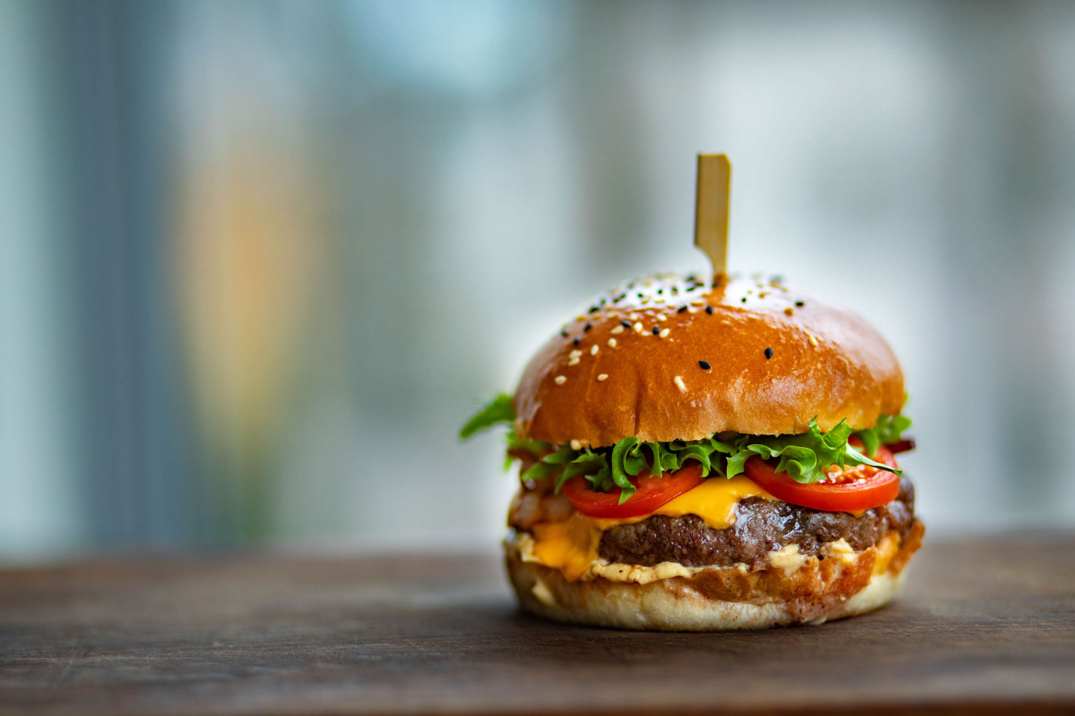

KEY INSIGHTS
CAGR
8.00%
2024- 2031

Slide 4
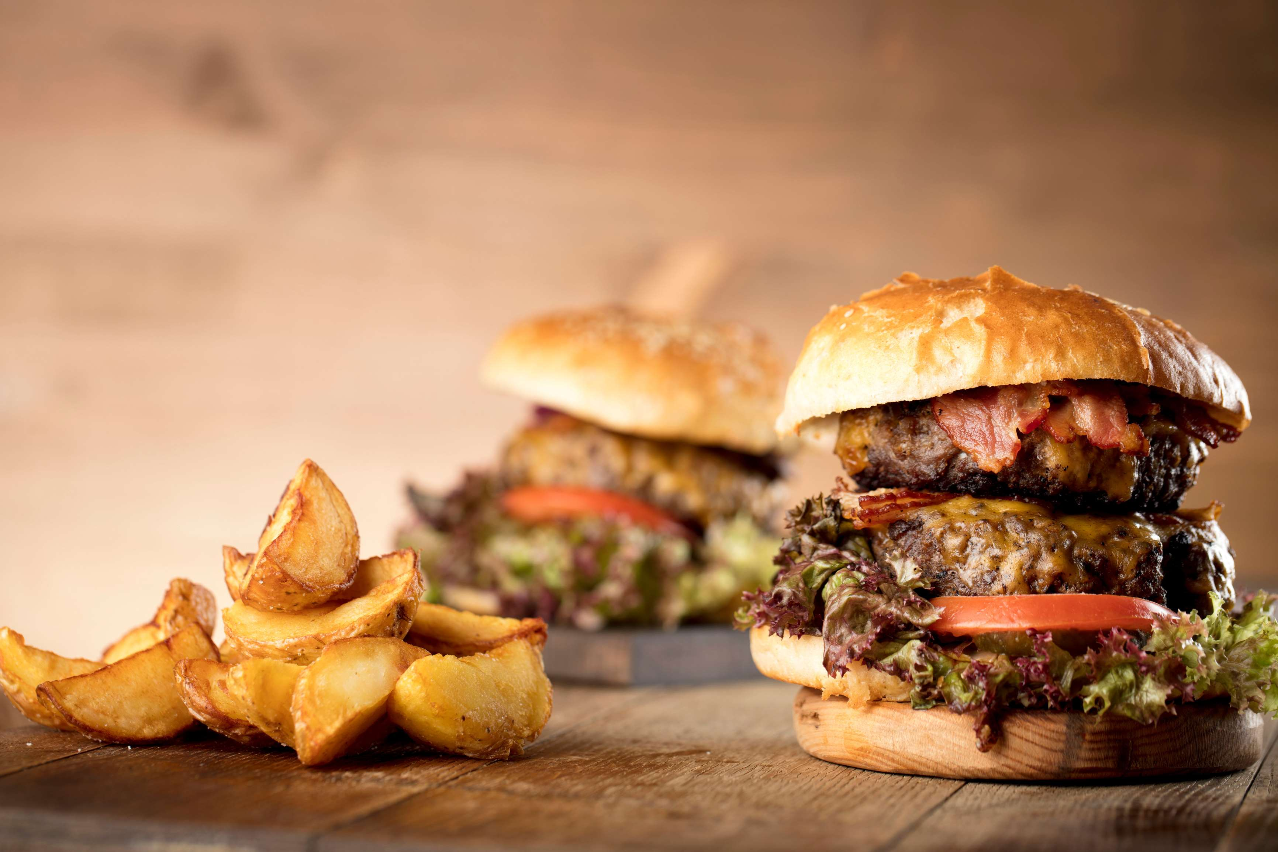
REVENUE MARKET SHARE BY SEGMENTS 2024
  Veg
  Chicken
  Fish
  Mutton
  Beef
Patty Segment
  HoReCa
  Supermarket
  Online retail
  Others
Distribution Channel

Slide 5


North America
40%
North America Burgers Market Revenue share for 2024 is 40%

Slide 6
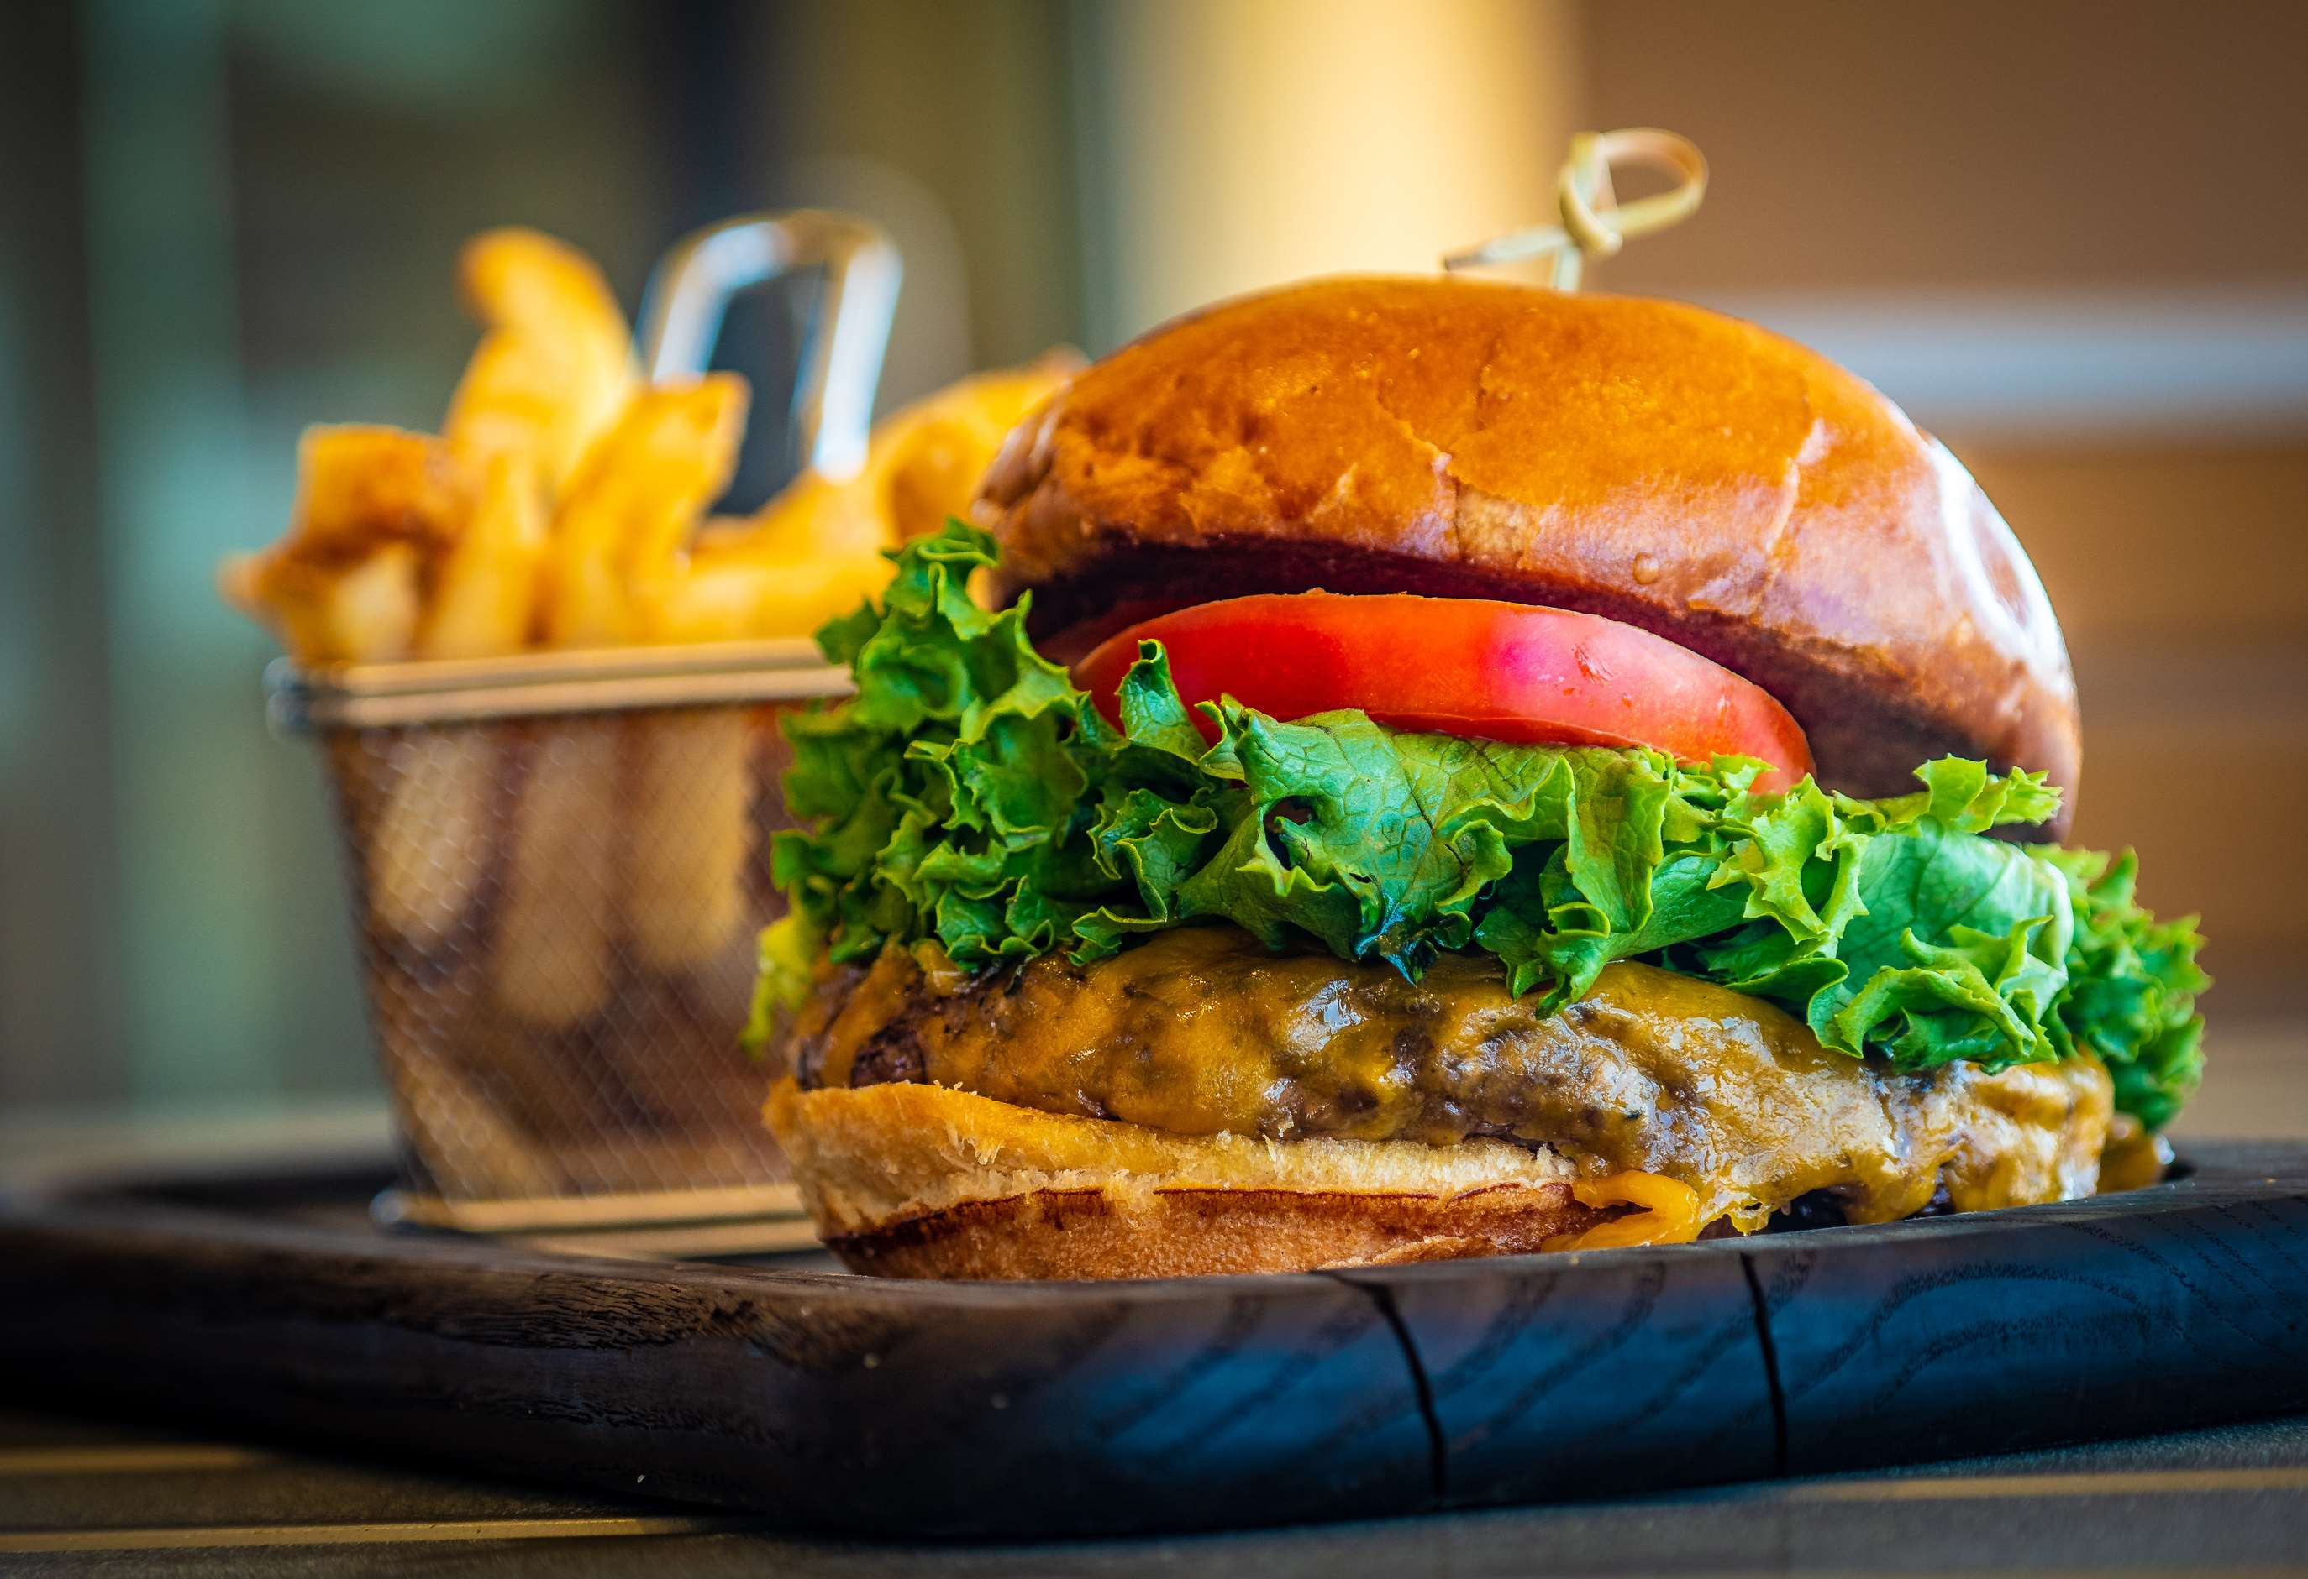
Demand for Plant-Based and Low-Fat Options Influences Burger Market Dynamics
Drivers
Limited Brightness and Image Quality to Limit the Sales
Restraints

Slide 7
AUTHOR'S PERSPECTIVE
  The global burger market will expand significantly by 8.00% CAGR between 2024 to 2031.
  Non-veg options hold a major share in the burgers market, dominating consumer preferences for their traditional taste and widespread availability across various fast-food and casual dining establishments.
  Despite the rise of plant-based alternatives, non-veg burgers hold a significant market share, especially among consumers seeking indulgence and protein-rich meals.
  Frozen burgers dominate the burger market, offering convenience and longer shelf life.
  They appeal to consumers seeking quick meal solutions without compromising taste or quality.

Slide 8
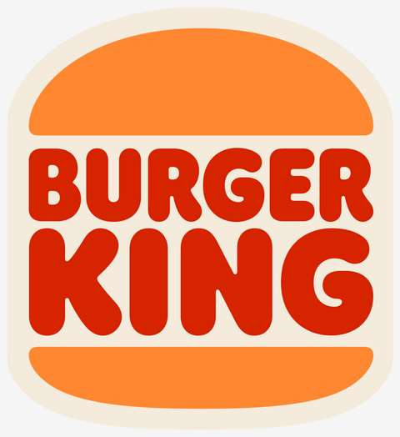

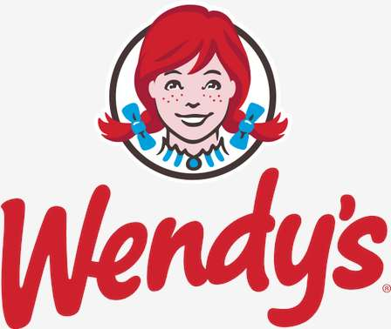


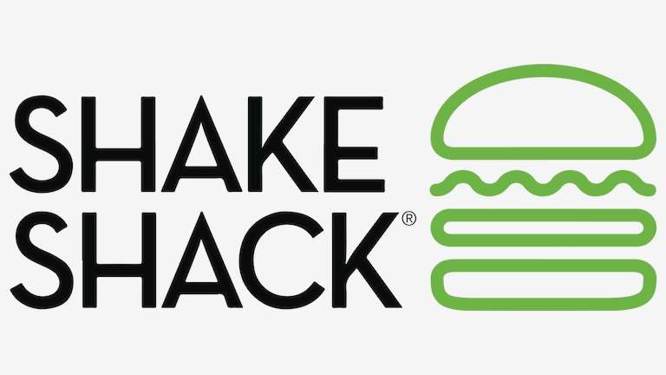





KEY PLAYERS

Slide 9


For Full Report
Contact us
COGNITIVE MARKET RESEARCH
Tel: +1 312-376-8303 | +44 020-8123-0732
India: (+91) 983-496-8611
sales@cognitivemarketresearch.com
Access the Full Report : https://tinyurl.com/pm6wnchv
Please visit our website:
https://www.cognitivemarketresearch.com

