Slide 1
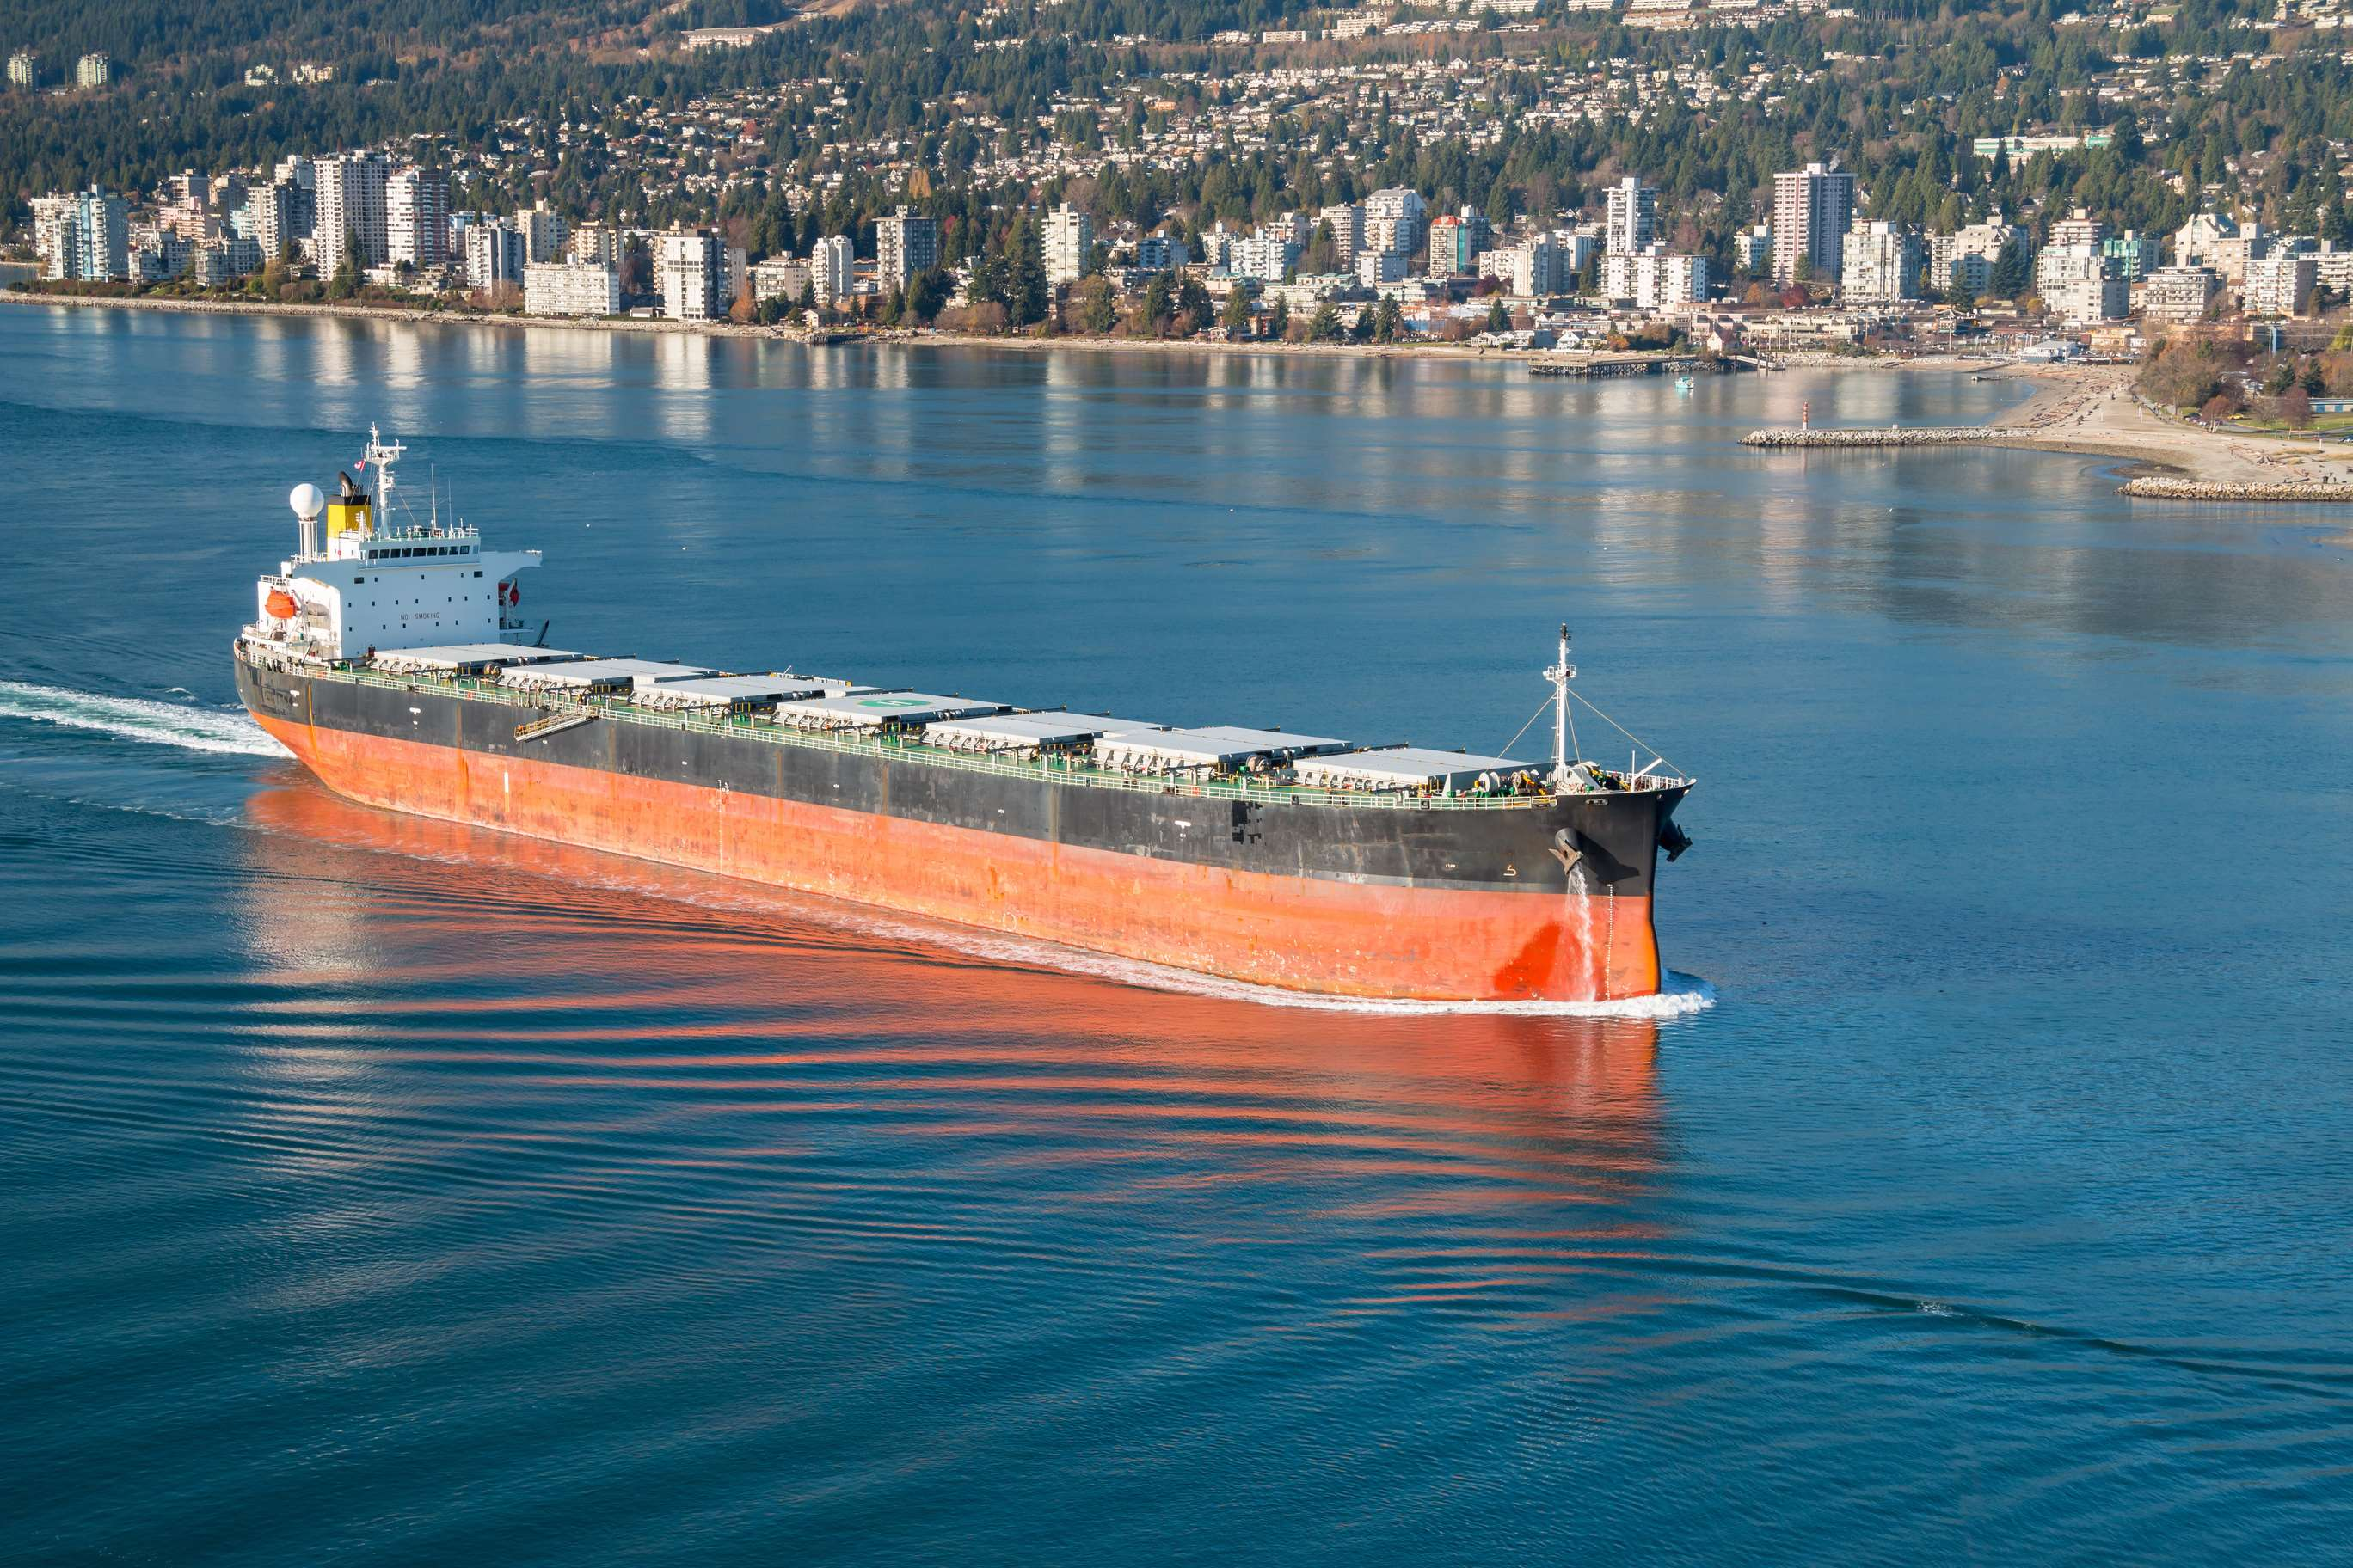
GLOBAL
BULK CARRIER SHIPS
MARKET REPORT
2024
Global,Regional,CountryAnalysis

Slide 2
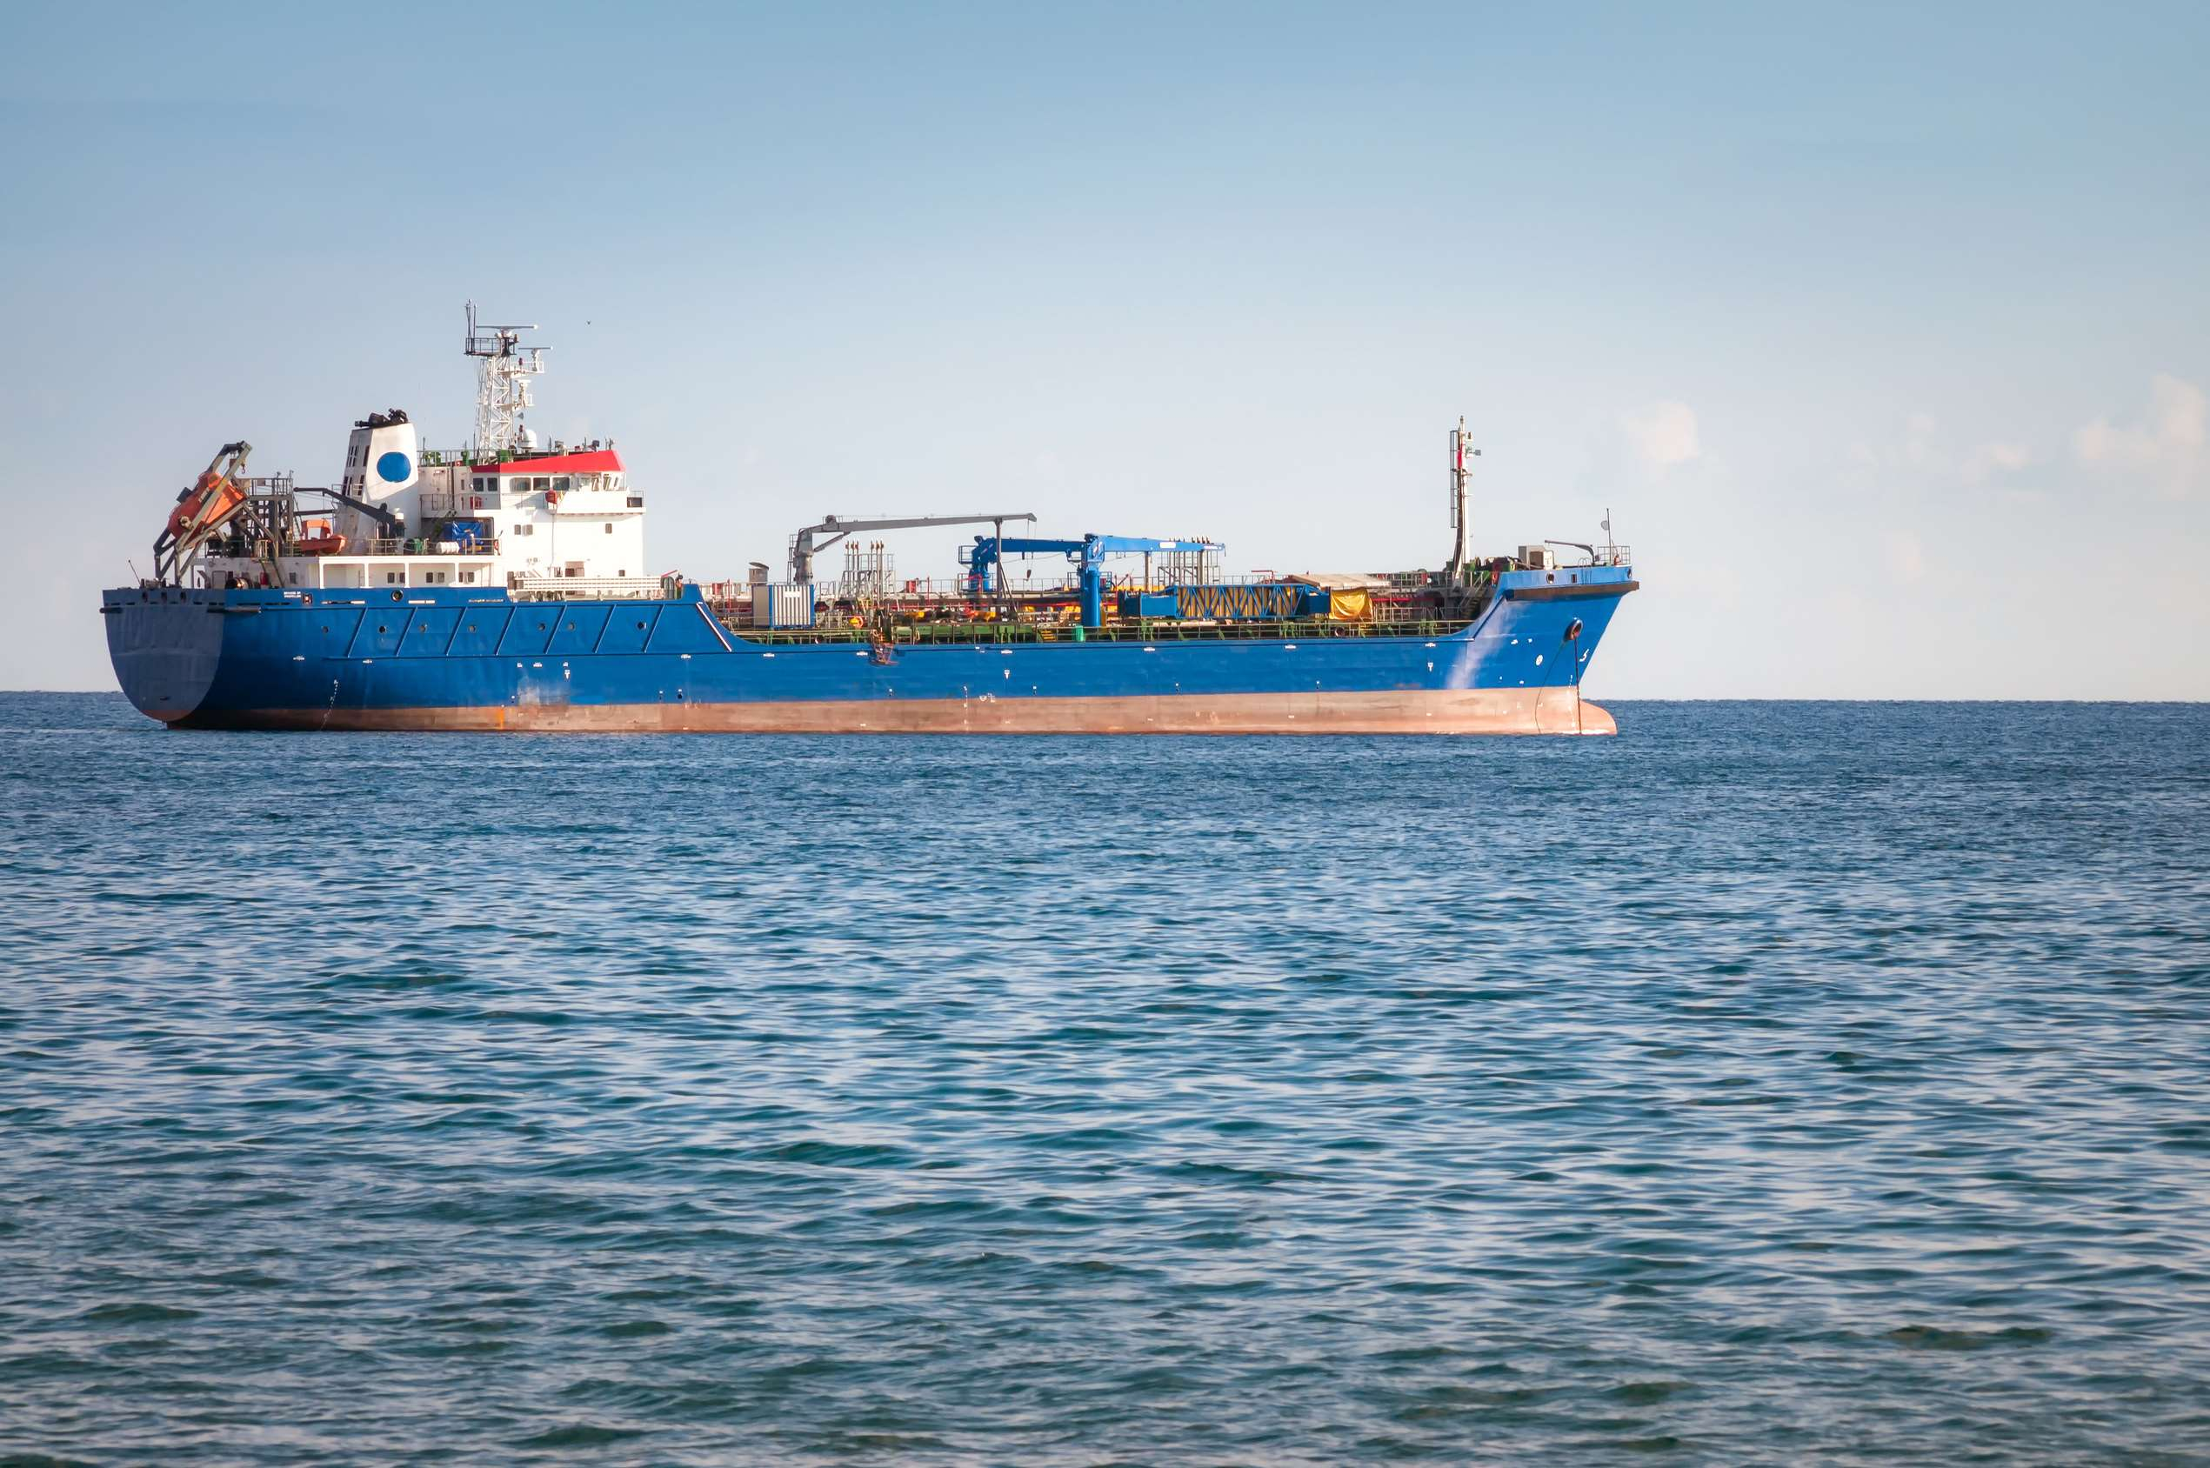
INTRODUCTION
Carrier ships are the integral link between the production and its consumption all across the globe. It thus plays very crucial part in connecting global economy. It has been estimated that almost 80% of global goods gets transported across oceans via ships. Though air freight is less time consuming, but the cost associated with it is too high in comparison to carrier ships. Further, carrier shipping allows heavy loads, as well as hazardous materials which brings flexibility in transportation driving the market for cargo ships.

Slide 3
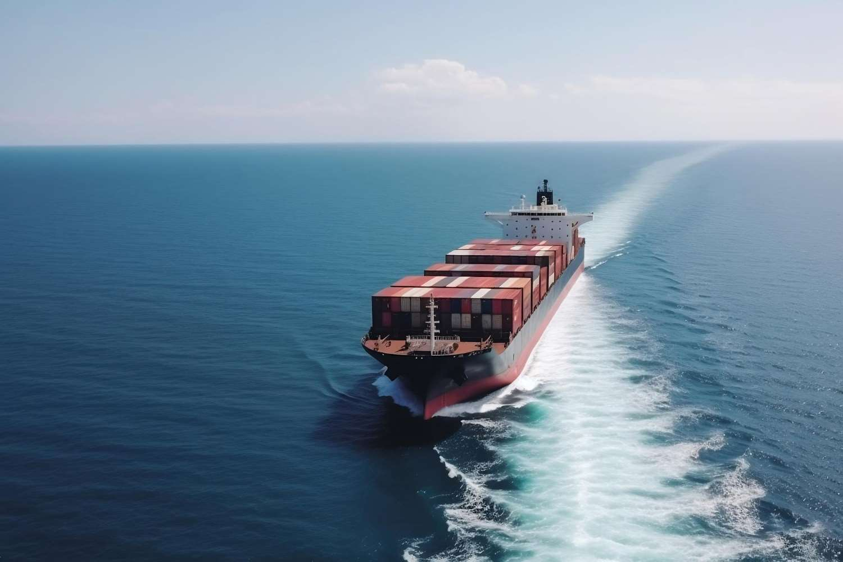

KEY INSIGHTS
MARKET SIZE
$374.24 Bn
2022
FORECAST
$412.36 Bn
2030
2023-
2030
CAGR
4.4%

Slide 4



REVENUE MARKET SHARE BY SEGMENTS 2022
Geared Type:
34.6%
Handymax Size:
49.7%
Coal Buk Cargo:
33.6%

Slide 5

GLOBAL BULK CARRIER SHIPS MARKET REVENUE SHARE FOR 2022
Asia Pacific:
35.8%

Slide 6

Surging international trade drives the growth of bulk carrier’s market across the globe
Drivers
Geopolitical crisis somehow hinders the growth of bulk carriers ships market
Restraints

Slide 7
Author's Perspective
  Geared bulk carriers are made up with hatchways and alongside are equipped with cranes and transporters.
  Handymax segment generated highest revenue in the global bulk carrier ships market owing to their huge capacity of transporting goods.
  Currently, technological innovation, increased need for a variety of items, and rising desire for authentic products are all driving up international commercial activity.
  Bulk carrier ships play vital role in supply chain by carrying cargo across oceans linking

Slide 8










KEY PLAYERS

Slide 9


For Full Report
Contact us
COGNITIVE MARKET RESEARCH
Tel: +1 312-376-8303 | +44 020-8123-0732
India: (+91) 983-496-8611
sales@cognitivemarketresearch.com
Access the Full Report : https://tinyurl.com/yekv4mps
Please visit our website:
https://www.cognitivemarketresearch.com

