Slide 1
GLOBAL BROWN SUGAR
MARKET REPORT 2024
Global,Regional,CountryAnalysis

Slide 2

INTRODUCTION
Brown sugar is a sucrose product with a unique brown color due to the presence of molasses. Tradition dictates that it be an unprocessed or partially refined soft sugar made up of sugar crystals with a small amount of molasses. The Codex Alimentarius requires brown sugar to contain at least 88% of sucrose plus inverted sugar. It contains, about the same number of calories as white table sugar. The molasses used to make brown sugar comes from sugar cane, not sugar beets.

Slide 3


KEY INSIGHTS
MARKET SIZE
USD 17.80 Billion
2022
MARKET SIZE
USD 29.54 Billion
2030
20₋23
CAGR 7.9%
2030

Slide 4
REVENUE MARKET SHARE BY SEGMENTS 2022
Dark Light Regular
Type Segment
Hypermarkets/Supermarkets Convenience Stores Specialty Retailers
Distribution Channel
Bakery Products Beverages
Dairy Products Confectionery Products
Application Segment
Hotels Restaurants Café Lounges
End-user Segment
Powdered Brown Sugar Granules Brown Sugar Brown Sugar Syrup Brown Sugar Cubes
Form Segment

Slide 5
Global Brown Sugar Market Revenue share for 2022
Asia Pacific

Slide 6
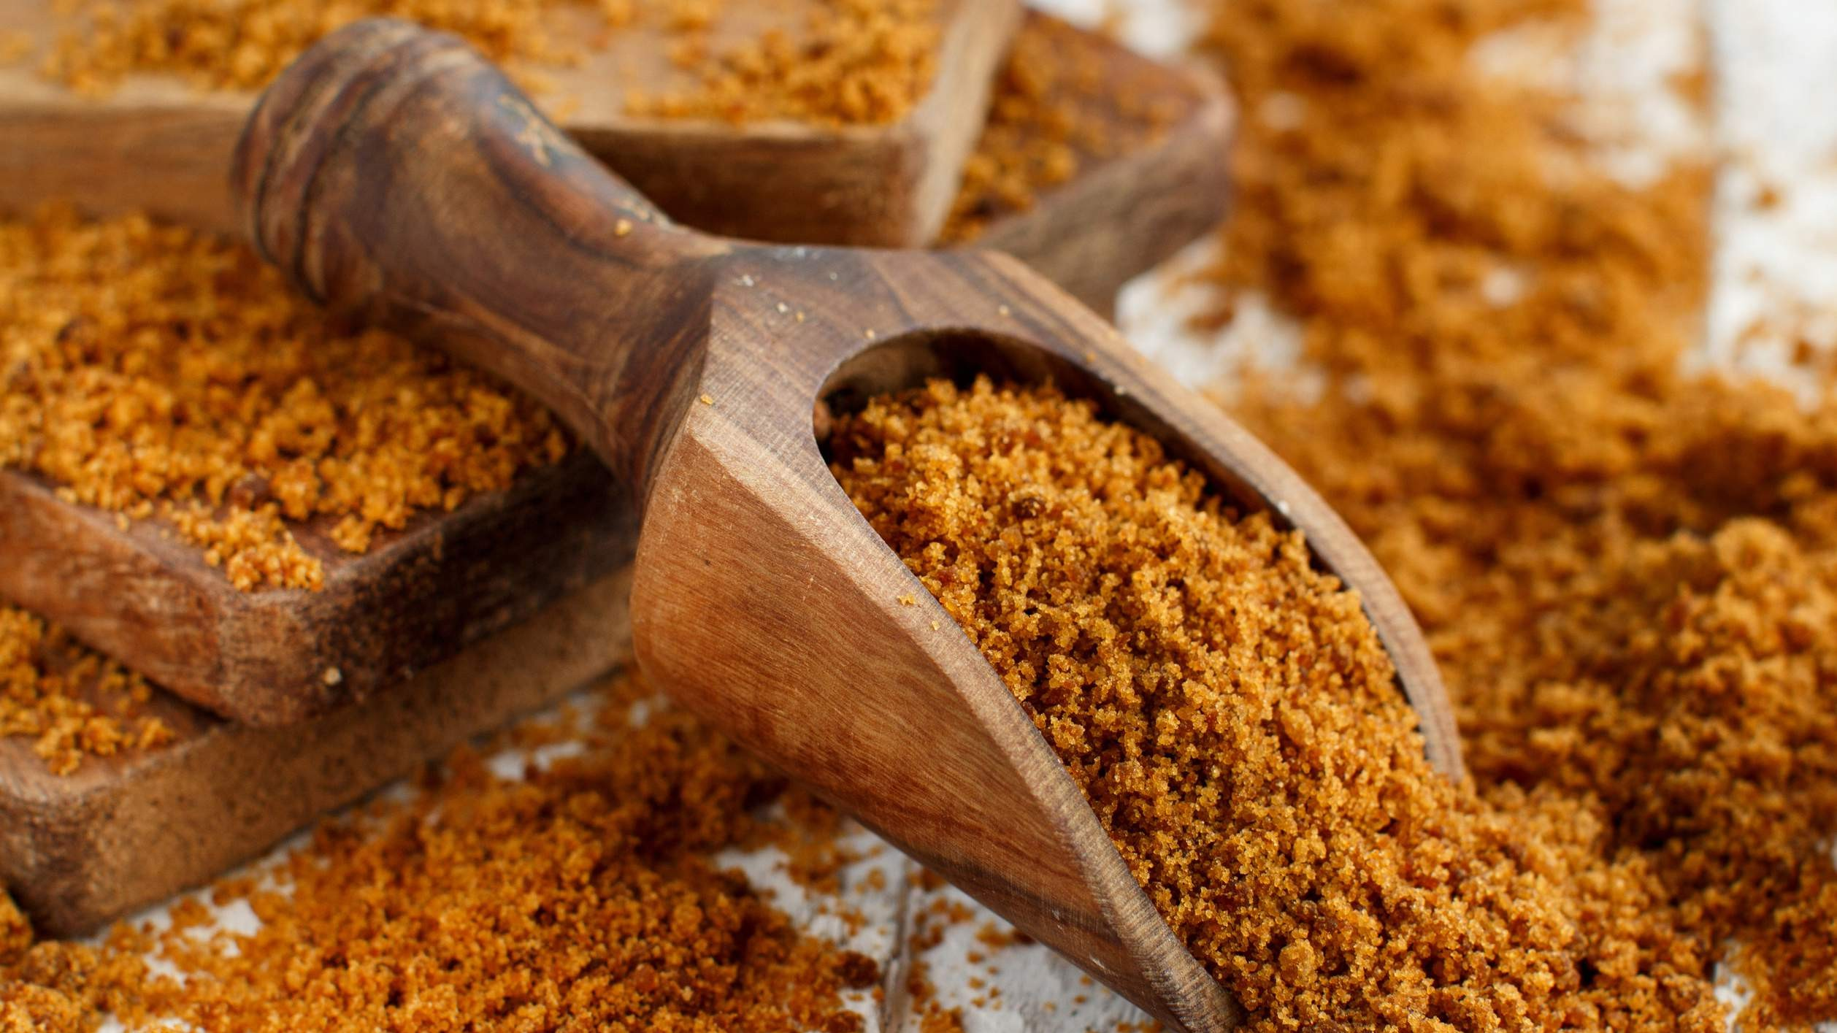
Drivers
Expansion of food processing activities, increasing demand for baked goods & confectionary products, and rising focus on the development of innovative food products are the major driving factors for the brown sugar market.

Slide 7

AUTHOR'S PERSPECTIVE
The Global Brown Sugar Market is witnessing significant growth in the near future.
The F&B industry encompasses various products, from fresh produce to processed foods, beverages, and others.
Bakery products held the largest market share due to the wide array of applications of brown sugar in the bakery industry.
In 2023, the Dark segment accounted for noticeable share of global Brown Sugar Market and is projected to experience significant growth in the near future.
The Bakery Products segment is expected to expand at the significant CAGR retaining position throughout the forecast period.

Slide 8











KEY PLAYERS

Slide 9


Contact us
For Full Report
COGNITIVE MARKET RESEARCH
Tel: + 1 312 - 376 - 8303 | + 44 020 - 8123 - 0732
India: ( + 91 ) 983 - 496 - 8611
sales@ cognitivemarketresearch. com
Access the Full Report : http://tinyurl.com/ytz227xx
Please visit our website:
https://www.cognitivemarketresearch.com

