Slide 1
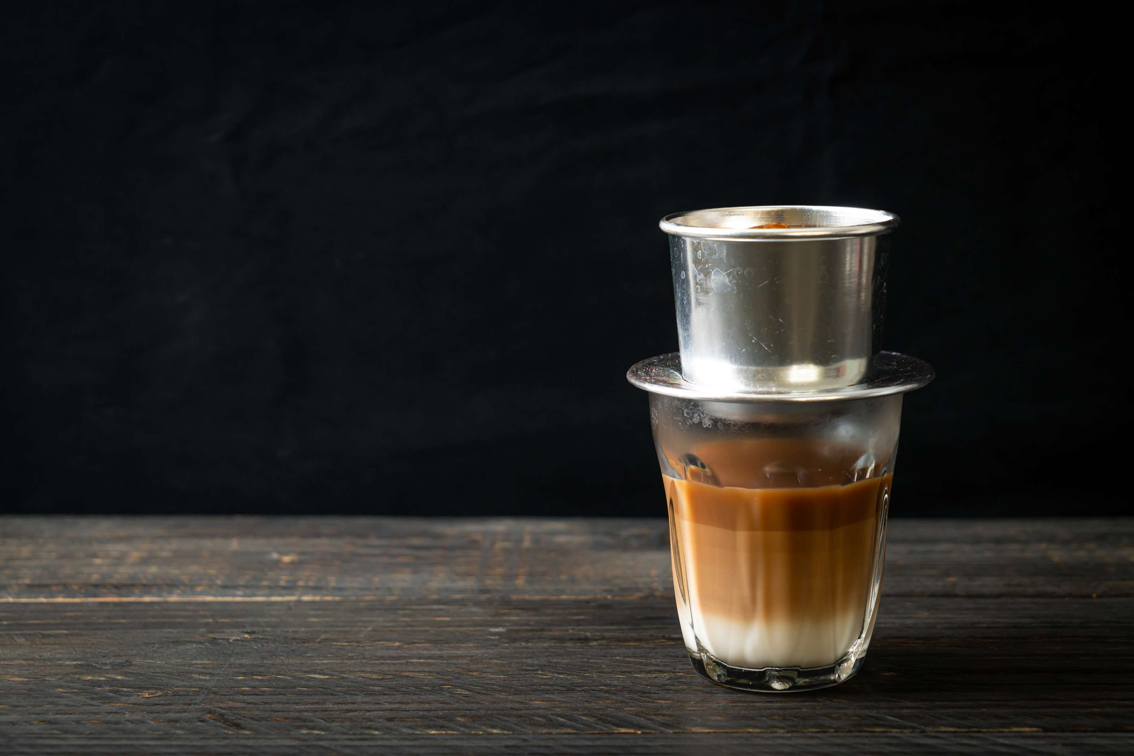
GLOBAL
BREWING
MARKET REPORT
2024
Global,Regional,CountryAnalysis

Slide 2
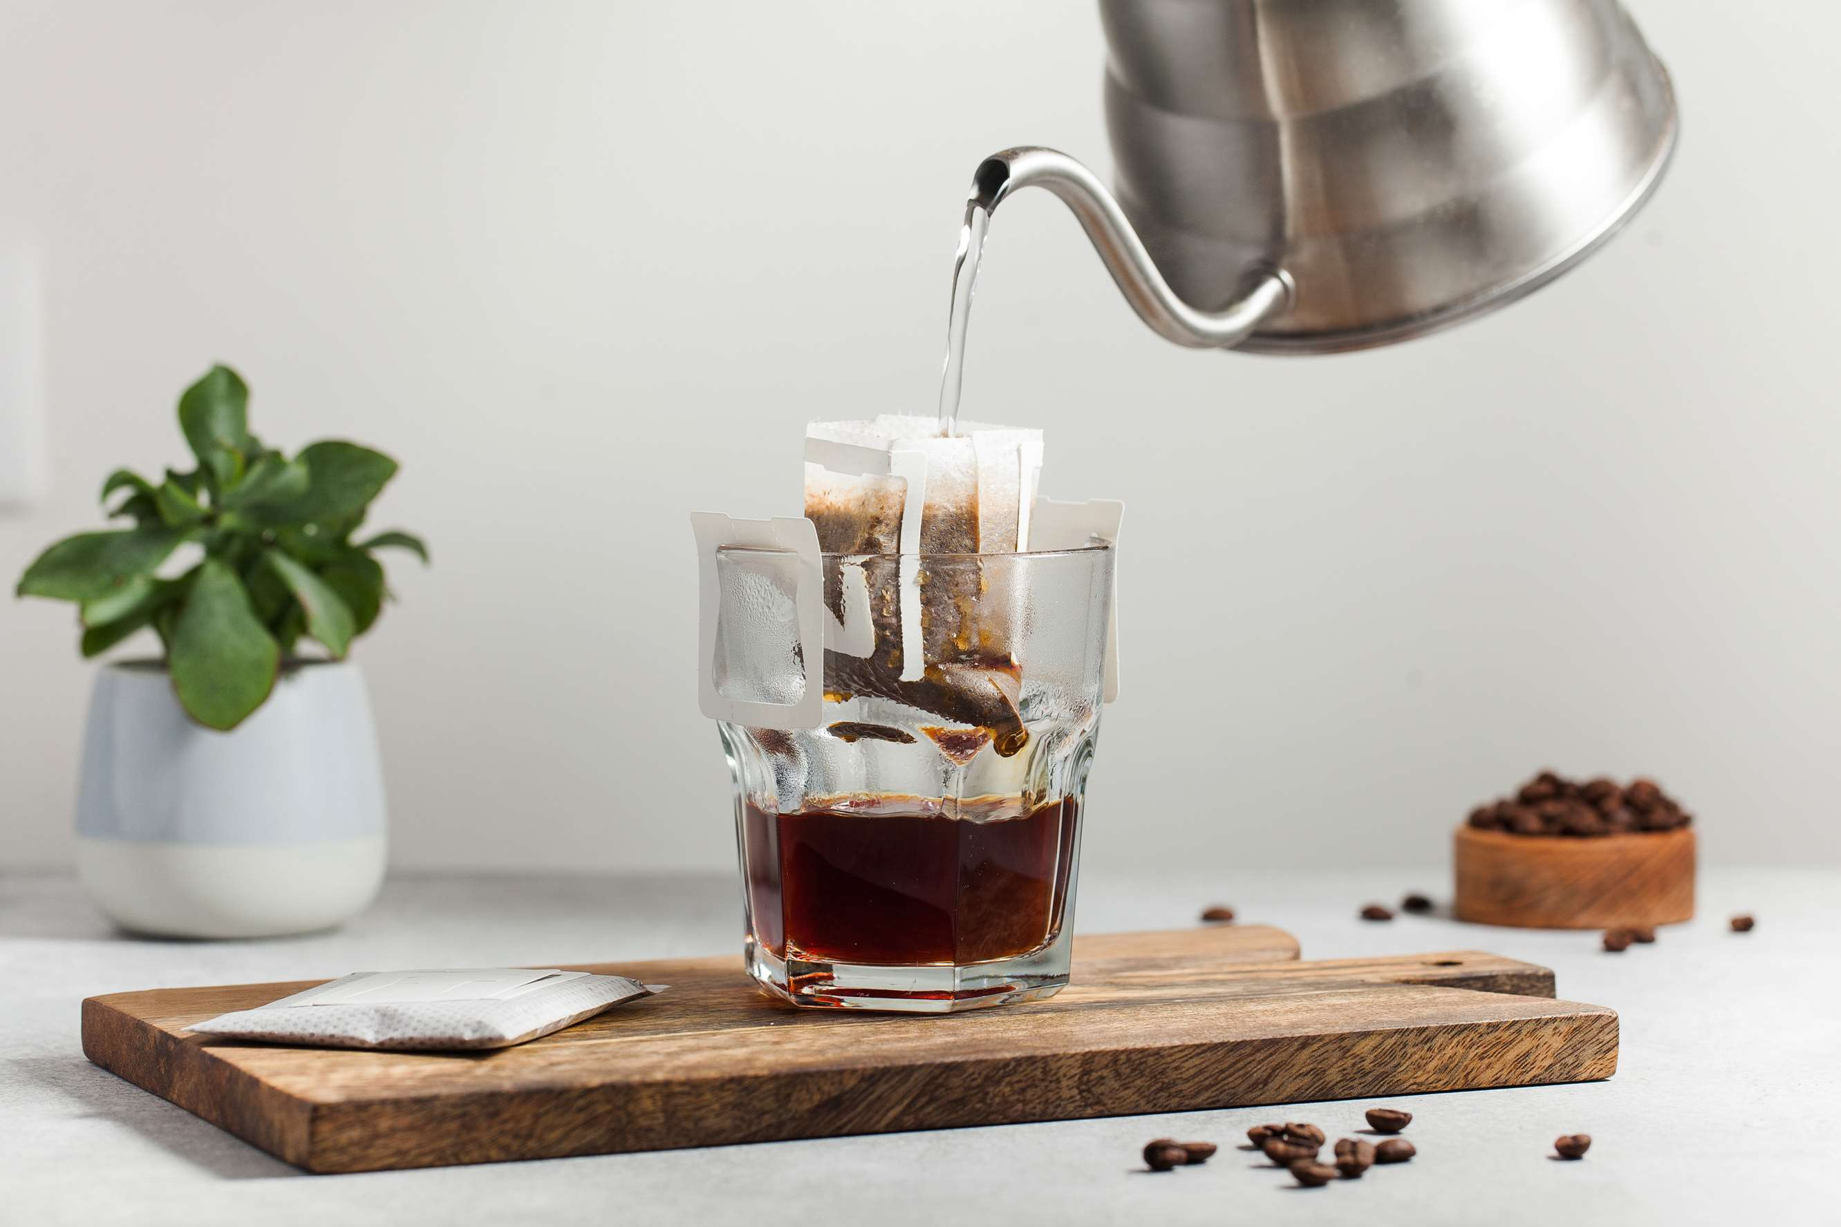
INTRODUCTION
Brewing is the process of producing alcoholic beverages, primarily beer, through the fermentation of various ingredients, typically including water, malted barley or other grains, hops, and yeast. The brewing process involves combining these ingredients in specific proportions, followed by controlled fermentation, which converts the sugars in the malted grains into alcohol and carbon dioxide, resulting in the final beer product. The rise of the brewing market is driven by a combination of consumer preferences for variety and quality, a focus on local and artisanal products, and the spirit of innovation and collaboration. The brewing industry's ability to adapt to changing trends and cater to evolving consumer demands has positioned it as a dynamic and growing sector within the broader beverage landscape.

Slide 3
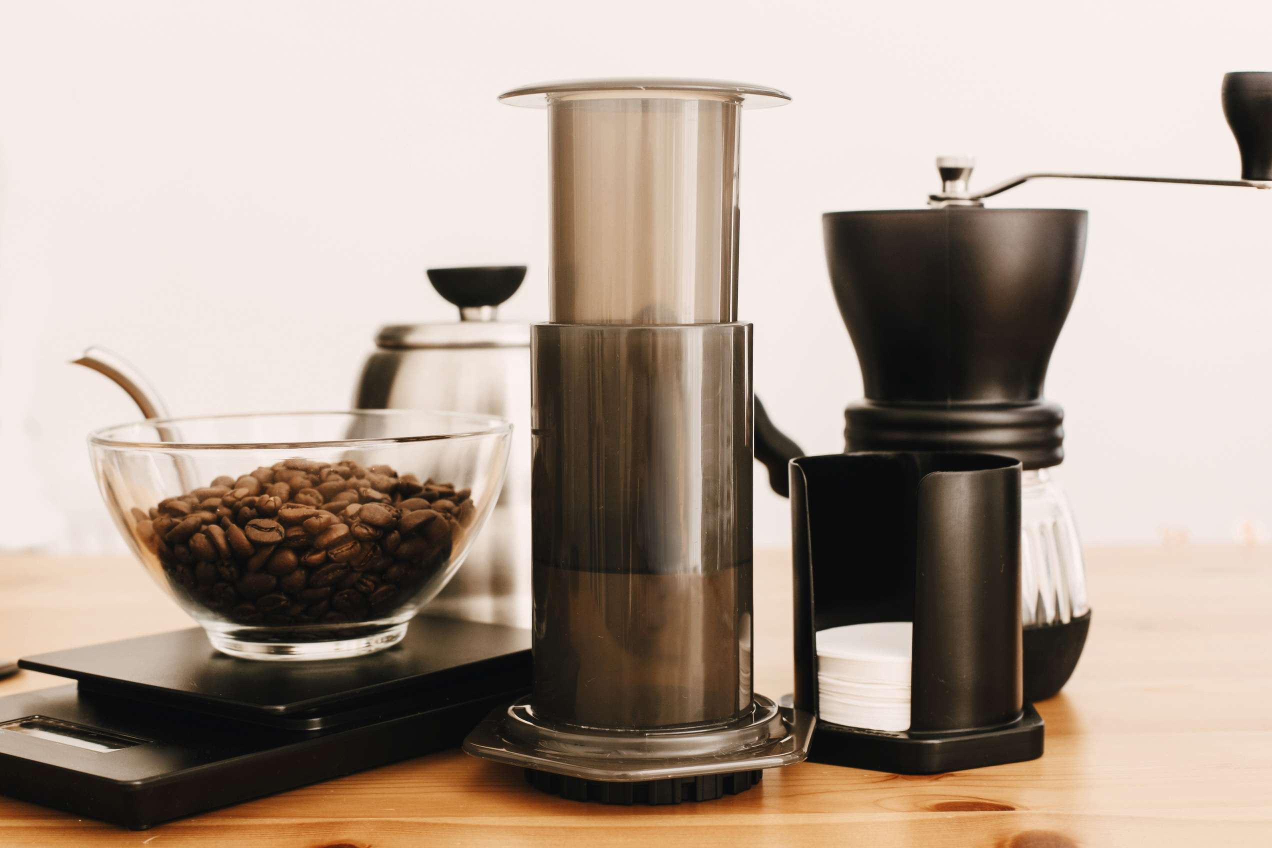

KEY INSIGHTS
MARKET SIZE
USD 35.2 billion
2022
CAGR
7.20%
2023- 2030

Slide 4
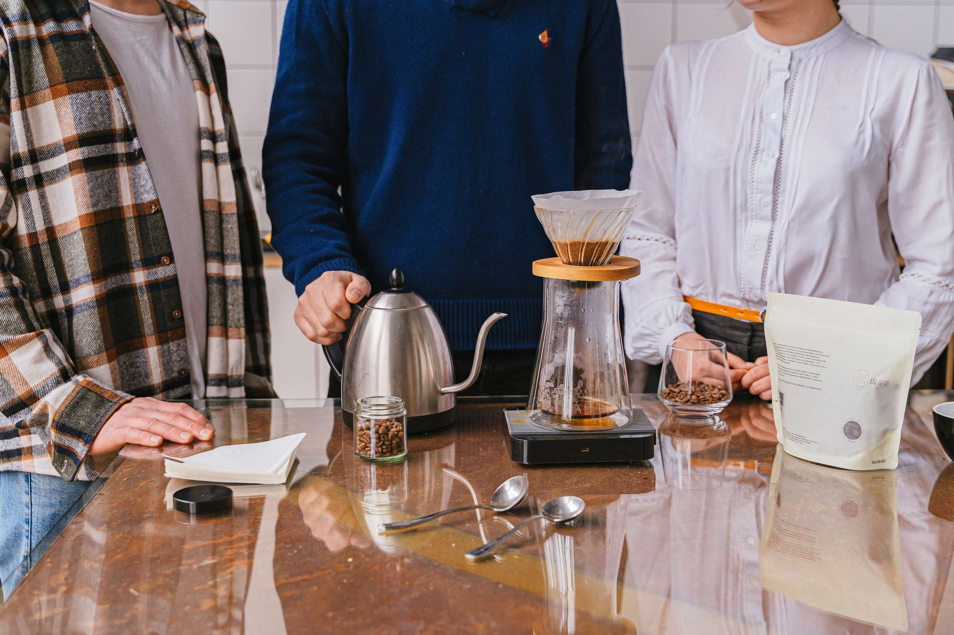
REVENUE MARKET SHARE BY SEGMENTS 2022
  Malt Extract
  Adjuncts/Grains
  Hops
  Beer Yeast
  Beer Additives
By Source
  Macro Brewery
  Craft Brewery
By Brewery Size
  Dry
  Liquid
Form Segment

Slide 5

Global Brewing Market Revenue share for 2024
North America

Slide 6
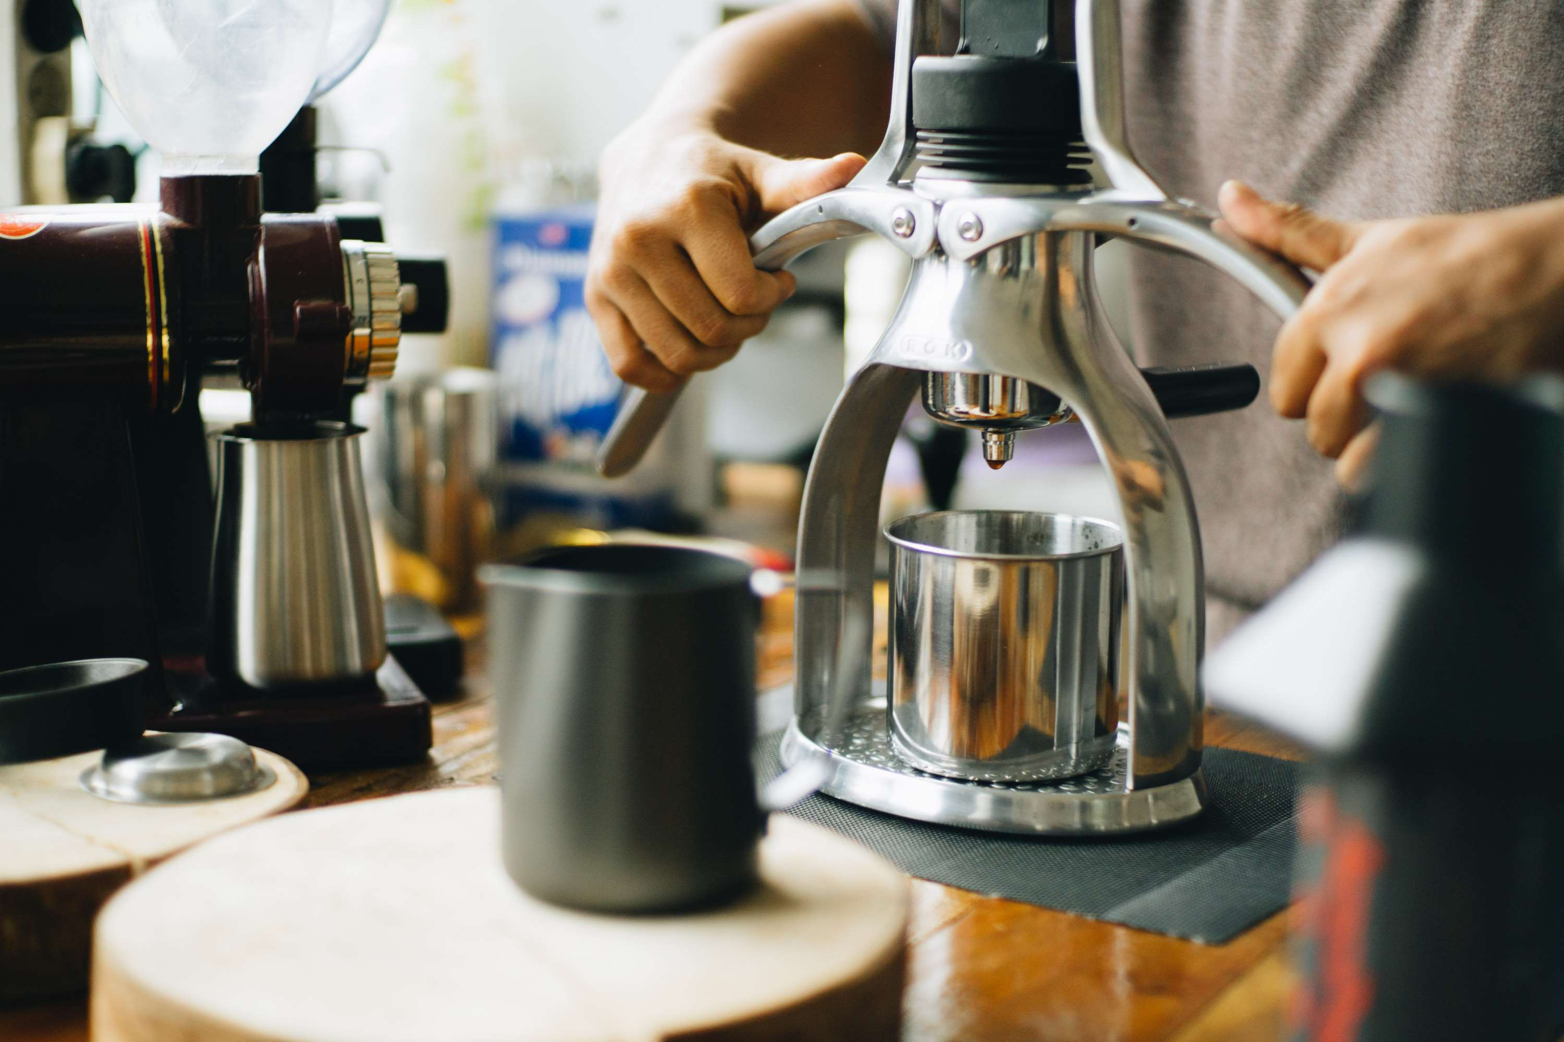
Growing Consumer Interest in Craft and Specialty Beers helps in the Growth of the Market
Drivers
Regulatory Obstacles and Standards for Compliance Hinder Market Growth
Restraints

Slide 7
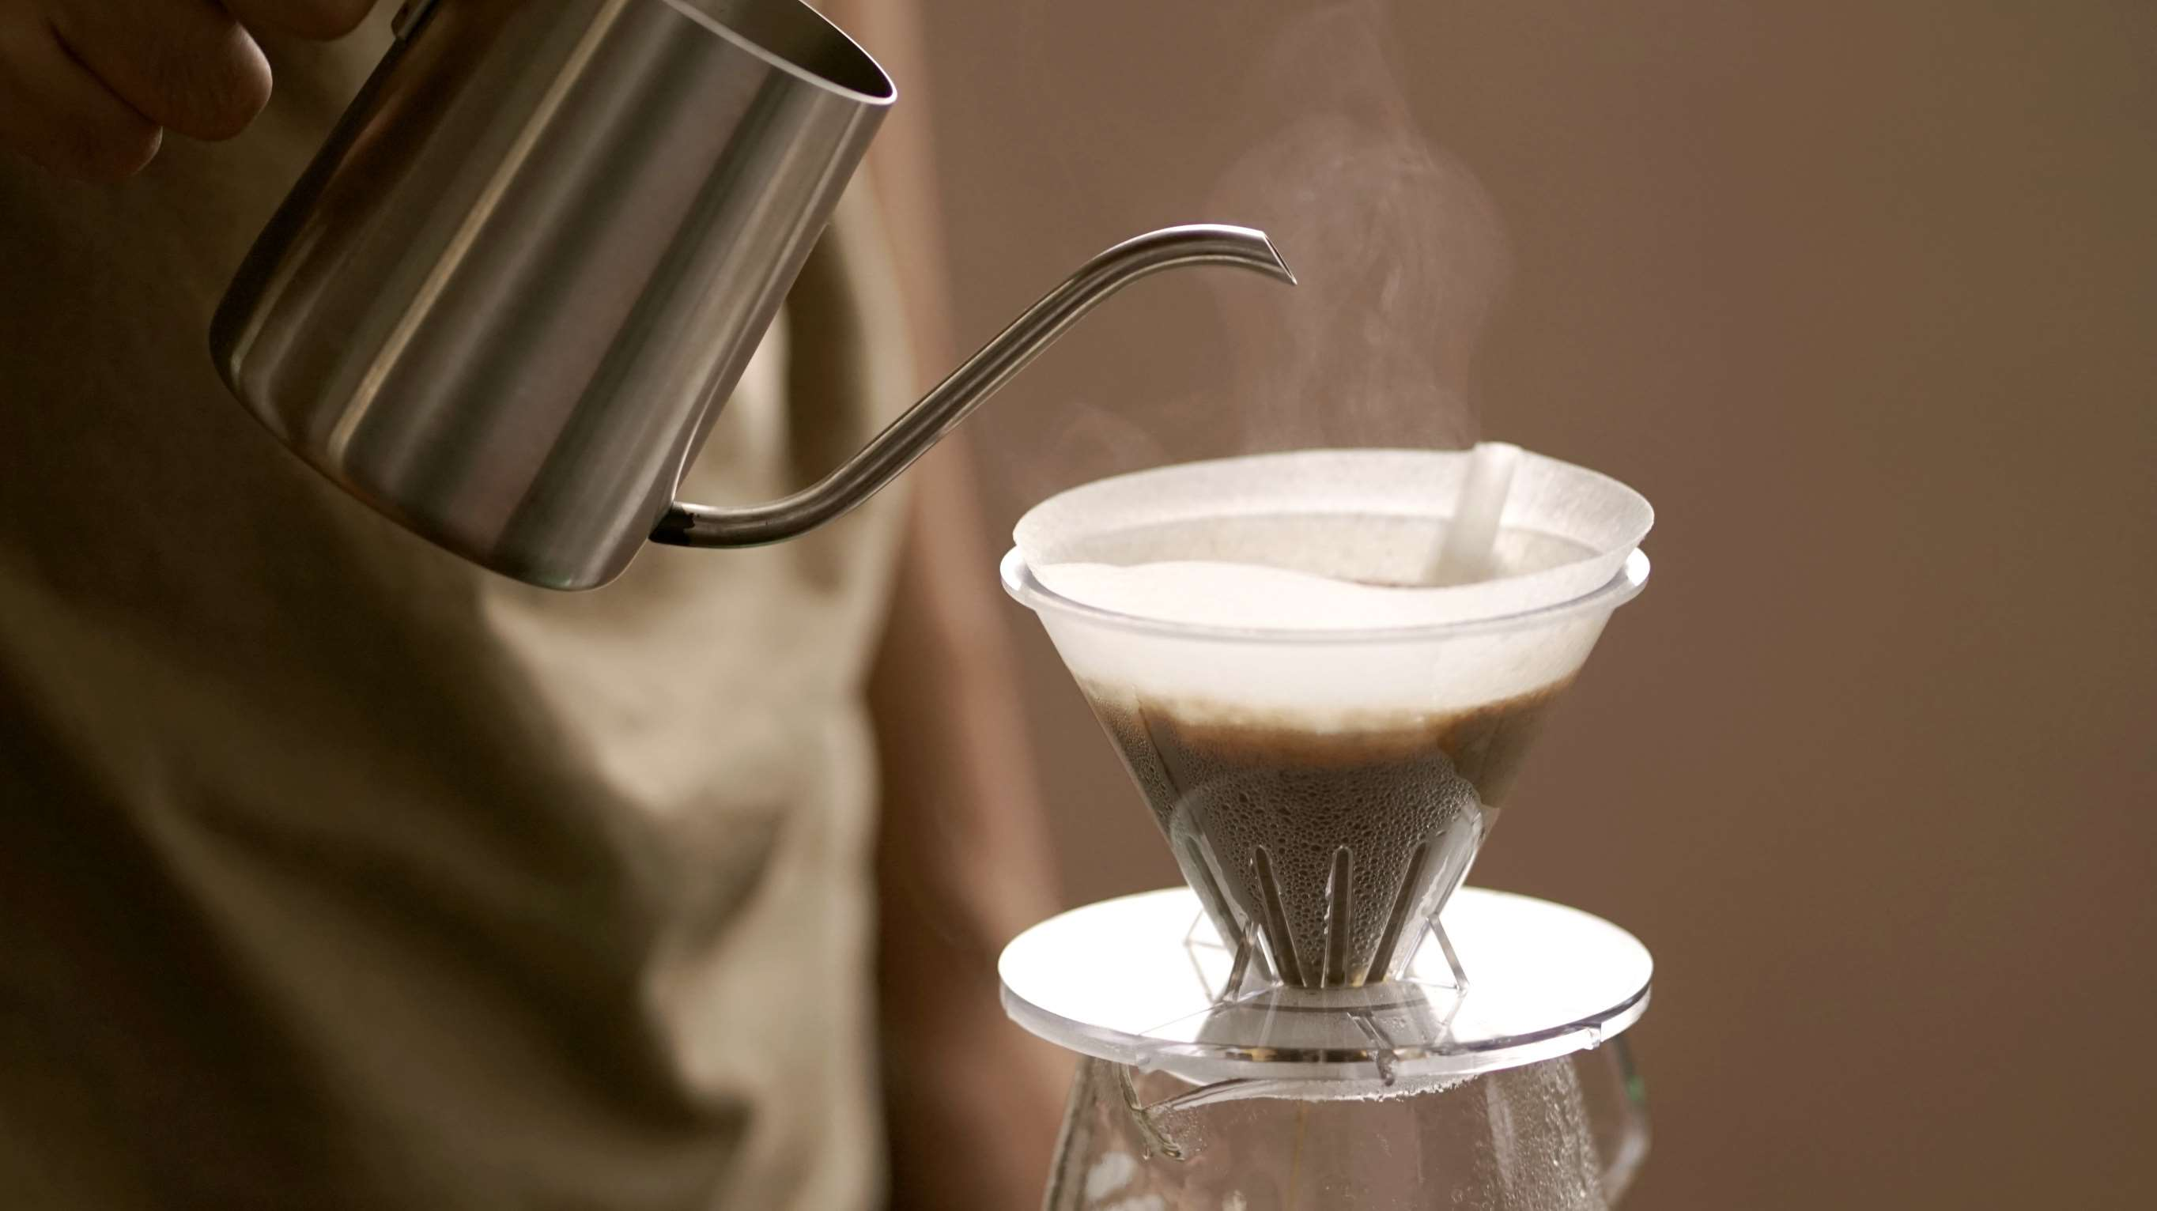
AUTHOR'S PERSPECTIVE
  The Global Brewing Market is witnessing significant growth in the near future.
  Brewing additives encompass a wide range of substances added to beer during brewing to achieve specific outcomes, whether improving flavor, color, aroma, stability, clarity, or other characteristics.
  A craft beer's average alcohol by volume (ABV) is from 5% to 10%, while some of the most well-known craft beers have an ABV of up to 40%.
  Macro breweries often have established distribution networks and well-recognized brands that can be found in numerous locations.
  Breweries can experiment with different ingredients, brewing techniques, and recipes to create an extensive range of liquid products that cater to diverse consumer preferences.

Slide 8
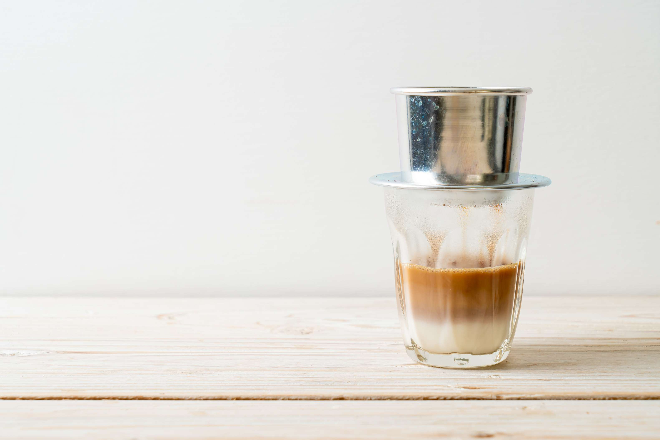








KEY PLAYERS

Slide 9


For Full Report
Contact us
COGNITIVE MARKET RESEARCH
Tel: +1 312-376-8303 | +44 020-8123-0732
India: (+91) 983-496-8611
sales@cognitivemarketresearch.com
Access the Full Report : https://tinyurl.com/3twpd3xe
Please visit our website:
https://www.cognitivemarketresearch.com

