Slide 1

GLOBAL
BREATH MINT
MARKET REPORT
2024
Global,Regional,CountryAnalysis

Slide 2

INTRODUCTION
Breath mints are small, flavored confections primarily designed to freshen breath by masking undesirable odors, often associated with food consumption, tobacco use, or oral hygiene issues. Typically made with ingredients like sugar, menthol, essential oils, and flavorings, these mints are intended for oral consumption, allowing their active ingredients to dissolve slowly in the mouth, releasing their refreshing properties. Beyond just providing a temporary sensation of freshness, breath mints may also contain additional components such as antibacterial agents to combat oral bacteria and promote oral health. They serve as a convenient and portable solution for individuals seeking quick and effective breath freshening.

Slide 3

KEY INSIGHTS
CAGR
3.80%
2024- 2031

Slide 4
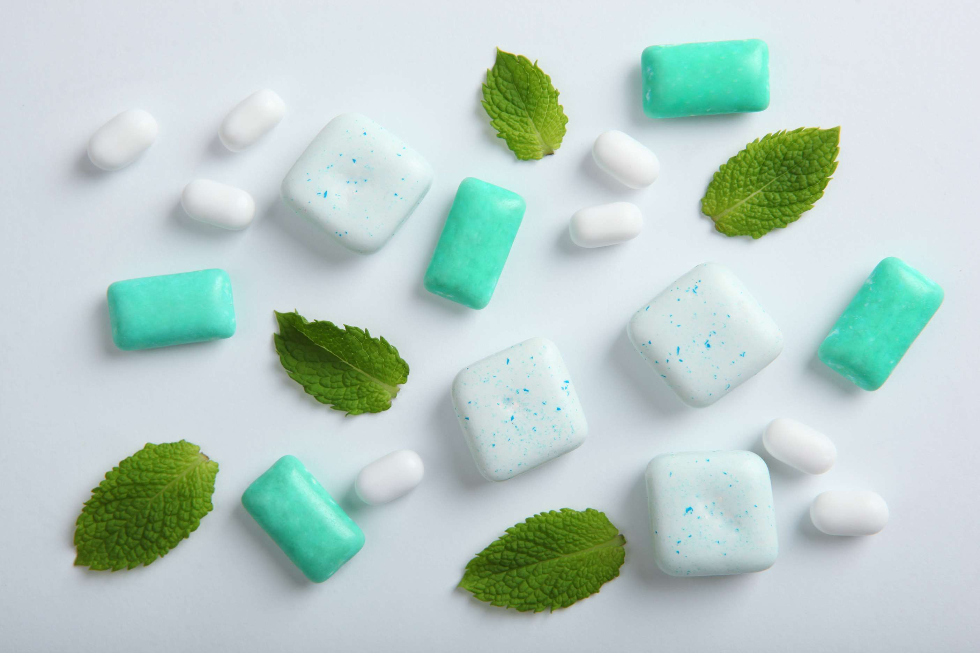
REVENUE MARKET SHARE BY SEGMENTS 2022
  Sugarfree Breath Mints
  Regular Breath Mints
  Pepper mint
  Sweet mint
  Bubble mint
  Freeze mint
Type Segment
Distribution Channel
  Hypermarket and Supermarket
  Pharmacies
  Specialty Store
  Convenience Store
  Organic
  Conventional
Nature Segment
Distribution Channel

Slide 5
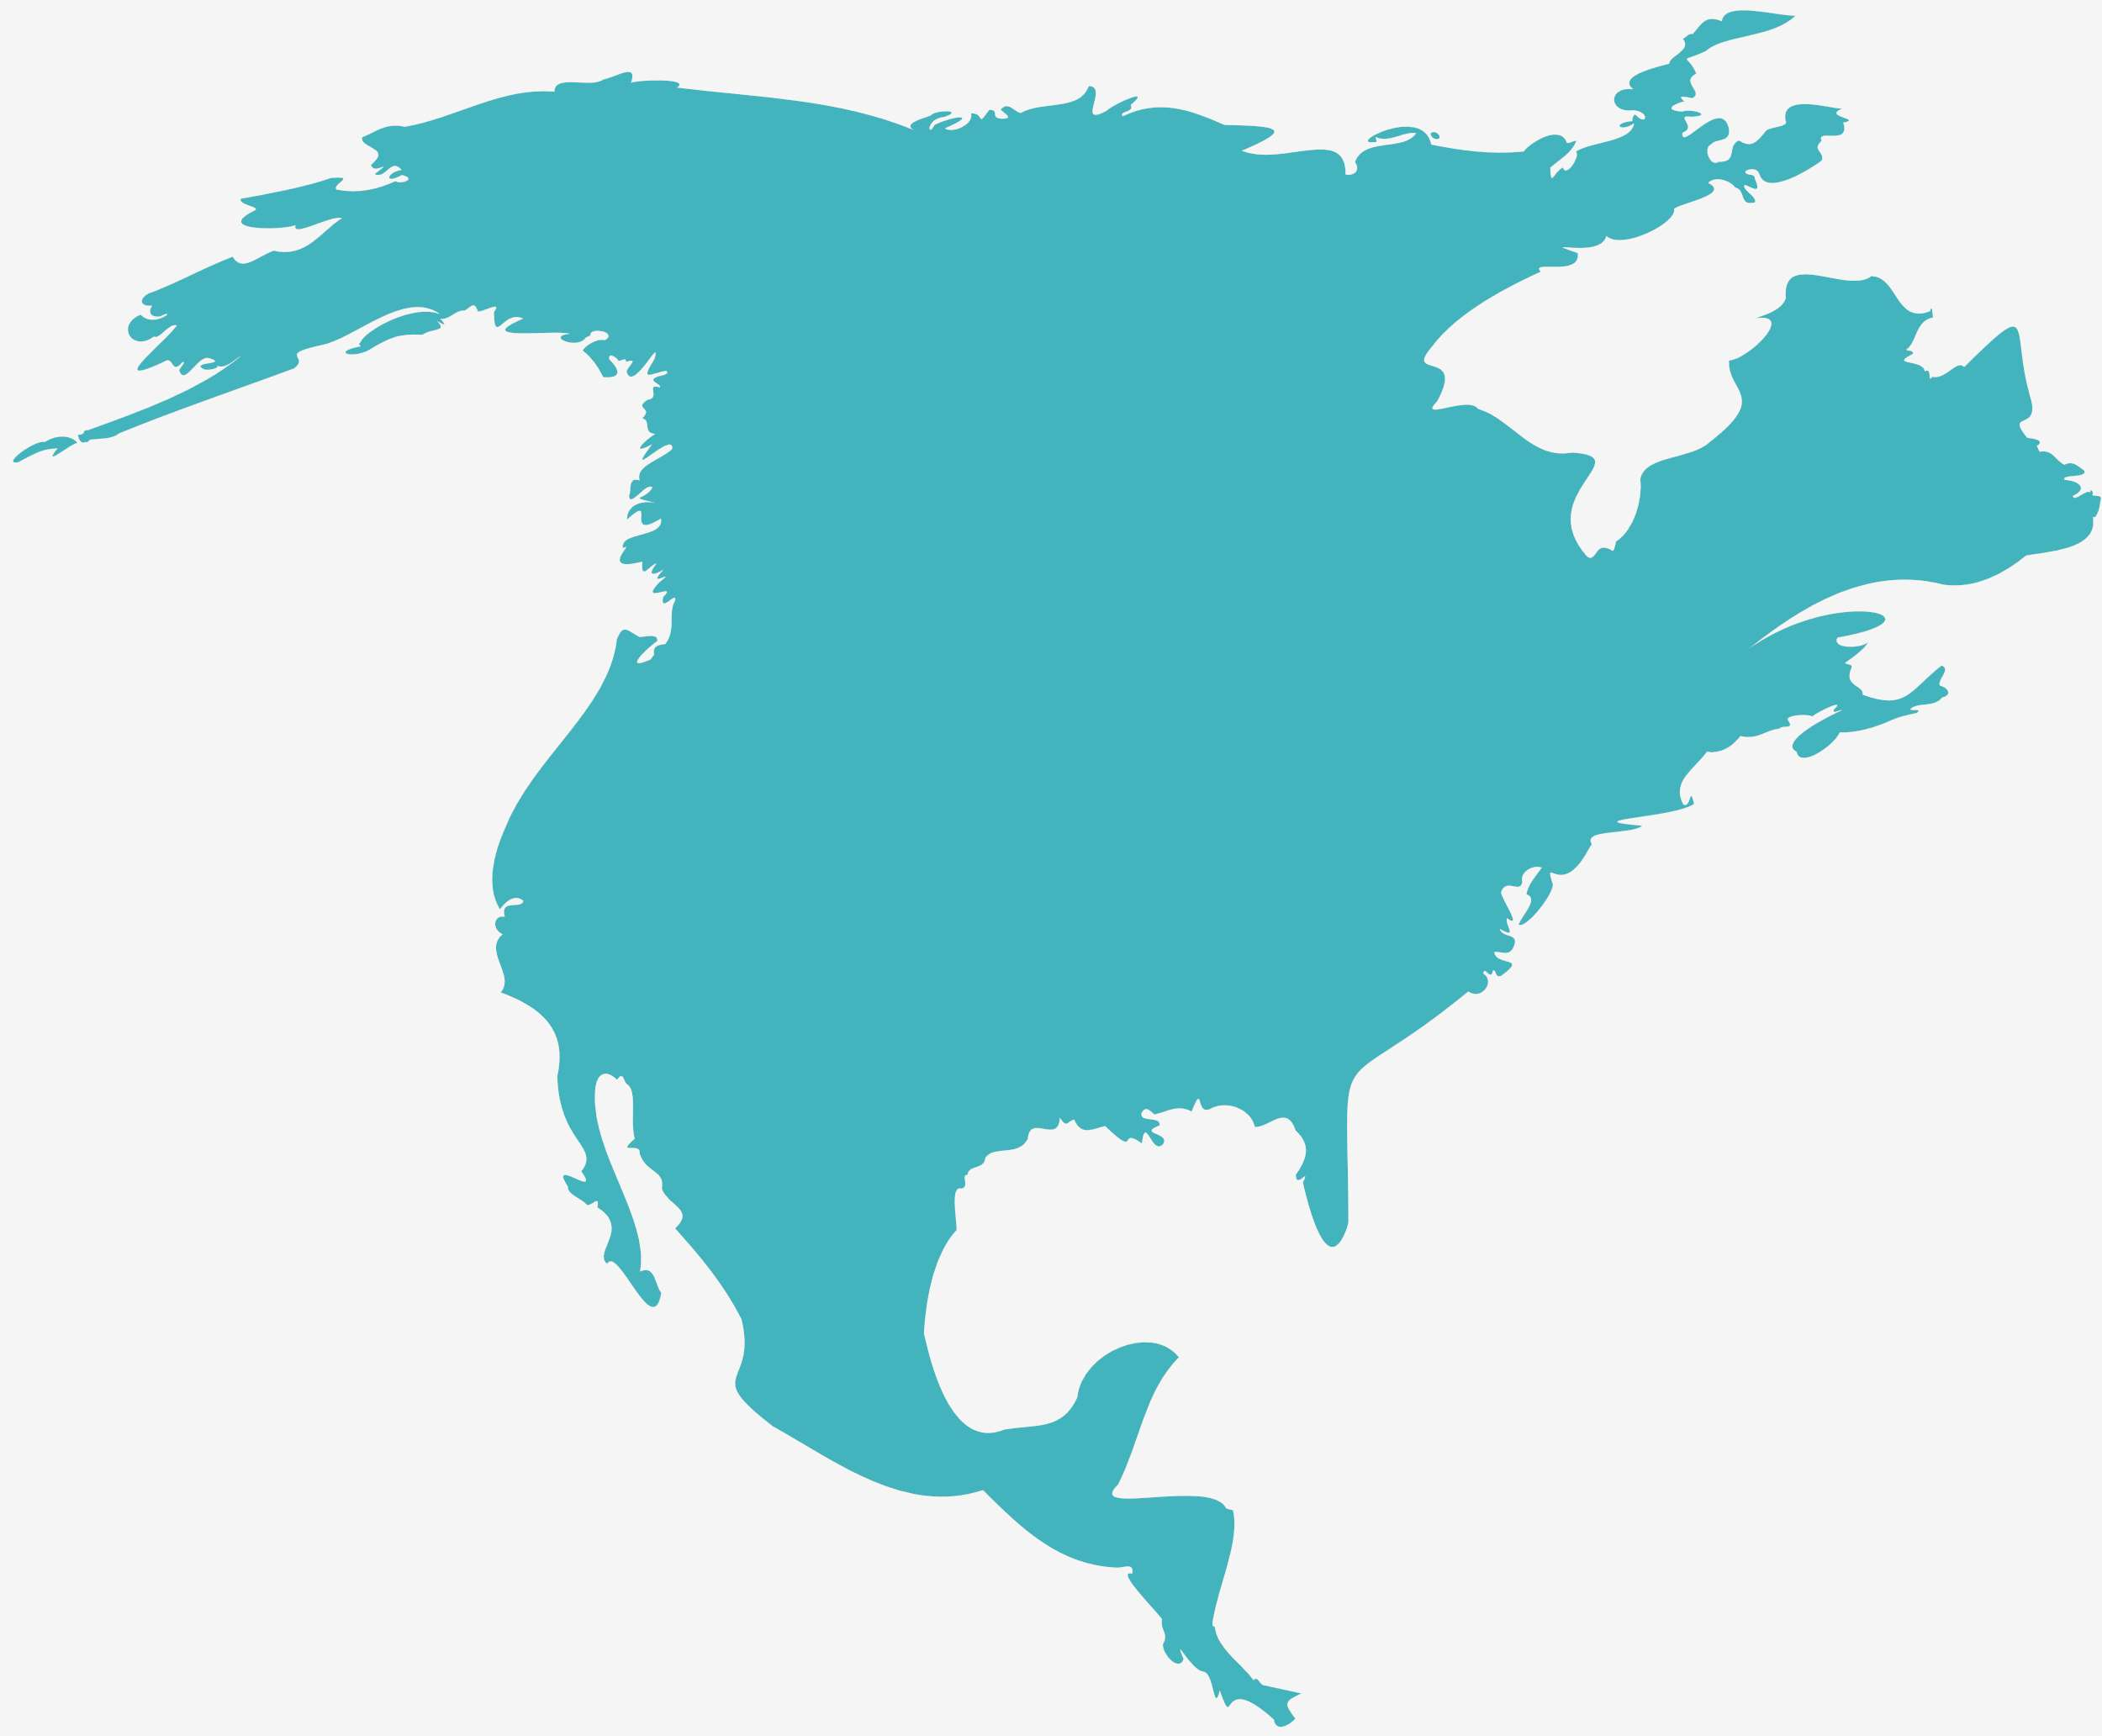
Global Breath Mint Market Revenue share for 2024
North America
40%

Slide 6
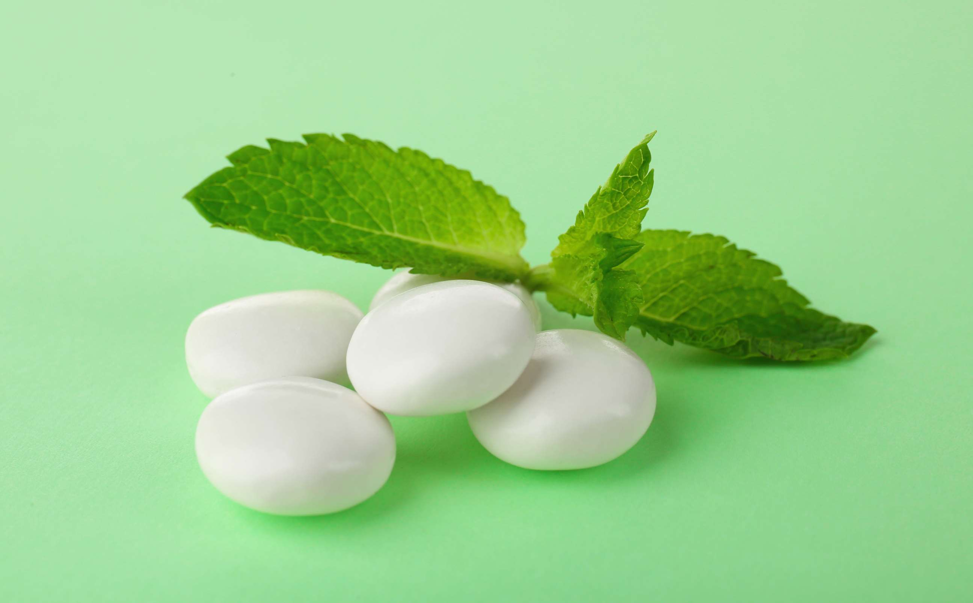
Preference for Natural and Organic Products to Propel the Market
Drivers
Health Concerns like Sugar Substitutes to Pose a Barrier
Restraints

Slide 7

AUTHOR'S PERSPECTIVE
  The global breath mint market will expand significantly by 3.80% CAGR between 2024 to 2031.
  The sales of sugar-free breath mints are poised to increase due to rising health consciousness among consumers, who seek oral care products that mitigate the risk of cavities and maintain stable blood sugar levels.
  Increasing consumer preference for natural and sustainable products is driving the surge in organic breath mint sales, as individuals prioritize health, environmental concerns, and ethical sourcing practices in their purchasing decisions.
  The pepper mint held the highest market share in breath mint market in 2024.

Slide 8

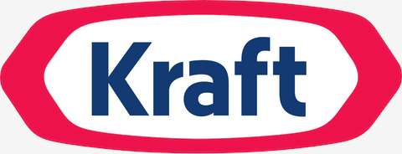


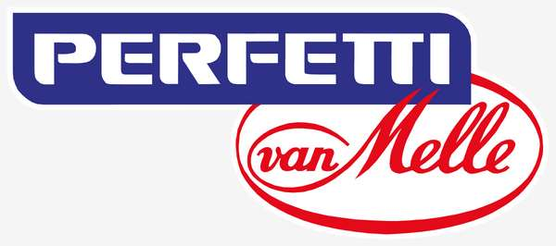
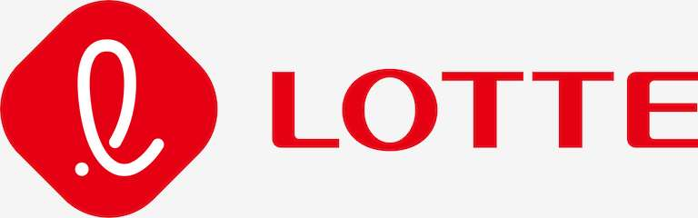



KEY PLAYERS

Slide 9


For Full Report
Contact us
COGNITIVE MARKET RESEARCH
Tel: +1 312-376-8303 | +44 020-8123-0732
India: (+91) 983-496-8611
sales@cognitivemarketresearch.com
Access the Full Report : https://tinyurl.com/3umbpr2x
Please visit our website:
https://www.cognitivemarketresearch.com

