Slide 1

GLOBAL
BOTTLE OPENER
MARKET REPORT
2024
Global,Regional,CountryAnalysis

Slide 2

INTRODUCTION
The global market for bottle openers is a vibrant, constantly changing industry that meets various customer needs. Bottle openers are necessary for quickly and easily opening liquids like beer, soda, and other bottled drinks. They are available in various designs, styles, and materials to suit various applications and consumer preferences.

Slide 3


KEY INSIGHTS
CAGR
5.90%
2023- 2030

Slide 4

REVENUE MARKET SHARE BY SEGMENTS 2022
  T-Shaped Bottle Opener
  Lever Shape Bottle Opener
  Waiter Shape Bottle Opener
  Rabbit Ear Shape Bottle Opener
  Metal Bottle Opener
  Plastic Bottle Opener
  PVC Bottle Opener
  Silicone Bottle Opener
  Glass Bottle Opener
Material Segment
Type Segment
  Households
  Hotels
  Restaurants
  Bars & Cafes
  Uncap
  Open The Plug
  Can-Openers
End User Segment
Application Segment

Slide 5

Global Bottle Opener Market Revenue share for 2024
North America
40%

Slide 6

Growing Popularity of Craft Beer to Drive Market Growth
Drivers
Economic Fluctuations to Hinder Market Growth
Restraints

Slide 7

AUTHOR'S PERSPECTIVE
  The Global Bottle Opener Market is witnessing significant growth in the near future.
  T-shaped bottle openers are versatile and can be used for a wide range of bottled beverages, including beer, soft drinks, mineral water, and more.
  Lever-shaped bottle openers are specifically designed for removing corks from wine bottles.
  Can-openers come in various styles, including manual, handheld, electric, and safety.
  Die-cast metal bottle openers are known for their quality and aesthetic appeal.
  Craft beer enthusiasts appreciate the use of specialized bottle openers that cater to these distinct bottle designs.

Slide 8
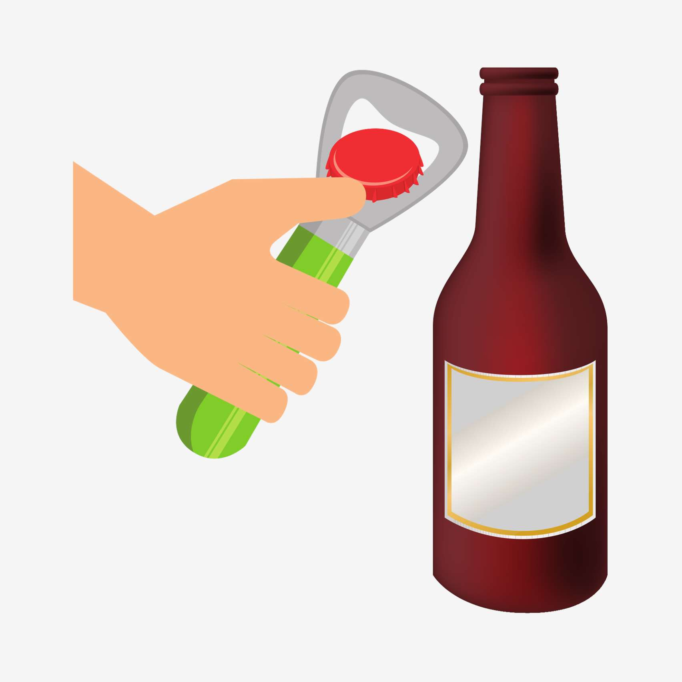

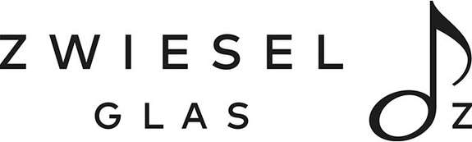

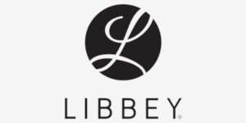




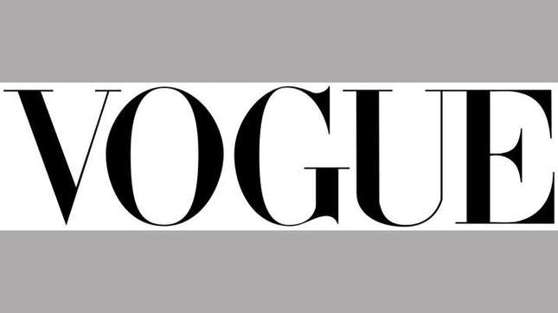

KEY PLAYERS

Slide 9


For Full Report
Contact us
COGNITIVE MARKET RESEARCH
Tel: +1 312-376-8303 | +44 020-8123-0732
India: (+91) 983-496-8611
sales@cognitivemarketresearch.com
Access the Full Report : https://tinyurl.com/3eavwrdv
Please visit our website:
https://www.cognitivemarketresearch.com

