Slide 1

GLOBAL
BODY WASH
MARKET REPORT 2024
Global,Regional,CountryAnalysis

Slide 2

INTRODUCTION
The rising awareness about personal hygiene, adoption of convenient and time-saving personal care products, increased consumer spending on premium and specialized body wash products, continuous innovation of products, increasing awareness of environmental issues, growth of e- commerce platforms, changing consumer preferences, effective marketing and advertising campaigns, growing demand for anti-aging and moisturizing body wash products are driving the growth of the Body Wash market. Social media platforms are crucial in shaping consumer preferences and promoting body wash products, especially among younger demographics.

Slide 3
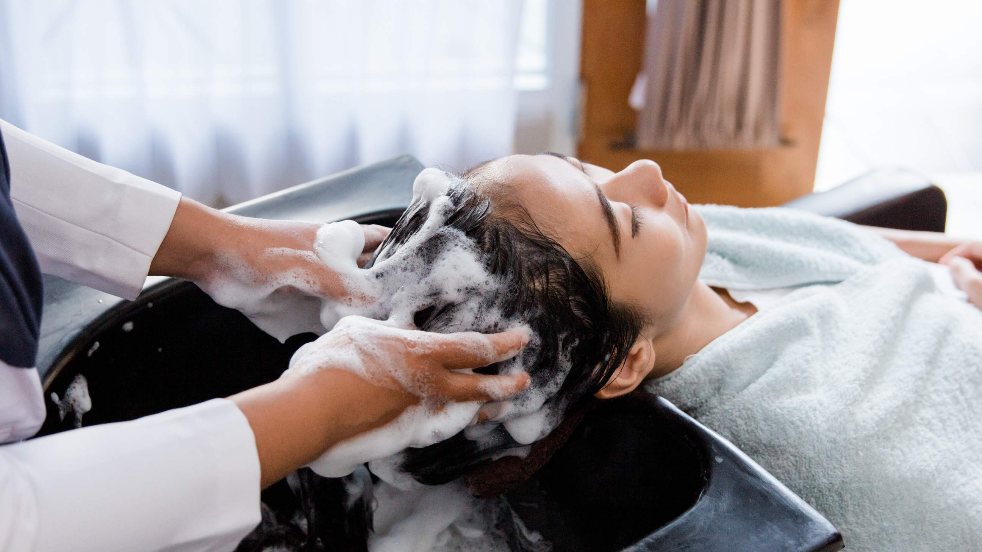

KEY INSIGHTS
CAGR 4.90%
20₋23
2030

Slide 4
REVENUE MARKET SHARE BY SEGMENTS 2022
Soap-type Surfactant Type Surfactant
Soap-based Complex Type
Type Segment
Women Men Kids
Application Segment

Slide 5
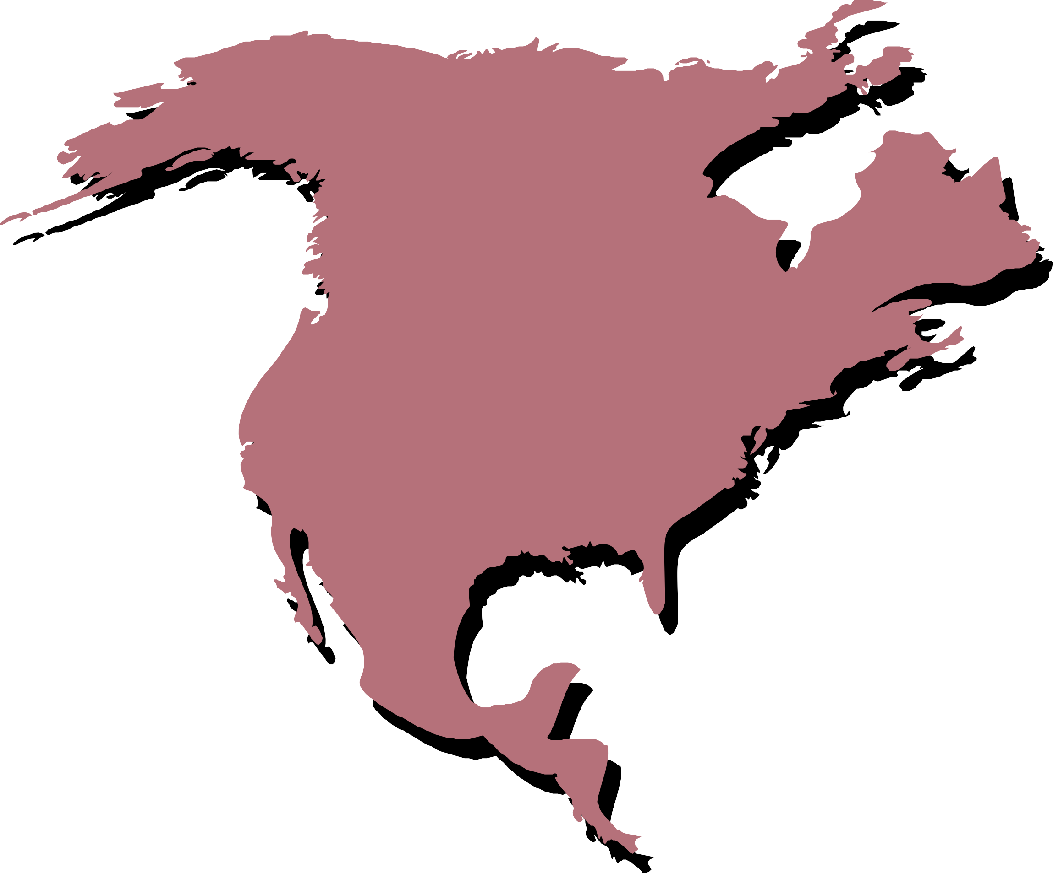
Global Body Wash Market Revenue share for 2022
North America

Slide 6
Companies offering a major range of products to Provide Viable Market Output
Drivers
Growing Preference for Natural Products to Hinder Market Growth
Restraints

Slide 7
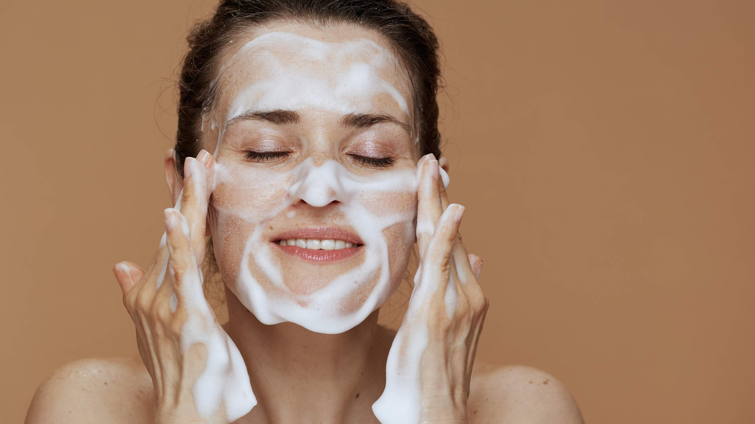
AUTHOR'S PERSPECTIVE
The Global Body Wash Market is witnessing significant growth in the near future.
Soap-based body washes are preferred by consumers who prioritize natural ingredients and may have sensitive skin.
Masculine fragrances like woodsy or earthy tones are commonly found in these products, appealing to men's preferences.
Women-oriented body wash products often feature floral or fruity scents, promoting a sense of freshness and self-care.

Slide 8
KEY PLAYERS

Slide 9


Contact us
For Full Report
COGNITIVE MARKET RESEARCH
Tel: + 1 312 - 376 - 8303 | + 44 020 - 8123 - 0732
India: ( + 91 ) 983 - 496 - 8611
sales@ cognitivemarketresearch. com
Access the Full Report : http://tinyurl.com/4y76evhz
Please visit our website:
https://www.cognitivemarketresearch.com

