Slide 1


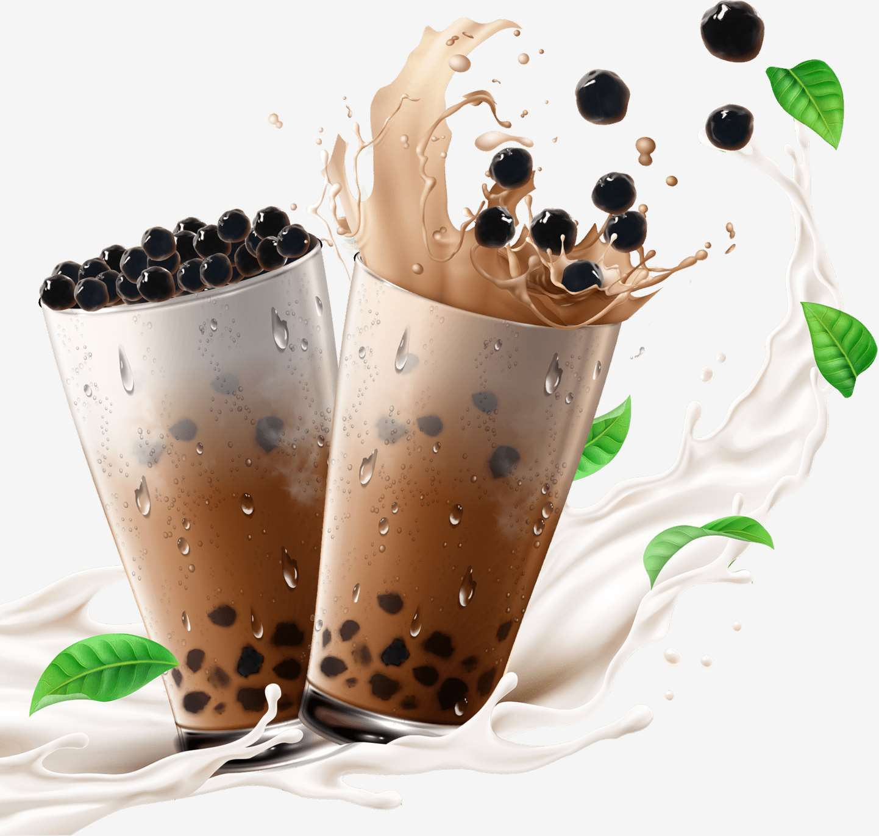
BOBA
MARKET REPORT
2024
Qualitative Analysis + Quantitative Analysis

Slide 2
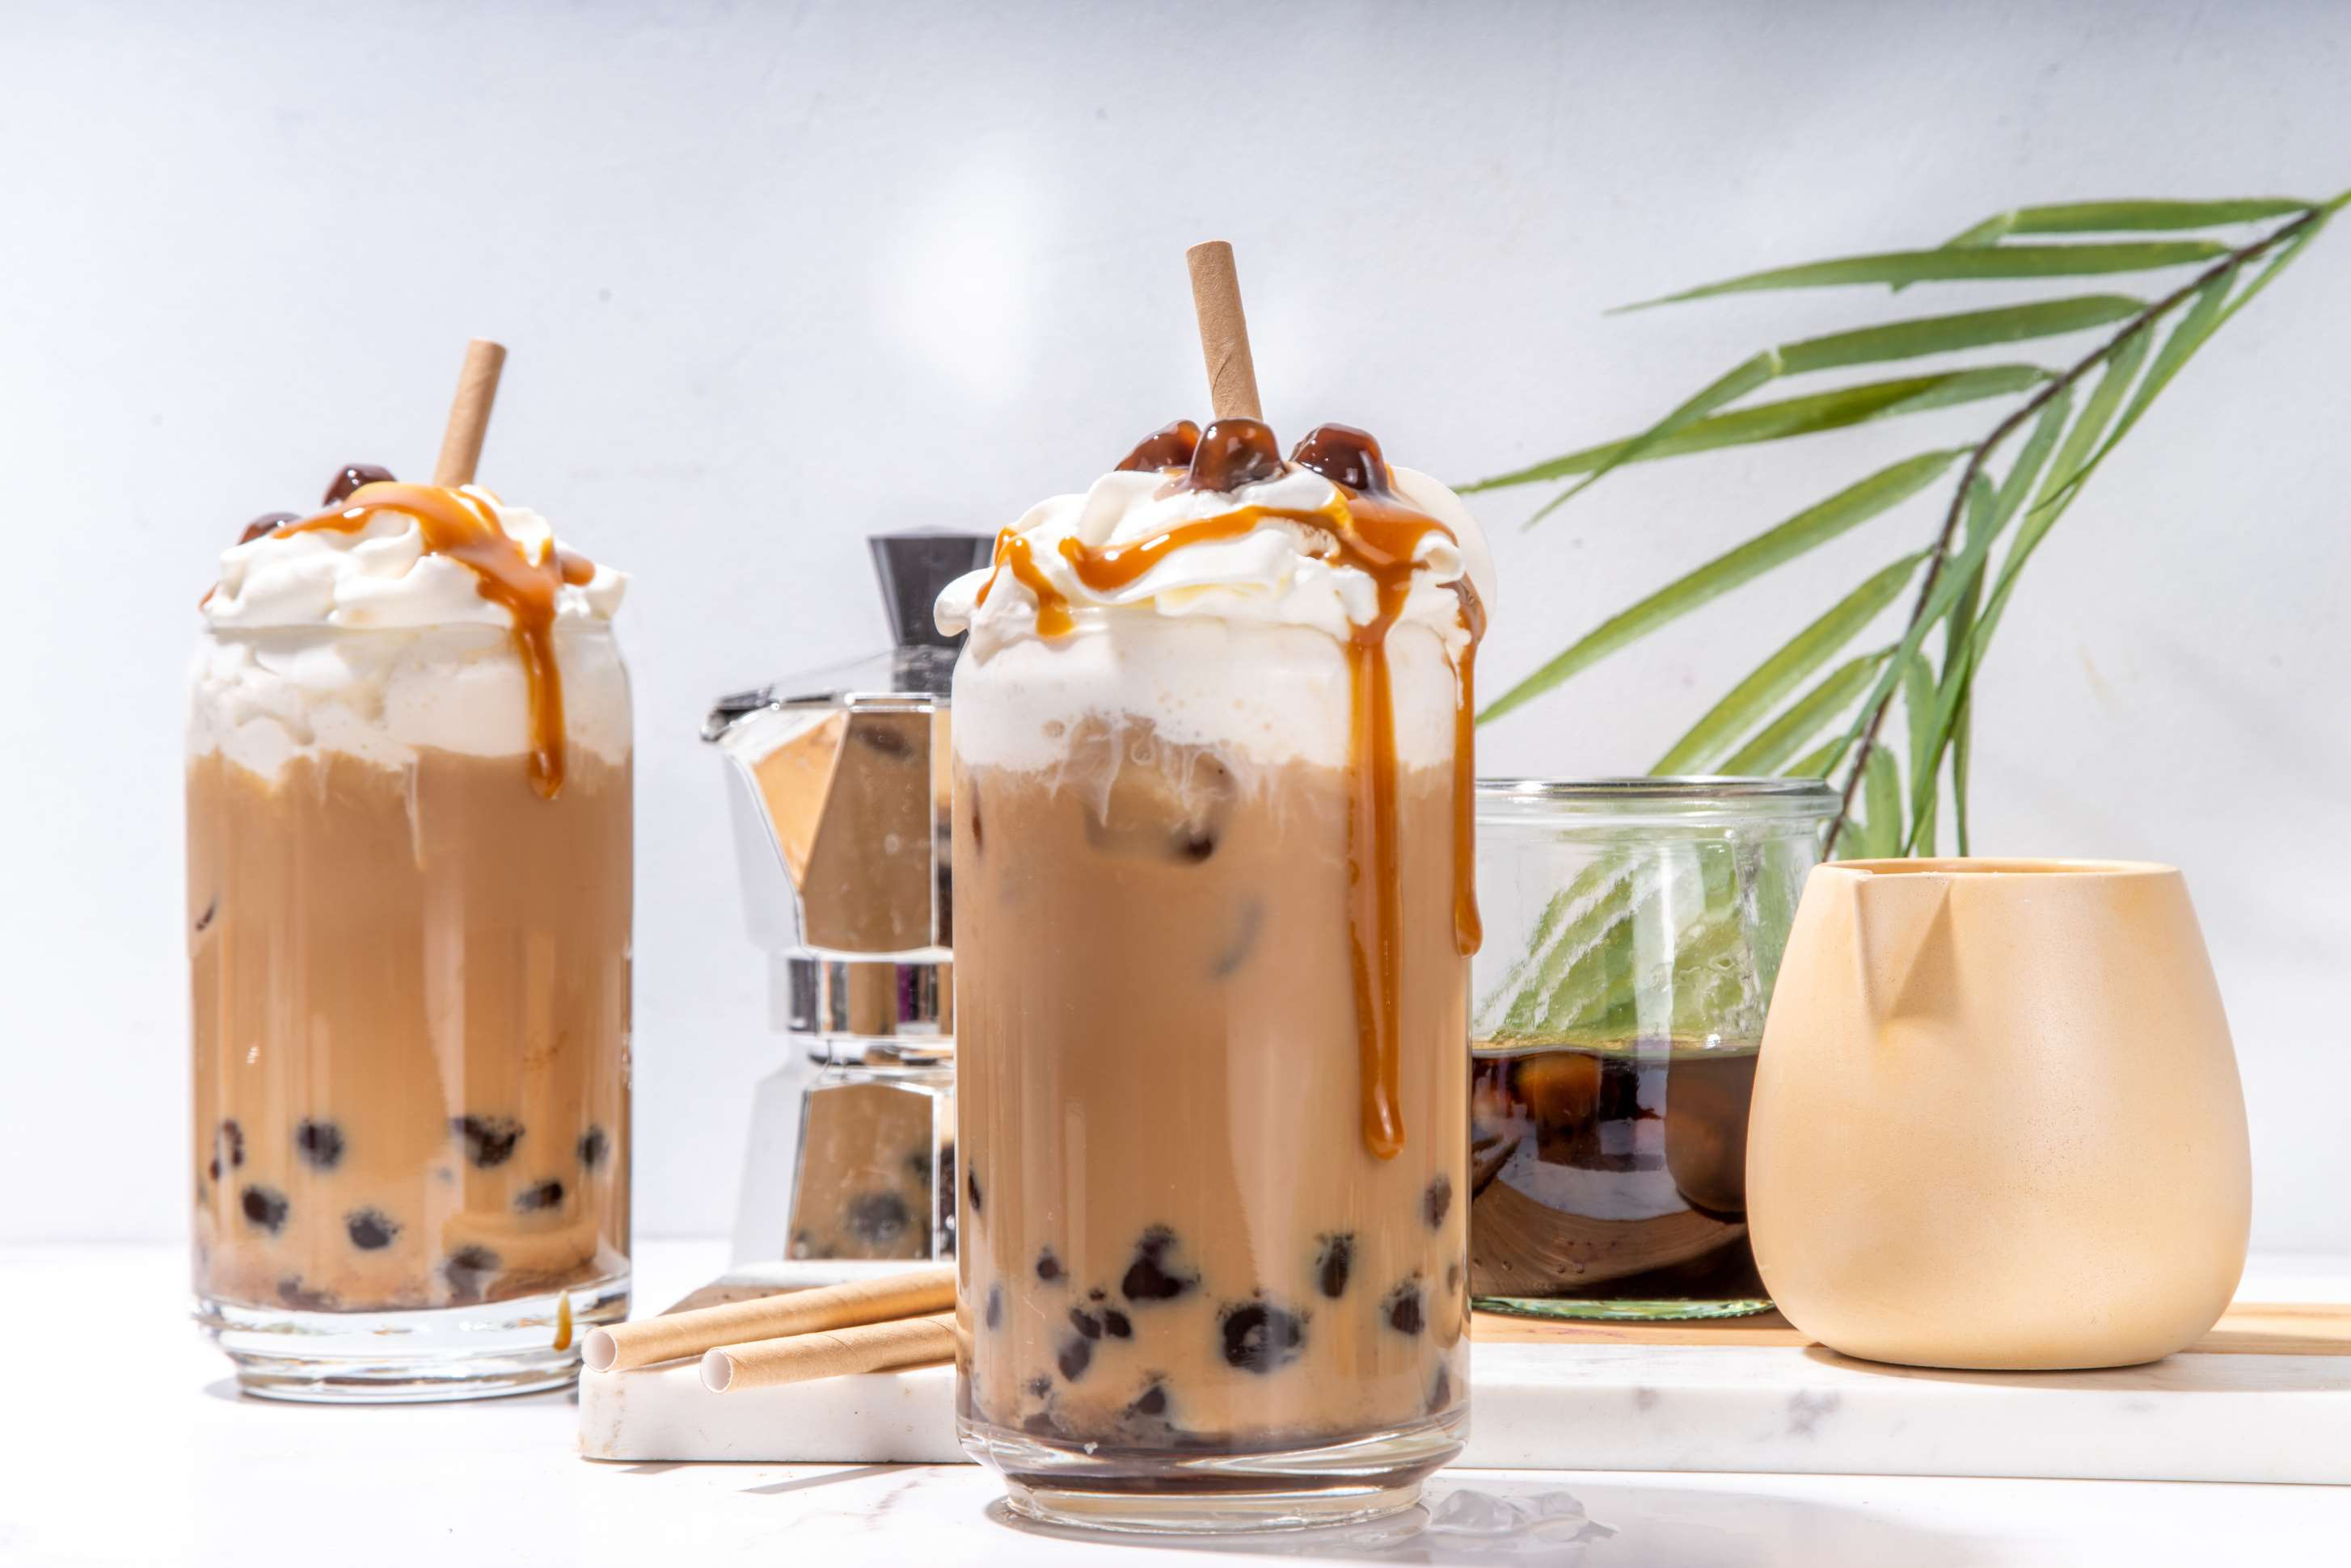
INTRODUCTION
The Taiwanese tea and fruit drinks that are commonly served with chewy tapioca pearls or other toppings are the main offerings of the boba market. Boasting bright tastes, eye-catching presentations, and customizable possibilities, the boba market has become incredibly popular all around the world, especially with younger consumers. Social media plays a major role in this trend by spreading the word about visually stunning boba creations, which in turn sparks further interest and involvement. To accommodate a wide variety of customer preferences, boba restaurants frequently provide a large selection of flavors, toppings, and customization options. The boba market thrives because of invention, ingenuity, and a strong sense of community among devotees, even in the face of problems like growing competition and market saturation.

Slide 3
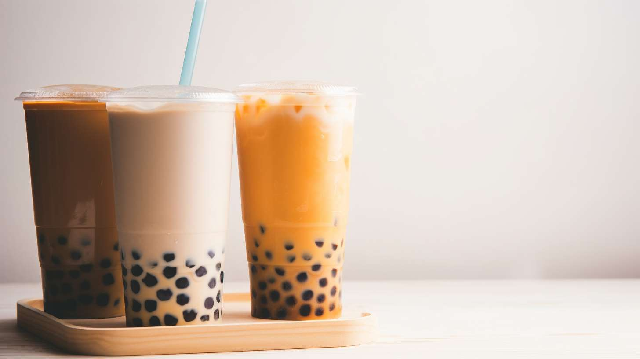

KEY INSIGHTS
MARKET SIZE
USD 2512.2 million
2024
CAGR
9.00 %
2024- 2031

Slide 4
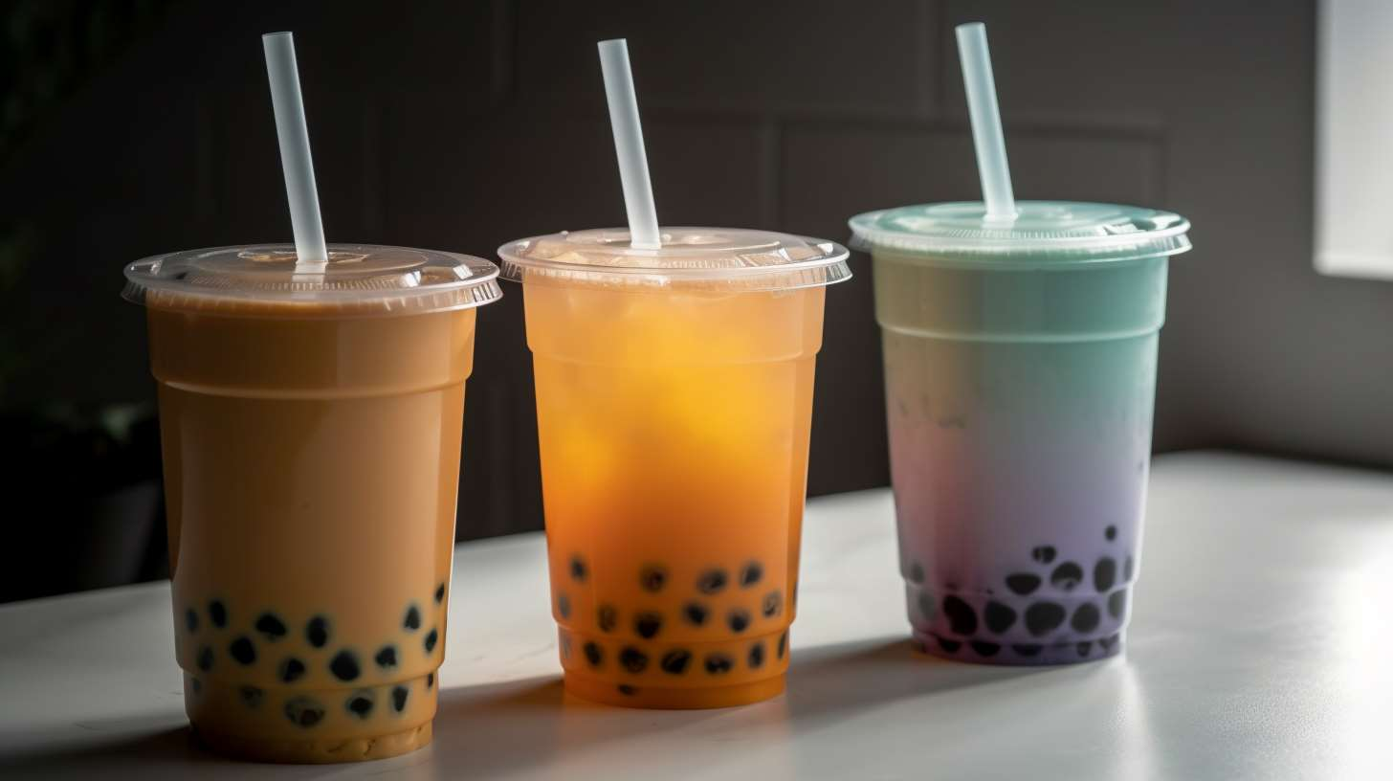
REVENUE MARKET SHARE BY SEGMENTS 2024
  Black Tea
  Green Tea
  Oolong Tea
  White Tea
  Pearl
  Grass Jelly
  Coconut Jelly
  Red Bean
Ingredient Segment
Toppings Segment
  Regular
  Reduced Sugar/Sugar-Free
  Direct (B2B)
  Indirect (B2C)
  Online Retailing
Sugar Content Segment
Distribution Channel

Slide 5

North America
40%
North America Boba Market Revenue share for 2024 is 40%

Slide 6
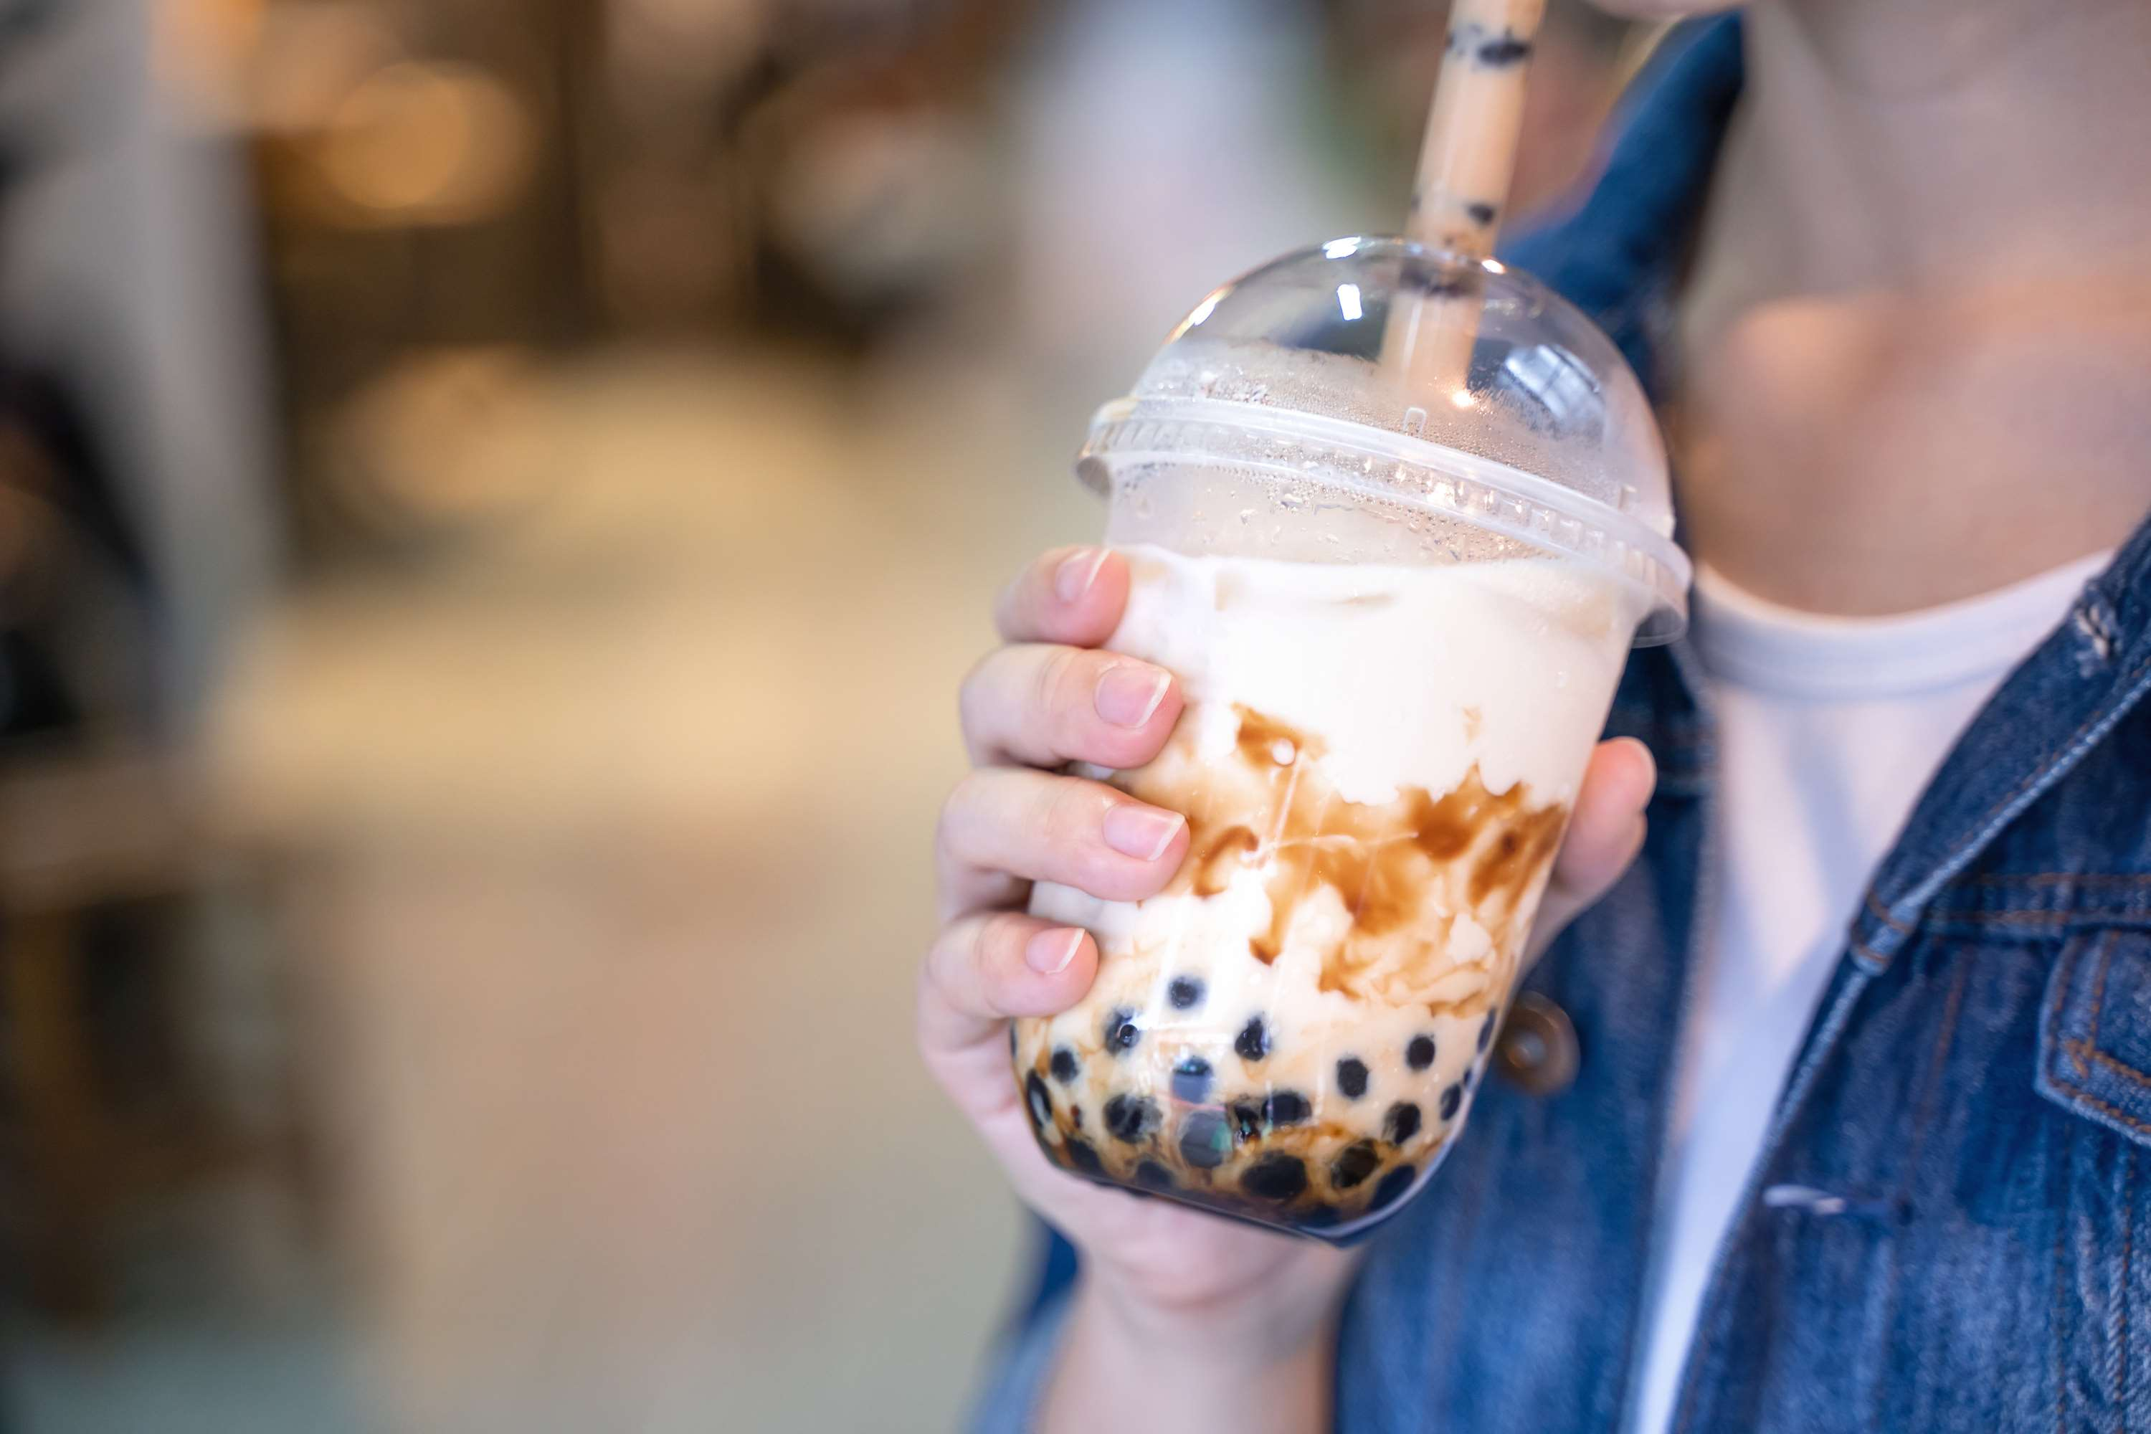
  Rising Popularity and Social Media Influence to Increase the Demand Globally
  Flavorful Innovation and Customization to Propel Market Growth
Drivers
Restraints
Competition and Market Saturation to Limit the Sales

Slide 7
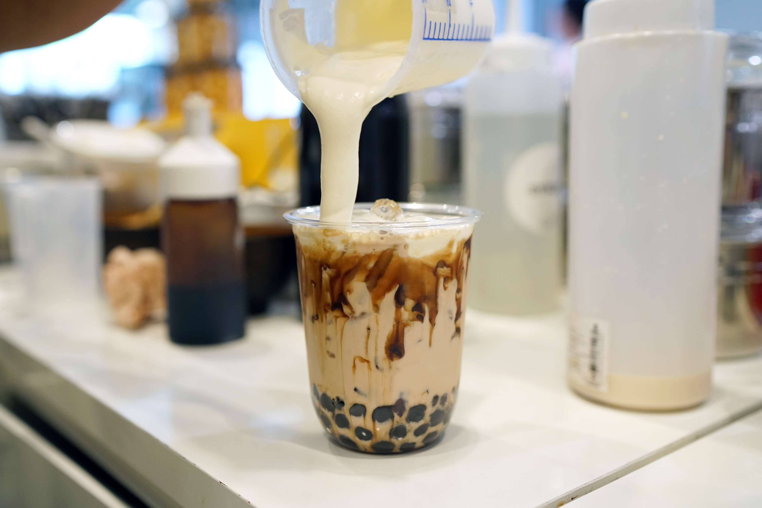
AUTHOR'S PERSPECTIVE
  The global Boba market will expand significantly by 9.00 % CAGR between 2024 to 2031.
  More and more boba stores are opening up, boosting consumer access to boba.
  This convenience component is quite important, particularly for busy urban lifestyles.
  Additionally, delivery businesses have made boba more accessible, enabling home consumption.
  Despite its reputation for being overly sweet, the boba market is now offering lower-sugar options, alternative sweeteners, and even dairy-free milk substitutes.
  This makes it possible for more individuals to enjoy boba without sacrificing their dietary requirements.

Slide 8
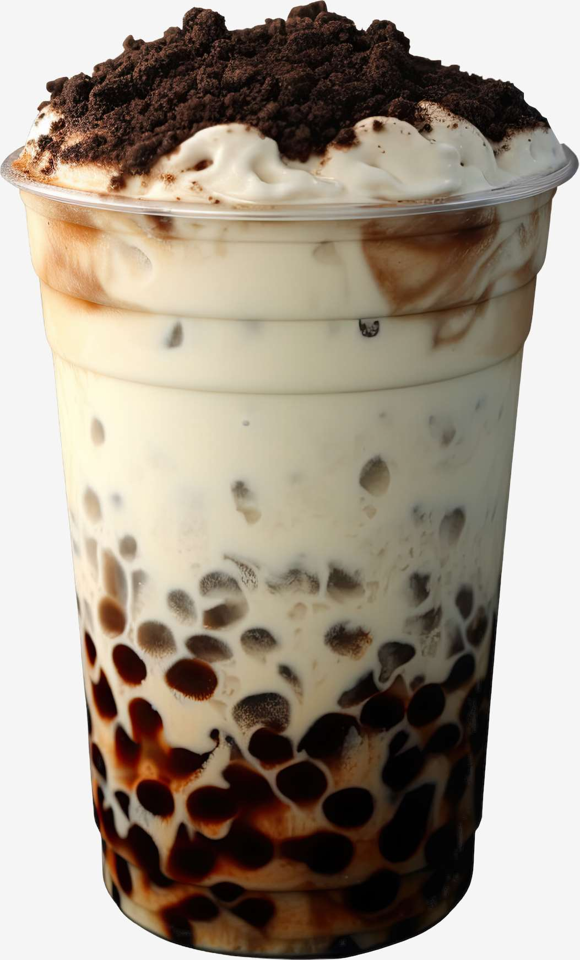
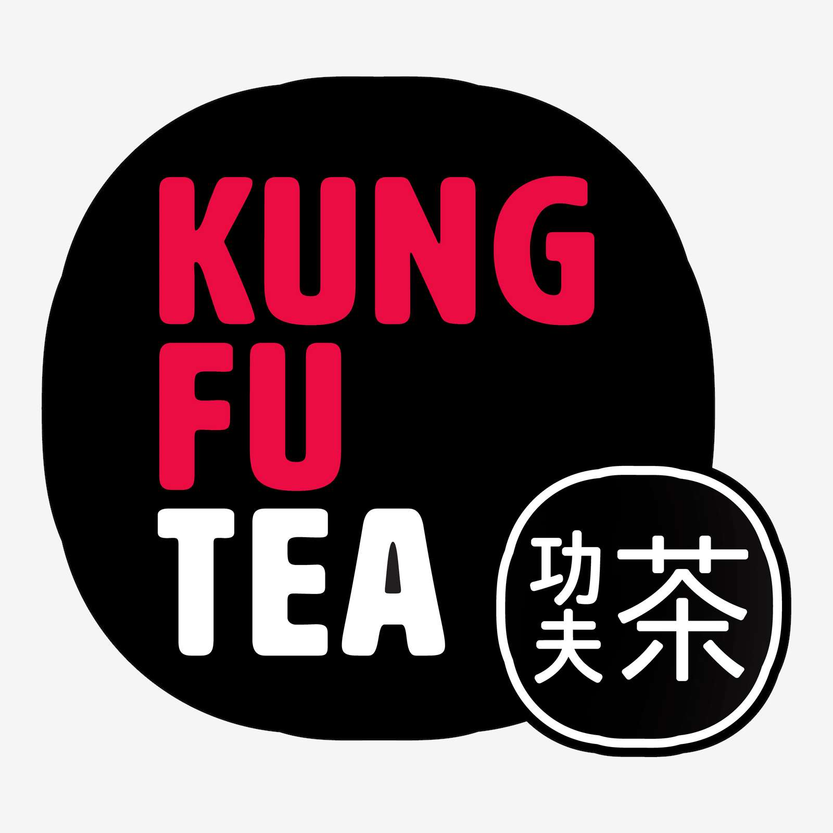
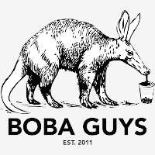

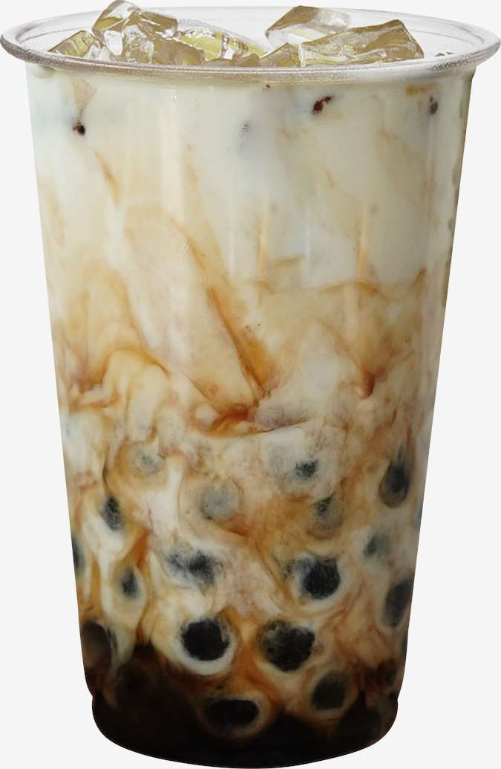

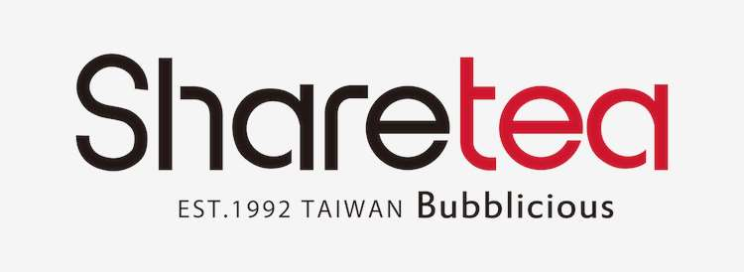
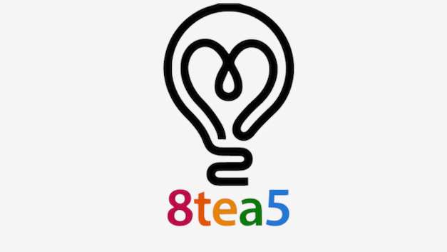

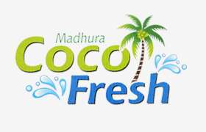

KEY PLAYERS

Slide 9


For Full Report
Contact us
COGNITIVE MARKET RESEARCH
Tel: +1 312-376-8303 | +44 020-8123-0732
India: (+91) 983-496-8611
sales@cognitivemarketresearch.com
Access the Full Report : https://tinyurl.com/5n7actsz
Please visit our website:
https://www.cognitivemarketresearch.com

