Slide 1

BOAT RENTAL MARKET REPORT

Slide 2

INTRODUCTION
The process of paying someone to use his or her boat is known as boat rental. This option provides a more customized experience. Rather than renting a stock boat from a marina fleet, the renter can select a boat depending on their interests and sailing ability. The renter can be guaranteed that the boat is in good working order and has all of the required safety equipment on board. They can even speak with or meet with the owner before taking to the water. The renter has the option of sailing the boat themselves or hiring a skipper to conduct the navigation for them.

Slide 3

KEY INSIGHTS
MARKET SIZE
USD 23,454.70 Million
2029
2023-
2030
CAGR 5.24%

Slide 4

REVENUE MARKET SHARE BY SEGMENTS 2022
BY PROPULSION TYPE
Fuel Powered USD 9,430.29 Million
BY APPLICATION
Fishing
USD 10,276.52 Million
POWER SEGMENT
3 HP
USD 746.85 Million

Slide 5

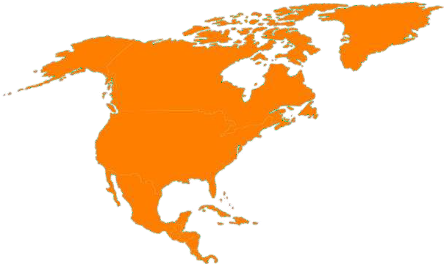
GLOBAL BOAT RENTAL MARKET REVENUE SHARE FOR 2022
North America USD 7,920.51 Million

Slide 6



The rising popularity of fishing as a recreational activity
High rent prices

Slide 7

AUTHOR'S PERSPECTIVE
The Global Boat Rentals Market revenue in 2017: USD 12,104.58 Million
Fuel Powered held for largest share of total revenue generated in 2020
up to 20 Feet held maximum ---are of Boat Rentals market in 2020
Fishing held maximum share of Boat Rentals market in 2020
26-50 HP held maximum share of Boat Rentals market in 2020
The rising popularity of fishing as a recreational activity drives the growth of the boat rental market
High rent prices for boats hindering the growth of the boat rental market
Technological advancement and digitalization are expected to provide numerous opportunities for the growth of the boat rental market

Slide 8

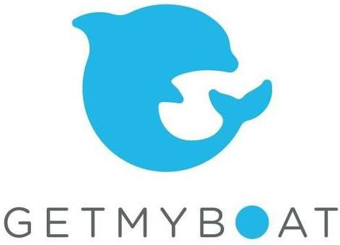





KEY PLAYERS

Slide 9


Contact us
For Full Report
COGNITIVE MARKET RESEARCH
Tel: + 1 312 - 376 - 8303 | + 44 020 - 8123 - 0732
India: ( + 91 ) 983 - 496 - 8611
sales@ cognitivemarketresearch. com
Access the Full Report : https://rb.gy/d7sat
Please visit our website:
https://www.cognitivemarketresearch.com

