Slide 1
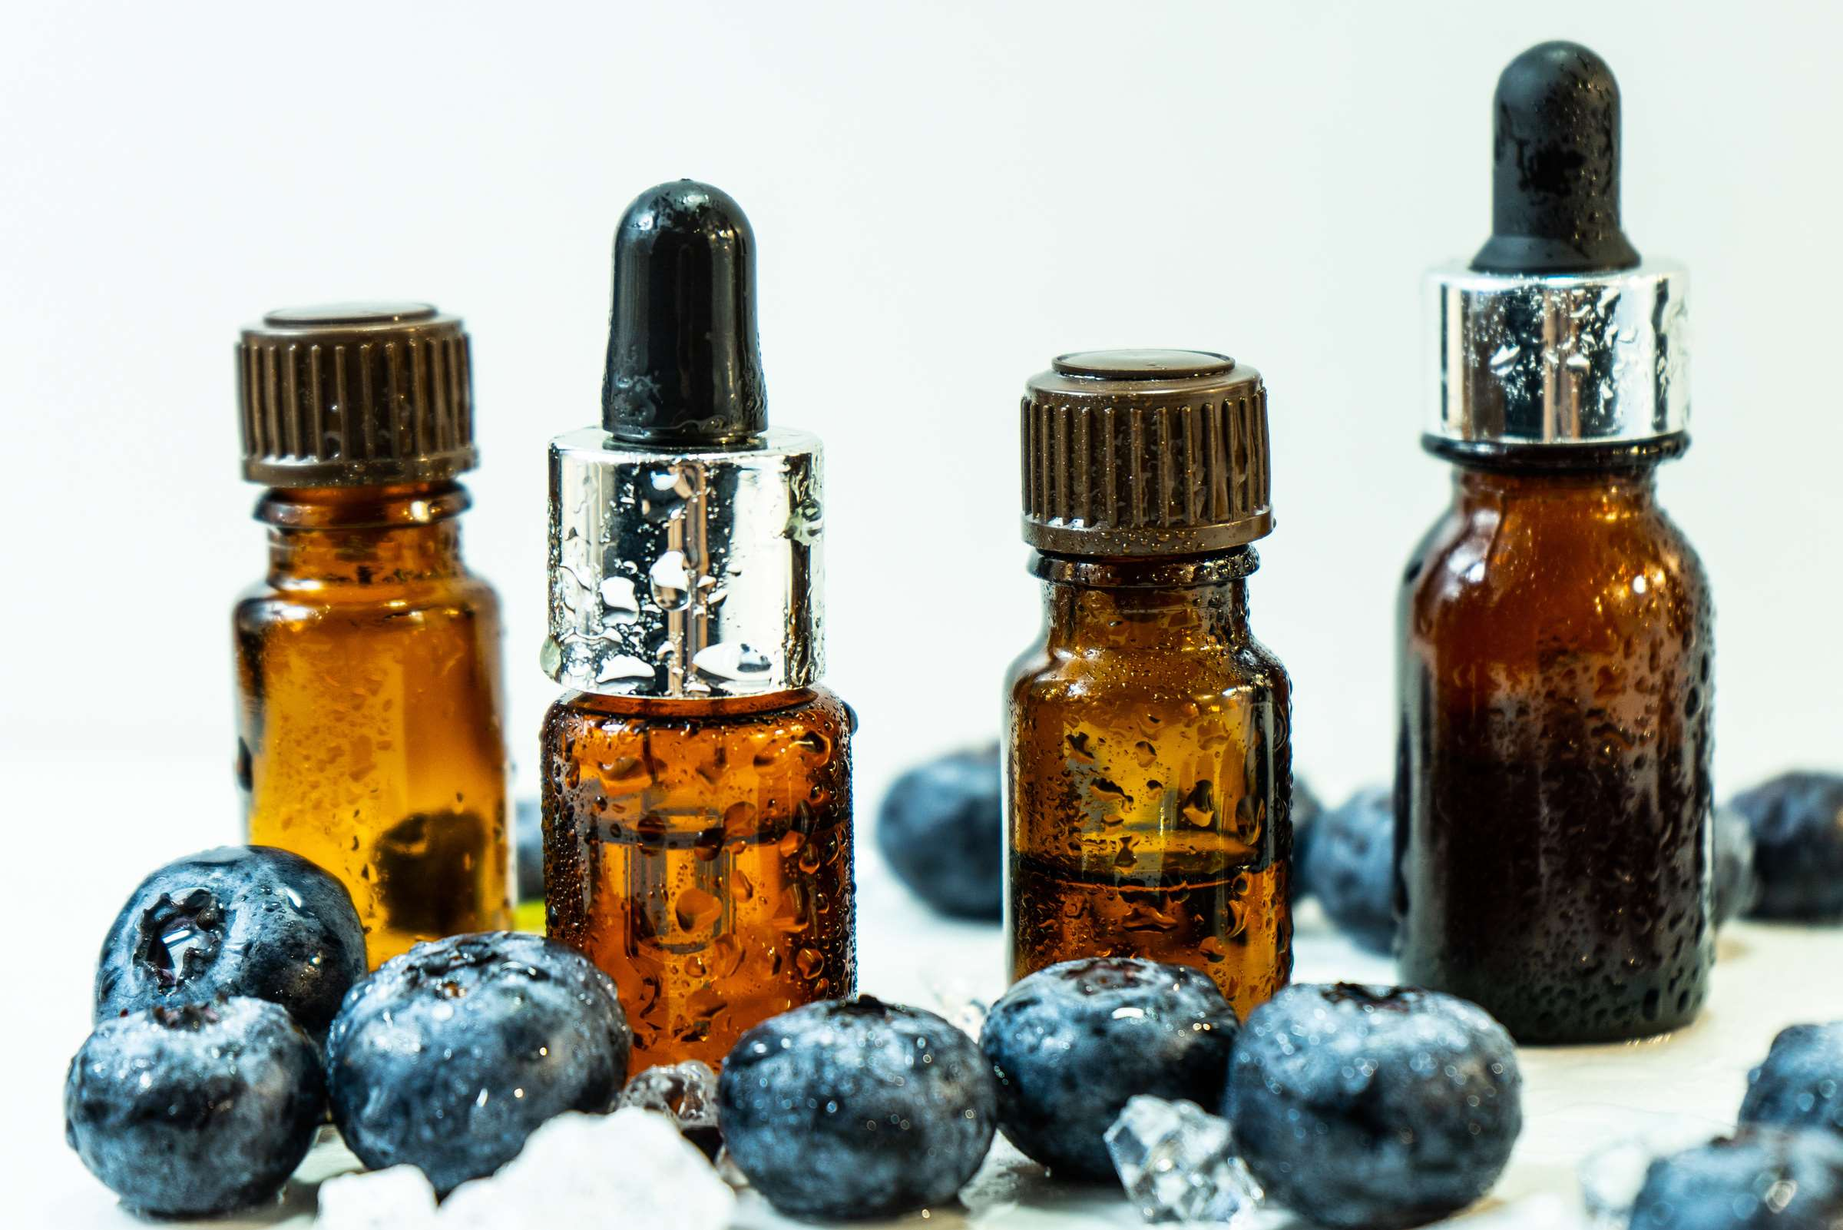
GLOBAL
BLUEBERRY EXTRACTS
MARKET REPORT
2024
Global,Regional,CountryAnalysis

Slide 2
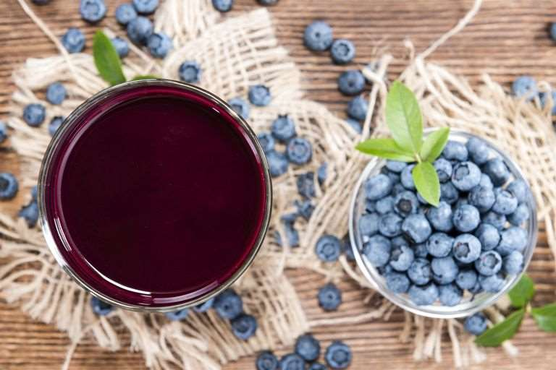
INTRODUCTION
The blueberry extracts market encompasses products derived from blueberries, rich in antioxidants, vitamins, and other bioactive compounds, utilized in various industries such as food and beverage, pharmaceuticals, and cosmetics. Blueberry extracts are known for their potential health benefits, including improving cognitive function, supporting heart health, and reducing inflammation. One key driver in the blueberry extracts market is the increasing consumer awareness and demand for natural and functional ingredients in food and beverage products. As consumers become more health-conscious and seek products with added nutritional value, the demand for blueberry extracts rises due to their perceived health benefits and antioxidant properties. Blueberry extracts are often incorporated into functional foods, beverages, and supplements, driving market growth as manufacturers respond to consumer preferences for natural and healthier options.

Slide 3
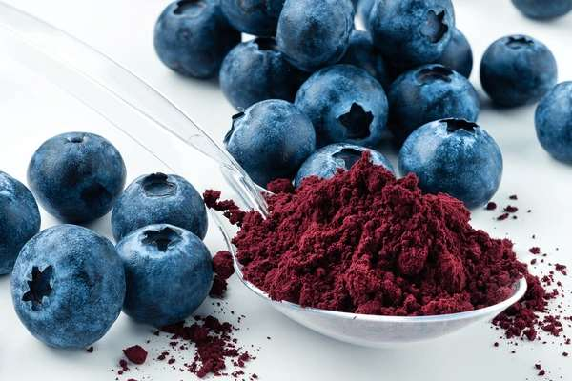

KEY INSIGHTS
CAGR
15.00%
2024- 2031

Slide 4
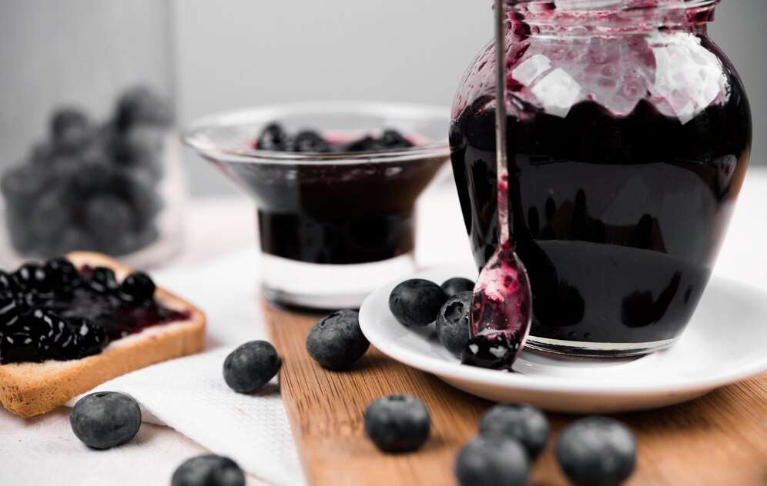
REVENUE MARKET SHARE BY SEGMENTS 2022
  Food and Beverages
  Cosmetics and Skin Care
  Nutraceuticals
Application Segment
  Direct Sale
  Indirect Sale
Distribution Channel

Slide 5

Global Blueberry Extracts Market Revenue share for 2024
North America
40%

Slide 6
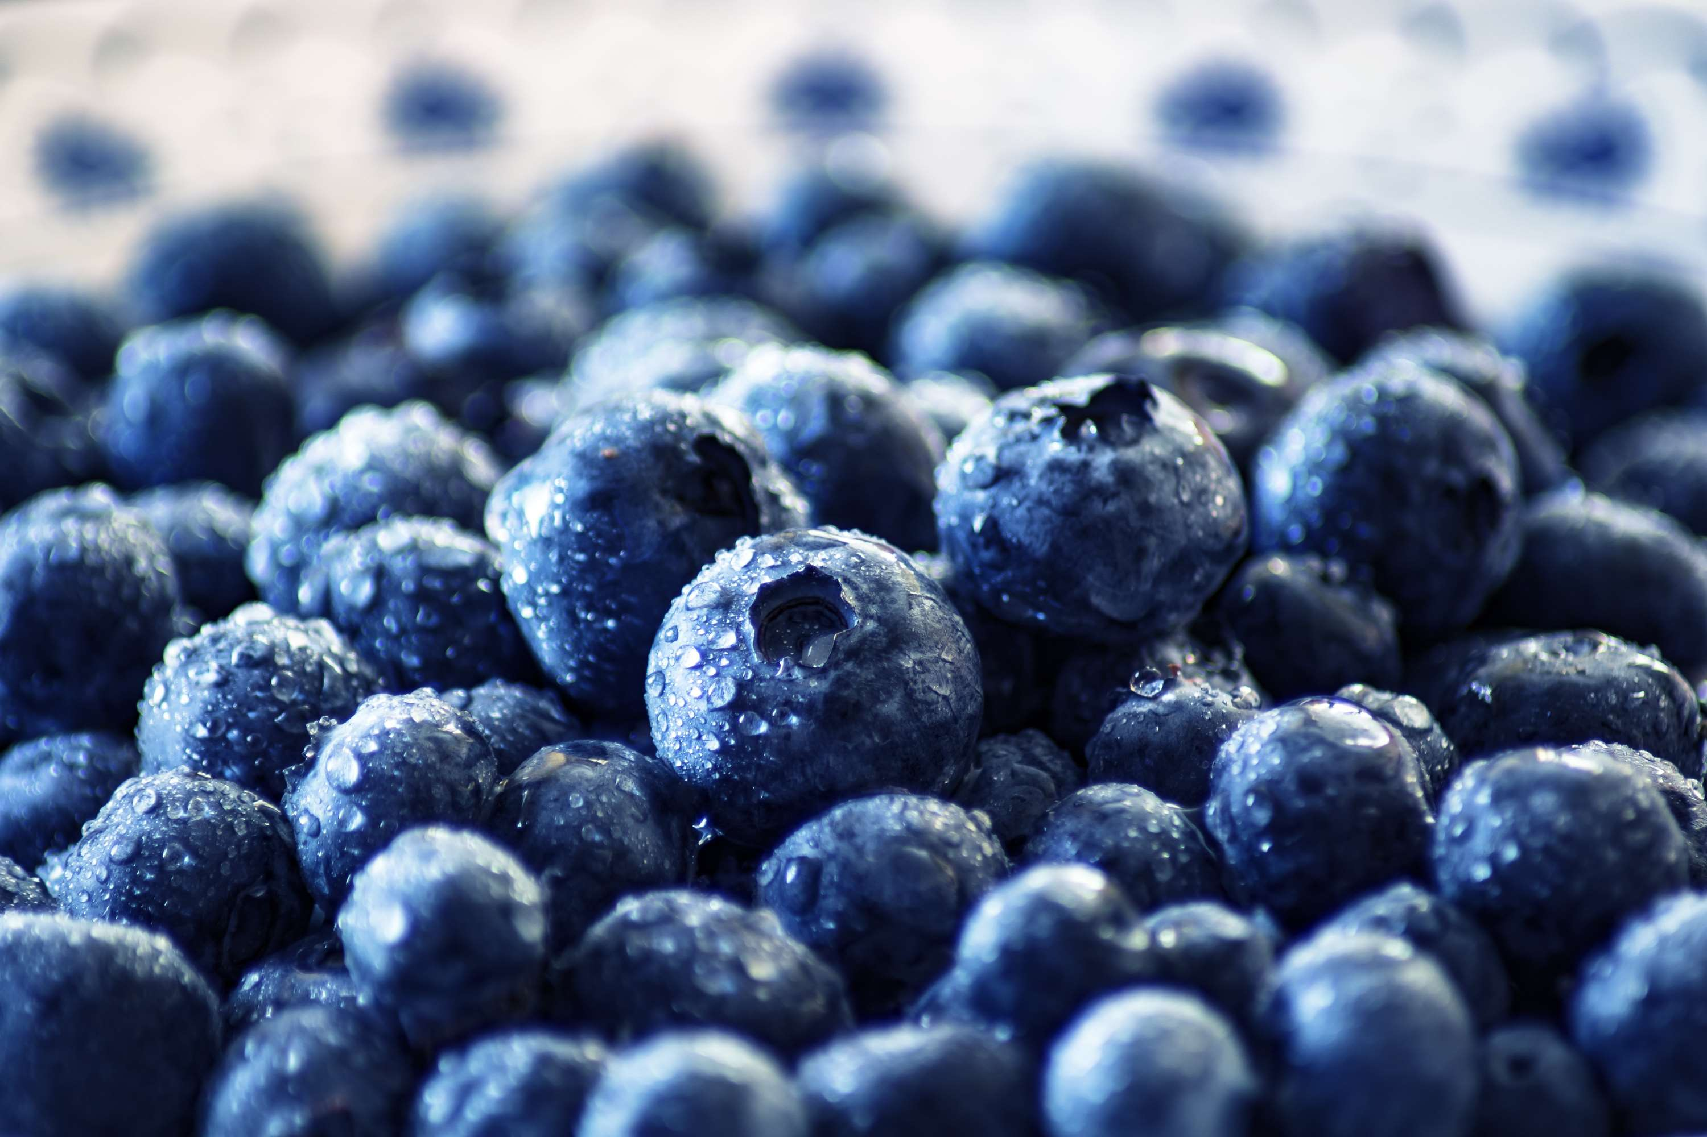
  Increasing Demand for Nutraceutical Products to Increase the Demand Globally
  Expanding Applications in Food and Beverage Industry to Propel Market Growth
Drivers
Seasonal Availability and Supply Chain Constraints to Limit the Sales
Restraints

Slide 7
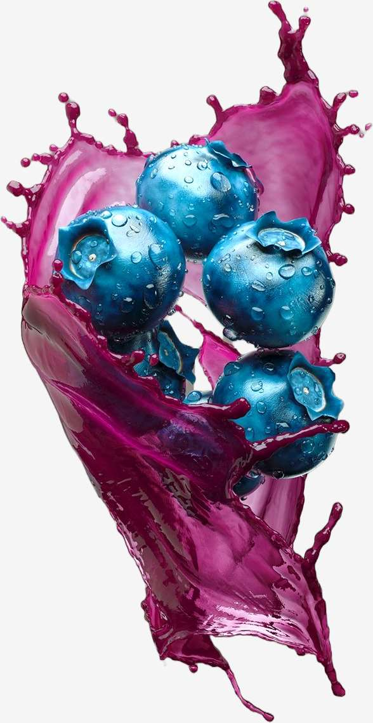
AUTHOR'S PERSPECTIVE
  The global Blueberry Extracts market will expand significantly by 15.00% CAGR between 2024 to 2031.
  Nutraceuticals are experiencing rapid growth due to the rising demand for dietary supplements and functional foods fortified with blueberry extracts. Blueberry extracts are rich in antioxidants, vitamins, and other bioactive compounds that offer various health benefits, including improving cognitive function, supporting heart health, and boosting immunity.
  The dominating category is Liquid extracts. Liquid extracts hold a dominant position due to their convenience and versatility in various applications.
  The dominating category is Food and Beverages. Food and beverages hold a dominant position due to the widespread use of blueberry extracts as natural flavourings, colorants, and nutritional additives in various food and beverage products.

Slide 8




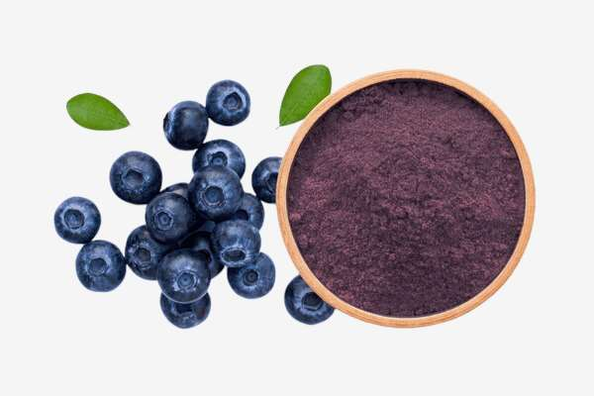
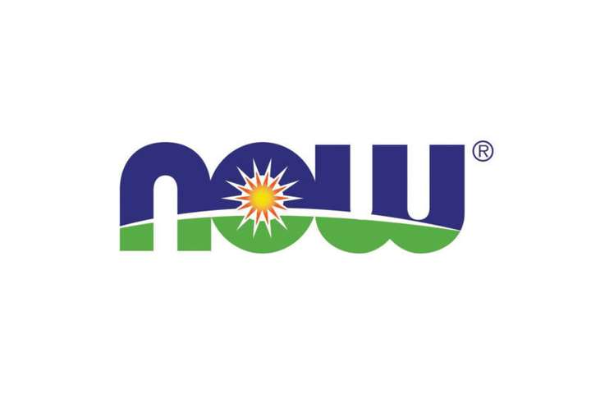
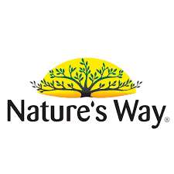



KEY PLAYERS

Slide 9


For Full Report
Contact us
COGNITIVE MARKET RESEARCH
Tel: +1 312-376-8303 | +44 020-8123-0732
India: (+91) 983-496-8611
sales@cognitivemarketresearch.com
Access the Full Report : https://tinyurl.com/hnzrfukk
Please visit our website:
https://www.cognitivemarketresearch.com

