Slide 1
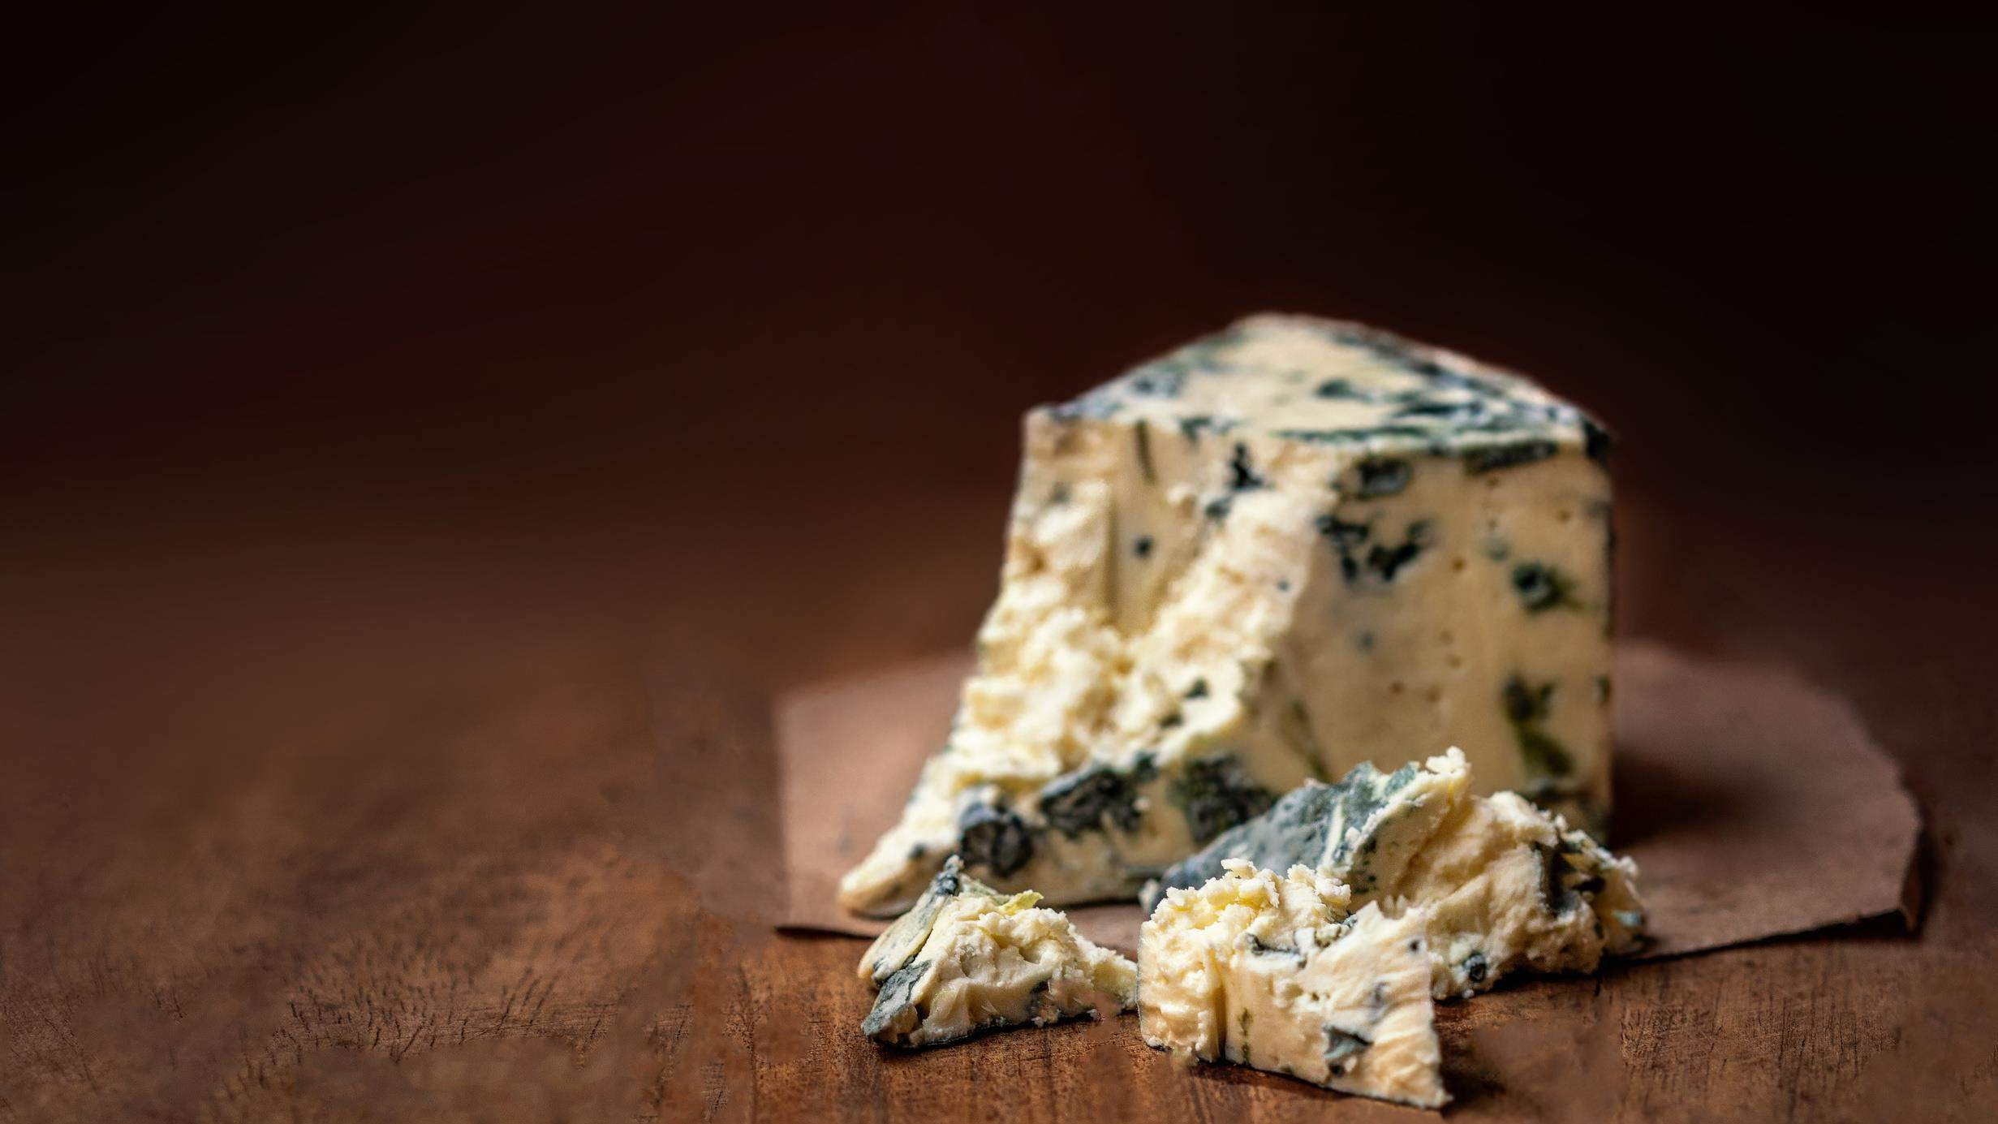




Global,Regional,CountryAnalysis

Slide 2

INTRODUCTION
The blue cheese market is experiencing growth due to several factors. The unique and bold flavor of blue cheese appeals to consumers seeking distinctive and gourmet taste experiences. Additionally, the growing trend of cheese consumption, especially in fine dining and culinary exploration, has boosted the demand for blue cheese. Its versatility in various dishes, from salads to dressings and cheeseboards, further drives its popularity. The increasing interest in artisanal and craft cheeses also contributes to the market's expansion.

Slide 3
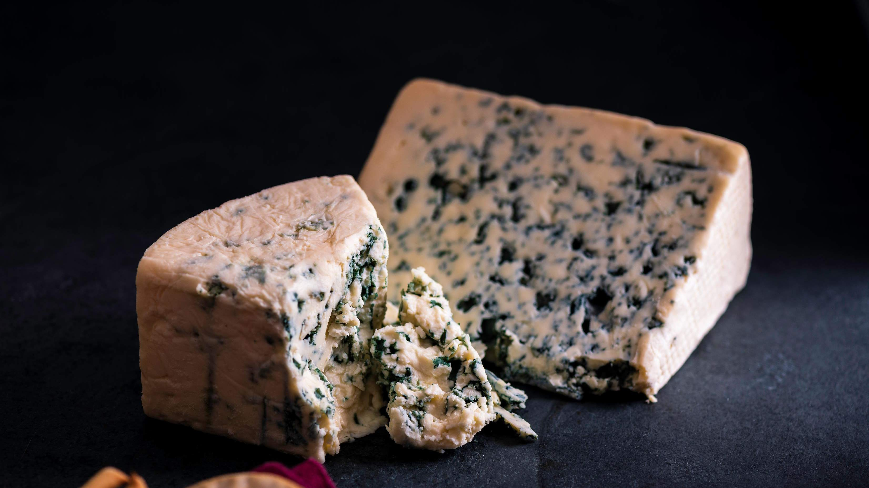

KEY INSIGHTS
MARKET SIZE
USD 1.6 billion
2023
20₋23
CAGR 4.6%
2030

Slide 4
REVENUE MARKET SHARE BY SEGMENTS 2022
Gorgonzola
Castello Double Blue
Roquefort
Stilton
Castello Traditional Danish Blue
Type Segment
Sheep's Milk
Cow's Milk
Goat's Milk
Source Segment
Air Drying
Glycerin
Silica Gel
pressing
Sand
Texture Segment

Slide 5
Global Blue Cheese Market Revenue share for 2022
Europ e

Slide 6
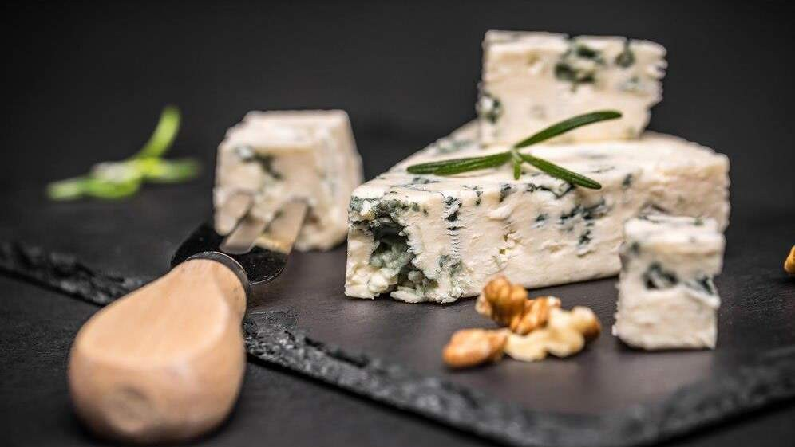




Slide 7
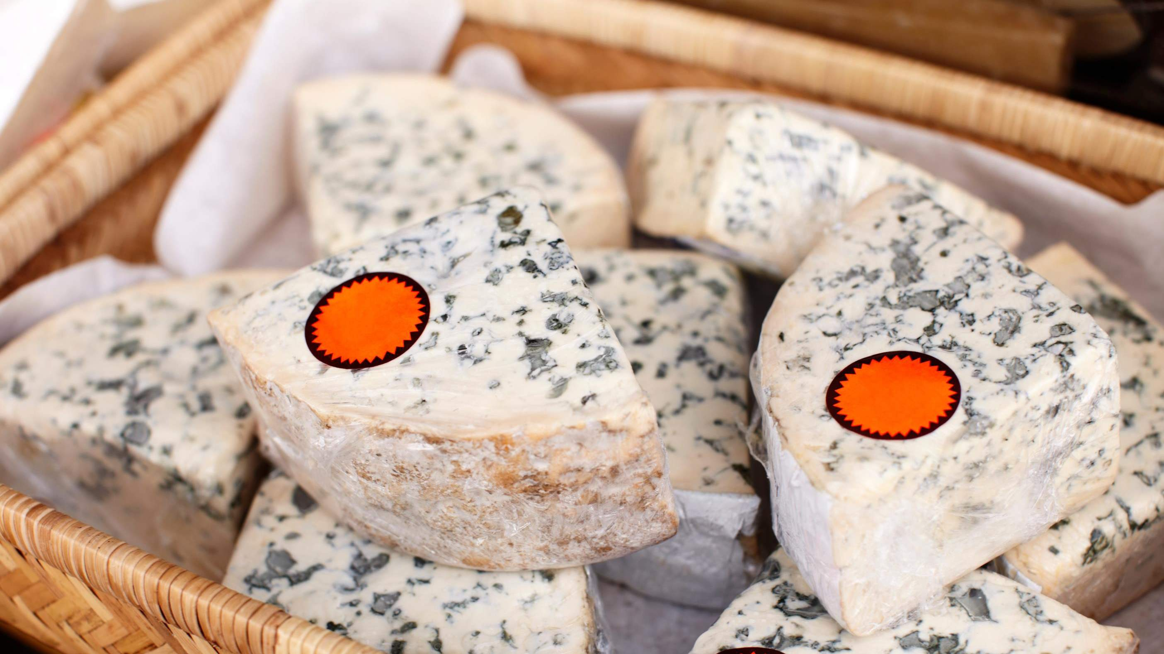
AUTHOR'S PERSPECTIVE
The Global Blue Cheese Market is witnessing significant growth in the near future.
Roquefort's reputation for quality and its unique production process using cave-aged Penicillium roqueforti molds contribute to its growing demand.
Goat's milk blue cheese is often associated with artisanal and small-batch production, aligning with the growing trend for craft and premium cheese varieties.
These cheeses, like Gorgonzola and Roquefort, offer a crumbly yet slightly creamy texture that enhances both culinary and cheese platter applications.
The Sheep\'s Milk segment is expected to expand at the significant CAGR retaining position throughout the forecast period.

Slide 8













KEY PLAYERS

Slide 9


Contact us
For Full Report
COGNITIVE MARKET RESEARCH
Tel: + 1 312 - 376 - 8303 | + 44 020 - 8123 - 0732
India: ( + 91 ) 983 - 496 - 8611
sales@ cognitivemarketresearch. com
Access the Full Report : http://tinyurl.com/3s4z3k2z
Please visit our website:
https://www.cognitivemarketresearch.com

