Slide 1

GLOBAL
Biscuits
MARKET REPORT 2024
Global,Regional,CountryAnalysis

Slide 2
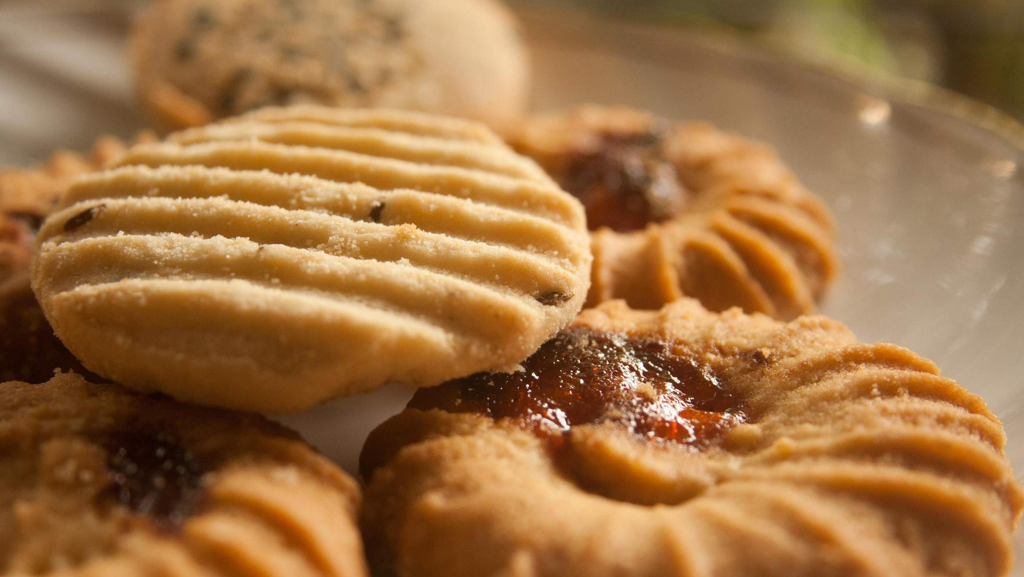
INTRODUCTION
Snacking culture is expanding as a result of shifting eating patterns and tastes, which is the main factor driving the industry.
Between-meal snacks like biscuits are popular because they provide a rapid energy boost.

Slide 3


KEY INSIGHTS
MARKET SIZE
USD 118.2 billion
2023
20₋23
CAGR 5.00%
2030

Slide 4
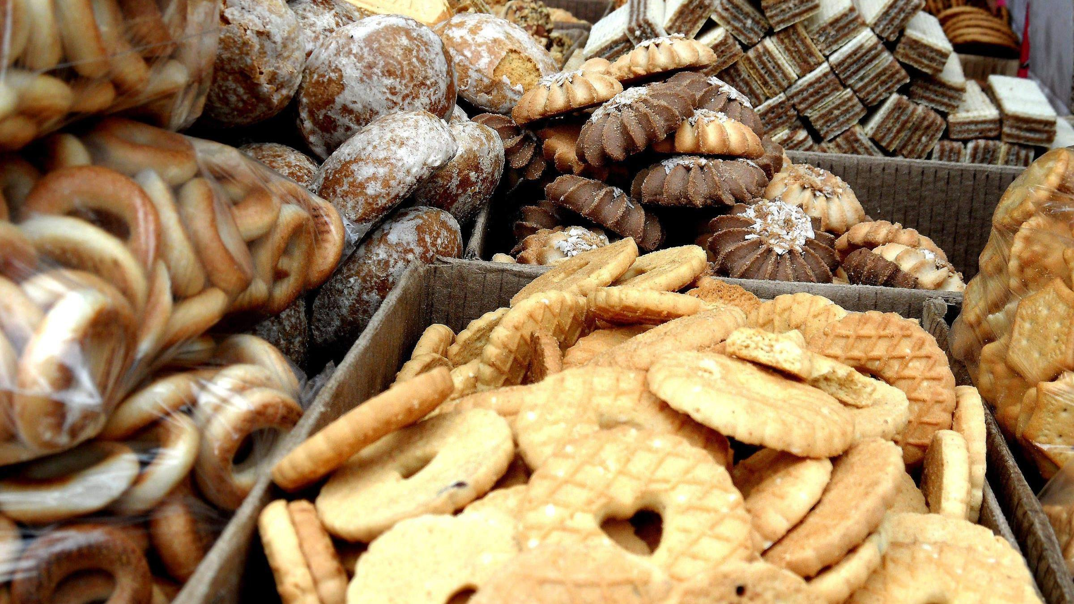
REVENUE MARKET SHARE BY SEGMENTS 2022
Crackers and Savory Biscuits
Sweet Biscuits
Type Segment
Wheat
Oats
Millets
Application Segment
Supermarkets and Hypermarkets
Convenience Stores
Independent Bakery
Online Stores
Distribution Channel

Slide 5
Global Biscuits Market Revenue share for 2022
North America 40%

Slide 6







Slide 7
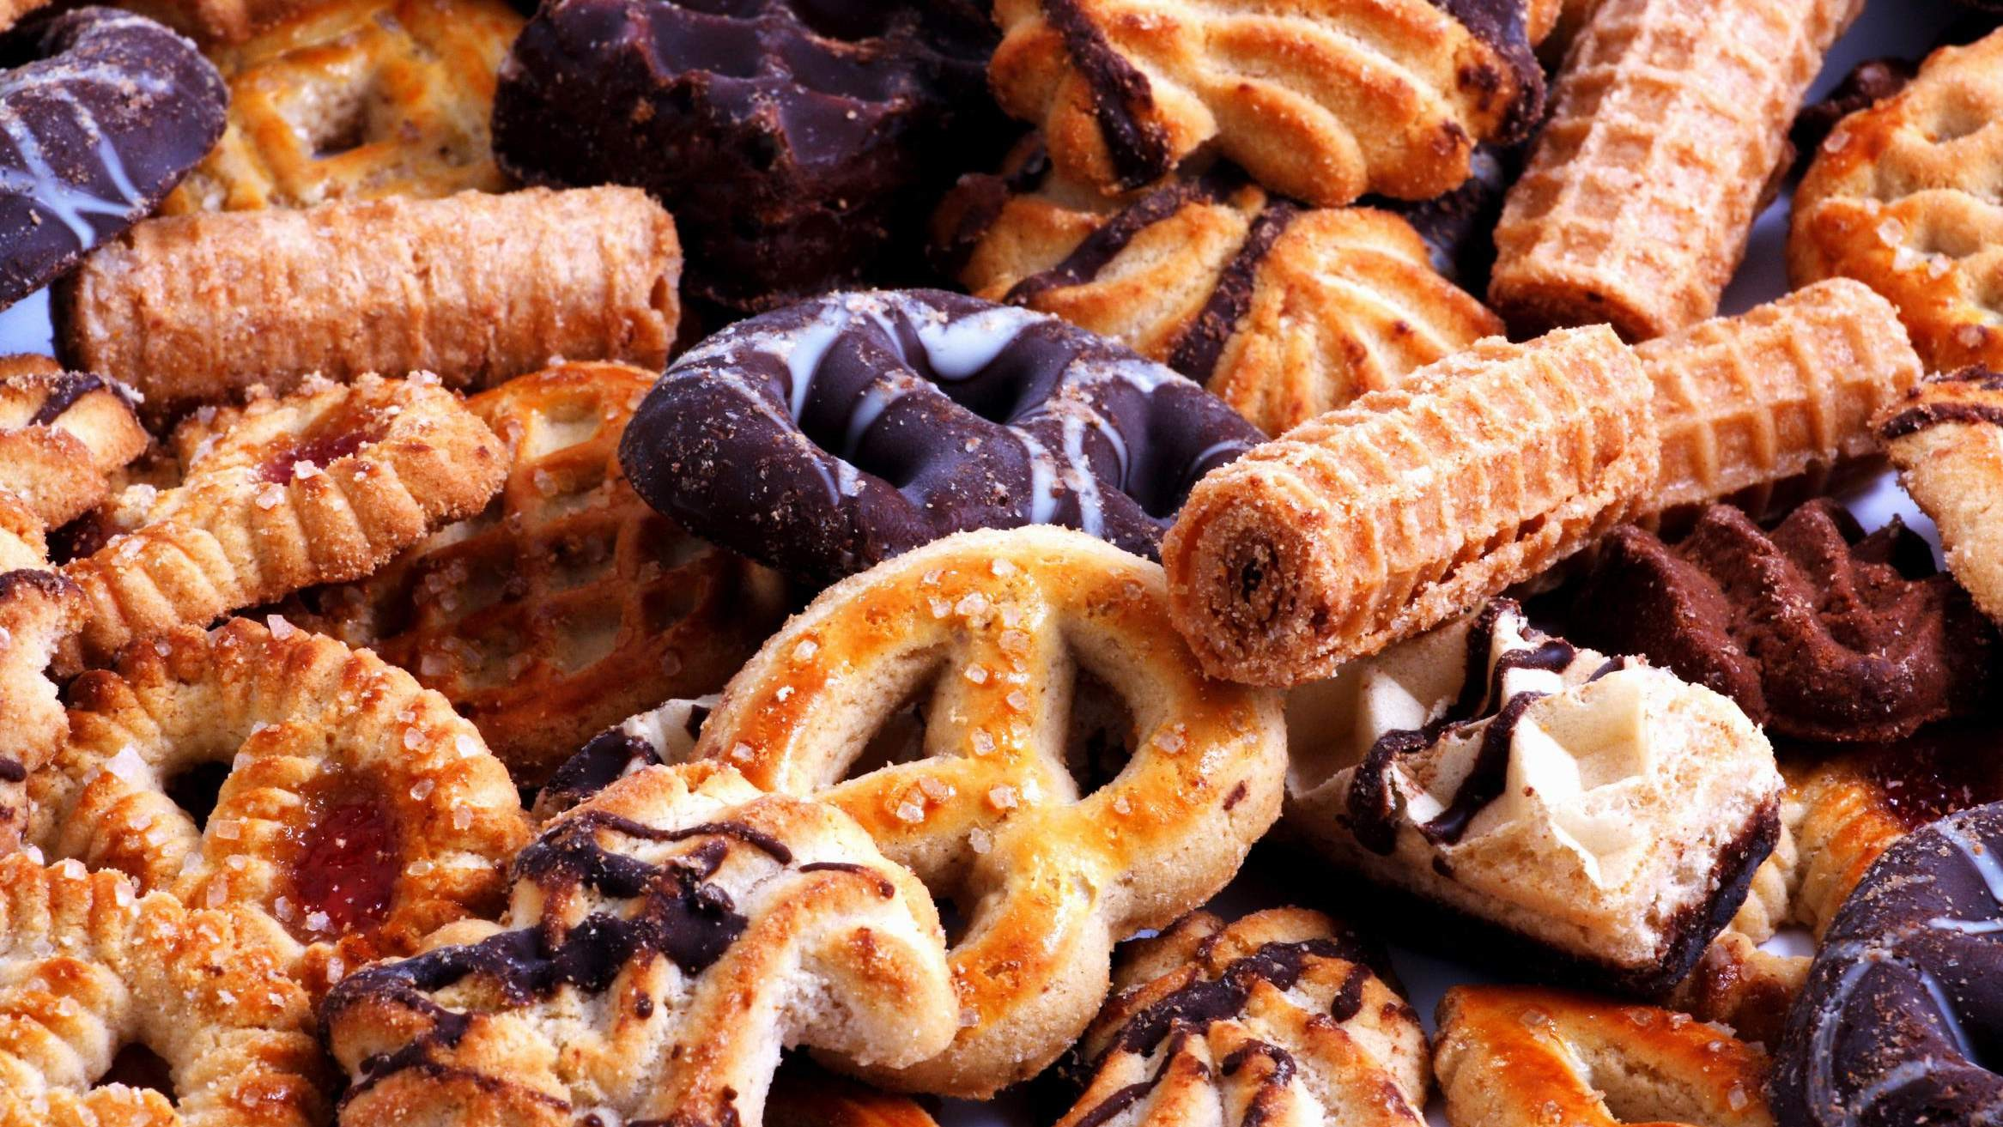
AUTHOR'S PERSPECTIVE
The Global Biscuits Market is witnessing significant growth in the near future.
Additionally, these biscuits come in a variety of flavors, textures, and shapes, including traditional butter cookies, chocolate chip cookies, sandwich biscuits with cream filling, wafer biscuits, and more, giving consumers a wide range of options.
Wheat flour also has functional advantages for making biscuits since it contributes to the dough's structure, adds volume and texture, and helps the cookies brown and develop flavor during baking.
Customers can benefit from pouches or packets because they are portable, easy to store, and come individually wrapped or in portion-controlled biscuit packages.

Slide 8
KEY PLAYERS

Slide 9


Contact us
For Full Report
COGNITIVE MARKET RESEARCH
Tel: + 1 312 - 376 - 8303 | + 44 020 - 8123 - 0732
India: ( + 91 ) 983 - 496 - 8611
sales@ cognitivemarketresearch. com
Access the Full Report : http://tinyurl.com/45kf9xf4
Please visit our website:
https://www.cognitivemarketresearch.com

