Slide 1

GLOBAL
BIOTECH CROP
MARKET REPORT
2024
Global,Regional,CountryAnalysis

Slide 2
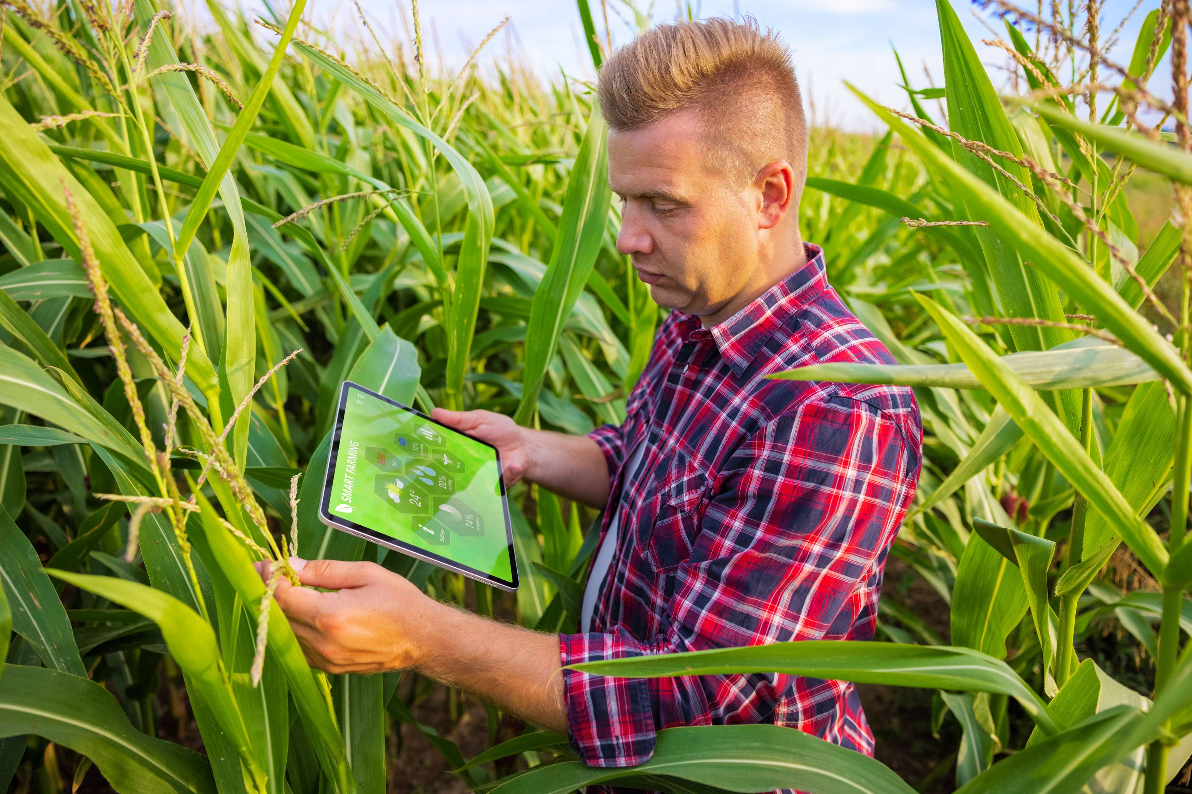
INTRODUCTION
An increase in the adoption of Genetically Modified (GM) crops globally is anticipated to drive the market over the forecast period. This is because genetic modification permits the production of feed and food crops with expanded characteristics such as high yield, high nutritional value, expanded food-processing qualities, and resistance against illness and insects. In various countries, GM crops have been embraced rapidly, and the market for herbicide-tolerant, insect-resistant GM seeds is among the increasing sectors of the agricultural industry.

Slide 3


KEY INSIGHTS
CAGR
9.30%
2023- 2030

Slide 4
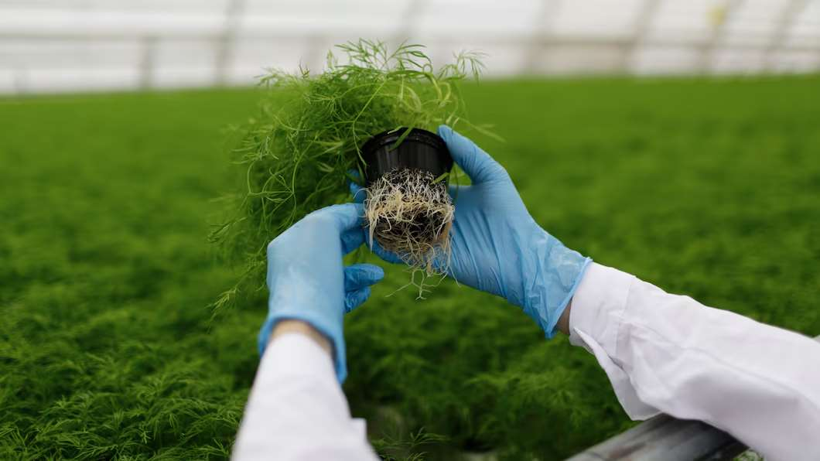
REVENUE MARKET SHARE BY SEGMENTS 2022
  Soybean
  Maize
  Rice
  Cotton
  Canola
Type Segment
  Herbicide Tolerance
  Drought Resistance
  Insect Resistance
  Stacked Traits
Trait Segment

Slide 5

Global Biotech Crop Market Revenue share for 2024
North America
37%

Slide 6
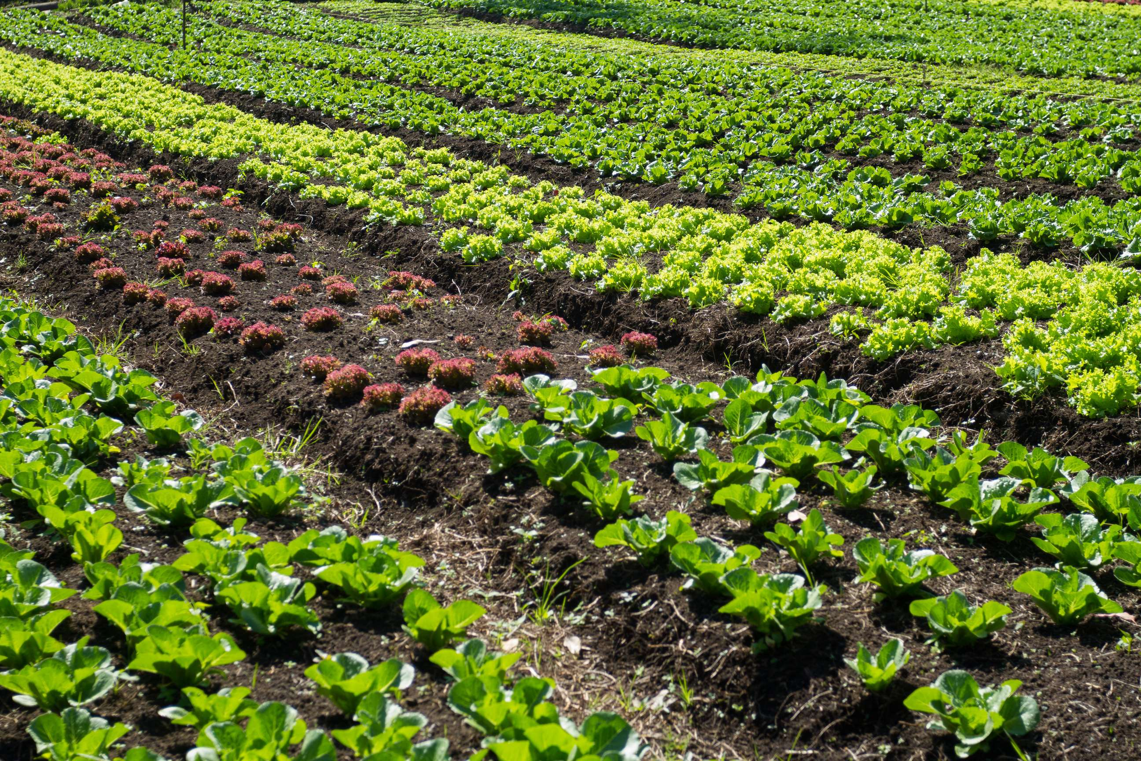
Impact of Climate Change to Provide Viable Market Output
Drivers
Stringent Regulations for Safety Testing to Hinder Market Growth
Restraints

Slide 7
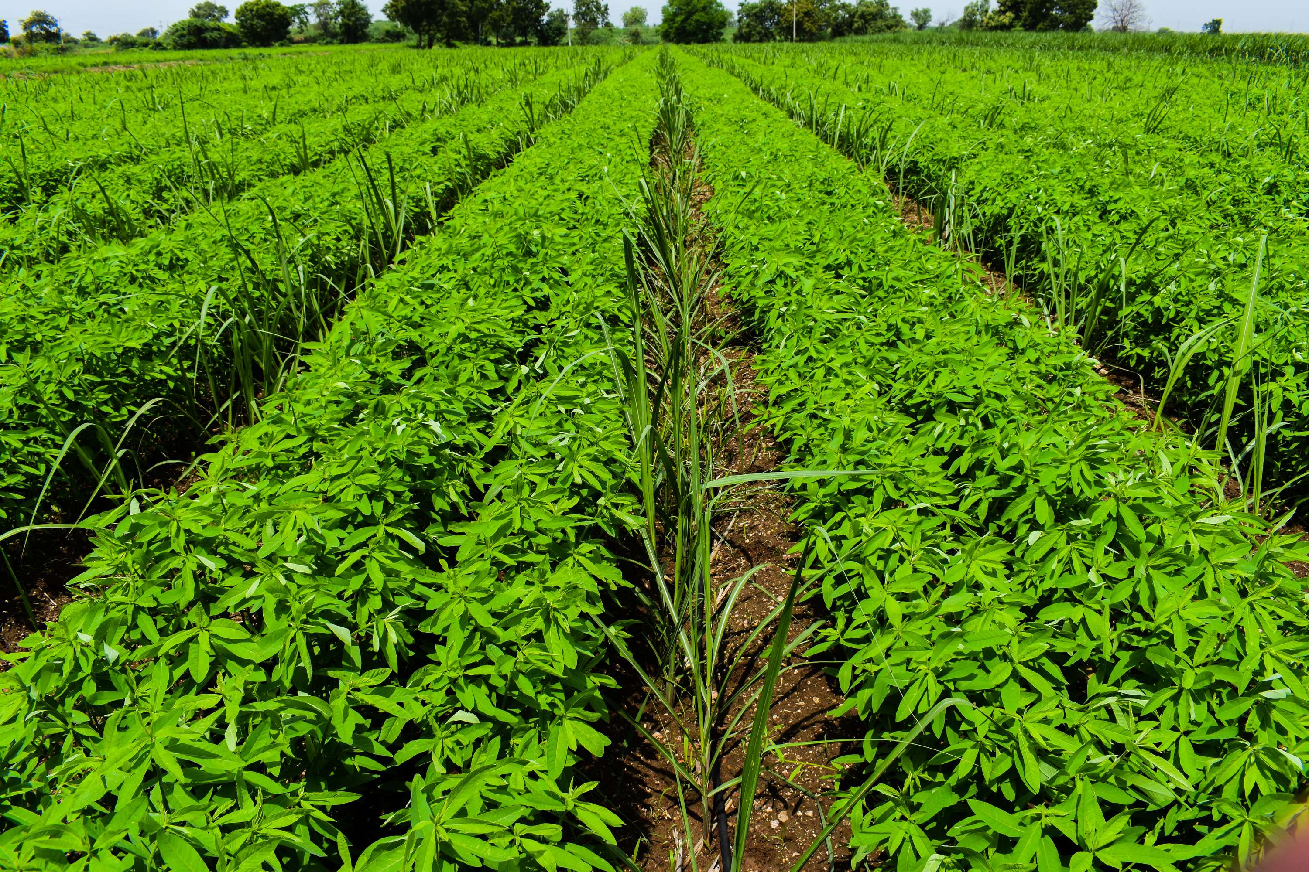
AUTHOR'S PERSPECTIVE
  The Global Biotech Crop Market is witnessing significant growth in the near future.
  Biotech maize can be engineered to produce toxic proteins for specific insect pests, such as the European corn borer. This reduces the need for chemical insecticides, potentially benefiting both the environment and farmers.
  Herbicide tolerance held the major share in the biotech crop market due to the wide availability of herbicide-resistant crops, increasing awareness regarding the advantages of herbicide-resistant crops in farm management and simplification of weed management, reduced negative impact on the environment due to decreased growth of weeds, increased crop yield and reduced costs of farming, and reduction in soil erosion.

Slide 8











KEY PLAYERS

Slide 9


For Full Report
Contact us
COGNITIVE MARKET RESEARCH
Tel: +1 312-376-8303 | +44 020-8123-0732
India: (+91) 983-496-8611
sales@cognitivemarketresearch.com
Access the Full Report : https://tinyurl.com/yd9s79bw
Please visit our website:
https://www.cognitivemarketresearch.com

