Slide 1

BIOPSY DEVICES MARKET REPORT

Slide 2
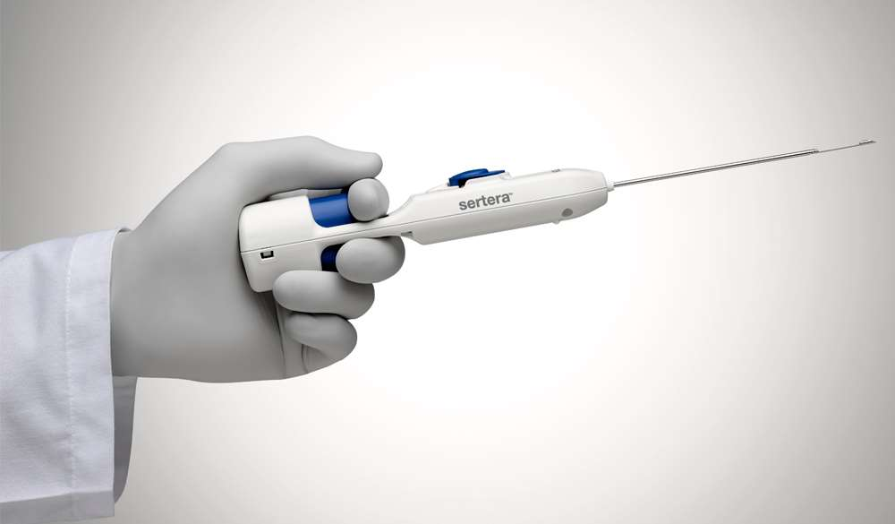
INTRODUCTION
A biopsy is a medical procedure in which a sample of tissue or cells is taken from the body for diagnostic evaluation. The purpose of a biopsy is to examine the sample under a microscope or through other laboratory tests to determine the presence of abnormal or diseased cells, identify the nature of a tumor or growth, or diagnose a specific medical condition.

Slide 3
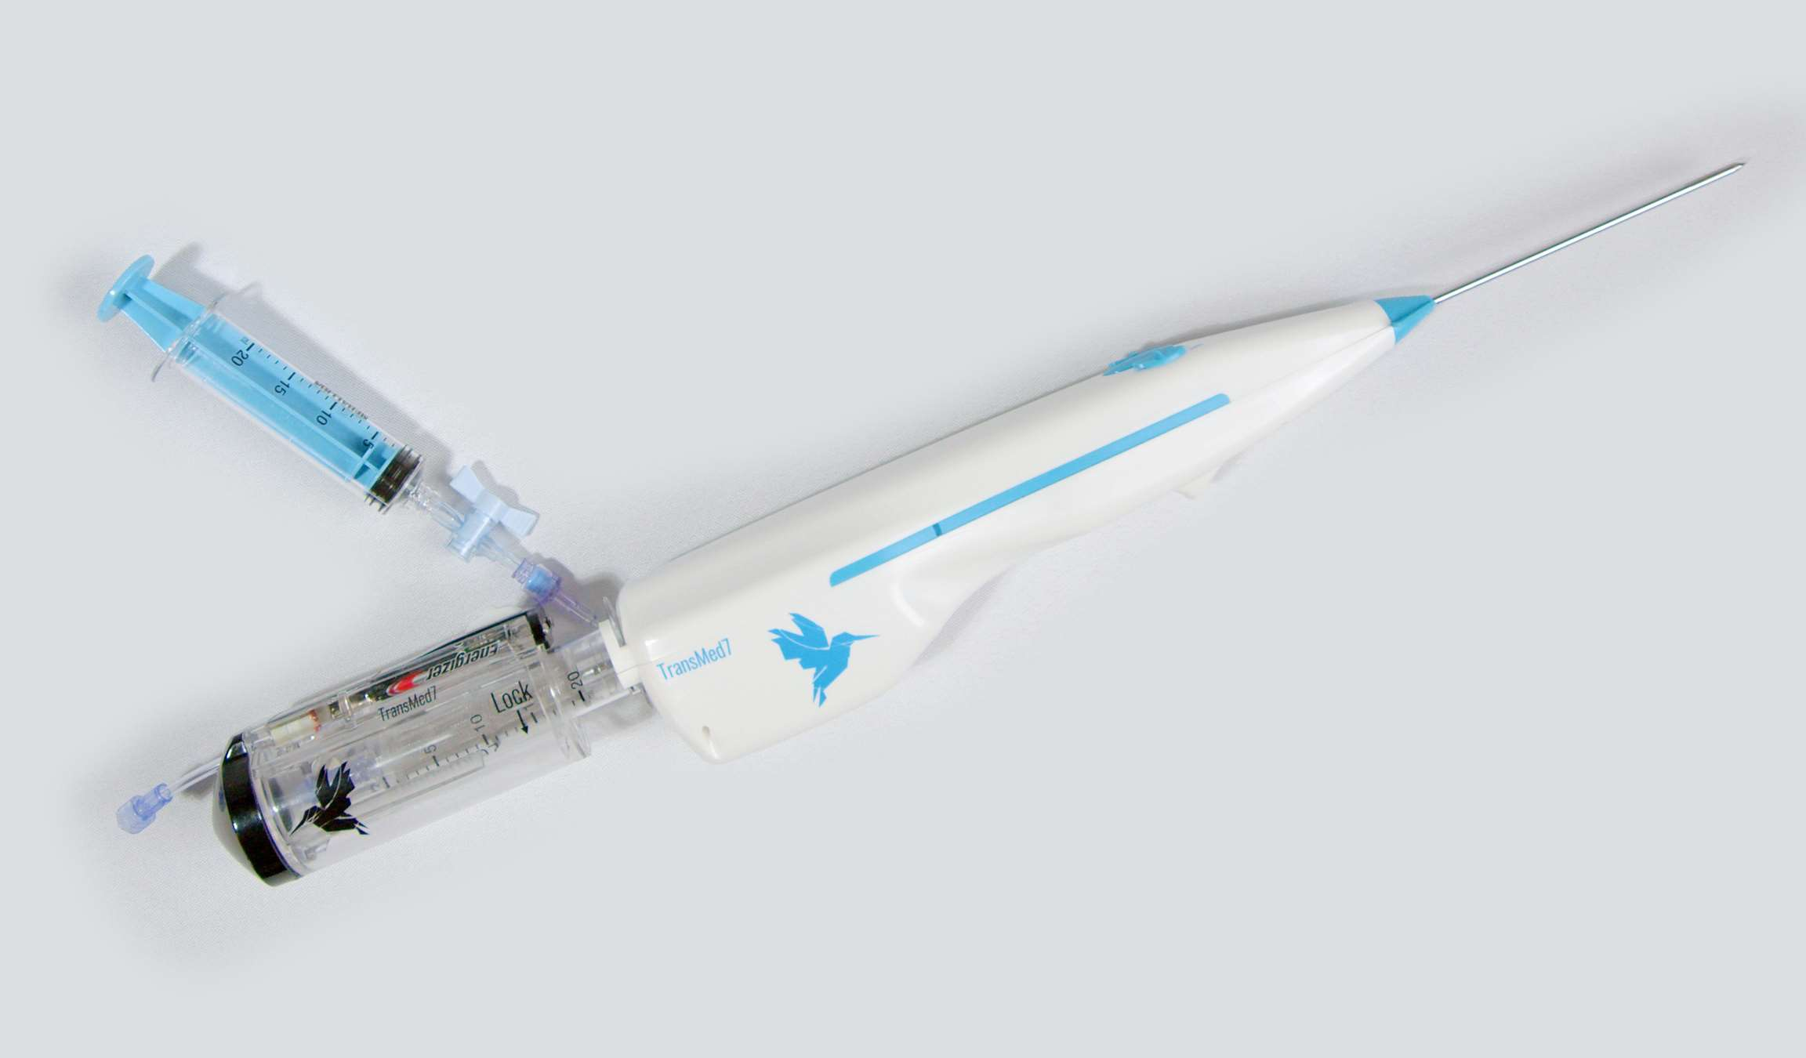

KEY INSIGHTS
MARKET SIZE
2.21 Billion
2022
FORECAST
3.91 Billion
2030
2023-
2030
CAGR
7.2%

Slide 4

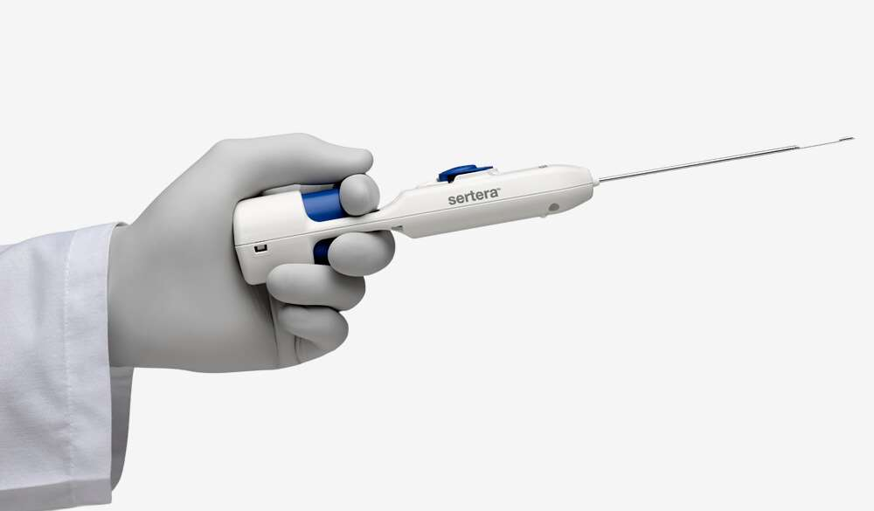
REVENUE MARKET SHARE BY SEGMENTS 2022
By Product: Core Biopsy Devices, Needle-Based Biopsy Instruments, Localization Wires, Aspiration Biopsy Needles, Biopsy Forceps, Vacuum-Assisted Biopsy Devices, and Other Products. (dominated product: Needle-Based Biopsy Instruments)
By Application: Lung biopsy, Breast biopsy, Gastroenterology biopsy, Gynecological biopsy, Prostate biopsy, Kidney biopsy, Liver biopsy, and Others. (dominated application: Breast biopsy)
By Imaging Technology: CT scan, MRI-guided biopsy, Ultrasound-guided biopsy, Stereotactic-guided biopsy, and Others. (dominated Imaging Technology: CT scan)
By End User: Hospitals, Diagnostic & Imaging Centers, and Others. (dominated end user: Hospitals)

Slide 5
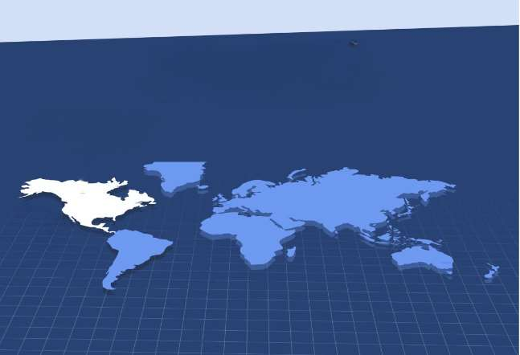
GLOBAL BIOPSY DEVICES MARKET REVENUE SHARE FOR 2022
North America Regional Share
40.6%

Slide 6
  Increasing demand for cancer treatment
  Significant increase in cancer incidence
Drivers
Restraints
Stringent regulations
Restraints

Slide 7
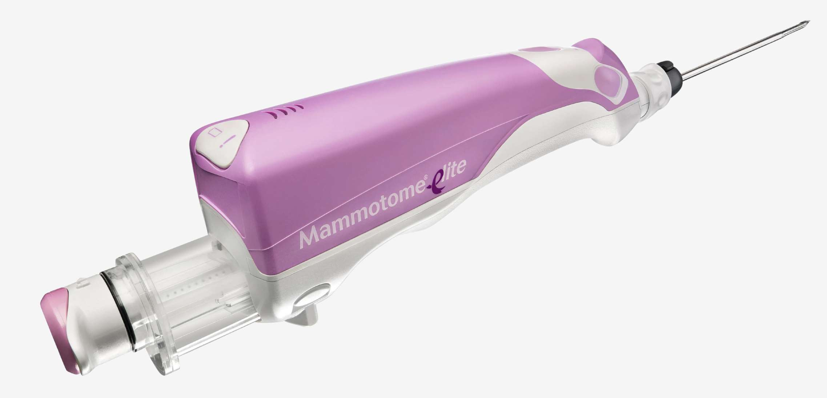
AUTHOR'S PERSPECTIVE
  The market for biopsy devices is expected to grow significantly due to increasing patient awareness of cancer improvement in biopsy procedures
  In 2023, the Needle-based Biopsy Guns segment accounted for noticeable share of global Biopsy Devices Market and is projected to experience significant growth in the near future.

Slide 8




KEY PLAYERS

Slide 9


For Full Report
Contact us
COGNITIVE MARKET RESEARCH
Tel: +1 312-376-8303 | +44 020-8123-0732
India: (+91) 983-496-8611
sales@cognitivemarketresearch.com
Access the Full Report : https://shorturl.at/lnvzN
Please visit our website:
https://www.cognitivemarketresearch.com

