Slide 1

GLOBAL
BIOACTIVE PROTEIN
MARKET REPORT
2024
Global,Regional,CountryAnalysis

Slide 2

INTRODUCTION
Bioactive proteins are specialized molecules with unique functional properties that actively engage in physiological processes within living organisms. These proteins play pivotal roles in cellular signalling, immune responses, and metabolic functions. Their distinct structures and interactive capabilities contribute to overall health, making them essential components for various biological activities. The Bioactive Protein market is set to experience growth in the coming years driven by a combination of factors that highlight its potential across various industries. As people worldwide become increasingly aware of their health and well-being they are seeking products that not provide nourishment but also offer health benefits.

Slide 3


KEY INSIGHTS
CAGR
9.20%
2023- 2030

Slide 4

REVENUE MARKET SHARE BY SEGMENTS 2022
  Functional Food
  Dietary Supplements
  Pharmaceuticals
  Animal Feed
  Others
Application Segment
  Liquid
  Powder
  Capsule
Form Segment

Slide 5

Global Bioactive Protein Market Revenue share for 2024
North America
40%

Slide 6
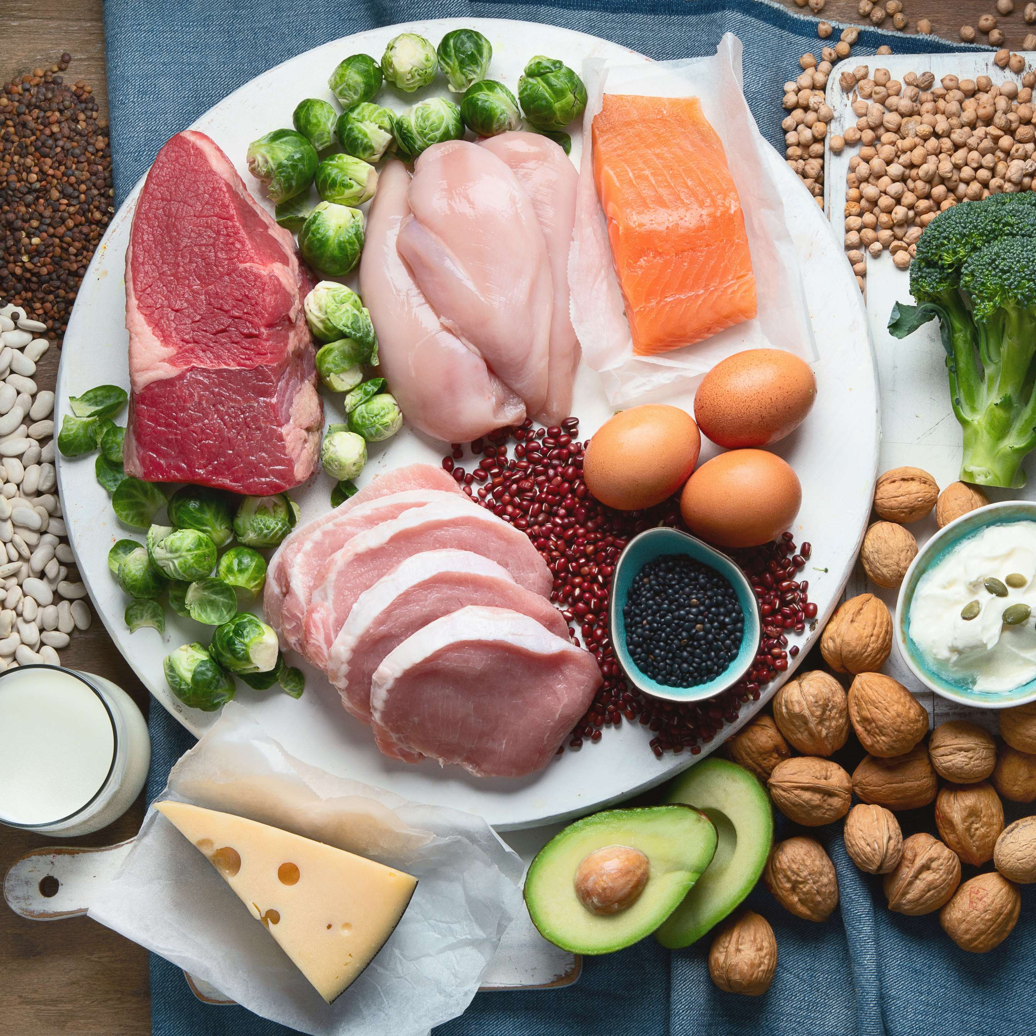
Rising Demand for Personalized Nutrition to Increase the Sales of Bioactive Proteins
Drivers
High Production Costs to Limit the Growth of Bioactive Protein Market
Restraints

Slide 7

AUTHOR'S PERSPECTIVE
  The global bioactive protein market will expand significantly by 5.80% CAGR between 2023 and 2030.
  Milk peptide is leading the market due to their recognized bioactive properties and versatile applications, particularly in functional foods and dietary supplements.
  The increasing preference for plant-derived proteins, driven by environmental consciousness and health considerations, propels the demand for plant-sourced bioactive proteins.
  North American bioactive protein will continue to lead, whereas the Asia-Pacific bioactive protein market will experience the most substantial growth until 2030.

Slide 8







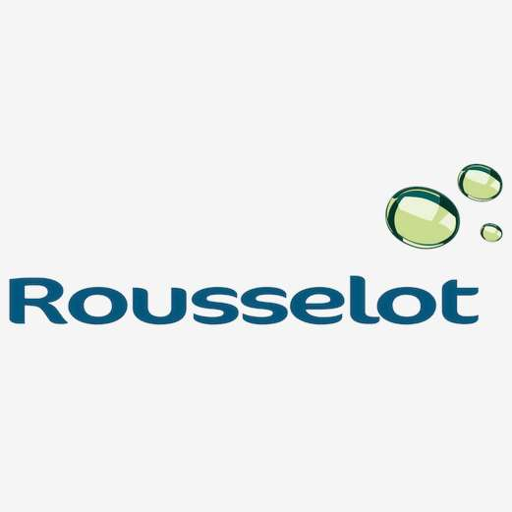



KEY PLAYERS

Slide 9


For Full Report
Contact us
COGNITIVE MARKET RESEARCH
Tel: +1 312-376-8303 | +44 020-8123-0732
India: (+91) 983-496-8611
sales@cognitivemarketresearch.com
Access the Full Report : http://tinyurl.com/wtymw5at
Please visit our website:
https://www.cognitivemarketresearch.com

