Slide 1
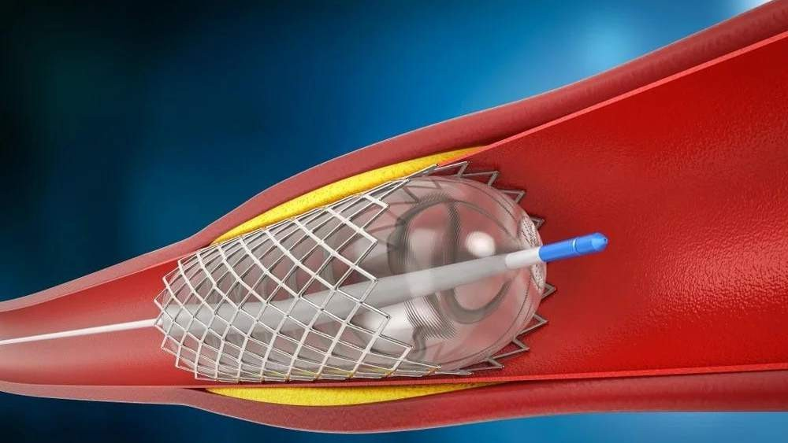
BIOABSORBABLE STENTS MARKET REPORT 2024

Slide 2

INTRODUCTION
The bioabsorbable stents market refers to the global industry that deals with the development, manufacturing, and commercialization of stents made from bioabsorbable materials. Stents are small, tubular devices used to treat narrow or blocked blood vessels by providing support and maintaining their open structure.

Slide 3
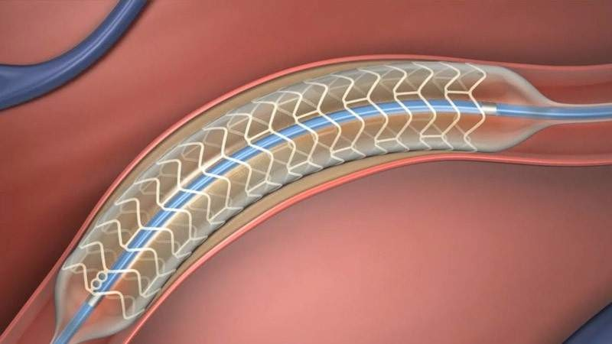




KEY INSIGHTS
MARKET SIZE
417.2 Million
2022
FORECAST
996.7 million
2030
2023-
2030
CAGR 11.5%

Slide 4



REVENUE MARKET SHARE BY SEGMENTS 2022
By Material:Bioresorbable polymer-based stents (Dominated),Bioresorbable metallic stents
By Absorption rate:Slow-absorption stents,Fast-absorption stents (dominated)
By Application:Coronary Artery Diseases (Dominated),Peripheral Artery Diseases
By End-user:Hospitals,Cardiac Centers(dominated)

Slide 5
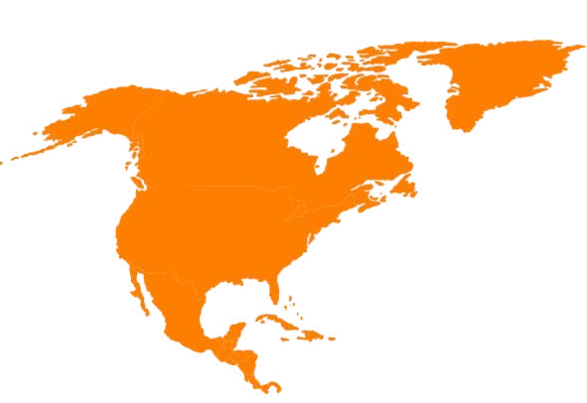
GLOBAL BIOABSORBABLE STENTS MARKET REVENUE SHARE FOR 2022
North America
46.6%

Slide 6
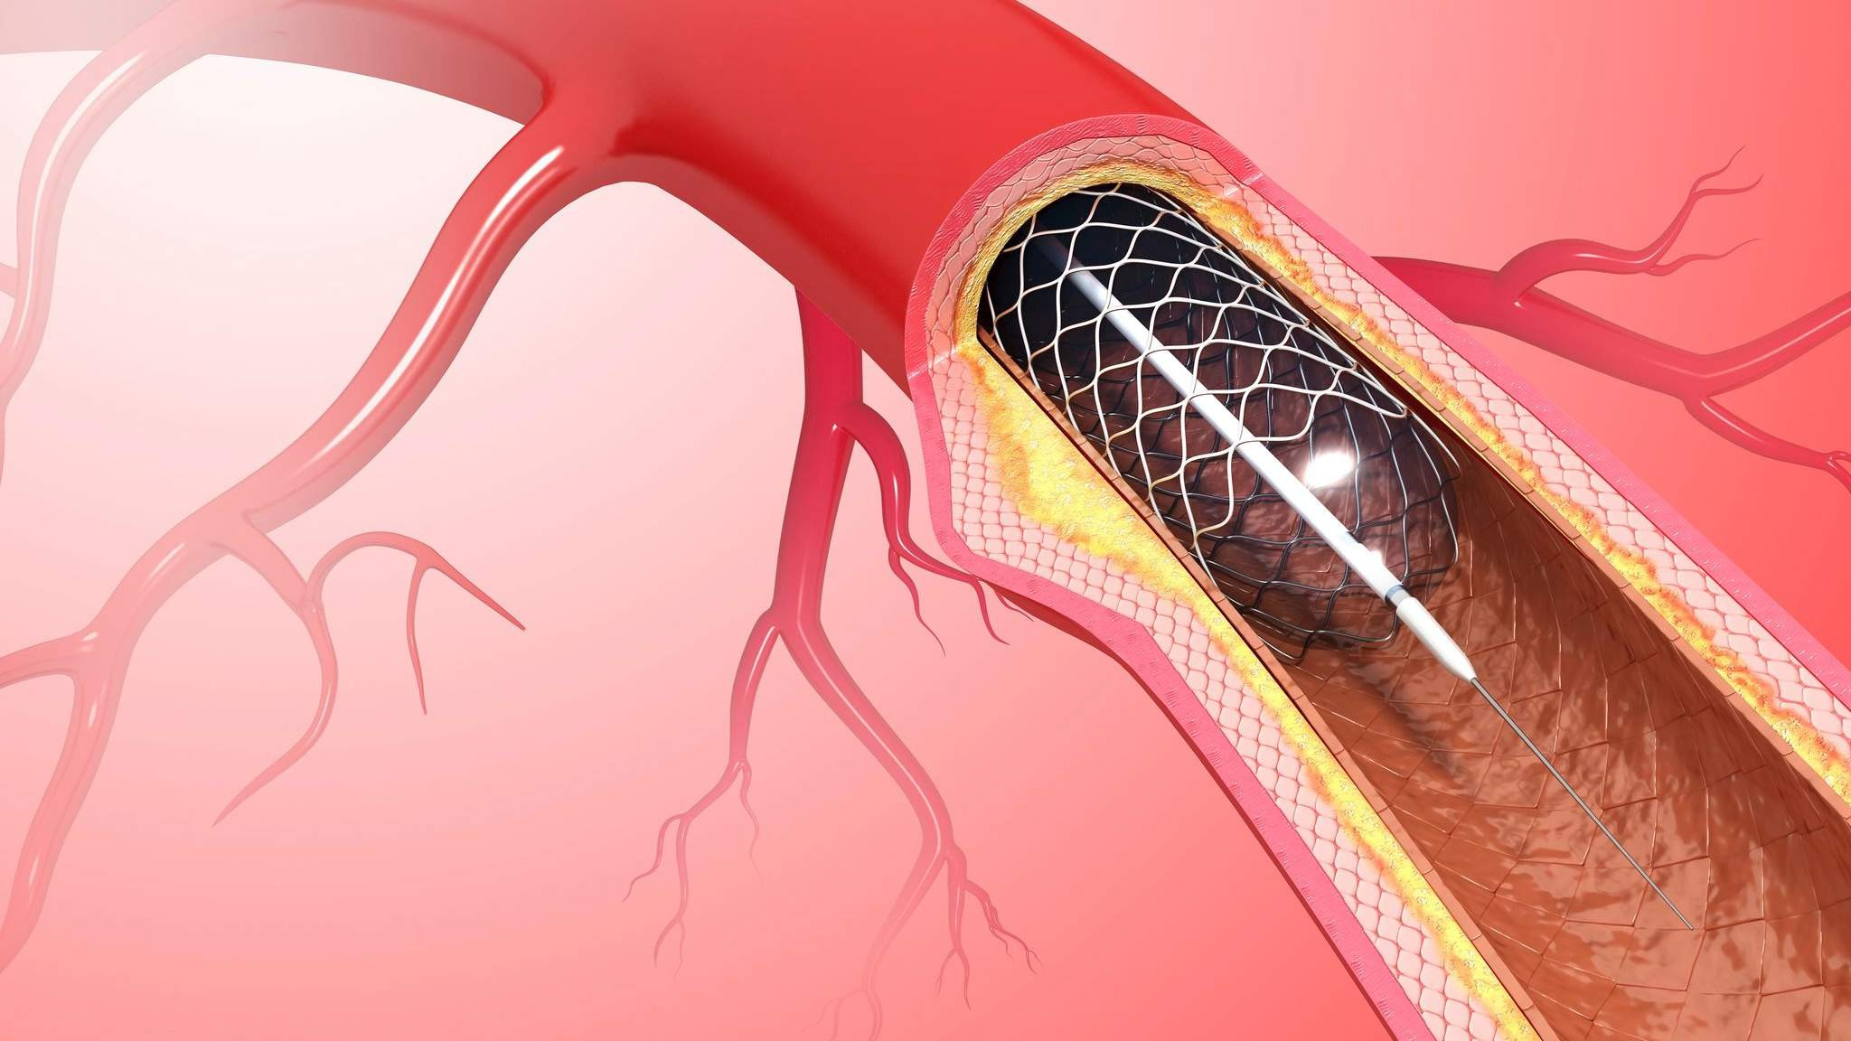
Reduced risk of long- term complications
Increasing prevelance of coronory disese
Drivers
_{Restraints} Limited clinical
evidence

Slide 7
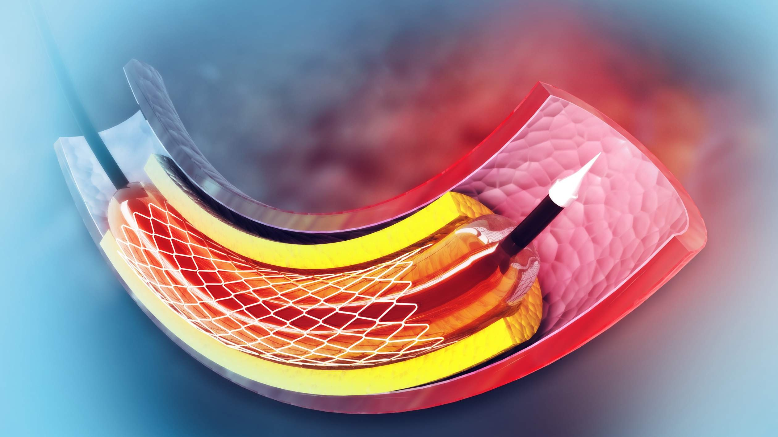
AUTHOR'S PERSPECTIVE
The market for bioabsorbable stents is expected to grow significantly due to focus on improved clinical outcomes.
In 2023, the Bioresorbable polymer-based stents segment accounted for
noticeable share of global Bioabsorbable Stents Market and is projected to experience significant growth in the near future.
The Coronary Artery Diseases segment is expected to expand at the significant CAGR retaining position throughout the forecast period.

Slide 8
KEY PLAYERS

Slide 9


Contact us
For Full Report
COGNITIVE MARKET RESEARCH
Tel: + 1 312 - 376 - 8303 | + 44 020 - 8123 - 0732
India: ( + 91 ) 983 - 496 - 8611
sales@ cognitivemarketresearch. com
Access the Full Report : http://tinyurl.com/33vptmfx
Please visit our website:
https://www.cognitivemarketresearch.com

