Slide 1
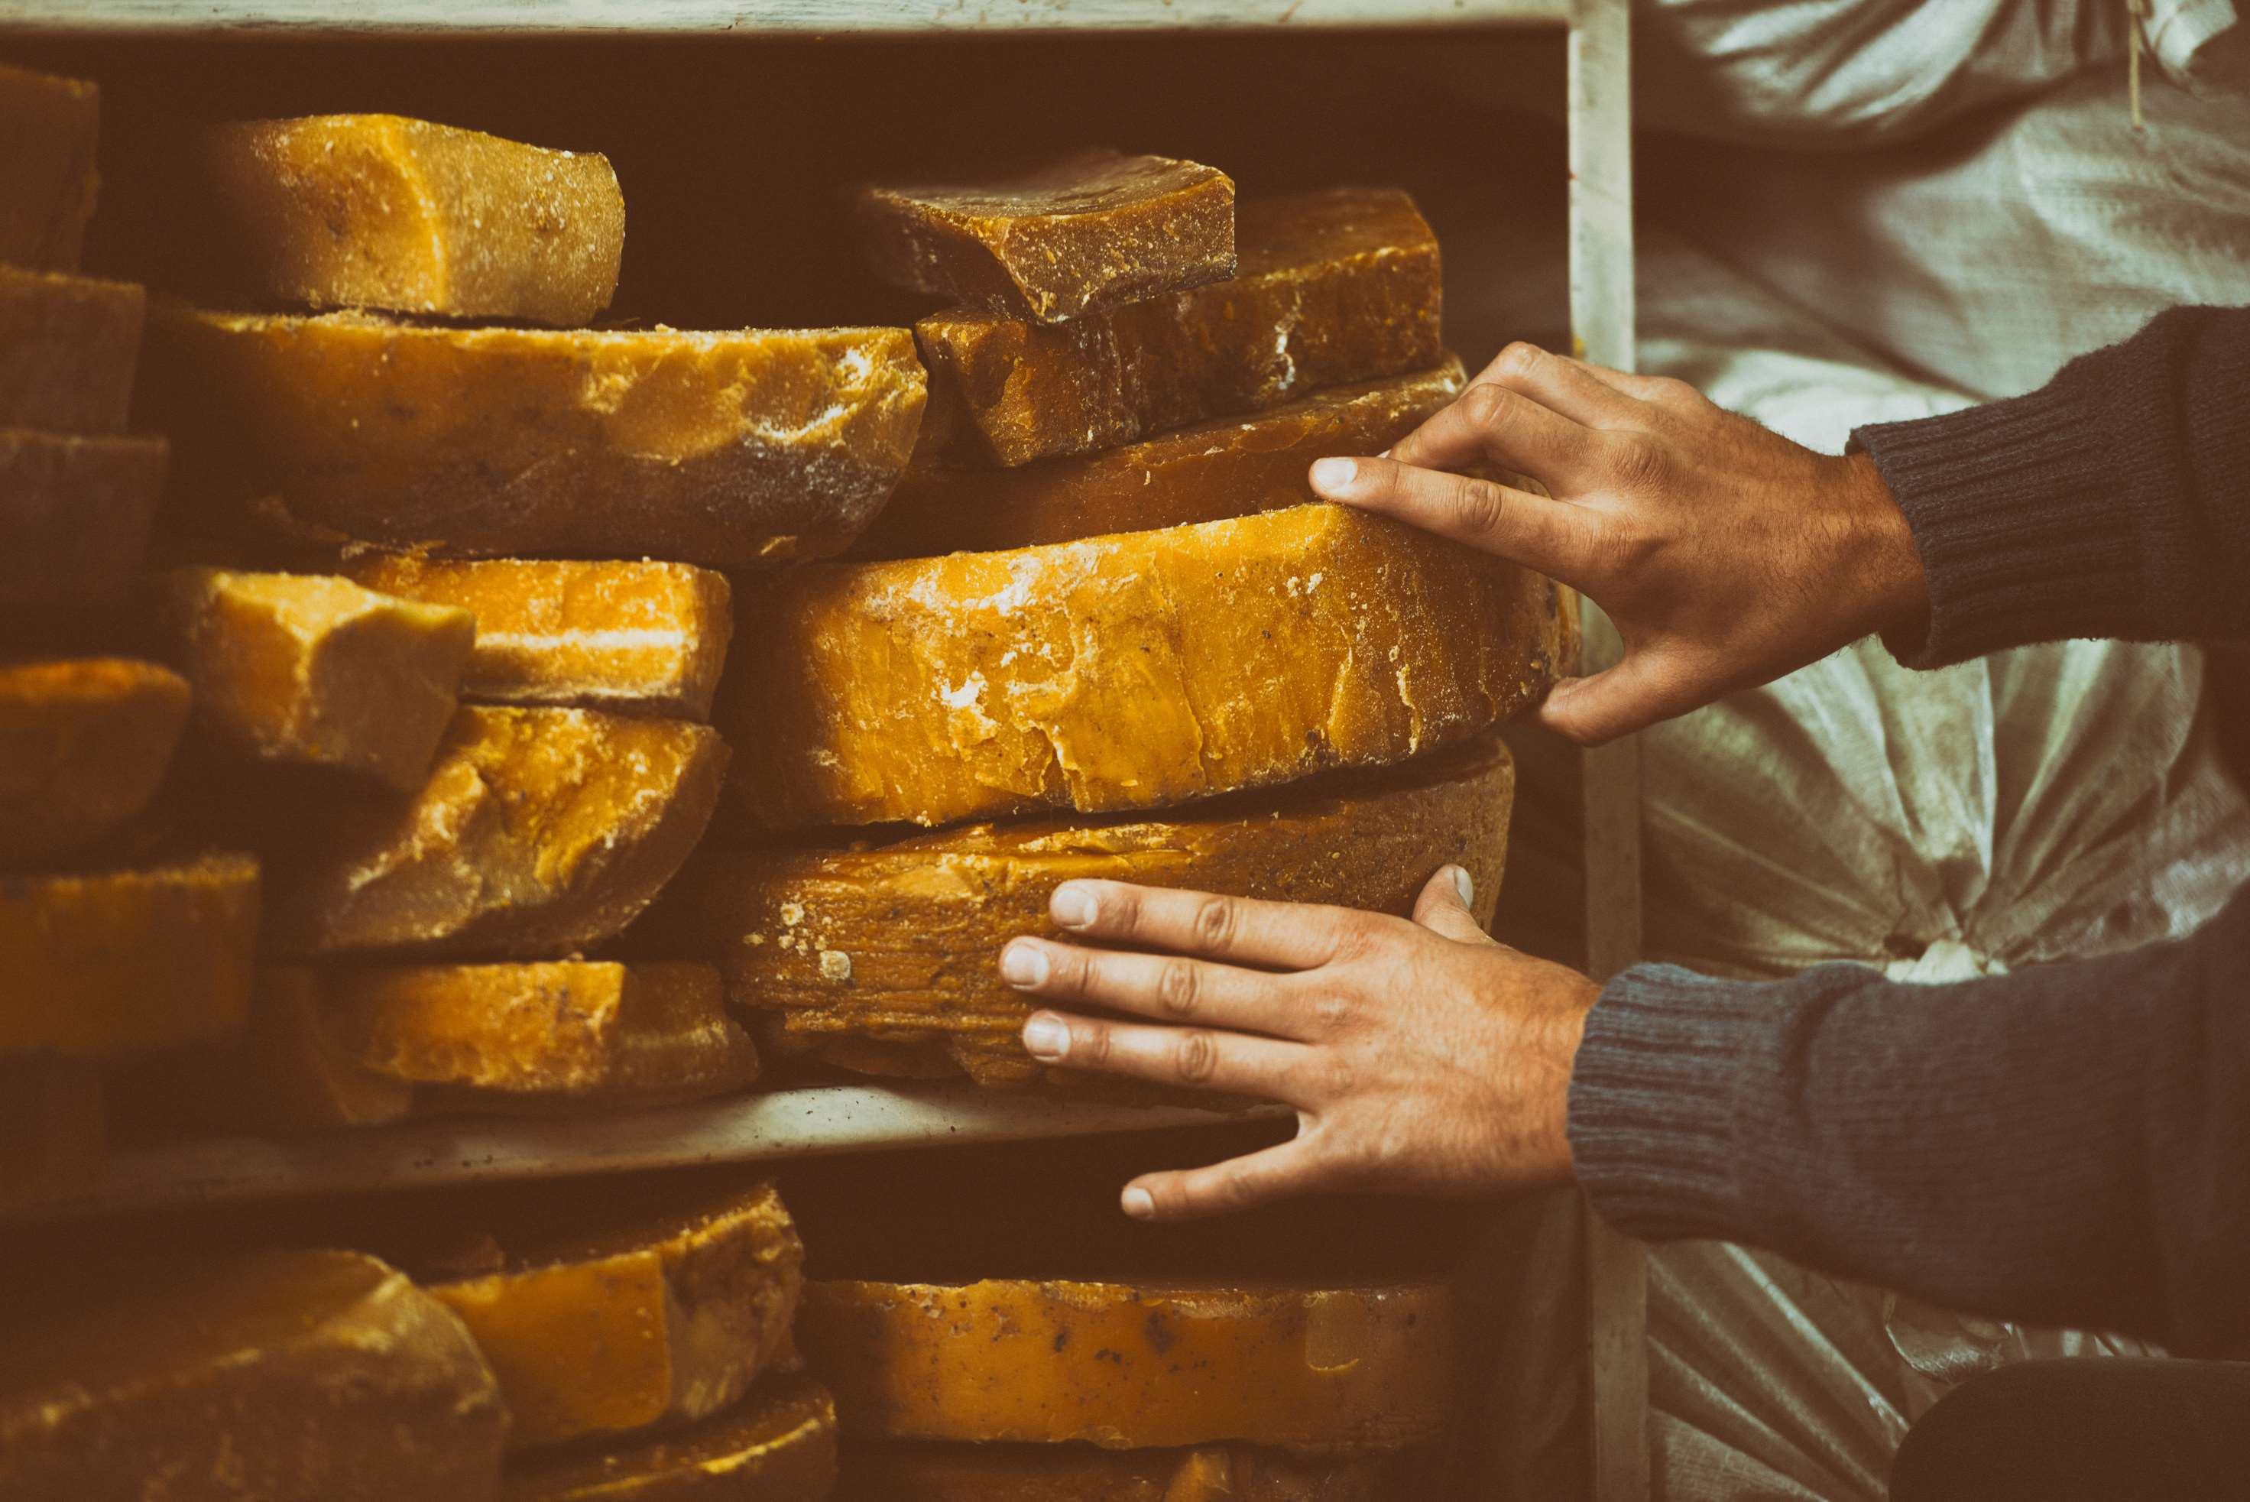
GLOBAL BEESWAX
MARKETREPORT
2024
Global,Regional,CountryAnalysis

Slide 2
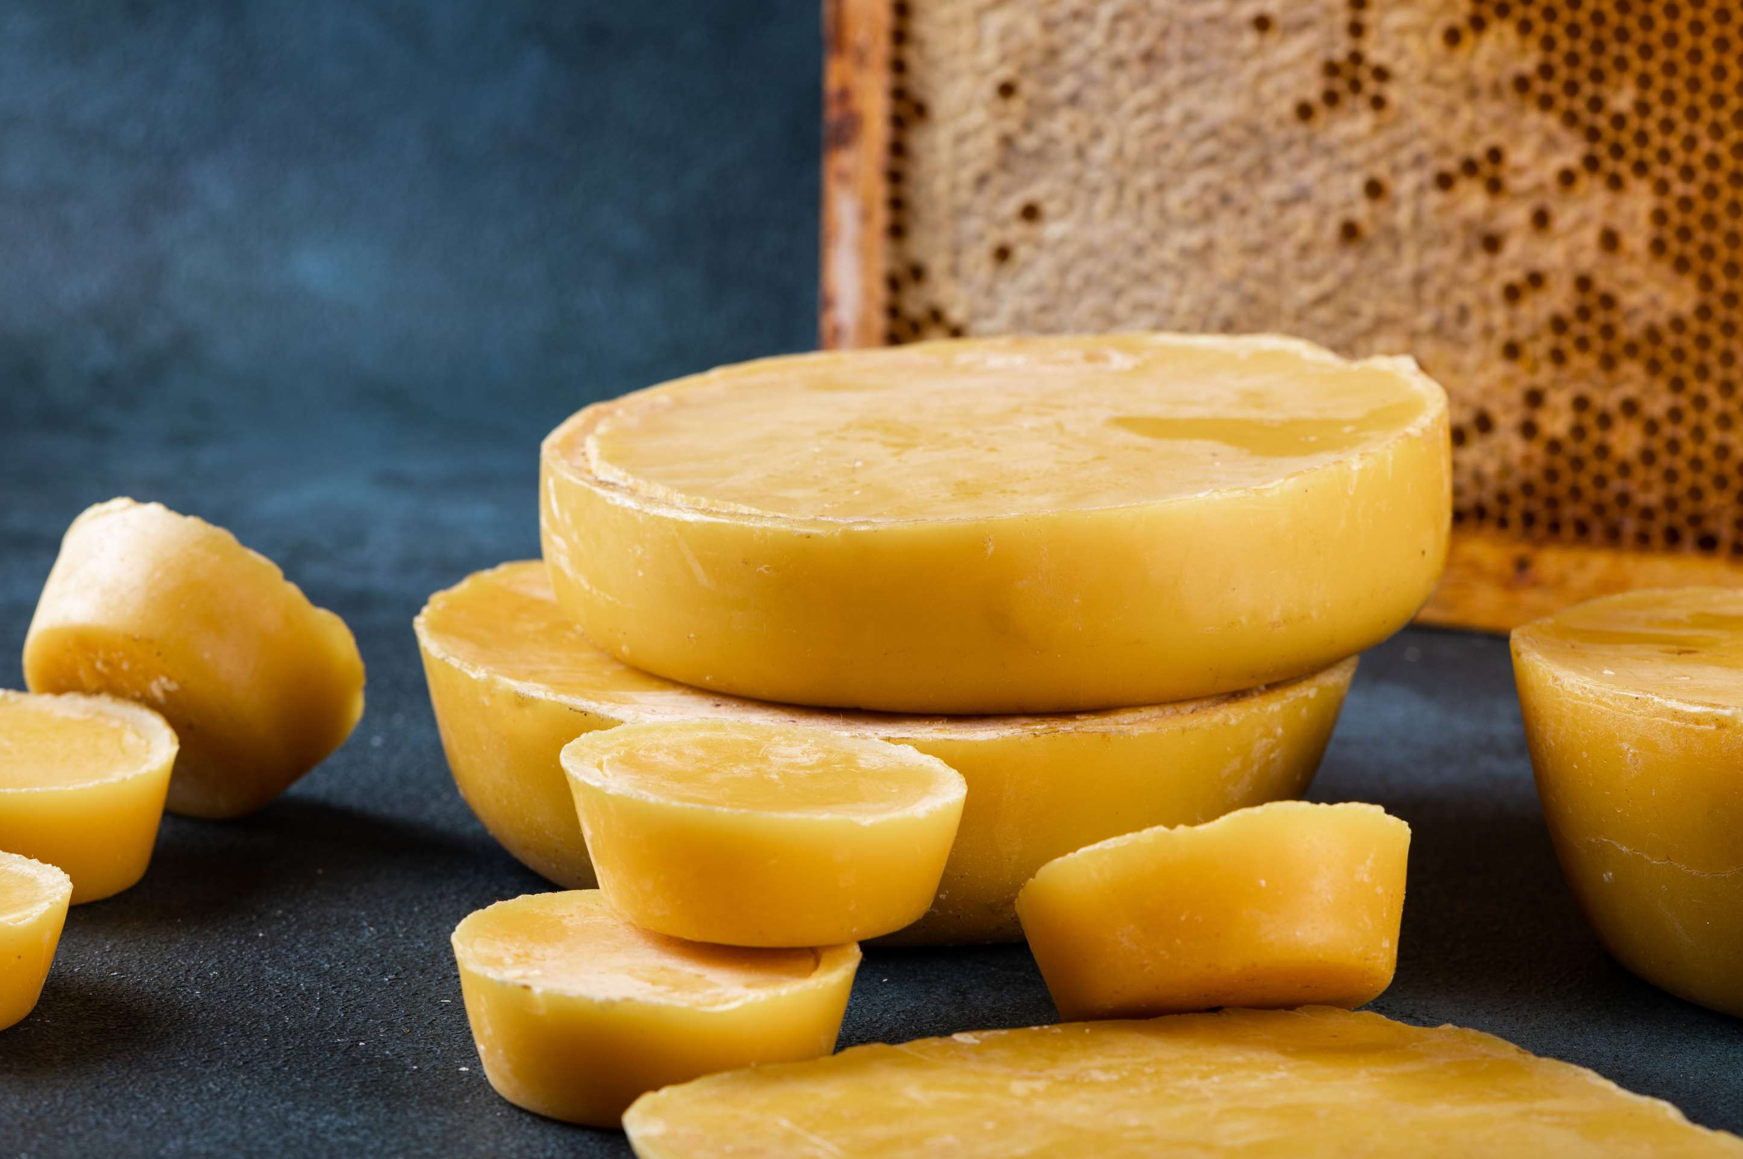
INTRODUCTION
Beeswax is a substance derived from the honeycomb of honeybees and other bees. The incorporation of pollen oils into honeycomb wax transforms the white wax into a yellow or brown tint.Beeswax is commonly available in yellow, white, or bleached forms. Yellow beeswax is extracted straight from the honeycomb, whereas white and bleached beeswax are derived from yellow beeswax. Man-made beeswax imitations have been created to resemble natural beeswax.

Slide 3
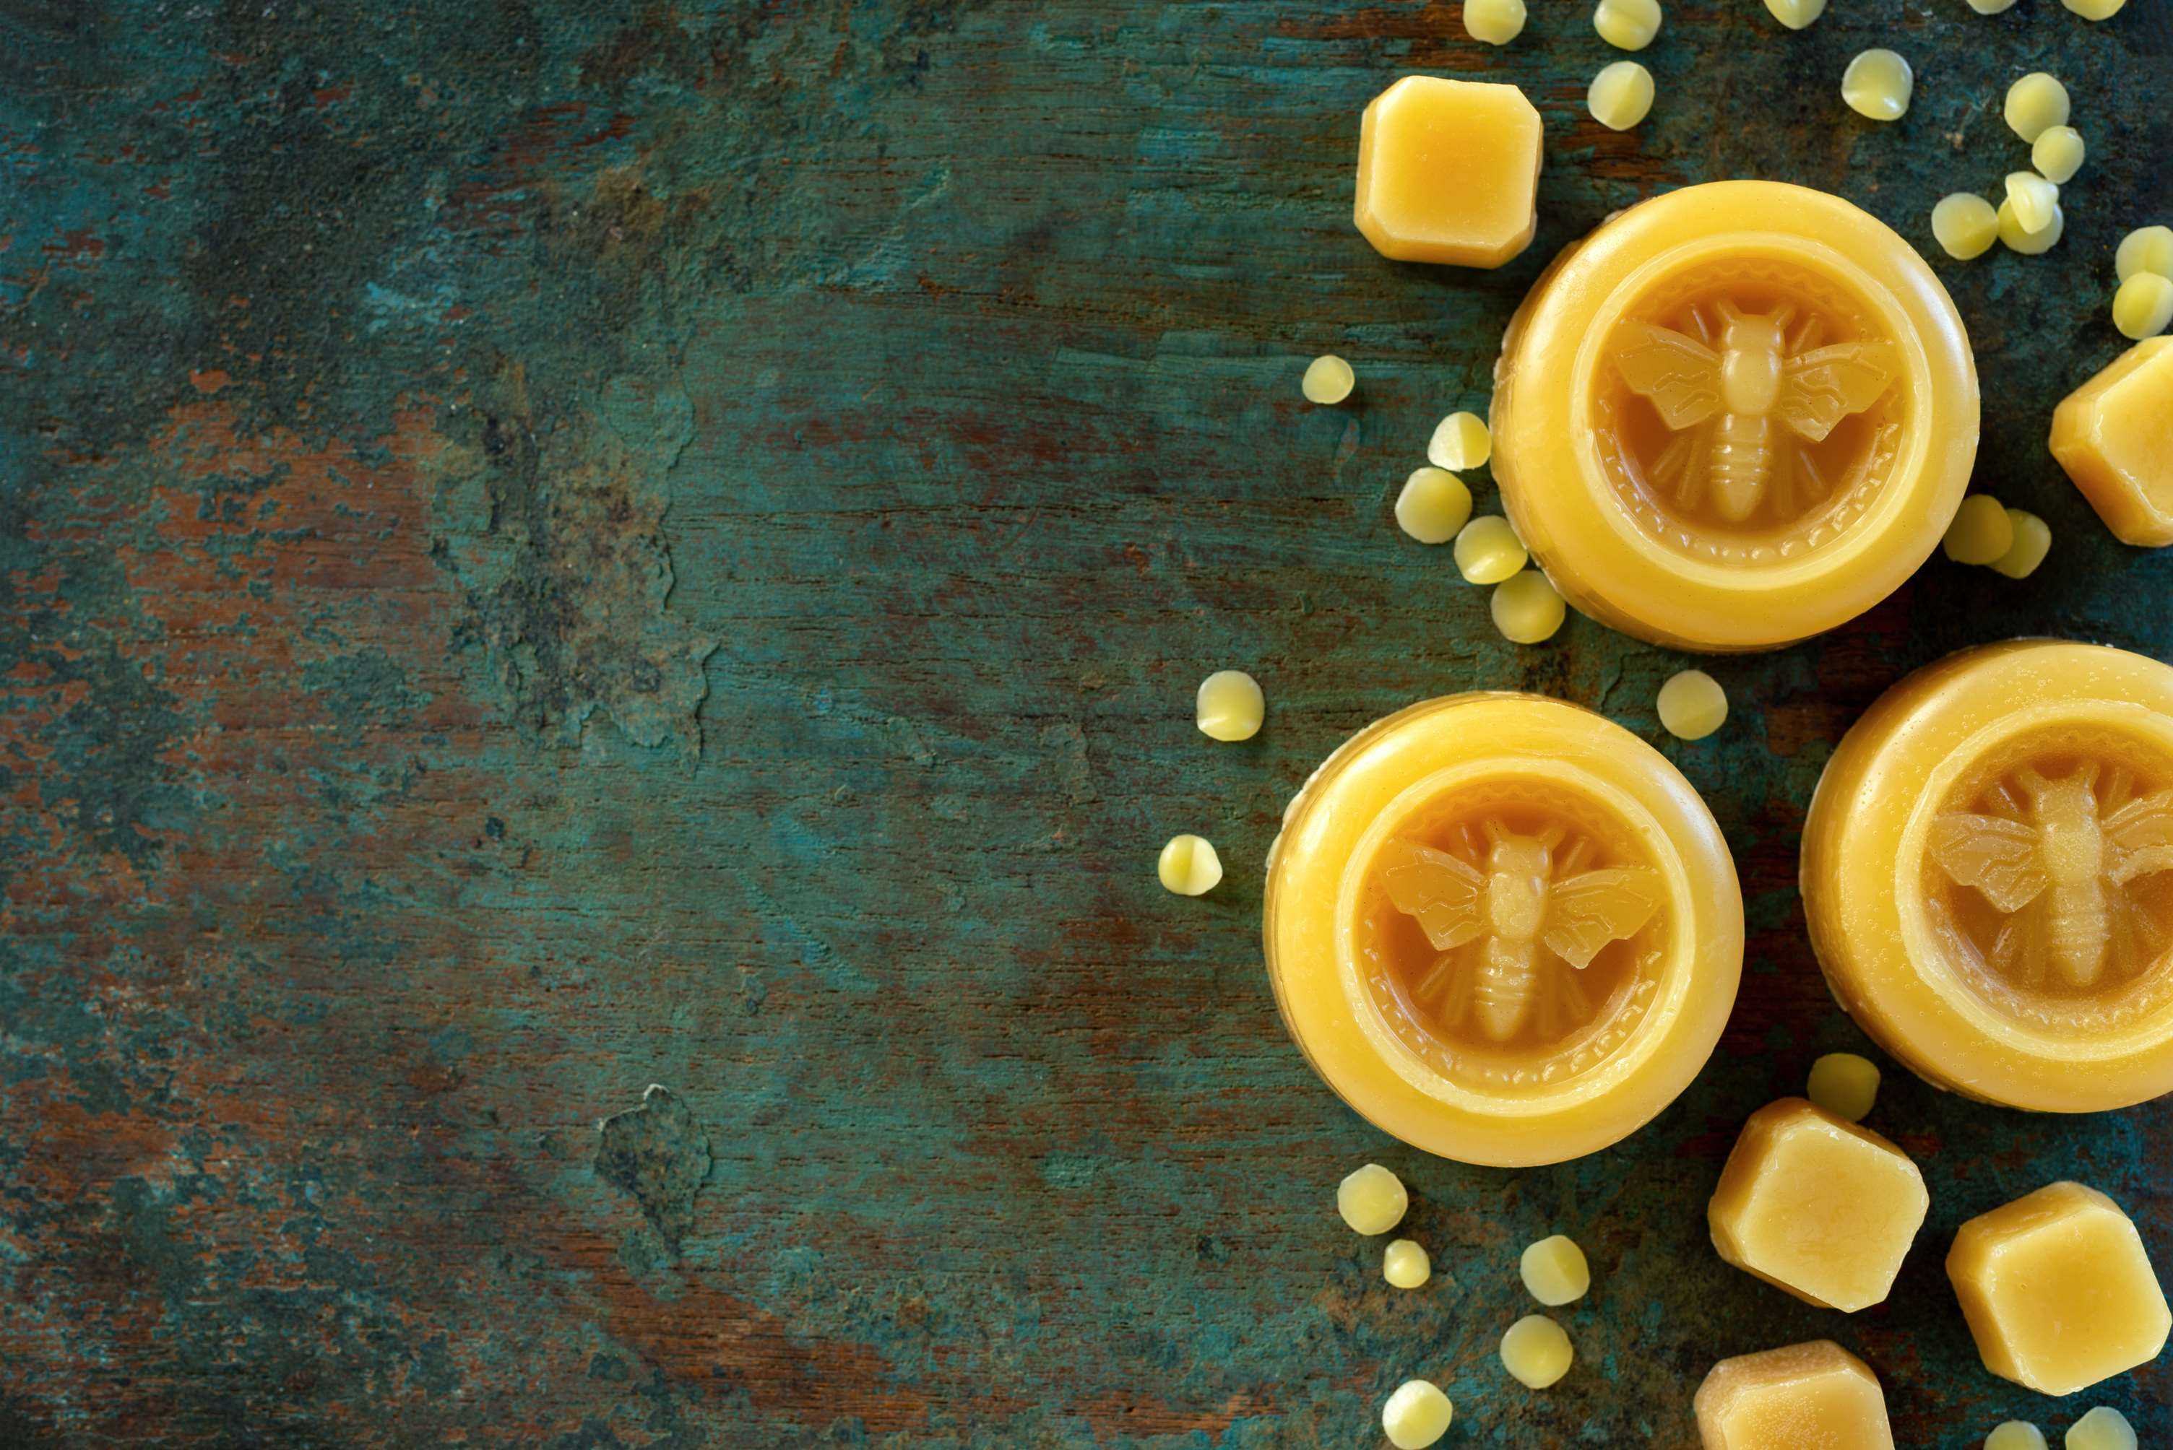

KEY INSIGHTS
MARKET SIZE
USD 523.65 Million
2017
FORECAST
USD 733.63 Million
2028
CAGR
3.81%
2023- 2030

Slide 4
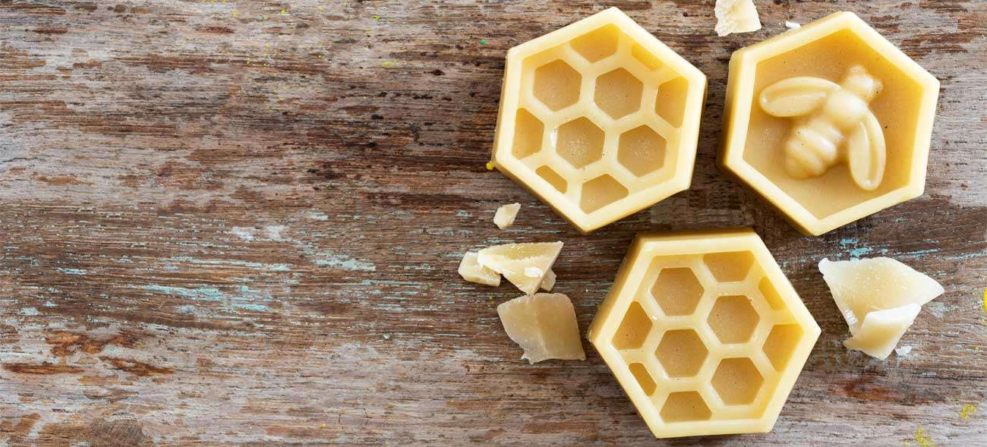
REVENUE MARKET SHARE BY SEGMENTS 2022
Type Segment
Yellow Beeswax
USD 303.41 Million
By Application
Cosmetic & Personal Care
USD 229.43 Million

Slide 5
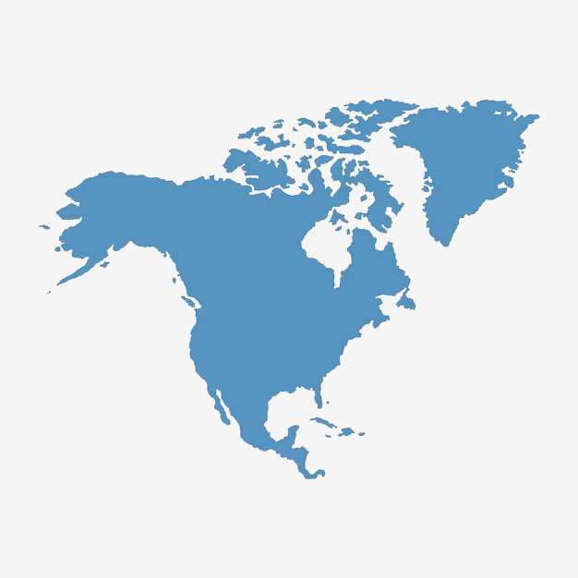
Global Beeswax Market Revenue share for 2022
North America
USD 189.41 Million

Slide 6
Rising cosmetic and personal care industry
Drivers
Side effect associated with high consumption
Restraints

Slide 7

AUTHOR'S PERSPECTIVE
  The Global Beeswax Market revenue in 2017: USD 523.65 Million
  White Beeswax held for largest share of total revenue generated in 2020
  Cosmetic & Personal Care held maximum share of Beeswax market in 2020
  Rising cosmetic and personal care industry and inclination towards healthy and natural food products drives the growth of the beeswax market
  Side effect associated with high consumption hamper the growth of the beeswax market
  Rapid industrialization will stimulate the growth of the beeswax market

Slide 8
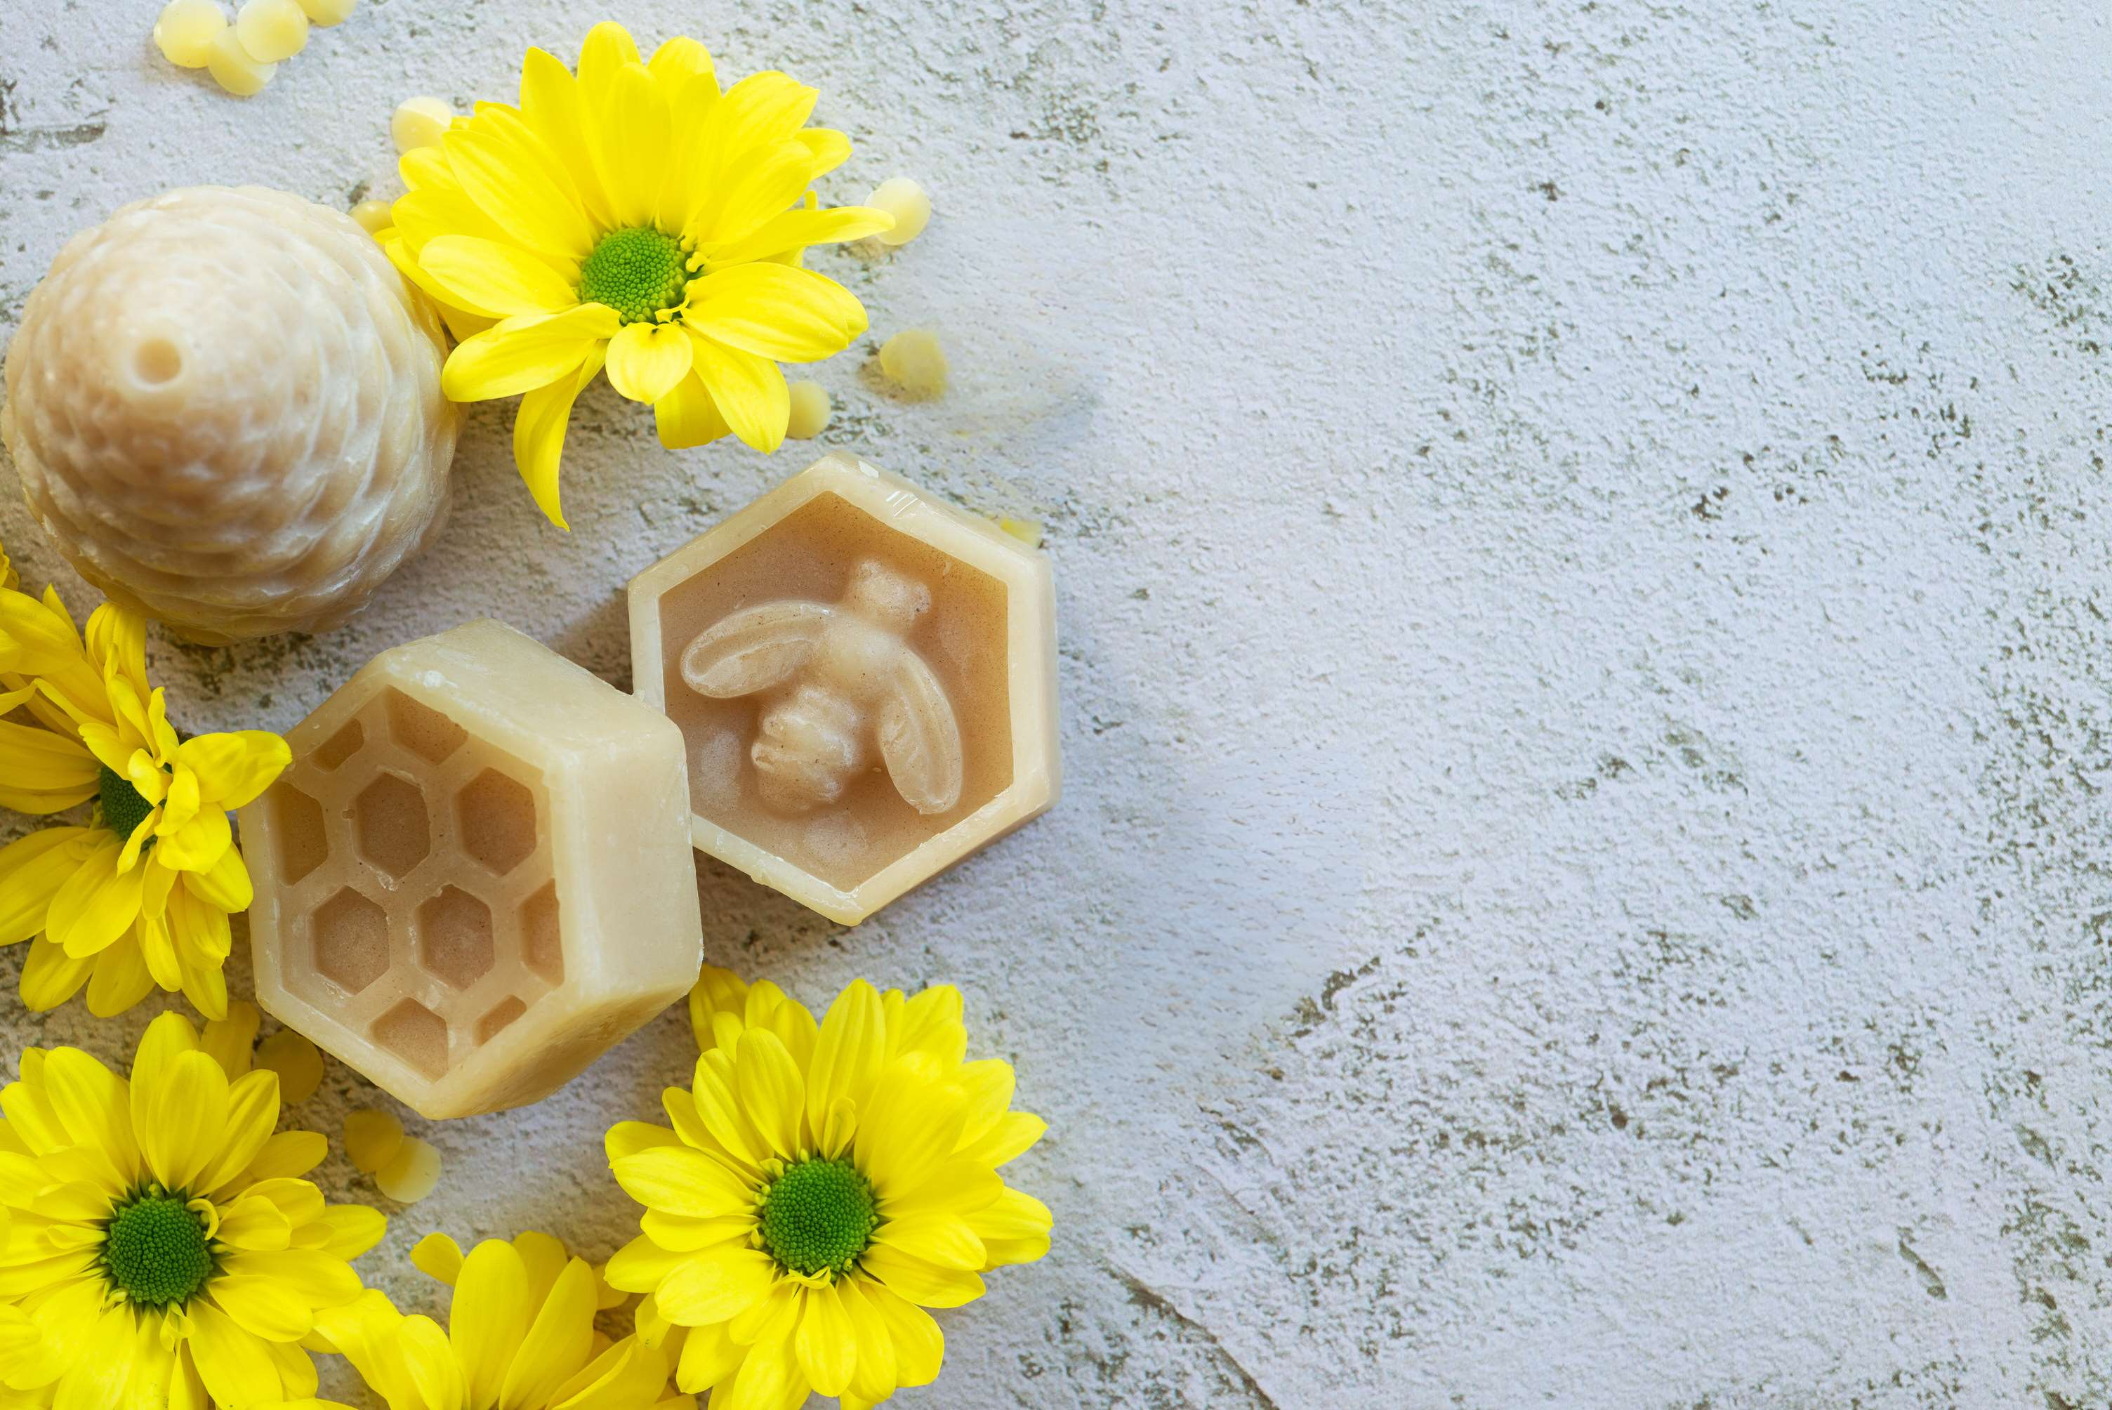

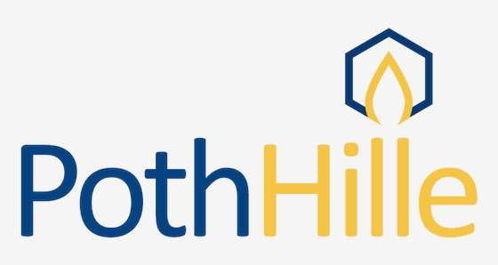




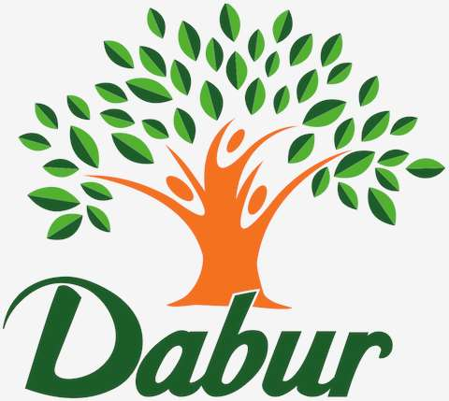






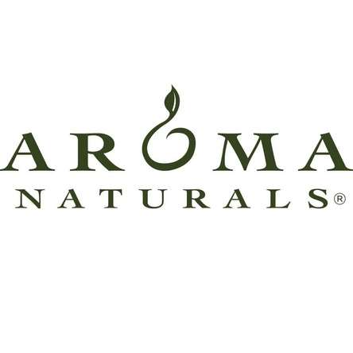

KEY PLAYERS

Slide 9
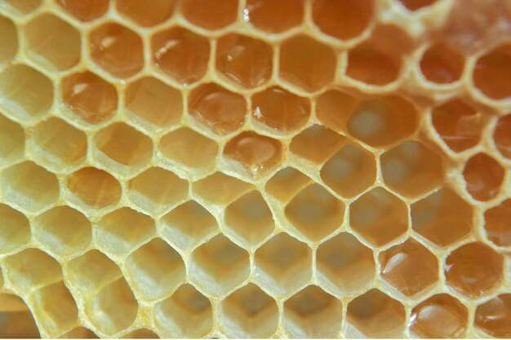

For Full Report
Contact us
COGNITIVE MARKET RESEARCH
Tel: +1 312-376-8303 | +44 020-8123-0732
India: (+91) 983-496-8611
sales@cognitivemarketresearch.com
Access the Full Report : https://tinyurl.com/3d9nx86s
Please visit our website:
https://www.cognitivemarketresearch.com

