Slide 1
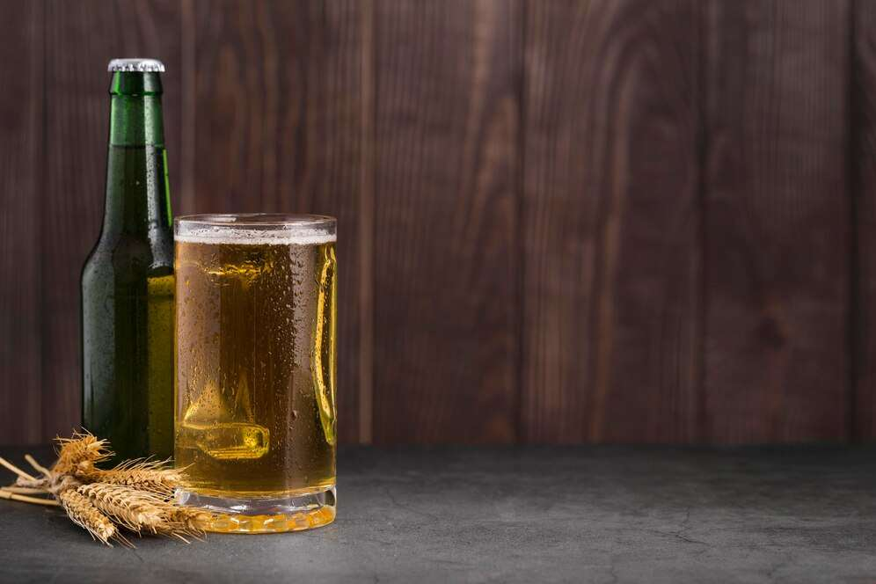
GLOBAL
BEER AND CIDER
MARKET REPORT
2024
Global,Regional,CountryAnalysis

Slide 2
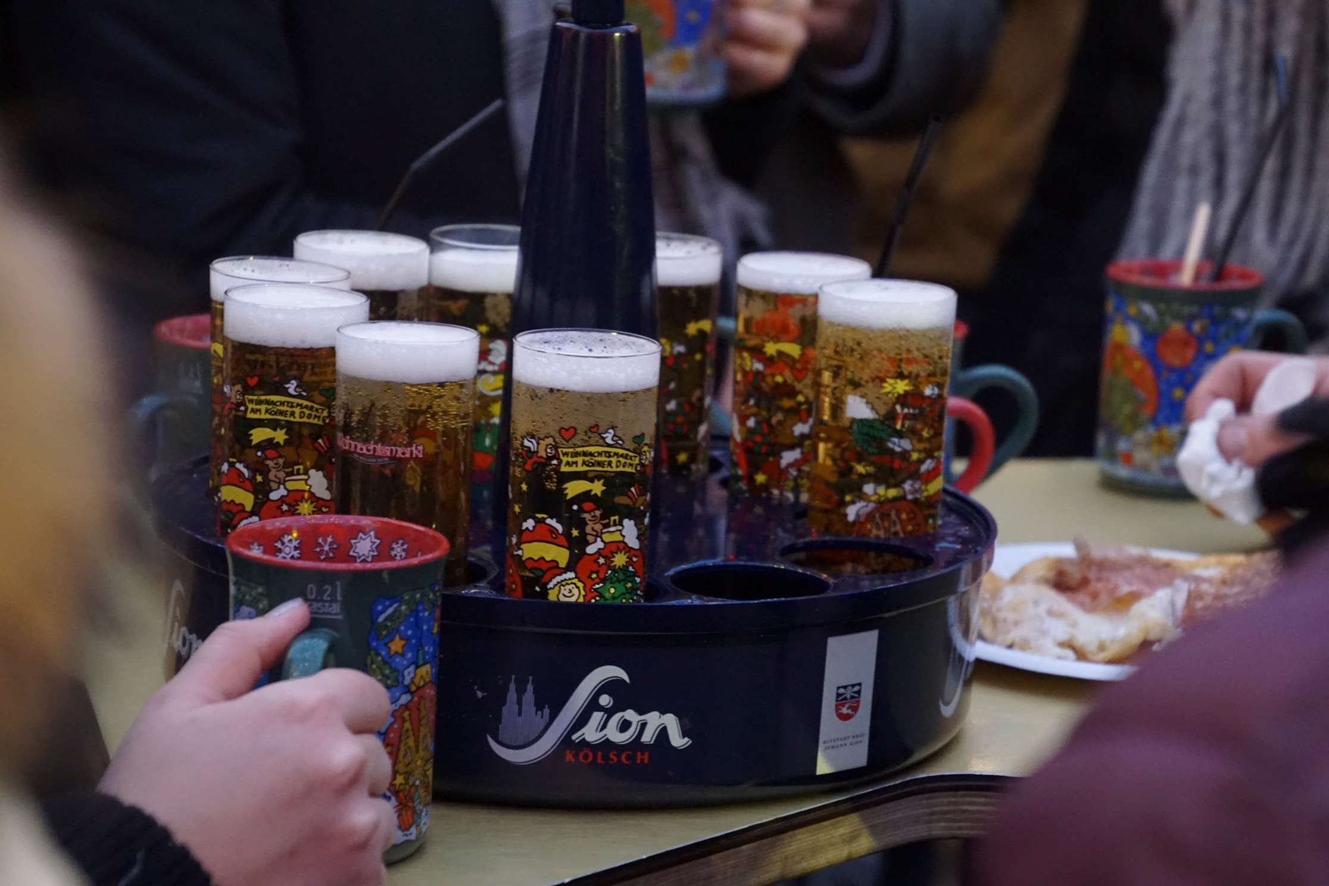
INTRODUCTION
The manufacture, distribution, and consumption of alcoholic beverages made from fermented grains (beer) or fermented fruits (cider) are all included in the beer and cider market. These drinks are available in various forms, tastes, and alcohol concentrations to suit consumers' tastes across the globe. Large multinational firms, local breweries, and craft cideries coexist in the market, each providing distinctive goods to satisfy consumer demand. Changing customer preferences, movements toward premiumization and artisan items, regulatory frameworks, and economic concerns are some of the major variables affecting the market. Furthermore, the market is being impacted by sustainability issues more and more, with a focus on environmentally friendly packaging and production methods. The market for beer and cider is a vibrant, changing sector of the economy that is influenced by social, cultural, and political factors.

Slide 3
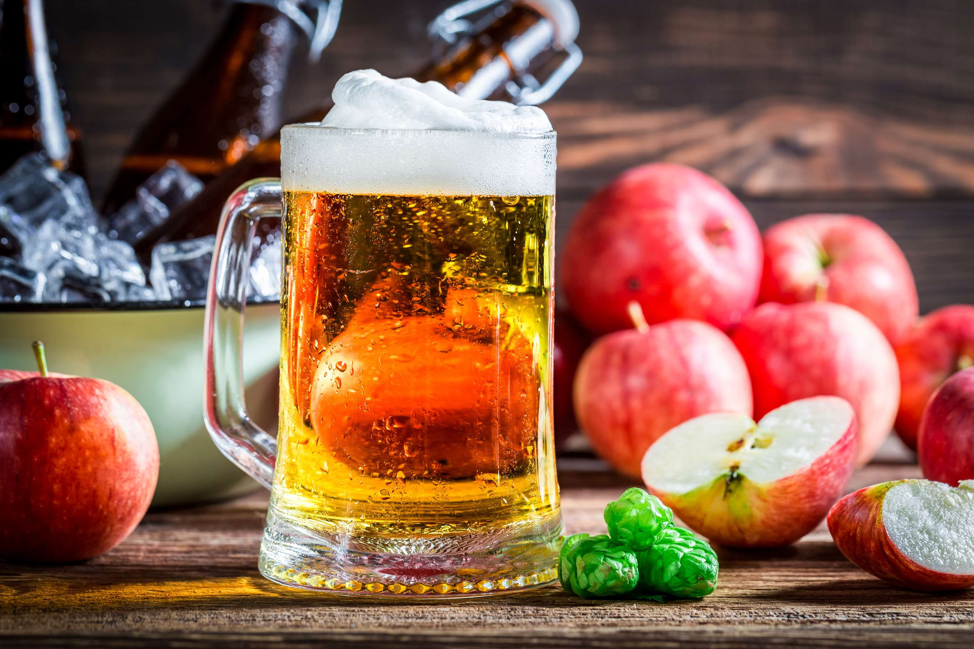

KEY INSIGHTS
CAGR
5.00%
2024- 2031

Slide 4
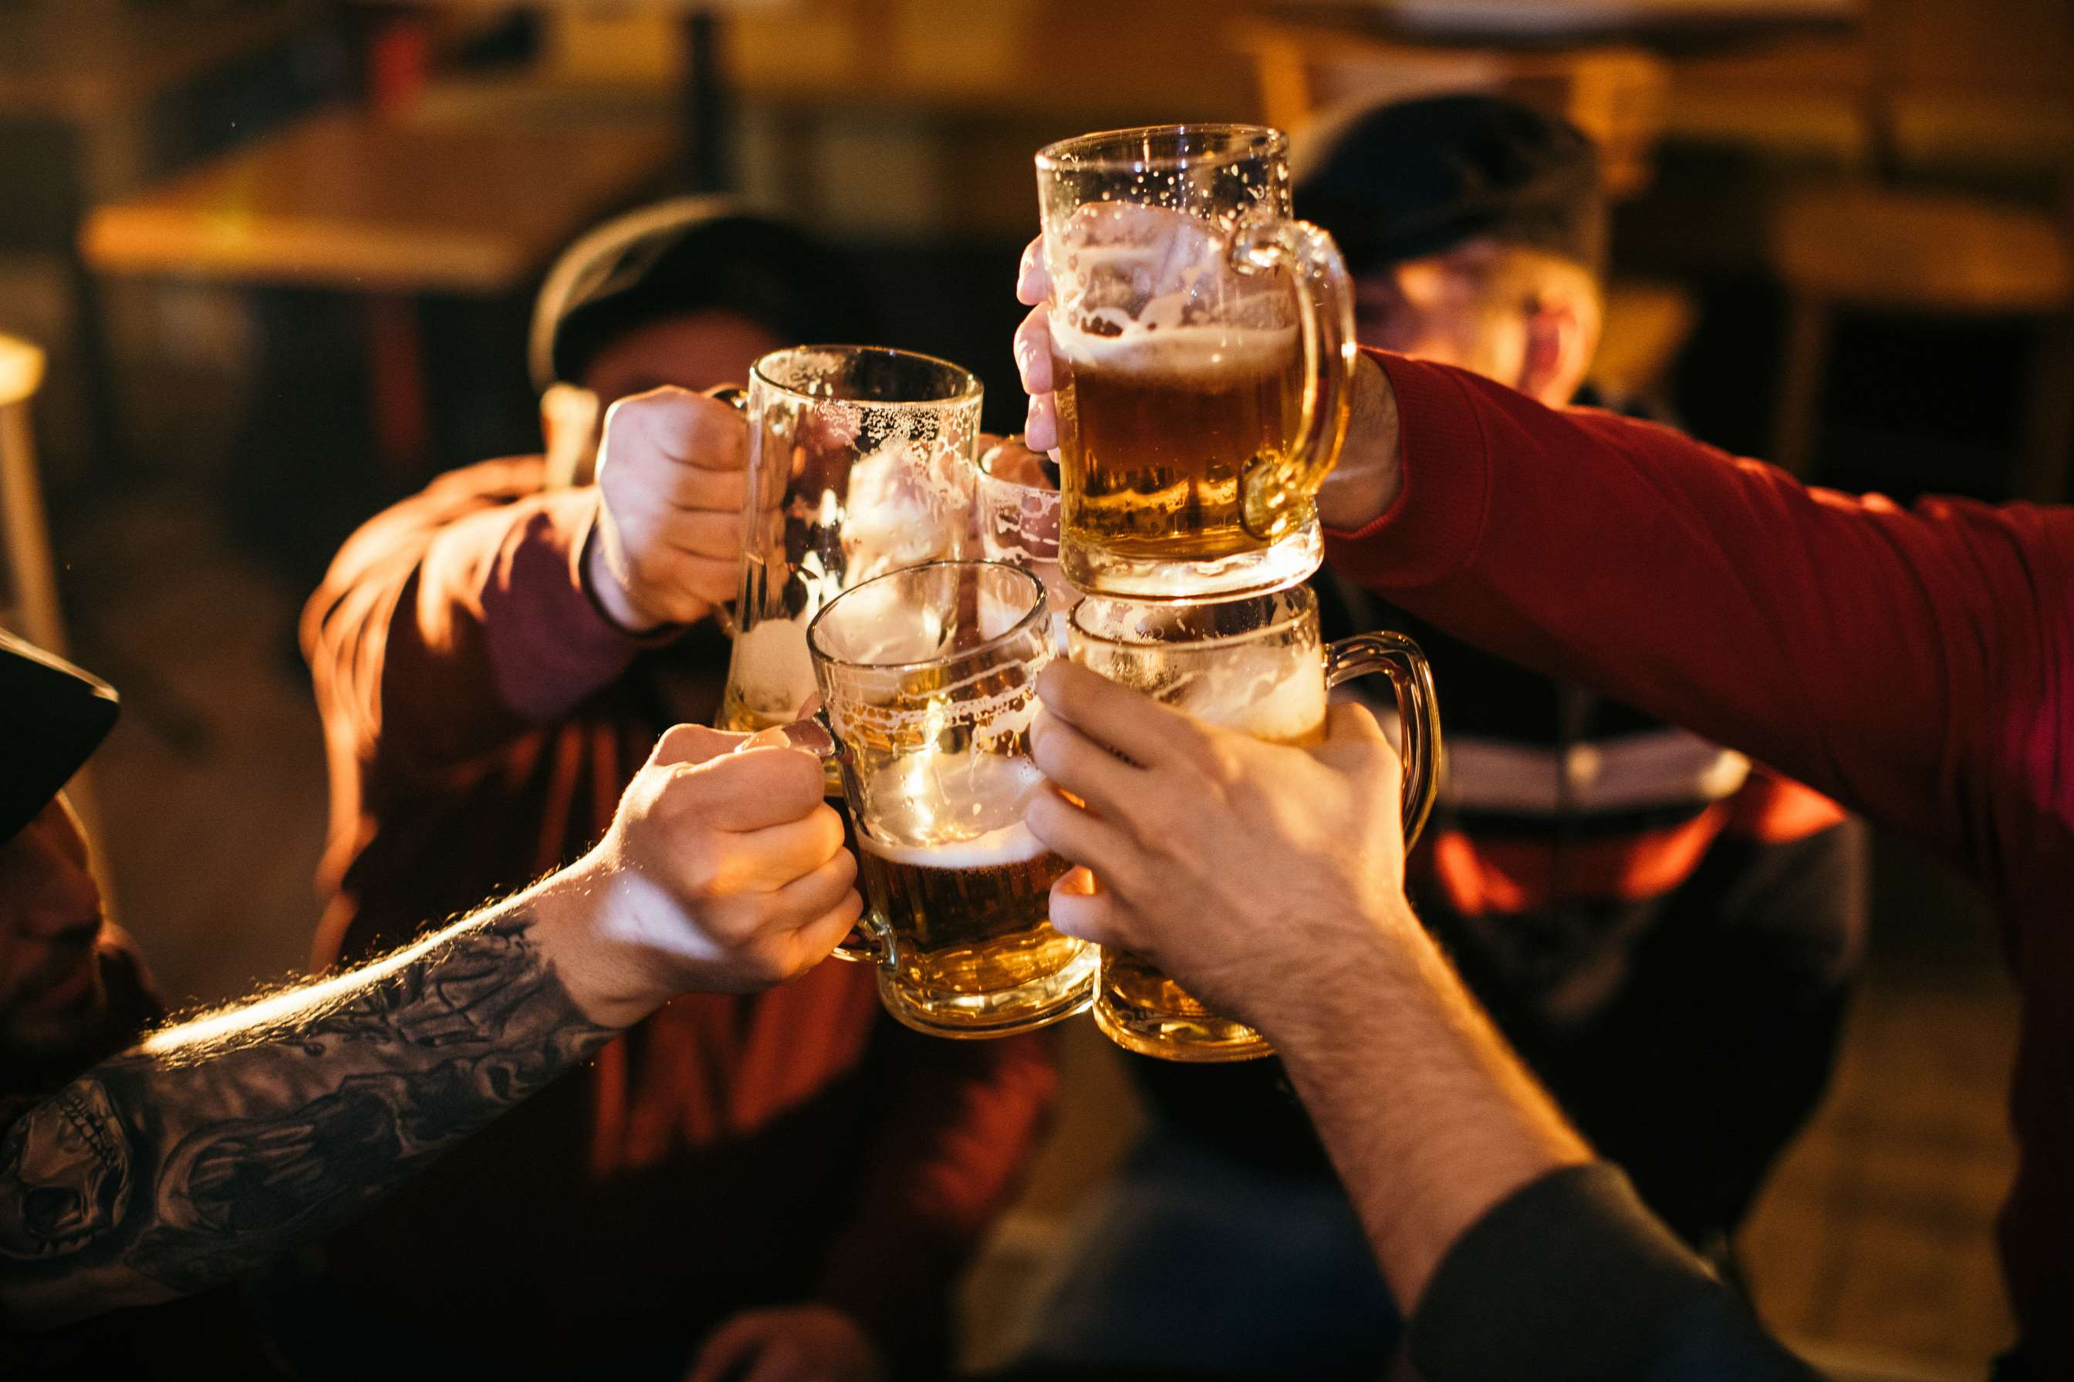
REVENUE MARKET SHARE BY SEGMENTS 2022
  < 1%
  1.2% - 8.5%
  3.5% - 12%
  > 12%
  Alcoholic
  Non-Alcoholic
Type Segment
ABV Segment
  Bars & Clubs
  Corporate Hospitality
  Hotels
  Residential
  Cans
  Bottles
Application Segment
Packaging Type Segment

Slide 5


Global Beer and Cider Market Revenue share for 2024
North America
40%

Slide 6
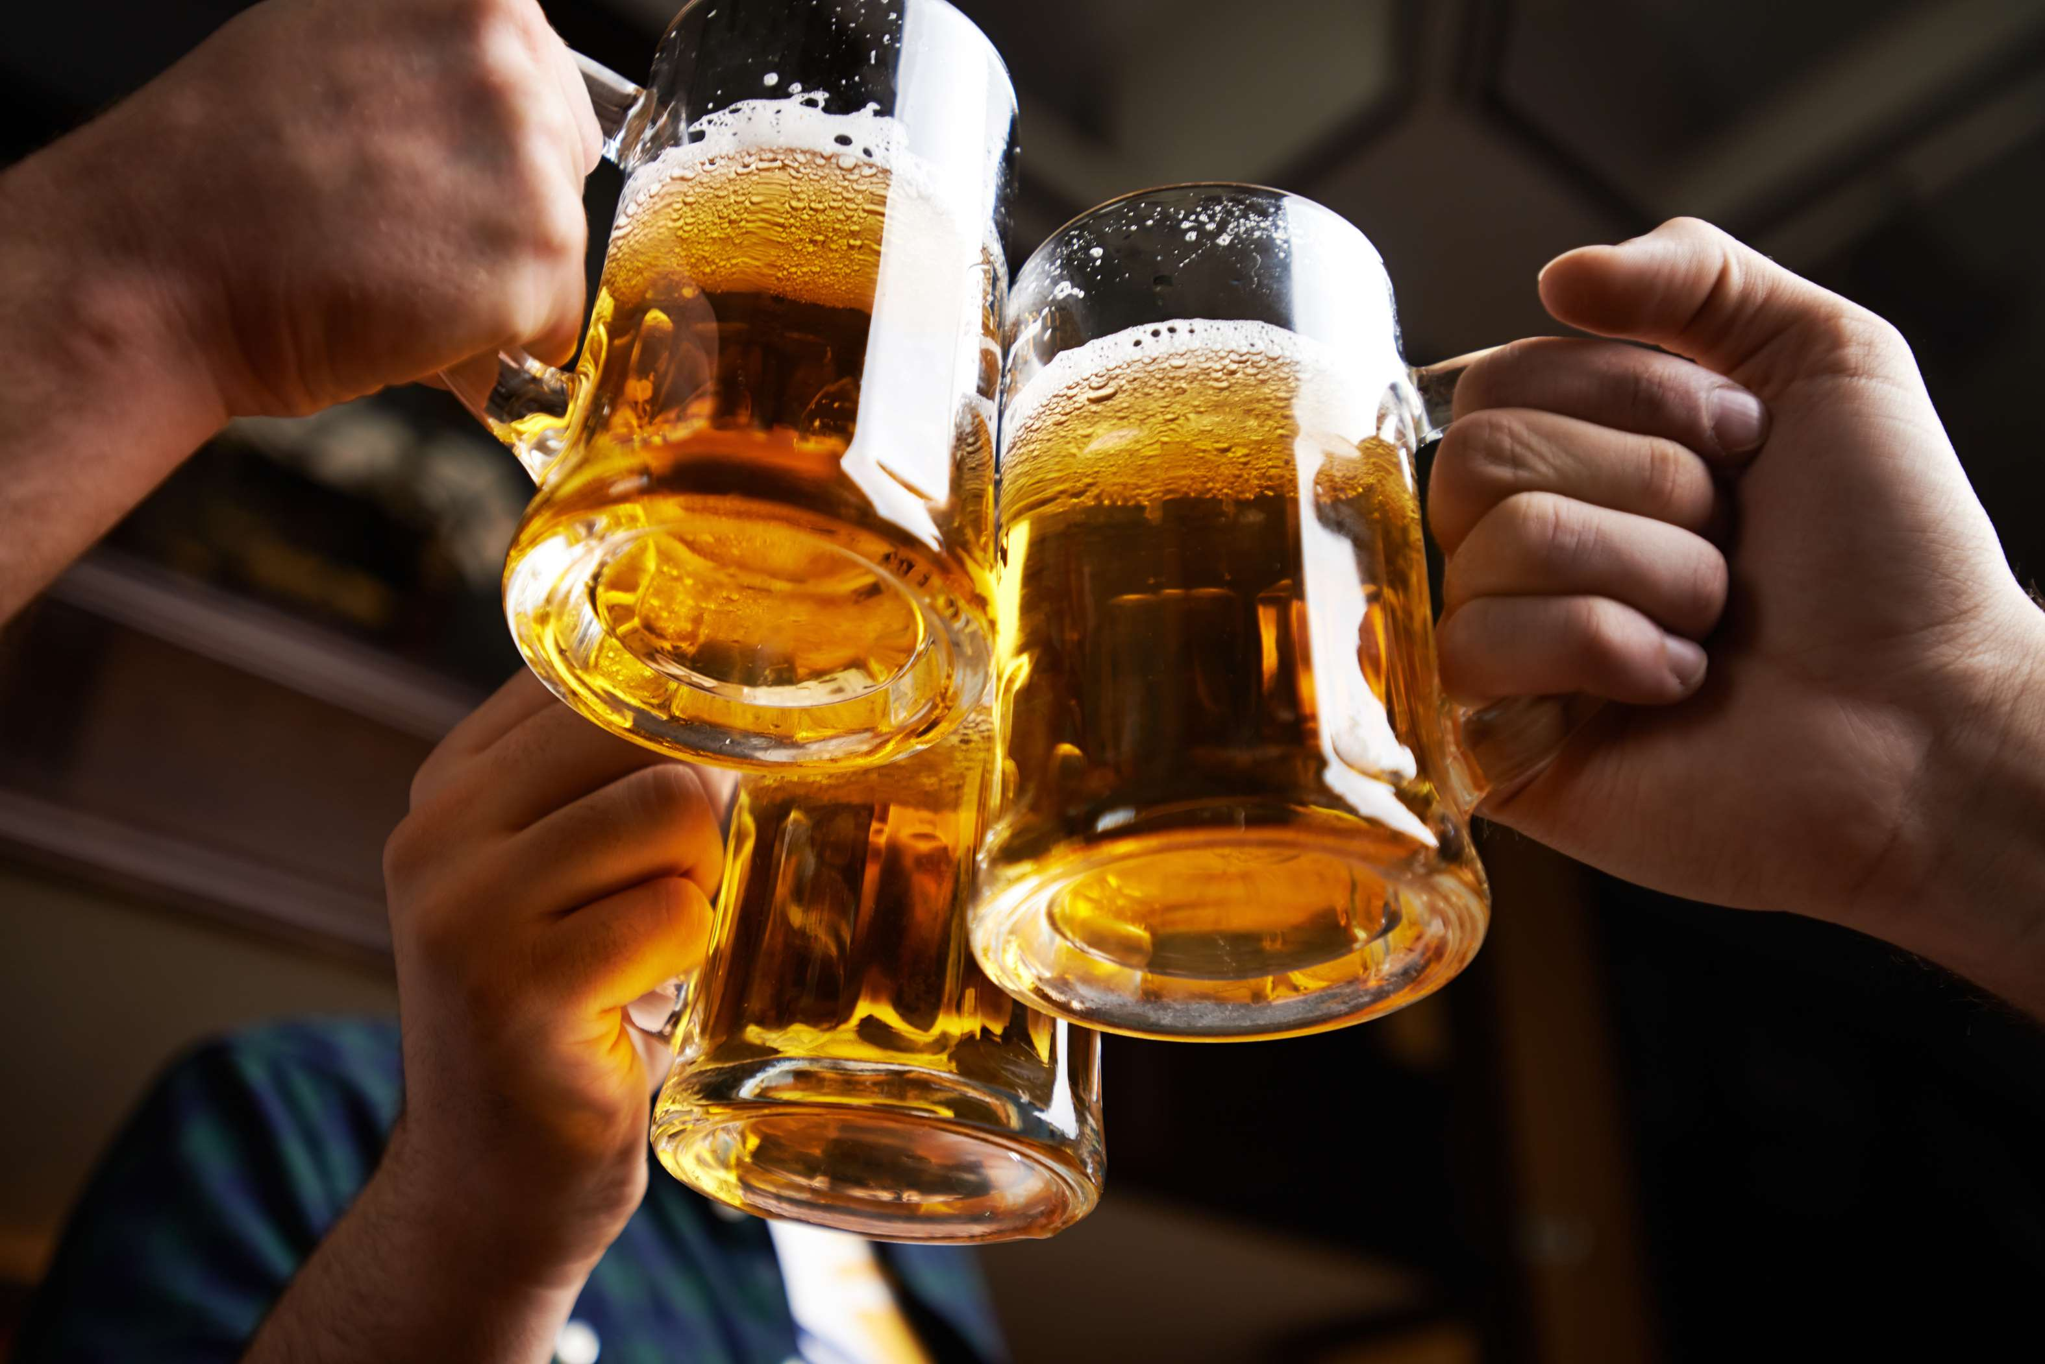
Growing Demand for Premium and Craft Products to Increase the Demand Globally
Drivers
Rising Raw Material Costs to Limit the Sales
Restraints

Slide 7

AUTHOR'S PERSPECTIVE
  The global Beer and Cider market will expand significantly by 5.00% CAGR between 2024 to 2031.
  Events such as beer festivals and focused marketing campaigns generate interest in new goods and inform customers about various varieties, which in turn drives market expansion.
  A shift towards drier and more flavorful alternatives is helping the cider market in particular by catering to a wider range of palates than just the typical sweet cider.

Slide 8
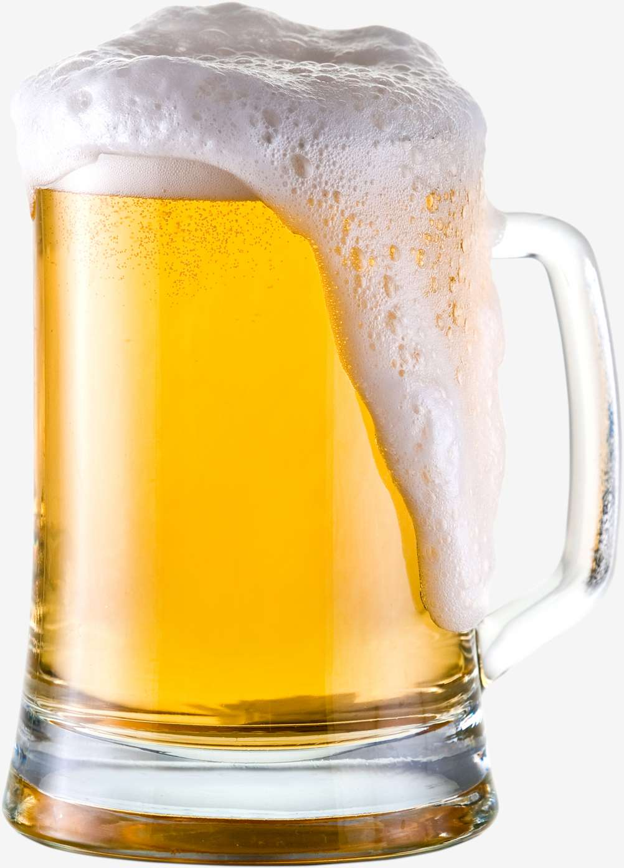









KEY PLAYERS

Slide 9


For Full Report
Contact us
COGNITIVE MARKET RESEARCH
Tel: +1 312-376-8303 | +44 020-8123-0732
India: (+91) 983-496-8611
sales@cognitivemarketresearch.com
Access the Full Report : https://tinyurl.com/wb8mpxxx
Please visit our website:
https://www.cognitivemarketresearch.com

