Slide 1
GLOBAL BEARBERRY MARKET REPORT 2024
Global,Regional,CountryAnalysis

Slide 2
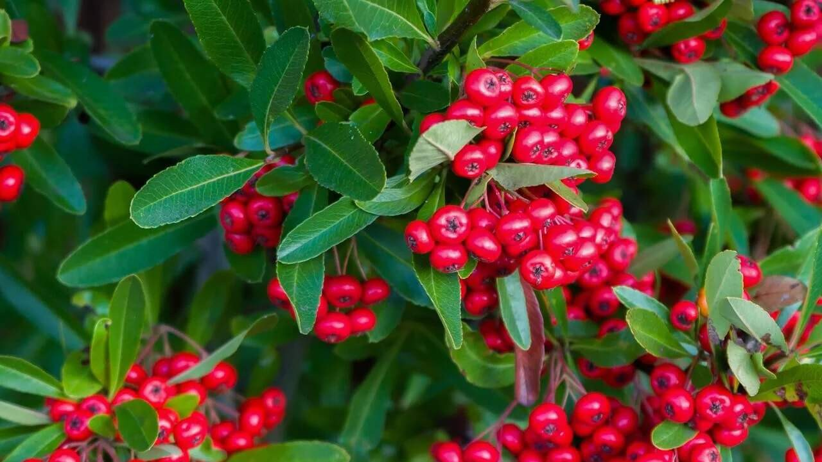
INTRODUCTION
Bearberry is a plant that has therapeutic uses. Arbutin, which has an antimicrobial function, is present in its leaves. It is a moderate diuretic that can be used to treat urinary tract conditions such as urinary stones and cystitis. Arbutin is used in cosmetics, has a whitening effect, and can help lessen the production of melanin in the skin. The market's expansion is ascribed to the growing need for bearberries in the drugs, dietary supplement, cosmetic, and healthcare industries, among other sectors. Since the beginning of time, berries have been used as food, and many primates still primarily eat them. Companies in the Bearberry market are trying to employ various strategies to maintain and innovate in the market to strengthen their market presence They also spend money on research to learn about consumer trends and preferences, which helps to meet changing standards for health-conscious consumers.
In the competitive Bearberry business, these tactics assist major firms in securing a substantial market share and preserving their competitiveness.

Slide 3
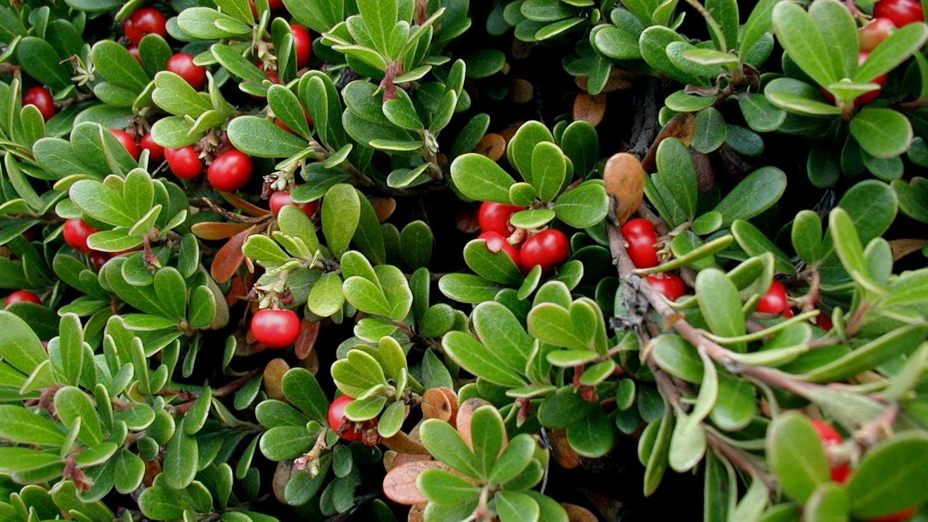

KEY INSIGHTS
CAGR 13.20%
2023
-
2030

Slide 4

REVENUE MARKET SHARE BY SEGMENTS 2022
Food and Beverage Industry Cosmetic and Personal care Pharmaceuticals
End-User Segment
Supermarkets Specialty Stores Others
Distribution Channel

Slide 5
Global Bearberry Market Revenue share for 2022
North America 40%

Slide 6
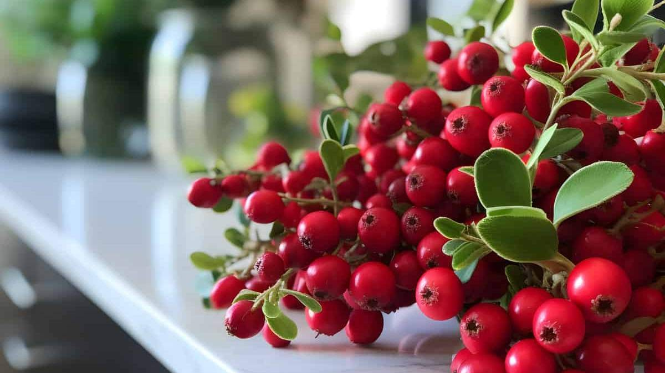
E-Commerce and Online Retail Stores to Propel Market Growth
Drivers
Potential Health Concerns Related to Usage of Pesticides and Insecticides to Restrict Market Growth
Restraints

Slide 7
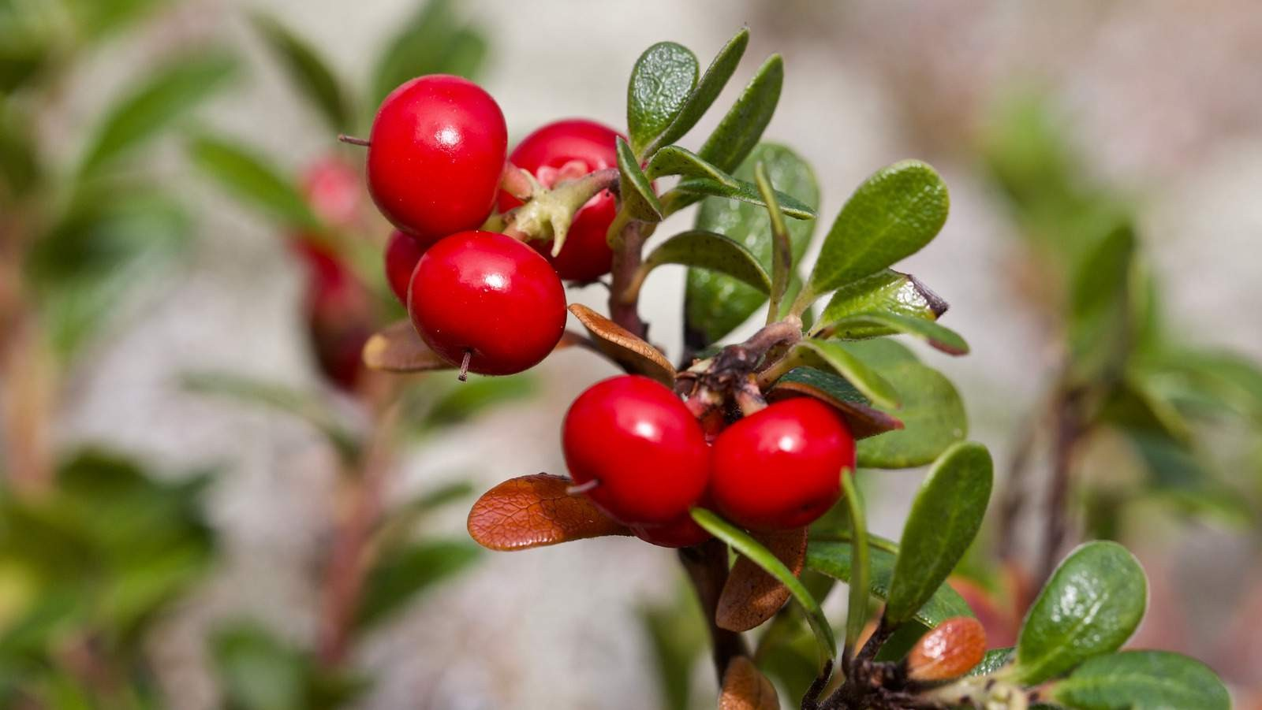
AUTHOR'S PERSPECTIVE
The Worldwide Bearberry market will expand significantly by 13.20% CAGR between 2023 and 2030.
The plant bearberry is also known as powdered bearberry. It is dried and powdered and has Potassium, magnesium, and vitamin C found in medications, meals, and cosmetics.
Ayurvedic and herbal medicines are leading to a paradigm shift in the bearberry sales sector.
Bearberry extract is beneficial against several skin disorders, including rashes and sunburns, dandruff and flakes, and acne and blackheads.

Slide 8
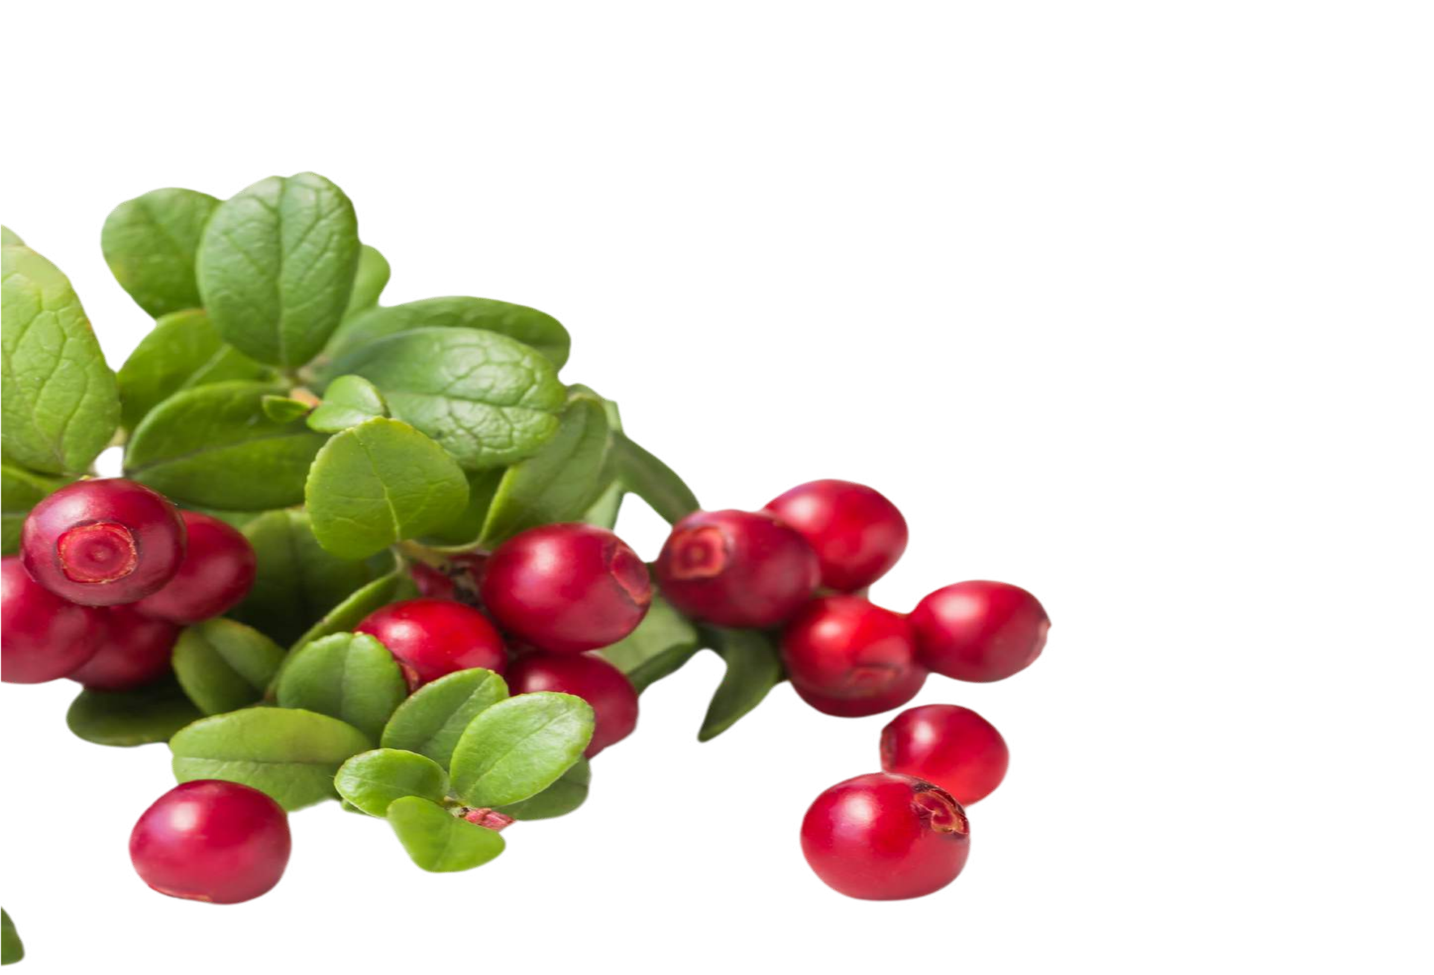


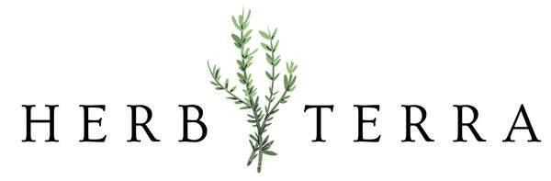





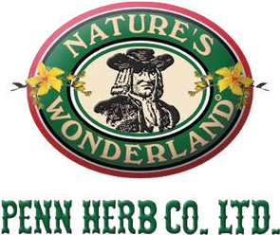
KEY PLAYERS

Slide 9


Contact us
For Full Report
COGNITIVE MARKET RESEARCH
Tel: + 1 312 - 376 - 8303 | + 44 020 - 8123 - 0732
India: ( + 91 ) 983 - 496 - 8611
sales@ cognitivemarketresearch. com
Access the Full Report : http://tinyurl.com/yc4eyncj
Please visit our website:
https://www.cognitivemarketresearch.com

