Slide 1

GLOBAL BASKETBALL BALLS MARKET REPORT 2024
Global,Regional,CountryAnalysis

Slide 2

INTRODUCTION
A basketball is a spherical inflated rubber ball used in the sport of basketball. It is about 26 inches (66 cm) in circumference and weighs about 14 to 15 ounces (400 to 430 g). The official men's size for the international competition is 7 ft 8.25 in (2.34 m) and the women's size is 6 ft 5 in (1.96 m).
Market fuled by increasing popularity of basketball as a sport, rising disposable income of the population, especially in developing countries and growing demand for branded basketball balls. These strategies help key
players capture a significant market share and remain competitive in the dynamic Basketball Balls market.

Slide 3


KEY INSIGHTS
CAGR 6.80%
2024
-
2031

Slide 4

REVENUE MARKET SHARE BY SEGMENTS 2022
Leather
Composite/Synthetic Leather
Rubberx
Offline
Online
Distribution Channel
Type Segment
Competition
Training
Recreational Activities
Youth
Adult
Application Segment
Age Group Segment
760mm Basketball Balls
730mm Basketball Balls
700mm Basketball Balls
570mm Basketball Balls
Professional
Amateur
Size Segment
End User Segment

Slide 5

Global Basketball Balls Market Revenue share for 2024
North America

Slide 6



Technological Advancements in Ball Design to Propel Market Growth
Challenges in Raw Material Costs to Restrict Market Growth

Slide 7

AUTHOR'S PERSPECTIVE
The global Basketball Balls market will expand significantly by 6.80% CAGR between 2023 and 2030.
The demand for Basketball Balls is rising due to the increasing popularity of basketball as a sport.
Demand for competition remains higher in the Basketball Balls market.
North American Basketball Balls will continue to lead, whereas the Asia
Pacific Basketball Balls market will experience the most substantial growth until 2030.

Slide 8


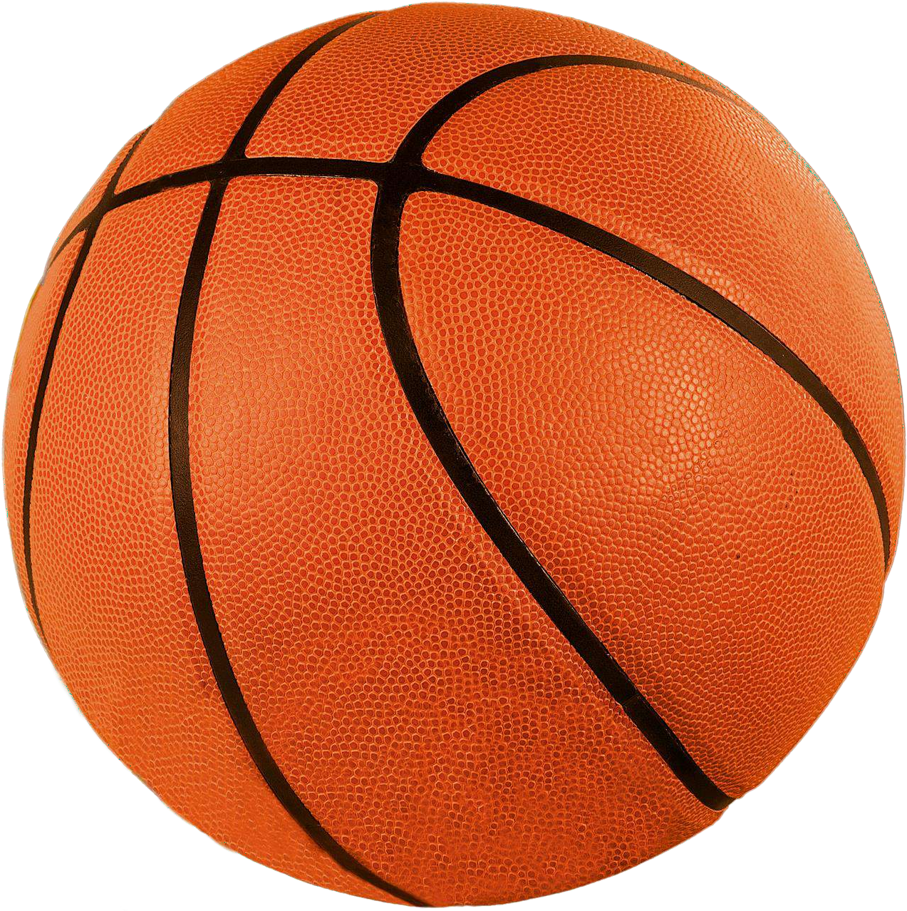

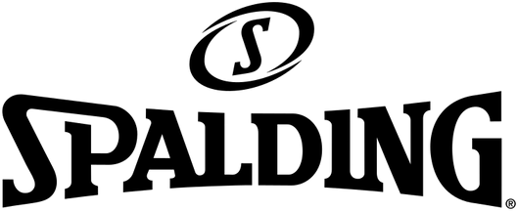

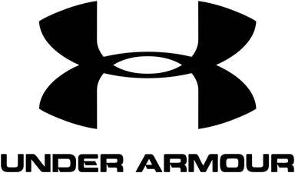



KEY PLAYERS

Slide 9


Contact us
For Full Report
COGNITIVE MARKET RESEARCH
Tel: + 1 312 - 376 - 8303 | + 44 020 - 8123 - 0732
India: ( + 91 ) 983 - 496 - 8611
sales@ cognitivemarketresearch. com
Access the Full Report : http://tinyurl.com/4dmdrfa2
Please visit our website:
https://www.cognitivemarketresearch.com

