Slide 1

BASEBALL CAP
MARKET REPORT

Slide 2
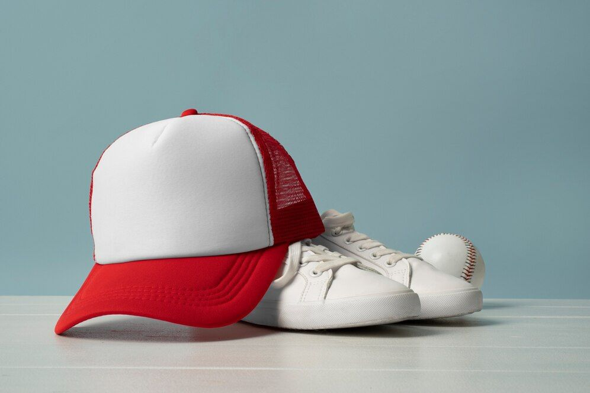
INTRODUCTION
A baseball cap is a soft hat with a rounded crown and a stiff bill that protrudes from the front. Some custom-made caps come in precise sizes to fit the user, while the majority of mass-produced versions feature a plastic extender in the center rear that may be adjusted to match the wearer's demands. On the peak of the crown, where all the fabric portions come together, is a button covered in fabric. The center front of the crown might have the team's lettering painted on or have team logos embroidered on it.

Slide 3
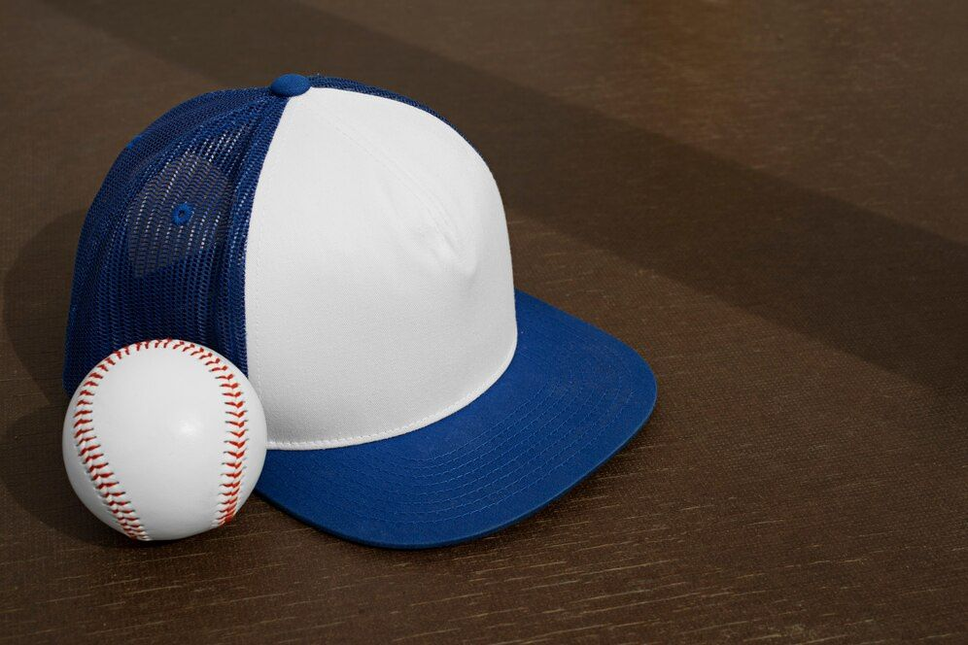

KEY INSIGHTS
MARKET SIZE
$17.98 Billion
2021
FORECAST
$25.64 Billion
2029
2023-
2030
CAGR
5.2%

Slide 4
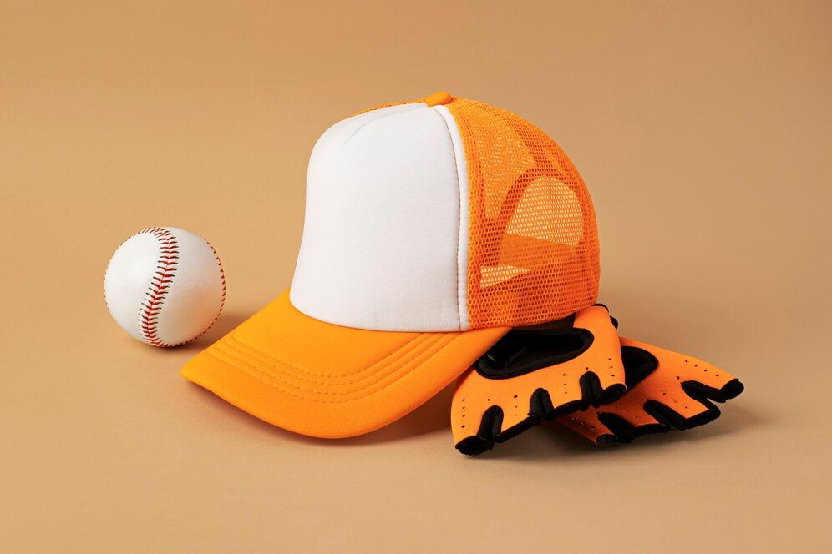
REVENUE MARKET SHARE BY SEGMENTS 2022
BY PRODUCT
Men
53.19%
BY APPLICATION
Athletic
46.78%

Slide 5

GLOBAL BASEBALL CAP MARKET REVENUE SHARE FOR 2022
North America
46.82%

Slide 6
As baseball caps are used during baseball, the rising number of baseball players majorly boosts the demand for baseball caps.
Drivers
Rising interest in designer baseball caps, which are regaining popularity.
Trends

Slide 7
AUTHOR'S PERSPECTIVE
  Global Baseball Cap Market Report 2023 talks about crucial market insights with the help of segments and sub-segments analysis.
  The men’s segment is dominating the baseball cap market owing to the rising demand from men and the rising number of men baseball players.
  The Application, the athletic segment dominates the market by taking high revenue market share.
  The Athletic segment is expected to expand at the significant CAGR retaining position throughout the forecast period.

Slide 8

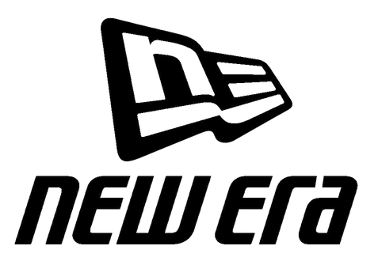

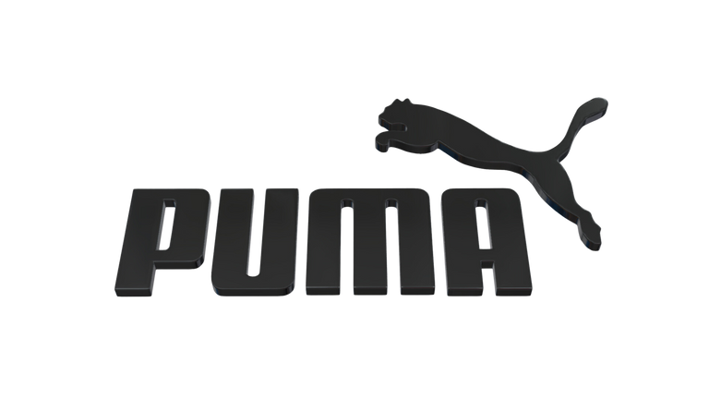
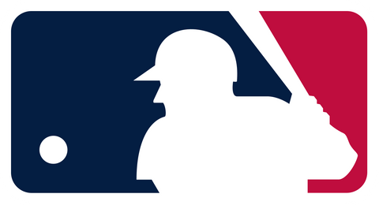
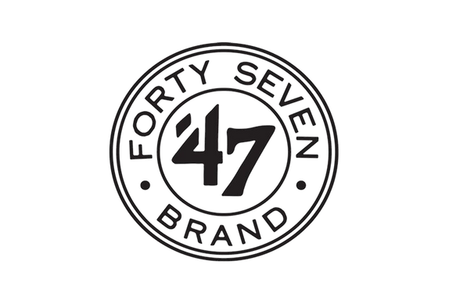

KEY PLAYERS

Slide 9


Contact us
For Full Report
COGNITIVE MARKET RESEARCH
Tel: +1 312-376-8303 | +44 020-8123-0732
India: (+91) 983-496-8611
sales@cognitivemarketresearch.com
Access the Full Report : https://tinyurl.com/4cr3sy95
Please visit our website:
https://www.cognitivemarketresearch.com

