Slide 1
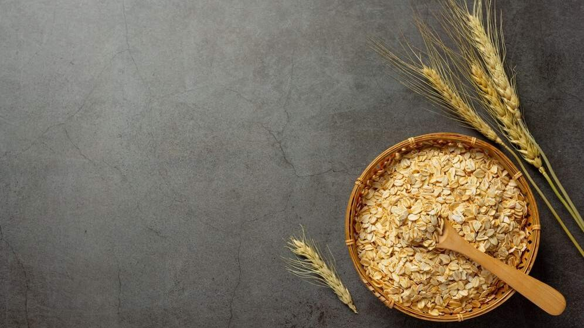
GLOBAL
BARLEY
MARKET REPORT 2024
Global,Regional,CountryAnalysis

Slide 2
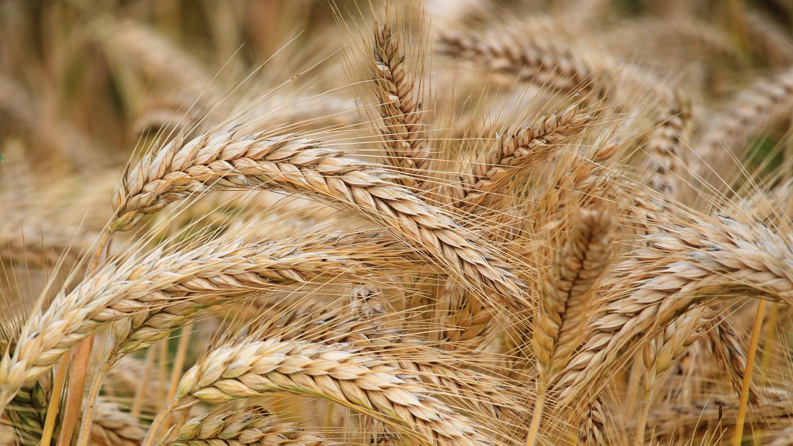
INTRODUCTION
Barley (Hordeum vulgare) is a versatile cereal grain crop of the grass family that is grown worldwide in temperate areas. It is largely farmed in Russia, France, Germany, Ukraine, Australia, and other nations, and is one of the most significant crops for farmers in these areas. It is high in maltose, often known as malt sugar. The rise in its demand, owing mostly to its use in both alcoholic and non-alcoholic beverages, is a major driving force in the global market.
Other market drivers include increased health awareness, an increase in cardiovascular illnesses, and its increasing use as a component in food goods. Barley is an important feed ingredient for livestock, particularly in the preparation of chicken, pig, and cattle feed.

Slide 3
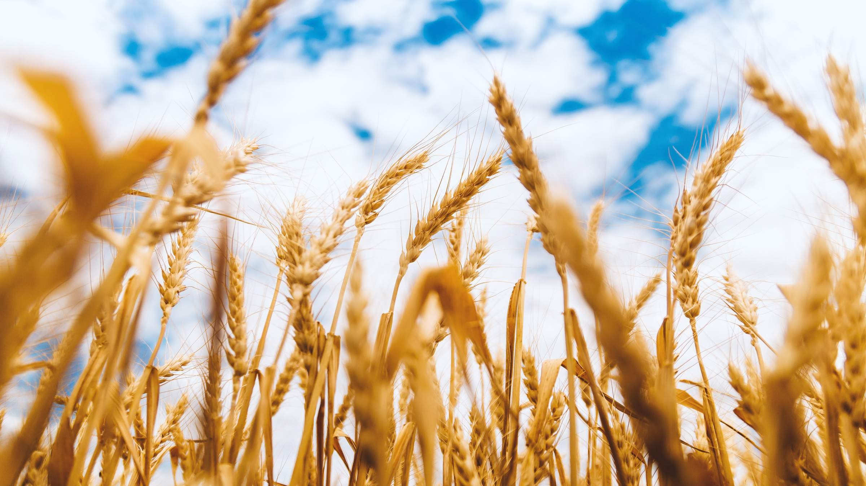

KEY INSIGHTS
MARKET SIZE
USD 142.5 billion
2023
20₋23
CAGR 3.20%
2030

Slide 4
REVENUE MARKET SHARE BY SEGMENTS 2022
Covered
Two-row Barley Six-row Barley Hulless
Type Segment
Food Grade Feed Grade Malt Grade
Grade Segment
Food Beverages Pharmaceuticals Personal Care Animal feed Nutraceuticals
Industry Vertical Segment

Slide 5
Global Barley Market Revenue share for 2022
Europe

Slide 6
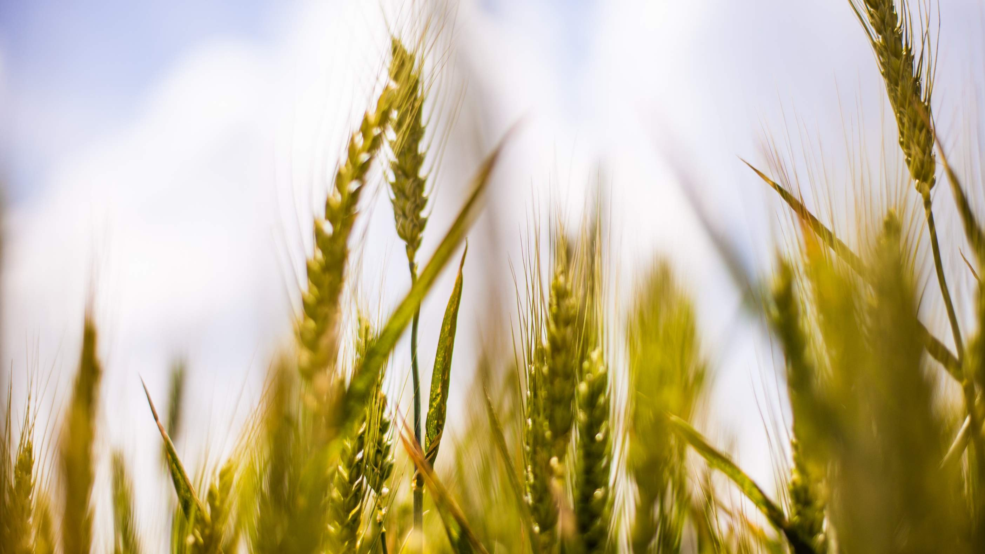
Increase Use in Pharmaceutical Sector to Propel Market Growth
Drivers
Health Issues to Restrict Market Growth
Restraints

Slide 7
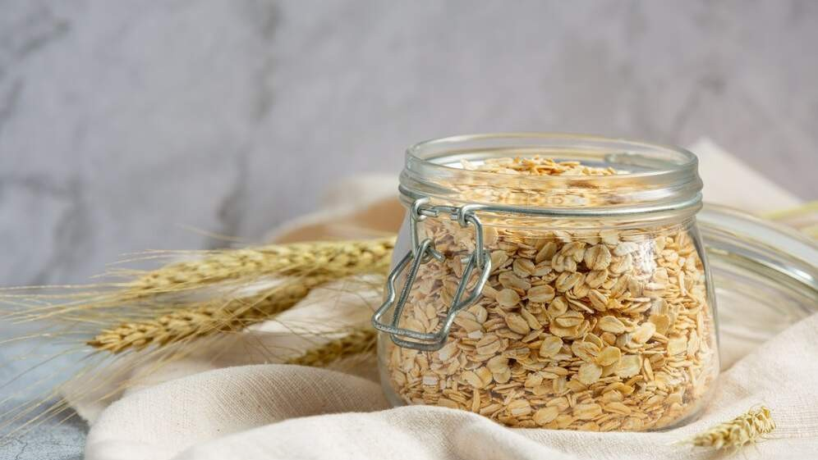
AUTHOR'S PERSPECTIVE
The Global Barley Market is witnessing significant growth in the near future. Six-row Barley is the fastest-growing category over the forecast period due to the booming barley market is expanding, owing largely to the adoption of six-row barley.
Specialty stores are the fastest-growing category over the forecast period Specialty stores are critical to the expansion of the barley market.
The pharmaceuticals is the fastest-growing category over the forecast period the nutritional characteristics of barley, as well as its potential health benefits, contribute to its inclusion in pharmaceutical goods and supplements.

Slide 8
KEY PLAYERS

Slide 9


Contact us
For Full Report
COGNITIVE MARKET RESEARCH
Tel: + 1 312 - 376 - 8303 | + 44 020 - 8123 - 0732
India: ( + 91 ) 983 - 496 - 8611
sales@ cognitivemarketresearch. com
Access the Full Report : http://tinyurl.com/muzc4rj7
Please visit our website:
https://www.cognitivemarketresearch.com

