Slide 1

GLOBAL
BANANA BREAD
MARKET REPORT 2024
Global,Regional,CountryAnalysis

Slide 2
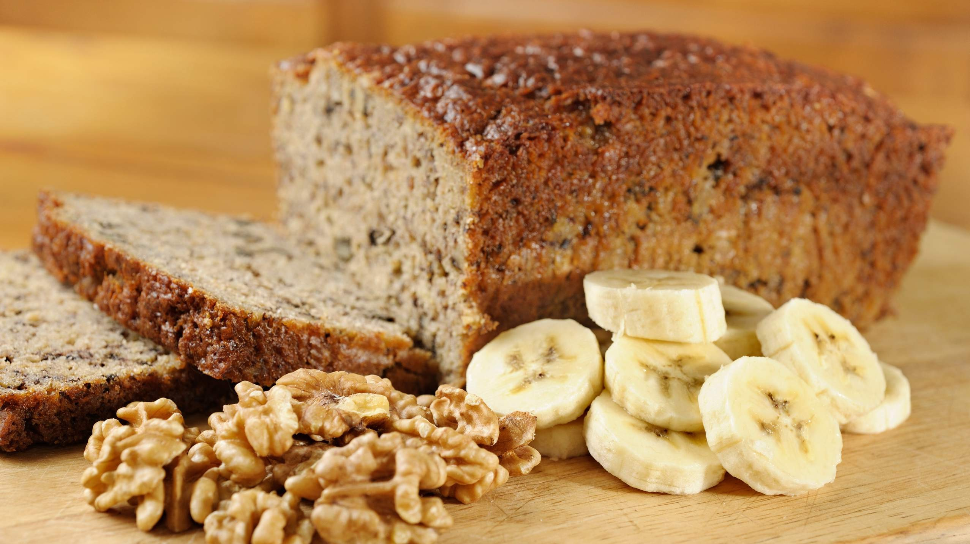
INTRODUCTION
A major factor is the rising popularity of banana bread, which mainly drives the growing need for baked goods that are delicious for consumers. This is because people's food tastes are changing, and there is an overall increase in health consciousness. This is happening simultaneously with rising disposable incomes and fast urbanization. Additionally, health-conscious shoppers and those who are gluten intolerant are jumping on the bandwagon for gluten- free banana bread. This, in addition to the widespread availability of products through both online and offline organized shopping platforms, is anticipated to fuel the market's expansion substantially more growth over the next few years.

Slide 3
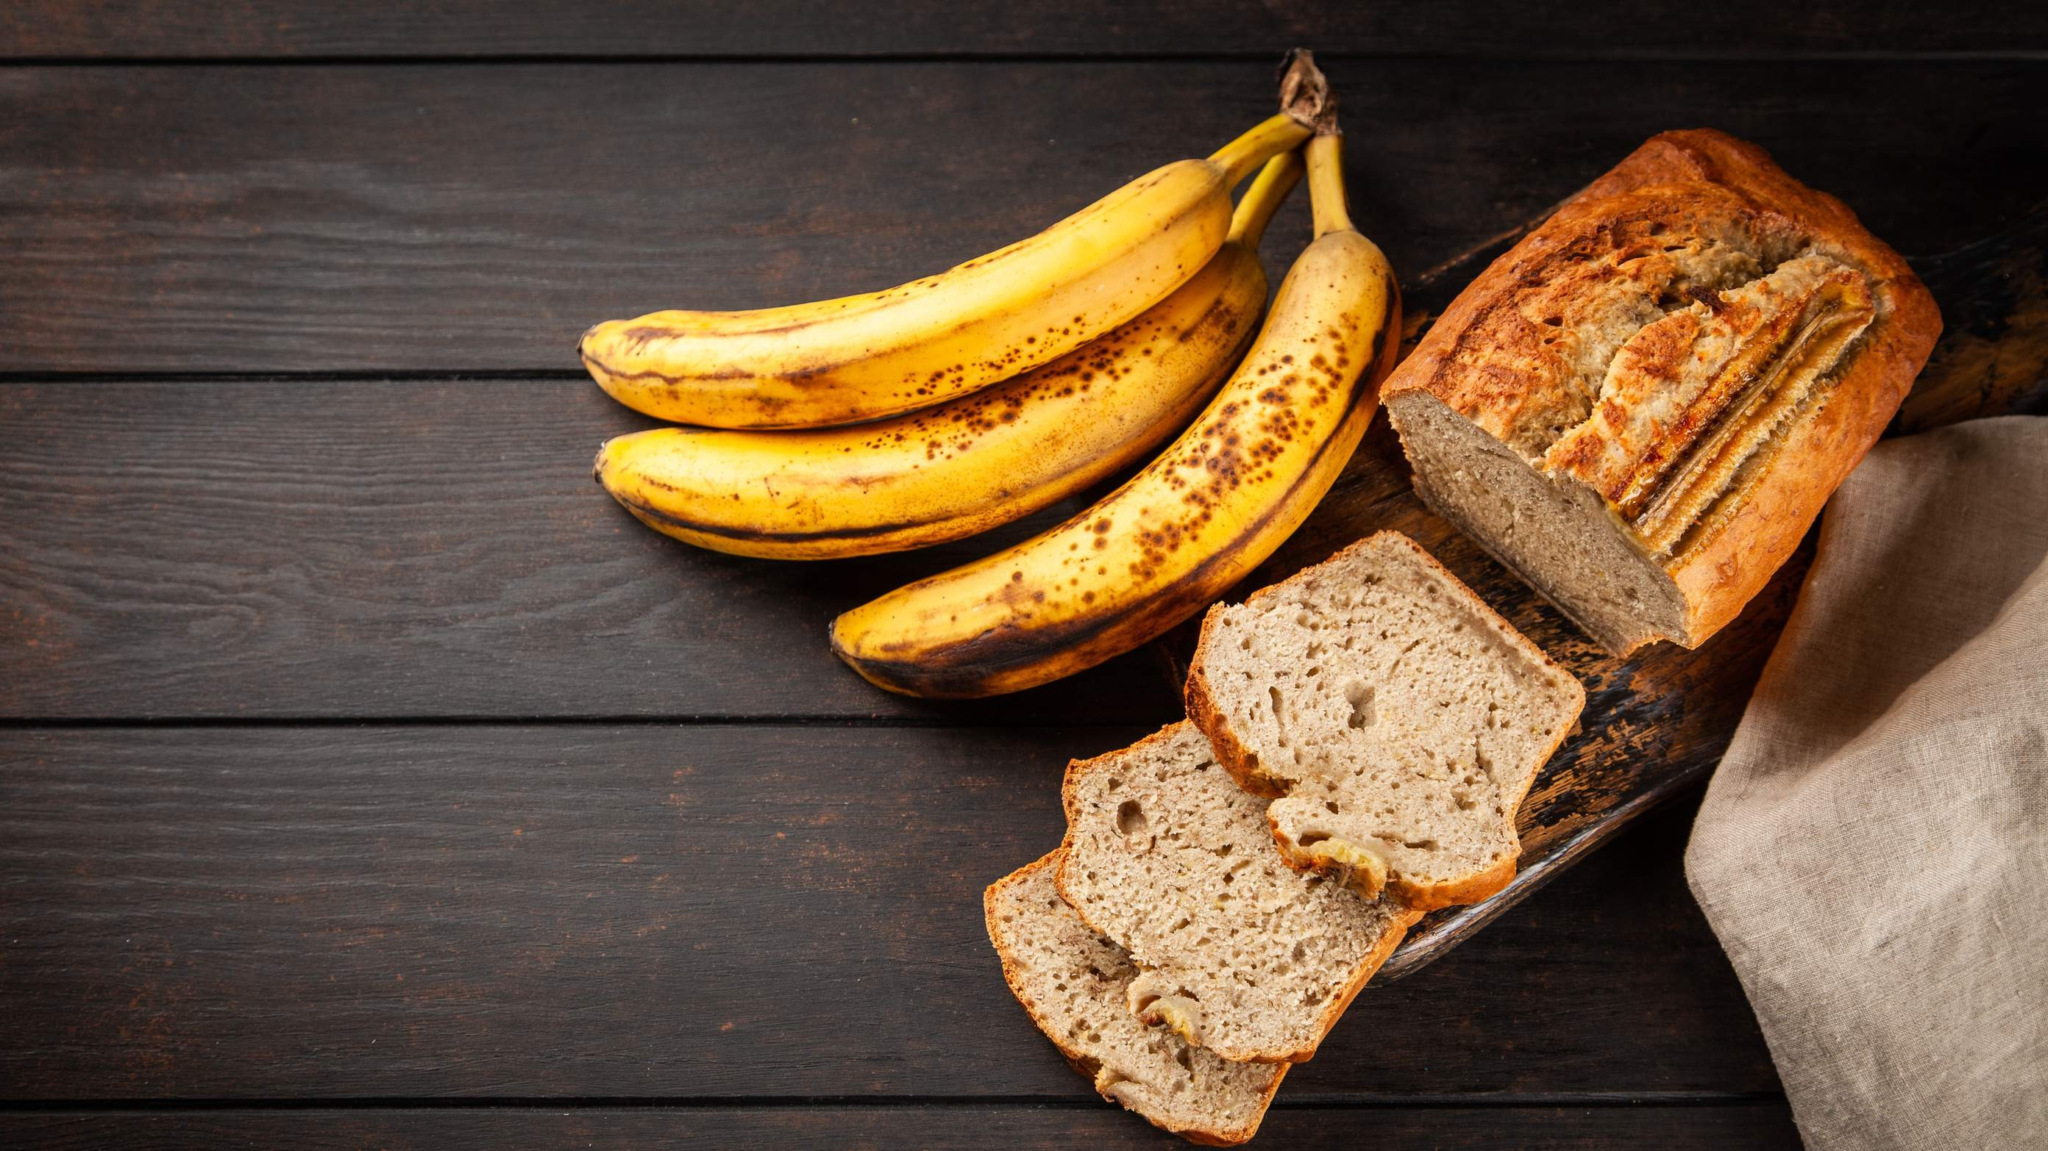

KEY INSIGHTS
MARKET SIZE
USD 1.3 billion
2023
20₋23
CAGR 4.20%
2030

Slide 4
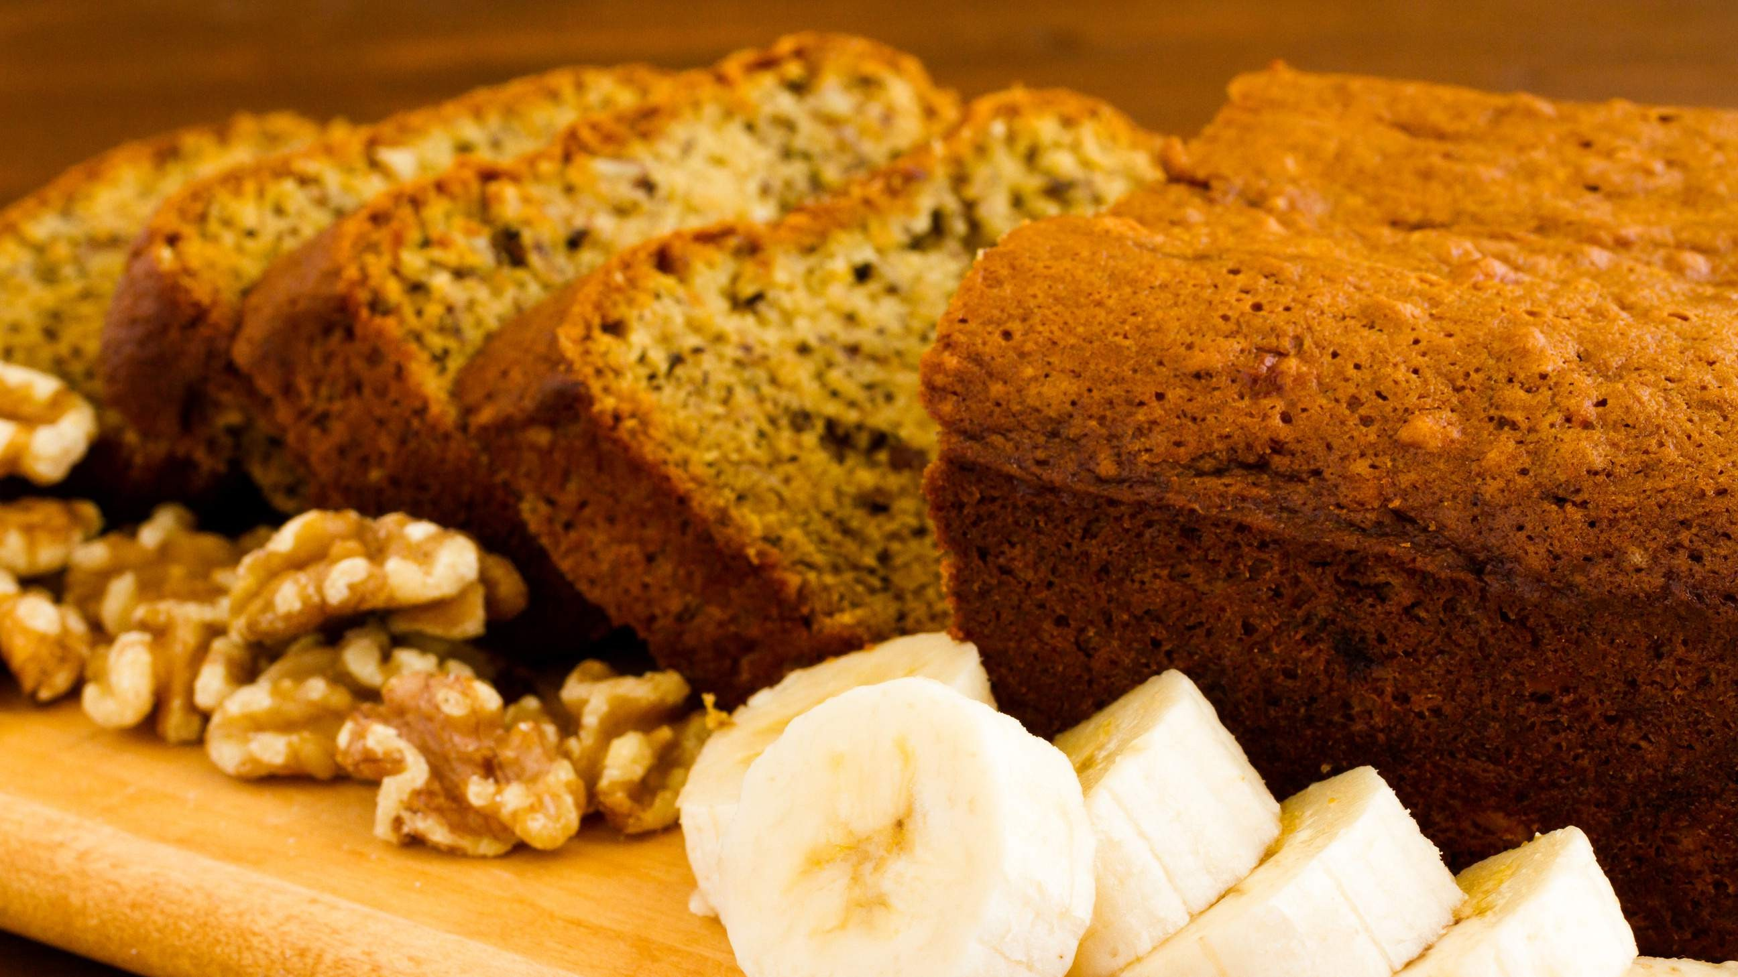
REVENUE MARKET SHARE BY SEGMENTS 2022
Unflavored Flavored
Product Segment
Commercial Residential
End-User Segment
Supermarkets and Hypermarkets Convenience Stores Online Stores
Distribution Channel

Slide 5
Global Banana Bread Market Revenue share for 2022
Asia Pacific

Slide 6
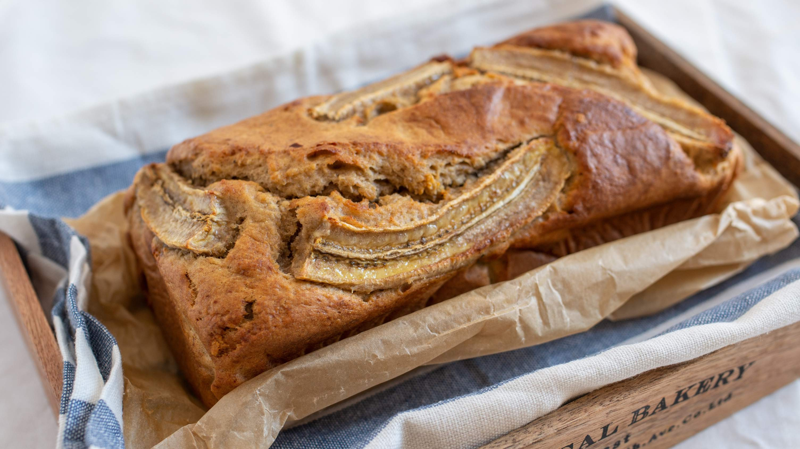
Increased Usage of Social-Media to Propel Market Growth
Drivers
Competitive with Similar Baked Goods to Restrict Market Growth
Restraints

Slide 7
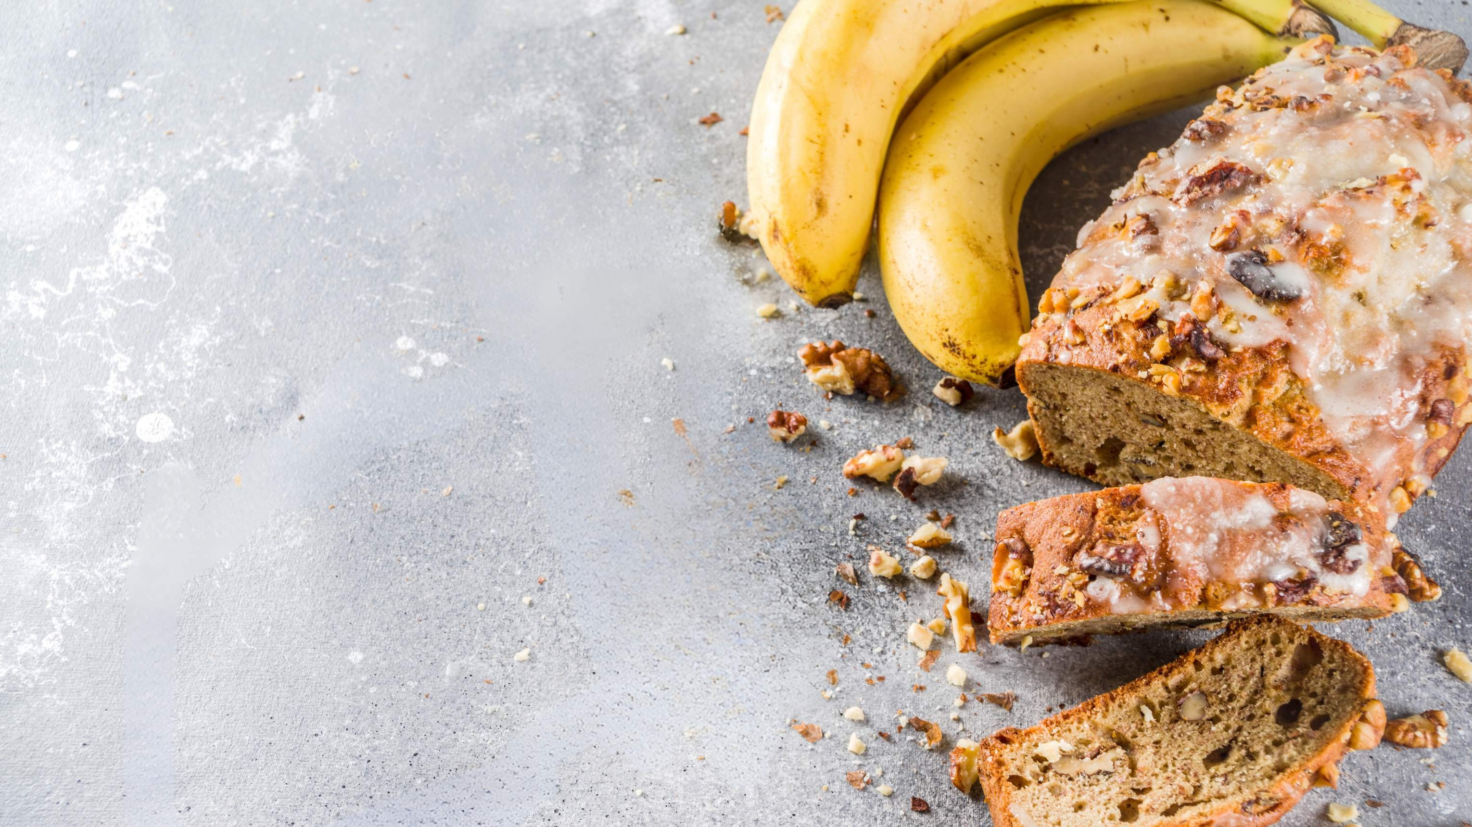
AUTHOR'S PERSPECTIVE
The Global Banana Bread Market is witnessing significant growth in the near future.
Flavoured is the fastest-growing category over the forecast period because people worldwide are embracing healthier lifestyles and not sacrificing flavor in the process.
Nutella butter, apple, blueberry-related, peach, fruit, oats, and cheese moisturizer are just a few of the flavors manufacturers offer in these breads.
Health objectives may involve using whole wheat flour, natural sweeteners, or other nourishing components.
Sales of banana bread help the bakery section of grocery stores and hypermarkets bring in some dough, which results in more sales, and income and fuels the demand for banana bread.

Slide 8

KEY PLAYERS

Slide 9


Contact us
For Full Report
COGNITIVE MARKET RESEARCH
Tel: + 1 312 - 376 - 8303 | + 44 020 - 8123 - 0732
India: ( + 91 ) 983 - 496 - 8611
sales@ cognitivemarketresearch. com
Access the Full Report : http://tinyurl.com/2ww5ehjd
Please visit our website:
https://www.cognitivemarketresearch.com

