Slide 1
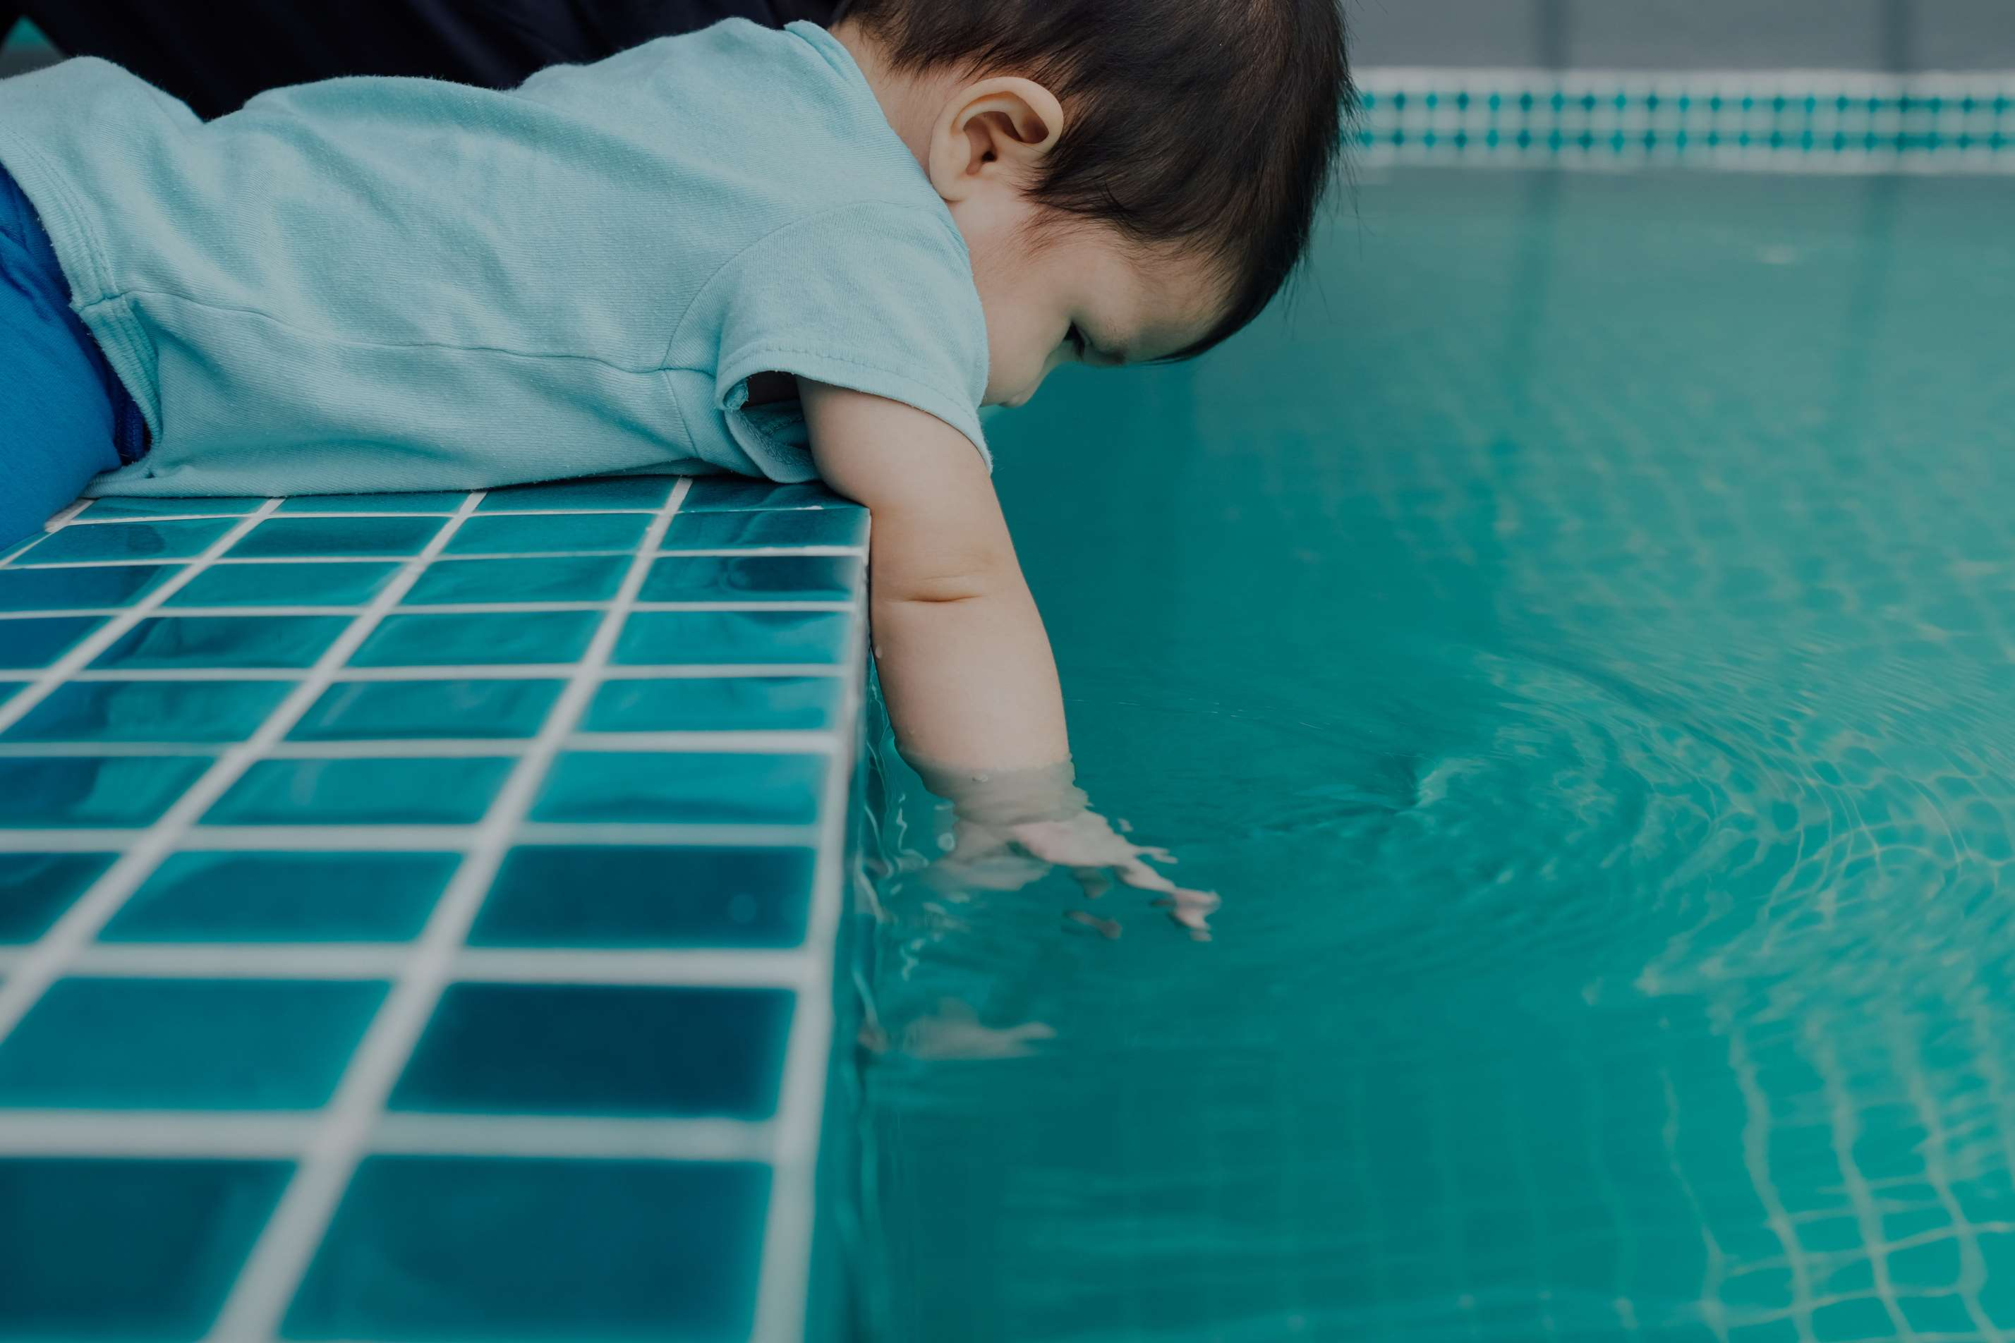

BABY SWIMMING POOLS
MARKET REPORT
2024
Qualitative Analysis + Quantitative Analysis

Slide 2
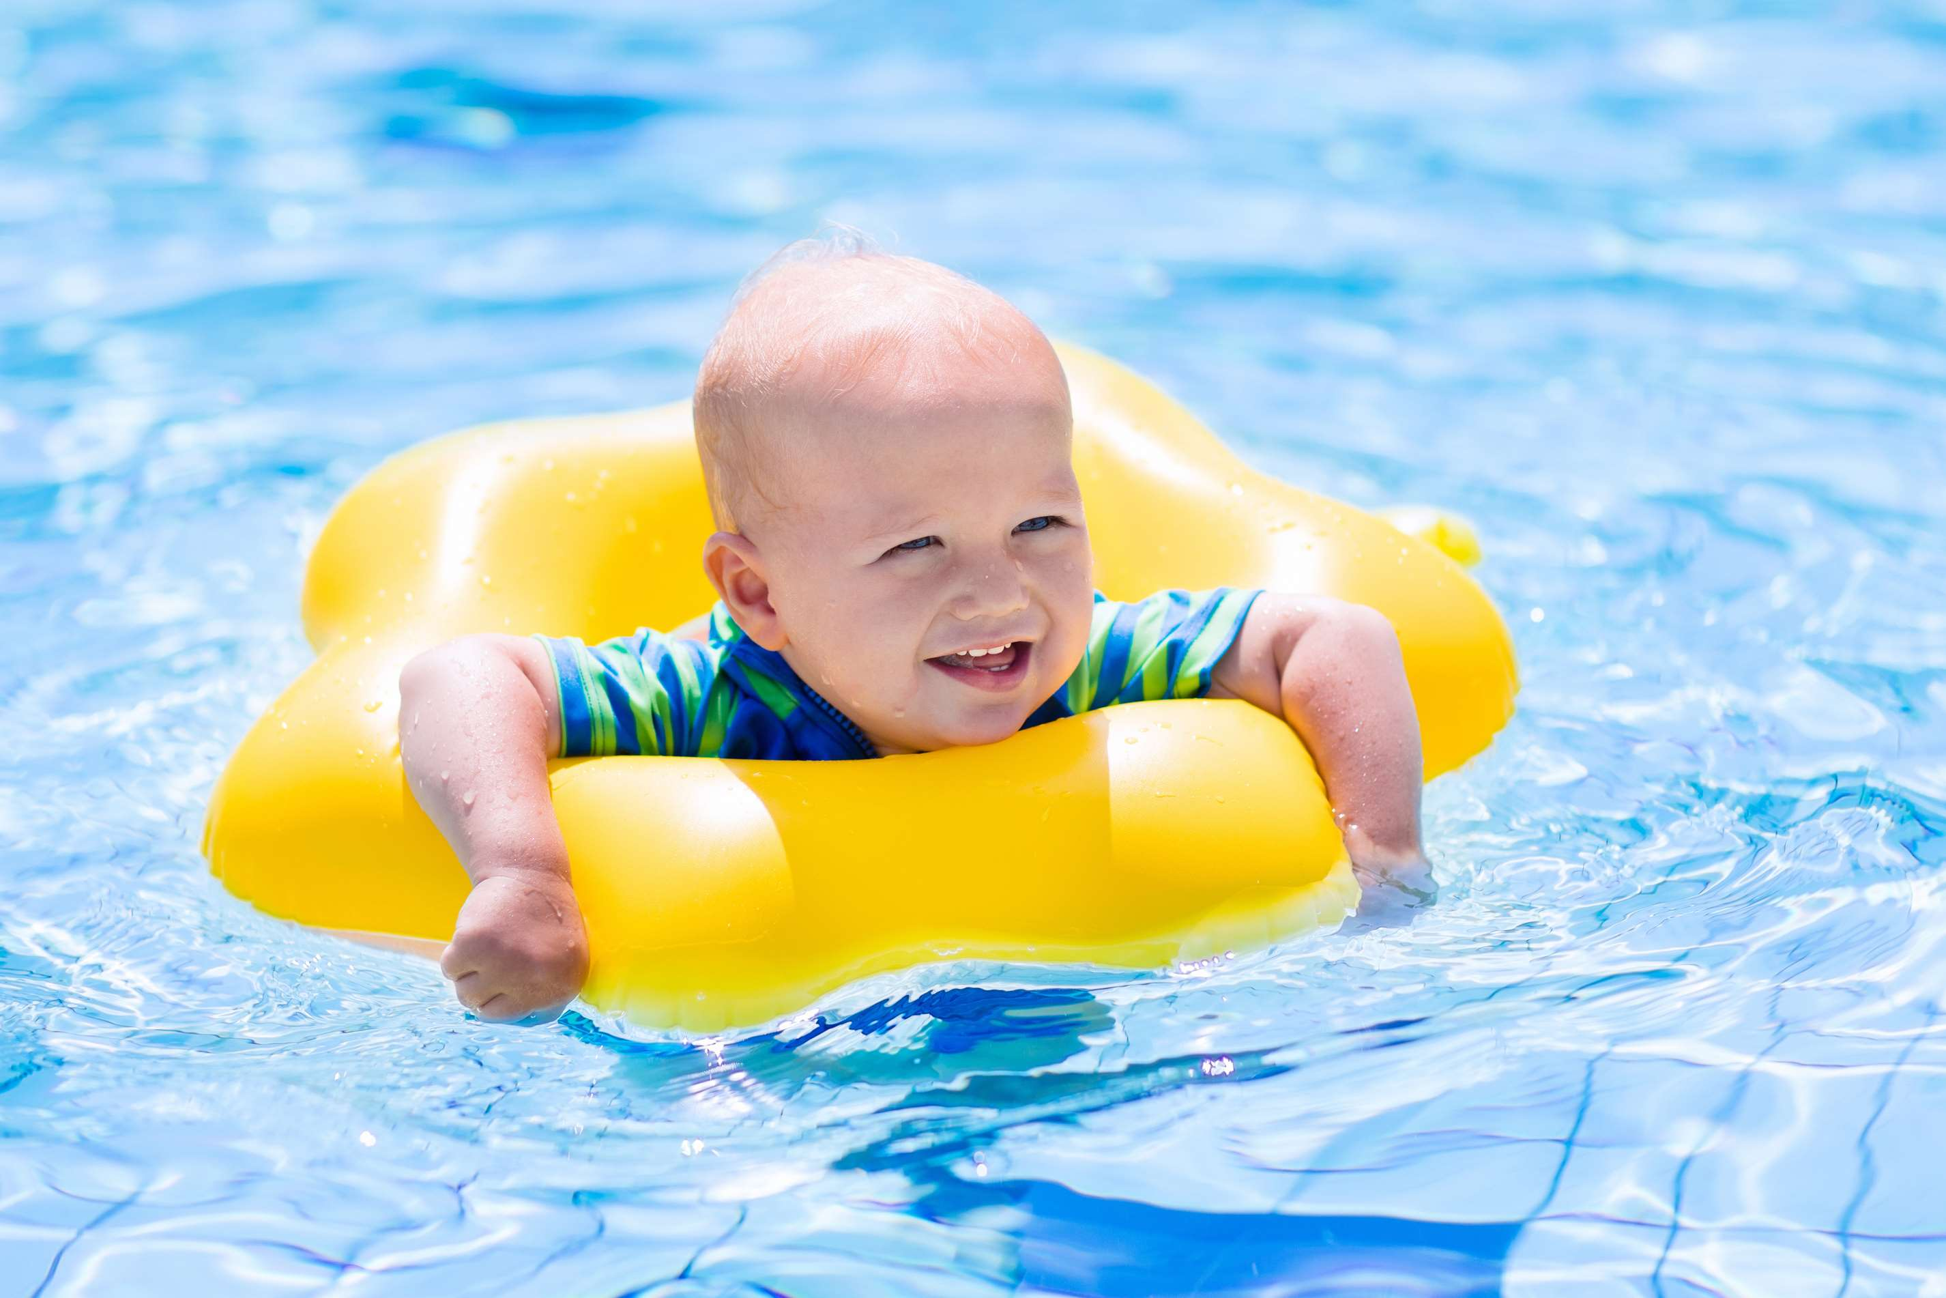
INTRODUCTION
The market for baby swimming pools includes various items made especially for young children to play in the water. Smaller in size, shallow, and frequently inflatable, these pools offer young children a secure and supervised setting for water play. To meet the needs and desires of parents who want to expose their kids to the water in a fun and supervised way, baby swimming pools are designed with safety, comfort, and developmental benefits like enhanced coordination and sensory stimulation in mind. Many different designs are available on the market, ranging from simple inflatable pools to more complex versions with extra features like interactive elements or sunshades. The market for infant swimming pools is a crucial sector of the larger leisure products business.

Slide 3


KEY INSIGHTS
MARKET SIZE
USD 56121.5 million
2024
CAGR
3.50%
2024- 2031

Slide 4

REVENUE MARKET SHARE BY SEGMENTS 2024
  Large Size
  Middle Size
  Small Size
  Inflatable Baby Pool
  Scaffolding Baby Pool
Type Segment
Size Segment
  Hypermarkets
  Department Store
  Independent Outdoor Activities Stores
  Online Retailers
  Home
  Commercial
  Hospital
Application Segment
Distribution channel

Slide 5

REGION ANALYSIS
NORTH AMERICA
Europe
Asia Pacific
Latin America
MIDDLE EAST AFRICA
USD 22448.6 million
USD 16836.45 million
USD 12907.95 million
USD 2806.08 million
USD 1122.43 million

Slide 6

  Growing Awareness of the Benefits of Early Water Exposure to Increase the Demand Globally
  Increasing Disposable Income to Propel Market Growth
Drivers
Restraints
Risk of Product Damage to Limit the Sales

Slide 7
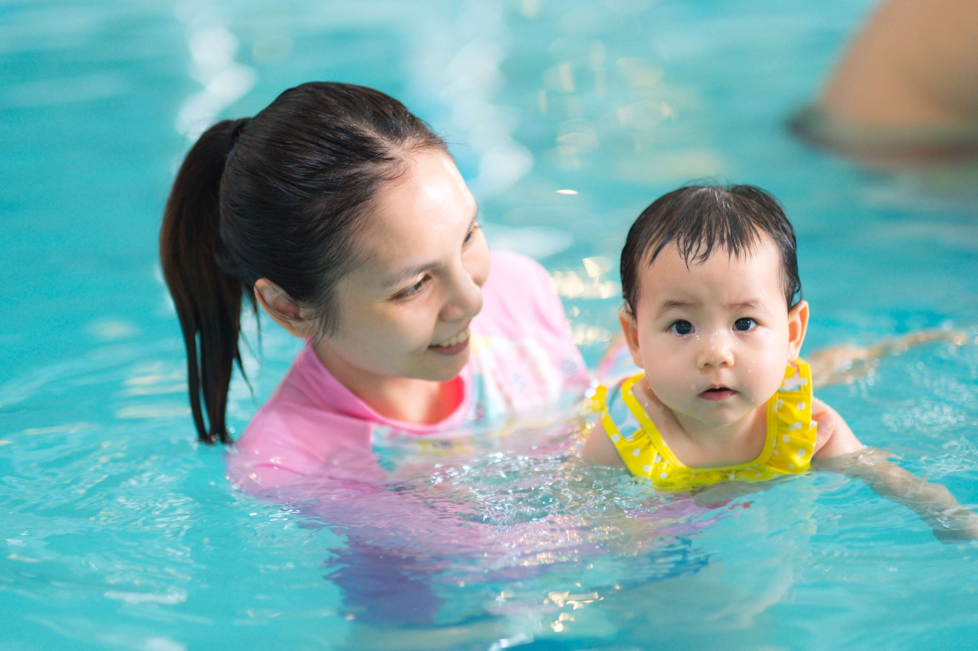
AUTHOR'S PERSPECTIVE
  The global Baby Swimming Pools market will expand significantly by 3.50% CAGR between 2024 to 2031.
  Manufacturers are always coming out with new and improved baby swimming pool designs.
  This includes accessories like inflatable seats, sunshades, and interactive toys.
  These developments can increase sales by enhancing parents' attraction to infant swimming pools.
  As more and more people live in cities, there is an increasing need for products that are compact in size.
  If parents don't have access to a backyard pool, they can consider investing in baby swimming pools.

Slide 8






KEY PLAYERS

Slide 9


For Full Report
Contact us
COGNITIVE MARKET RESEARCH
Tel: +1 312-376-8303 | +44 020-8123-0732
India: (+91) 983-496-8611
sales@cognitivemarketresearch.com
Access the Full Report : https://tinyurl.com/mrhhnhkd
Please visit our website:
https://www.cognitivemarketresearch.com

