Slide 1
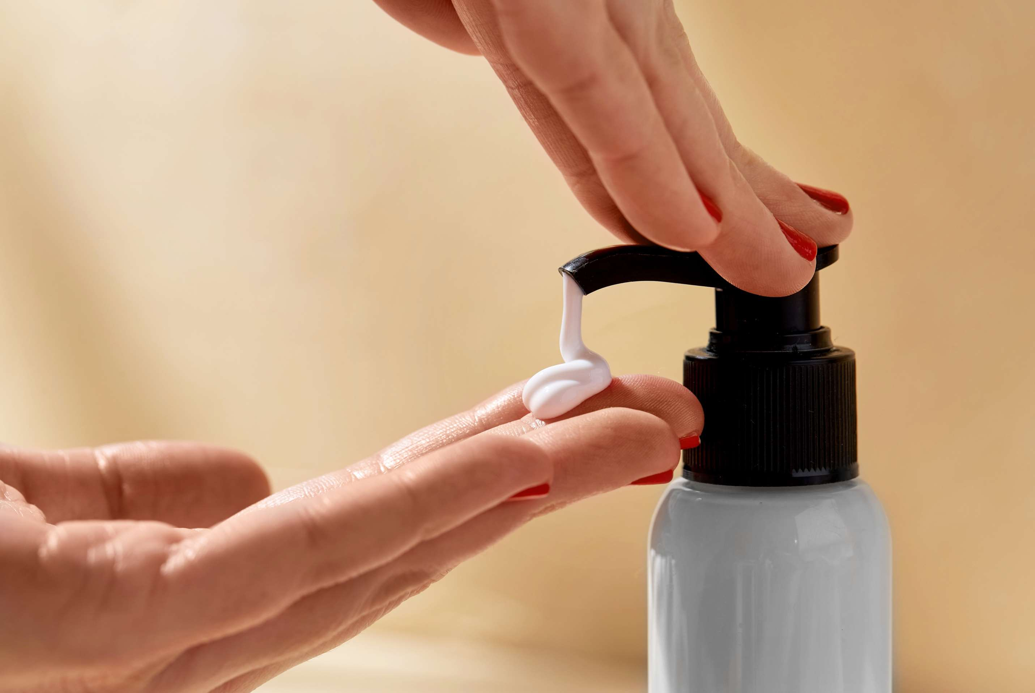

BODY LOTIONS
MARKET REPORT
2024
Qualitative Analysis + Quantitative Analysis

Slide 2
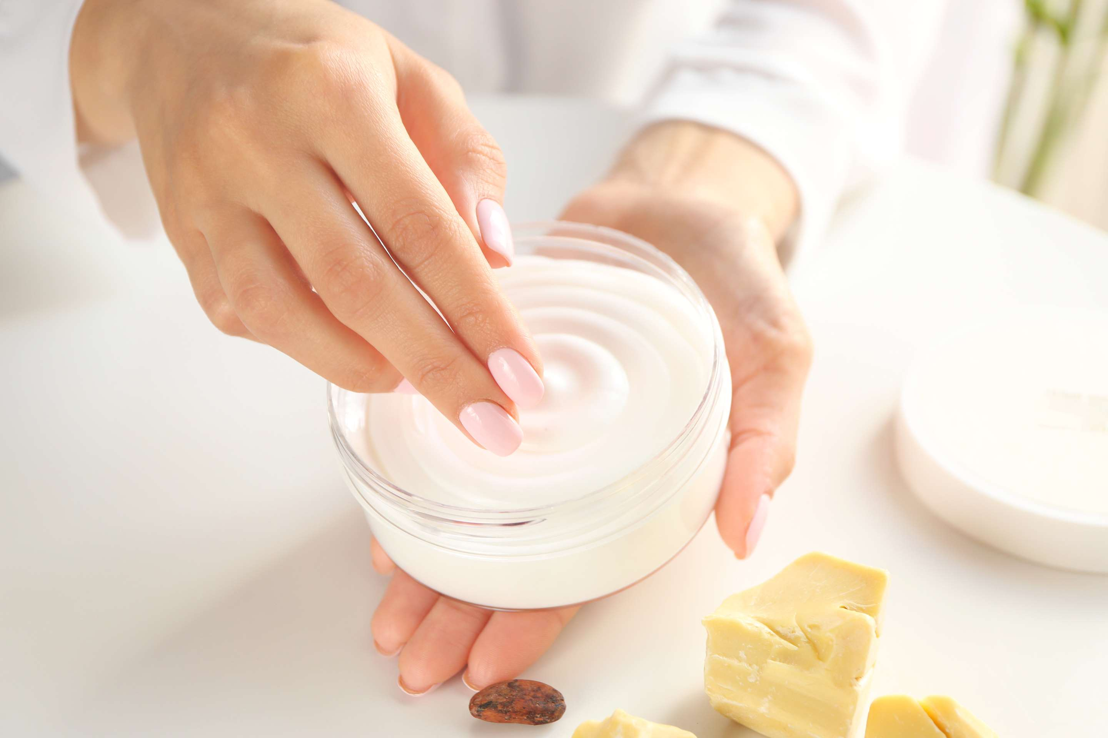
INTRODUCTION
Body lotion is a skincare product designed to moisturize and hydrate the skin. Typically made with a combination of water, oils, and other emollients, it is applied to the body after bathing or showering to replenish lost moisture, soothe dryness, and promote overall skin health and softness. The increasing awareness about skincare and the importance of moisturizing, evolving beauty trends, rising skin health concerns, climate variability, innovation in body lotion formulations, growth in disposable income, demographic shifts, convenience and accessibility of body lotions across various channels, increasingly investing in skincare products, growing focus on overall wellness and self-care practices and prioritizing skincare are the major factors influencing the growth of the Body Lotion Market.

Slide 3
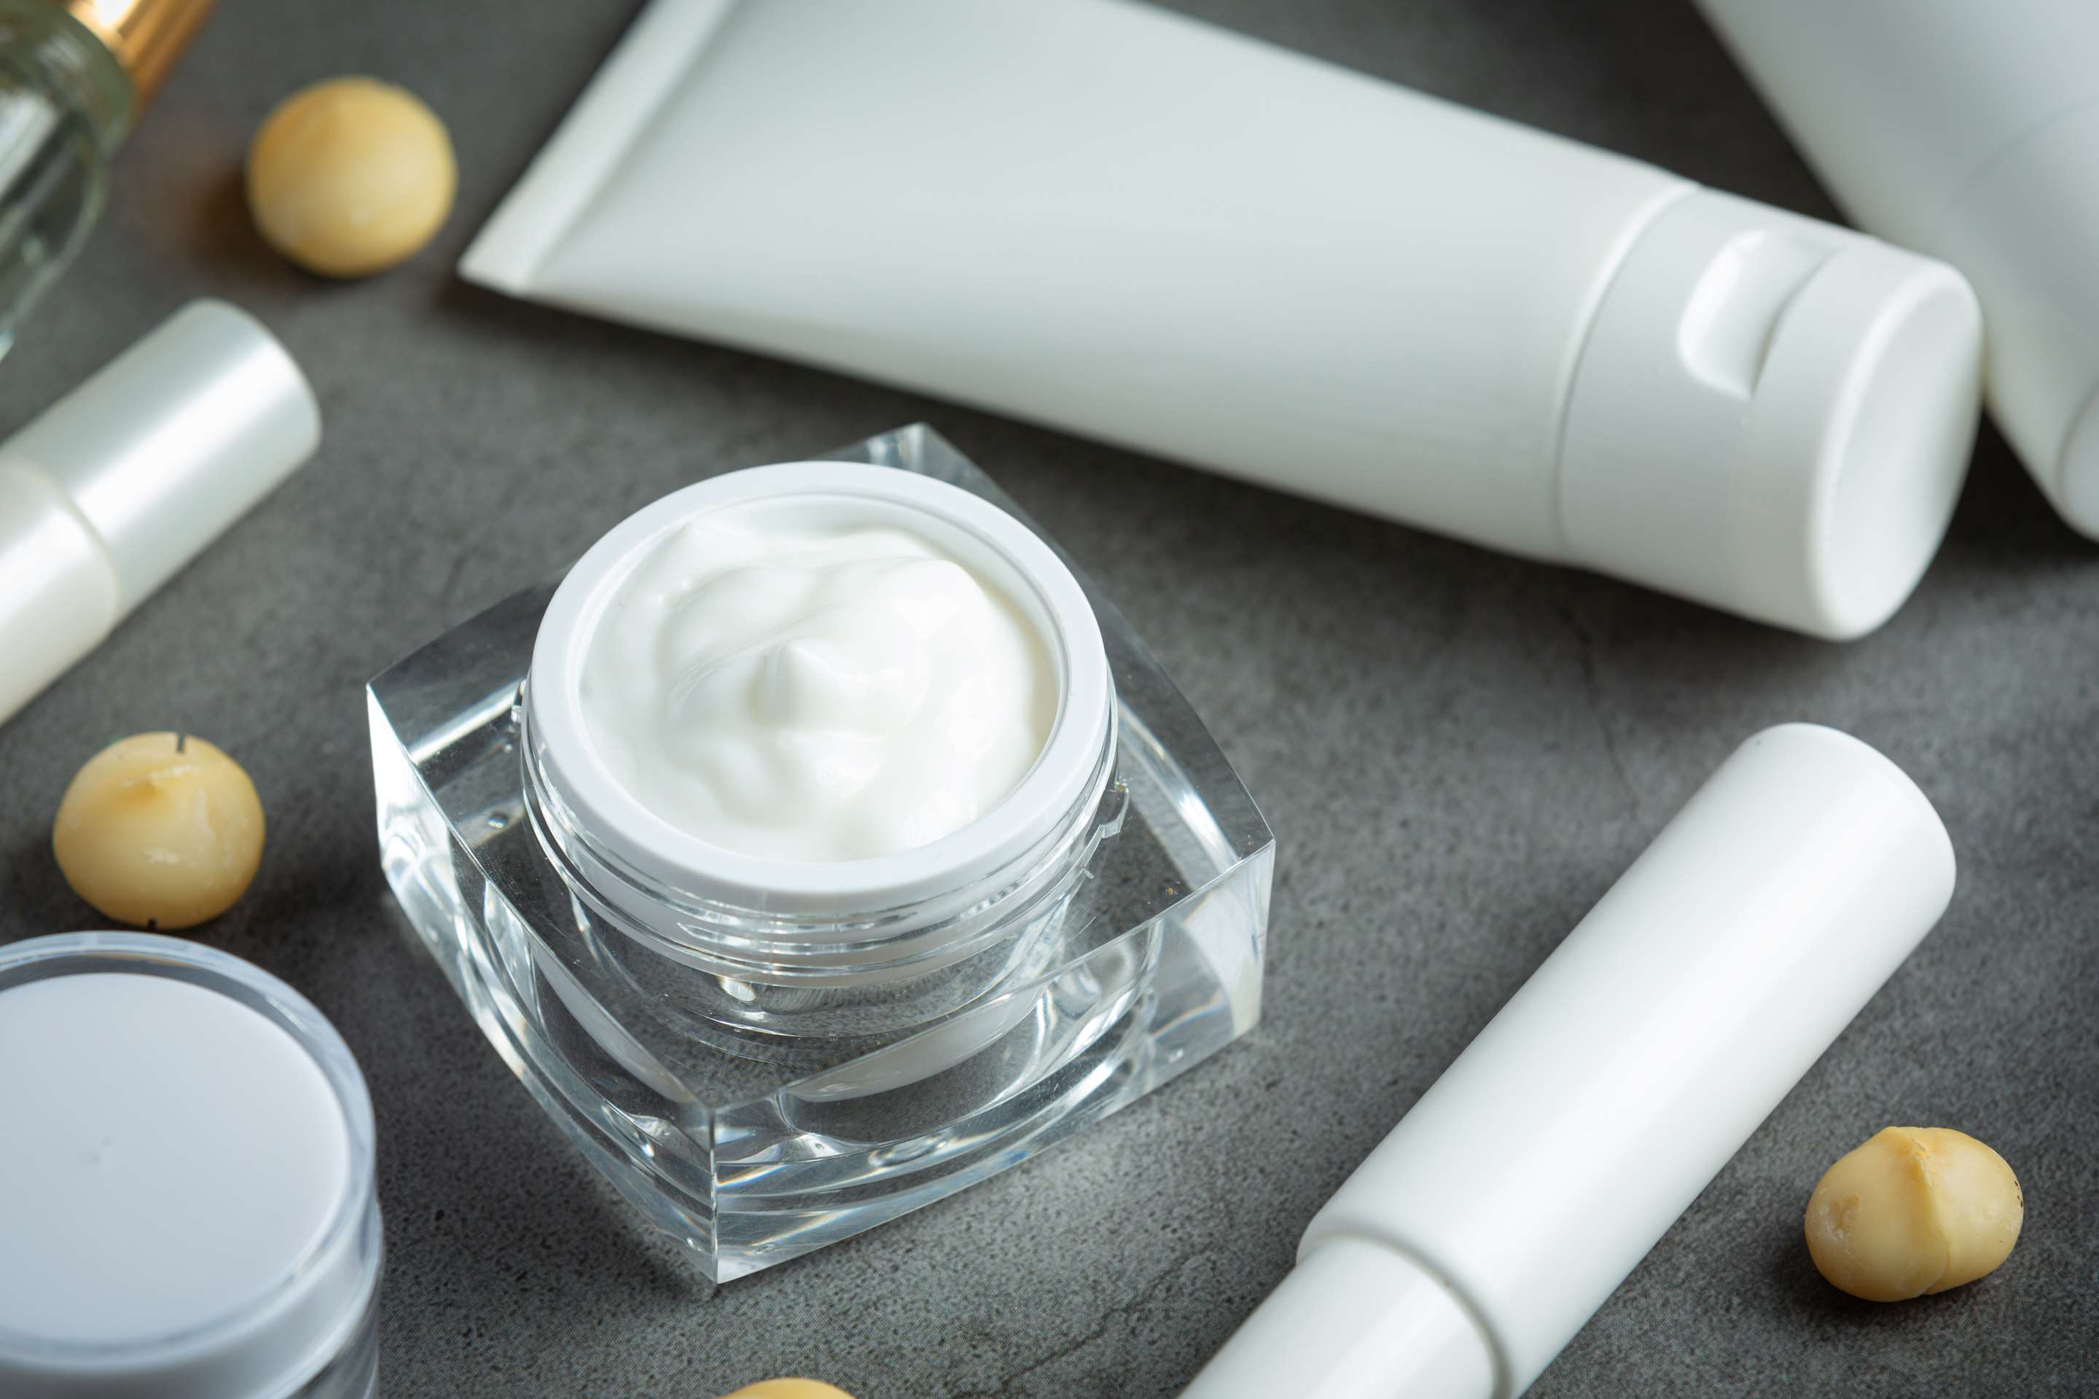

KEY INSIGHTS
MARKET SIZE
USD 57185.2 million
2024
CAGR
4.50%
2024- 2031

Slide 4

REVENUE MARKET SHARE BY SEGMENTS 2024
Type Segment
Packaging Segment
  Dry Skin
  Oily Skin
  Normal Skin
  Sensitive Skin
  Bottles
  Tubes
  Pumps
End-user Segment
Distribution Channel
  Male
  Female
  Kids
  Supermarket and Hypermarket
  Specialty Store
  Online Channel

Slide 5

REGION ANALYSIS
NORTH AMERICA
Europe
Asia Pacific
Latin America
MIDDLE EAST AFRICA
USD 22874.08 million
USD 17155.56 million
USD 13152.60 million
USD 2859.26 million
USD 1143.70 million

Slide 6
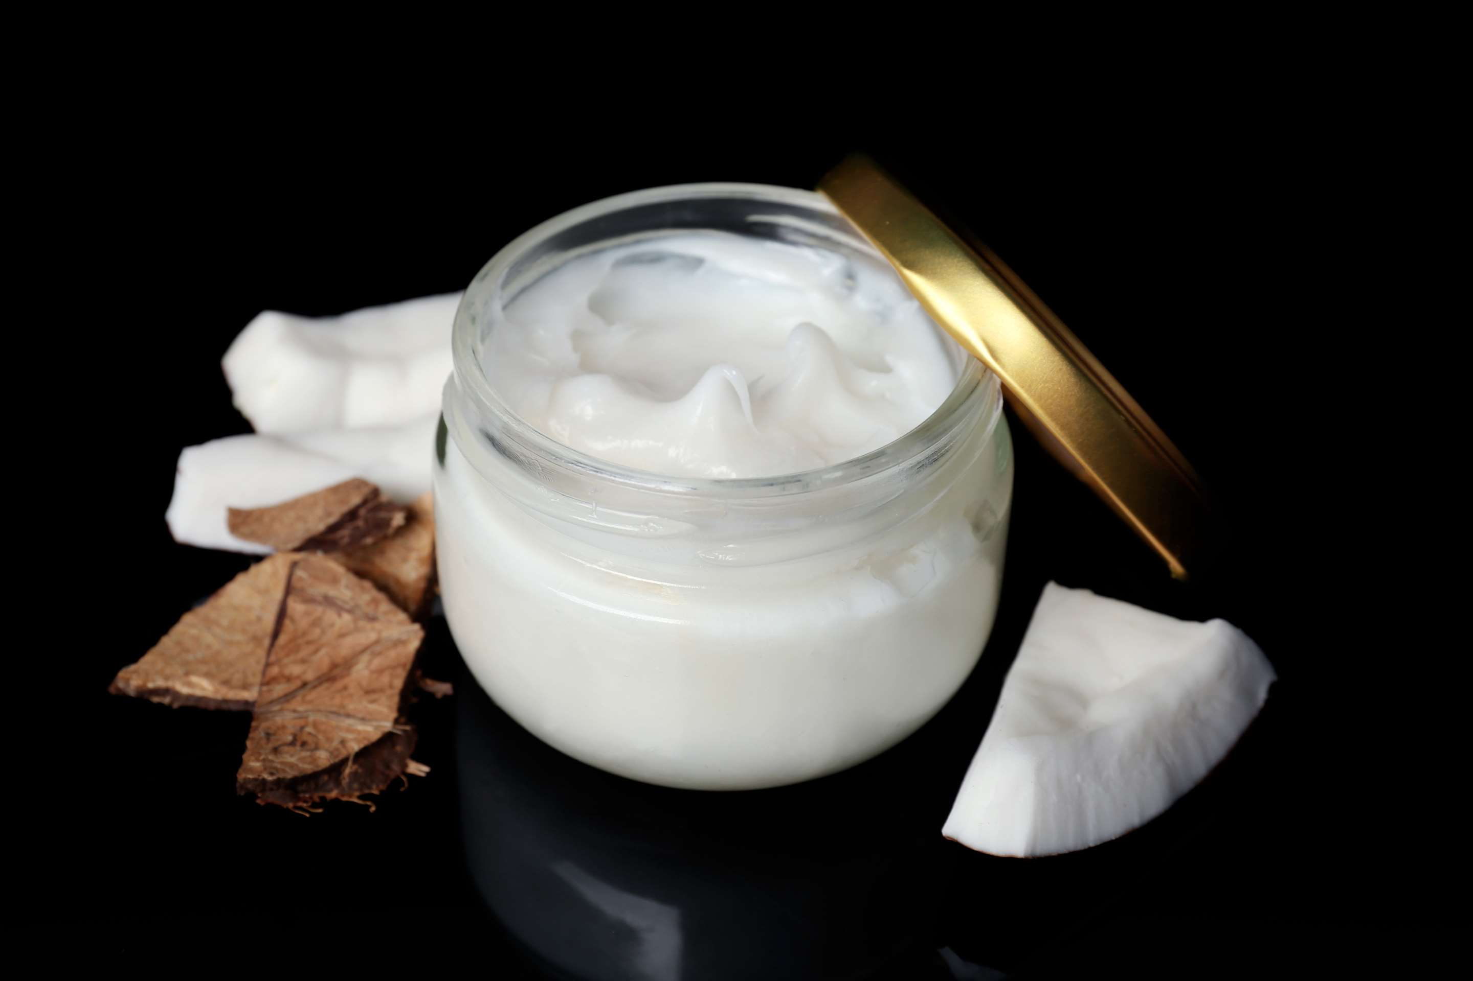
  Growing Awareness about Personal Grooming to Provide Viable Market Output
  Growth in Millennial Population to Propel Market Growth
Drivers
Restraints
Price Sensitivity to Restrict Market Growth

Slide 7
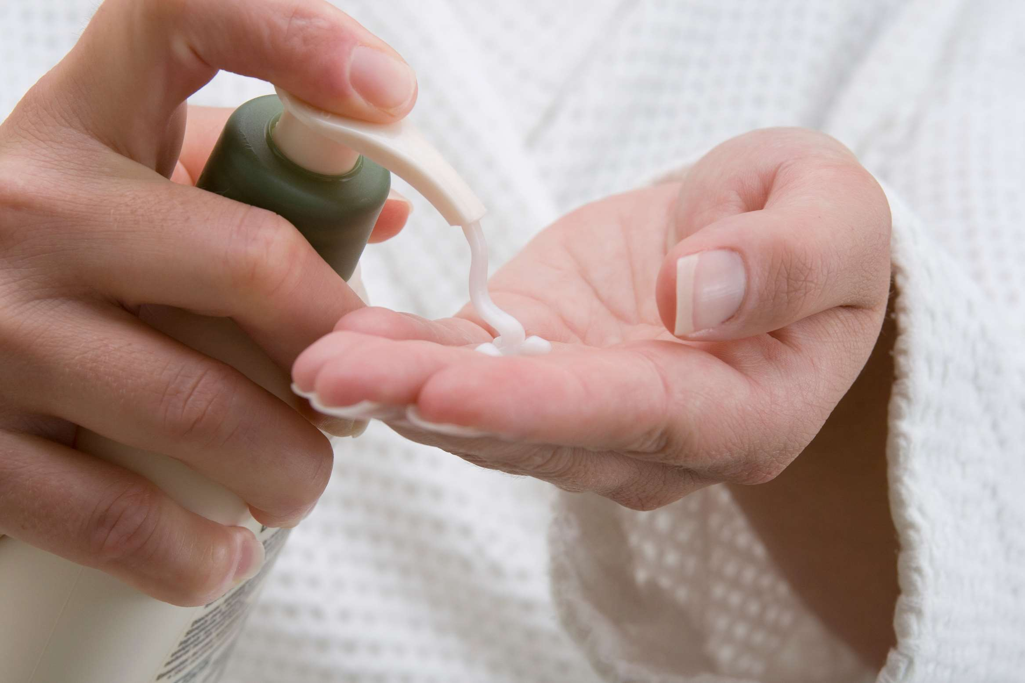
AUTHOR'S PERSPECTIVE
  The global Body Lotion market will expand significantly by 4.50% CAGR between 2024 and 2031.
  The dry skin segment is set to rise as it aims to provide intense hydration and nourishment.
  Evolving beauty trends, rising skin health concerns, and climate variability fuel market growth.

Slide 8









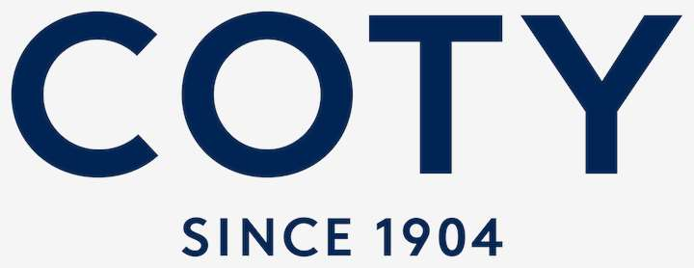
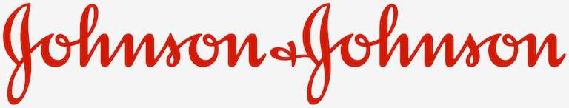
KEY PLAYERS

Slide 9


For Full Report
Contact us
COGNITIVE MARKET RESEARCH
Tel: +1 312-376-8303 | +44 020-8123-0732
India: (+91) 983-496-8611
sales@cognitivemarketresearch.com
Access the Full Report : https://tinyurl.com/46kzshda
Please visit our website:
https://www.cognitivemarketresearch.com

