Slide 1
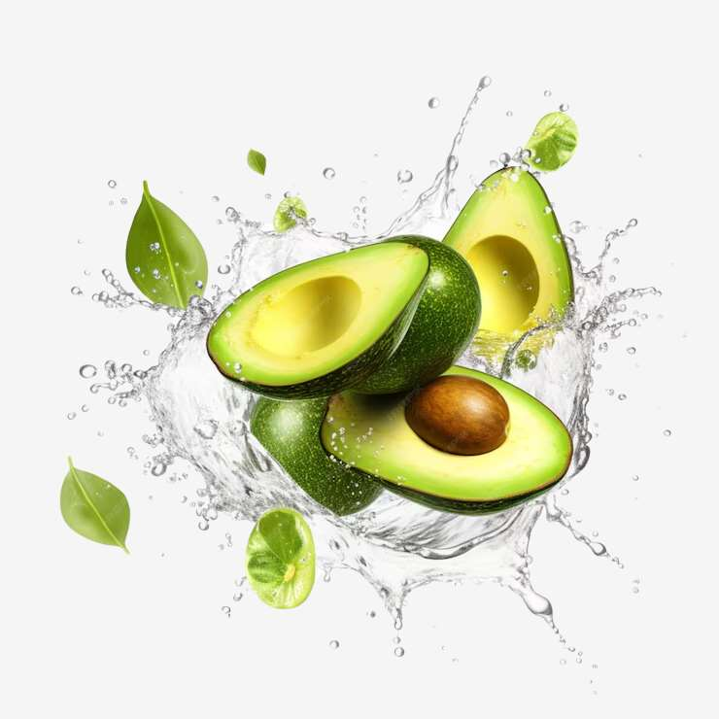
GLOBAL
AVOCADO
MARKET REPORT
2024
Global,Regional,CountryAnalysis

Slide 2
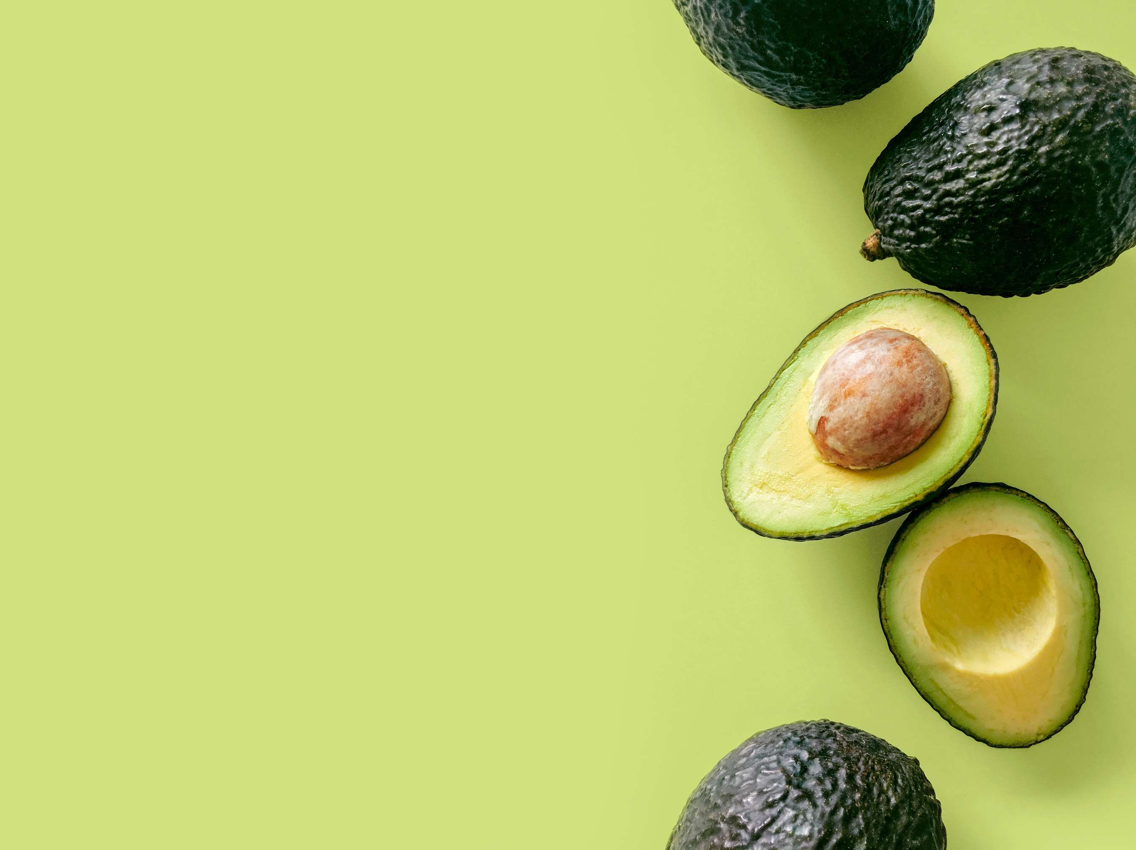
INTRODUCTION
The production, marketing, and consumption of avocados—a highly prized fruit renowned for its flavor and nutritional value—are all included in the avocado market. Because of their adaptability to various cuisines and meals, avocados are mostly farmed in regions with ideal weather, such as Mexico, California, and South America. Global demand for avocados is gradually rising. A major driver of market expansion is growing consumer knowledge of avocados' health benefits, which include their high vitamin, mineral, and healthy fat content. Demand has also increased due to the rising appeal of avocado-based foods like toast and guacamole. The avocado market is growing due to changing dietary habits and lifestyle trends, despite sporadic obstacles, including weather-related delays and logistical limitations.

Slide 3
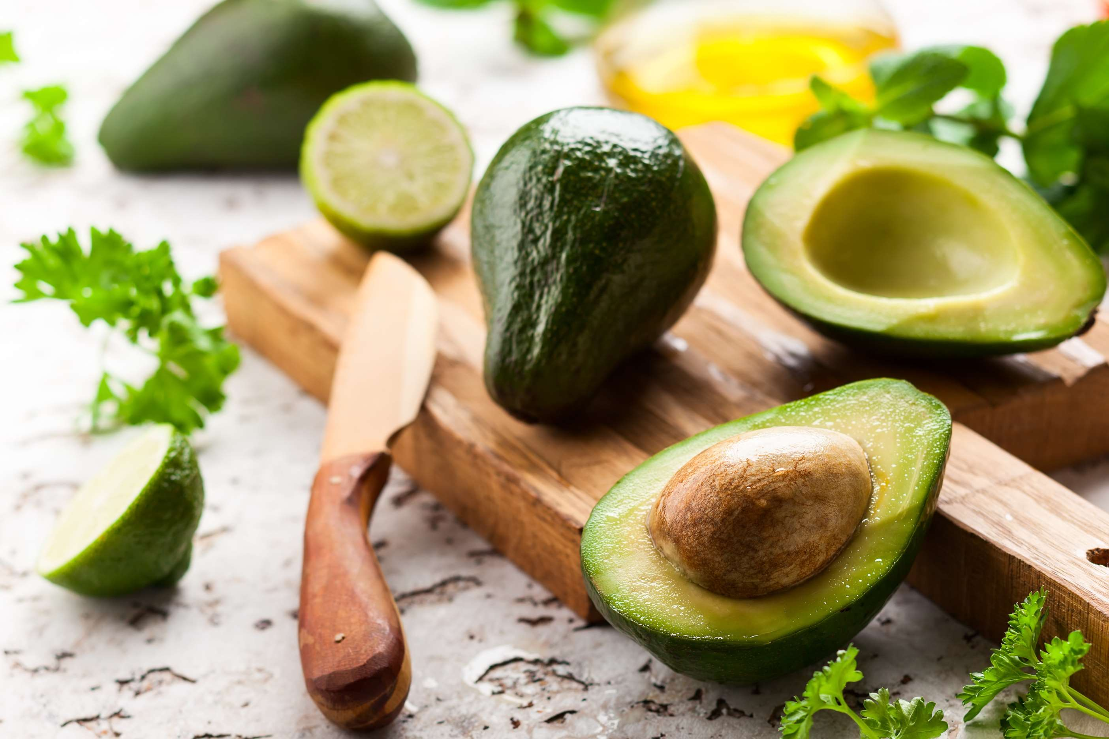

KEY INSIGHTS
MARKET SIZE
USD 15548.2 million
2024
CAGR
9.70%
2024- 2031

Slide 4
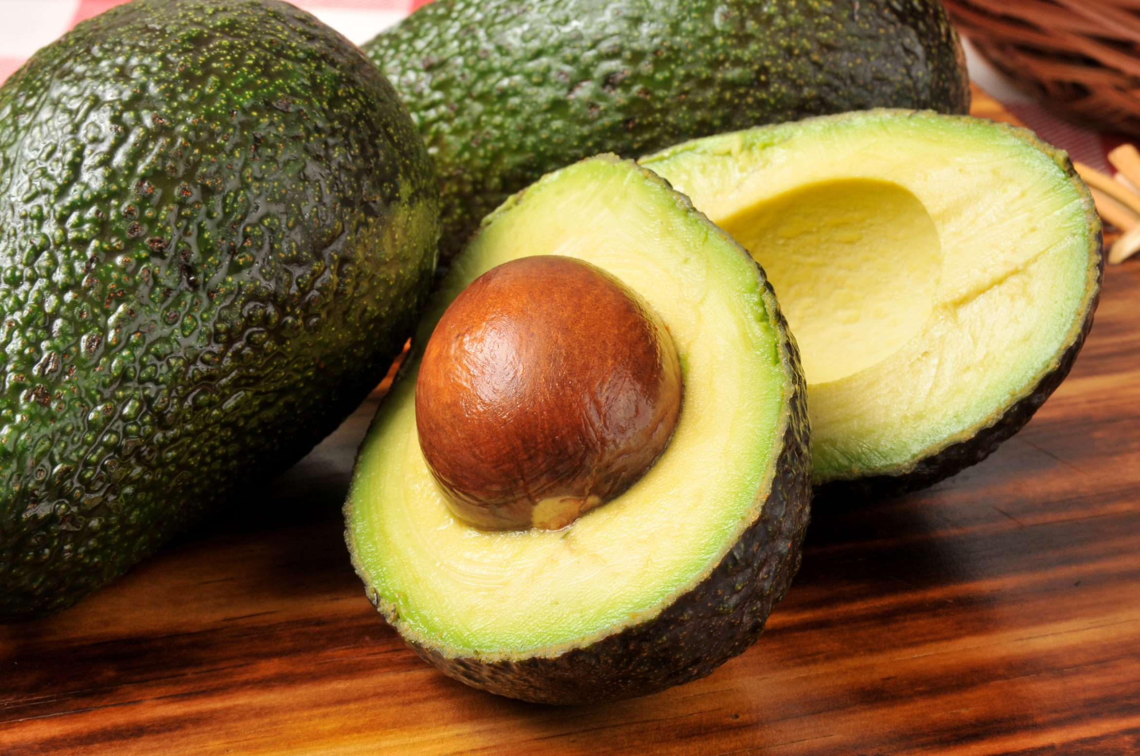
REVENUE MARKET SHARE BY SEGMENTS 2022
  Organic
  Conventional
Nature Segment
  Hass
  Reed
  Fuerte
Source Segment
  Food & Beverages Industry
  Snacks
  Dairy Products
  Sauces & Dressings
  Bakery Products
End-Use Segment
  Direct Sales
  Indirect Sales
  Store Based Retailing
Distribution Channel
  Raw
  Processed Oil
  Guacamole
  Puree
Form Segment

Slide 5

Global Avocado Market Revenue share for 2024
North America
40%

Slide 6
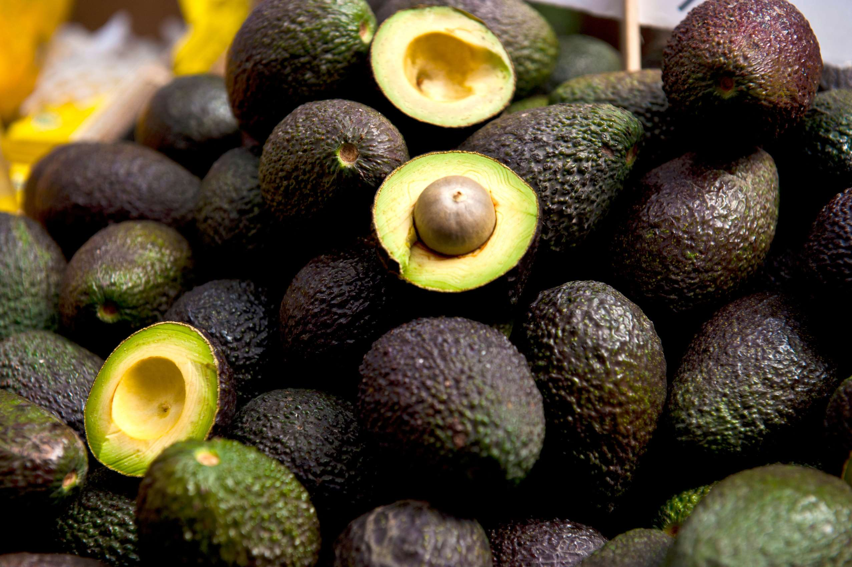
  Growing Health and Wellness Trends to Increase the Demand Globally
  Rising Popularity of Avocado-based Dishes to Propel Market Growth
Drivers
Environmental Concerns to Limit the Sales
Restraints

Slide 7
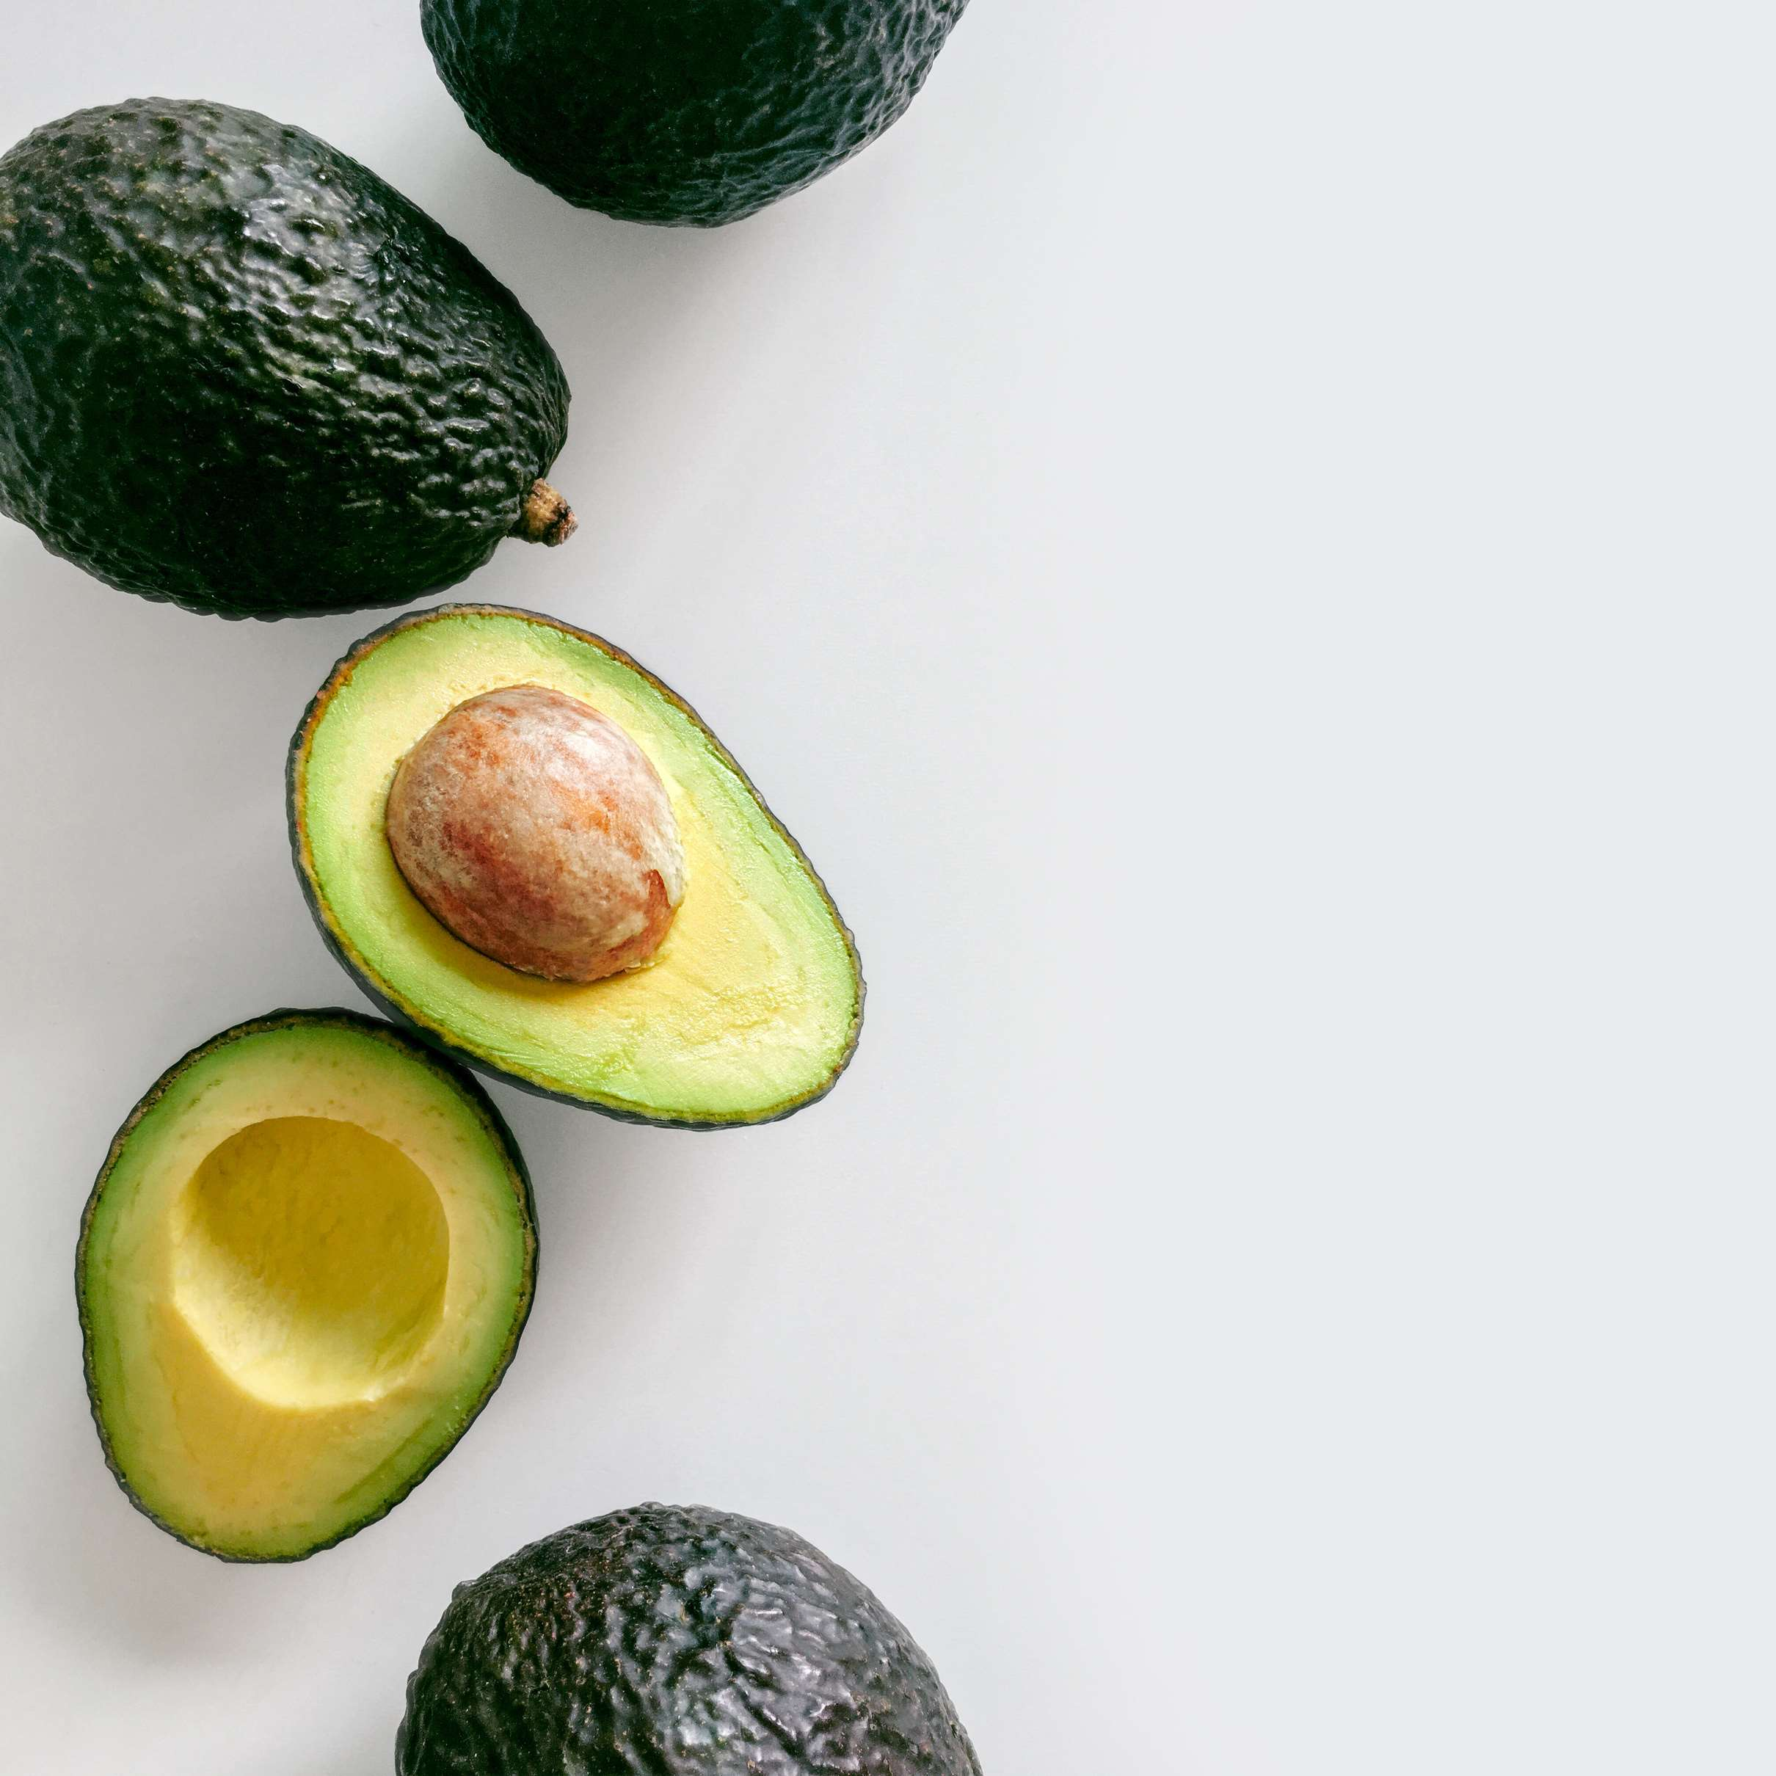
AUTHOR'S PERSPECTIVE
  The global Avocado market will expand significantly by 9.70% CAGR between 2024 to 2031.
  Improved international trade networks and increased avocado production in countries like Mexico, Peru, and Colombia guarantee increased availability and affordability for consumers everywhere.
  Marketing and promotional initiatives: Prominent producers and merchants have launched extensive marketing campaigns that emphasize the health advantages and adaptability of avocados, which further propel the market's expansion.

Slide 8
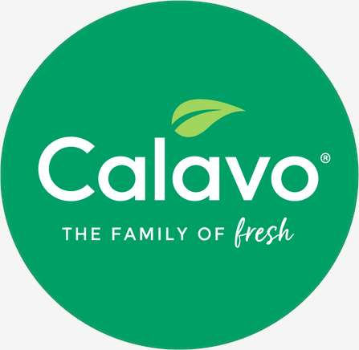
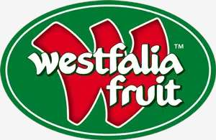

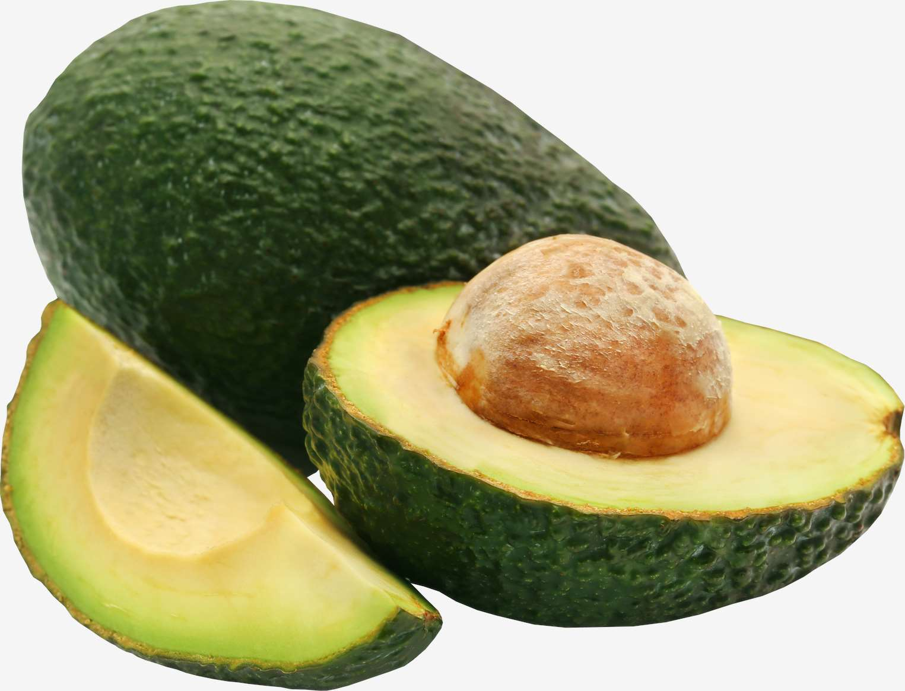




KEY PLAYERS

Slide 9


For Full Report
Contact us
COGNITIVE MARKET RESEARCH
Tel: +1 312-376-8303 | +44 020-8123-0732
India: (+91) 983-496-8611
sales@cognitivemarketresearch.com
Access the Full Report : https://tinyurl.com/49whdeav
Please visit our website:
https://www.cognitivemarketresearch.com

