Slide 1
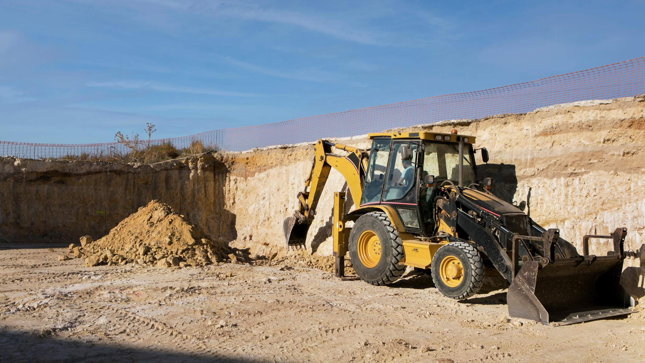
AUTONOMOUS MINING TRUCK MARKET REPORT

Slide 2
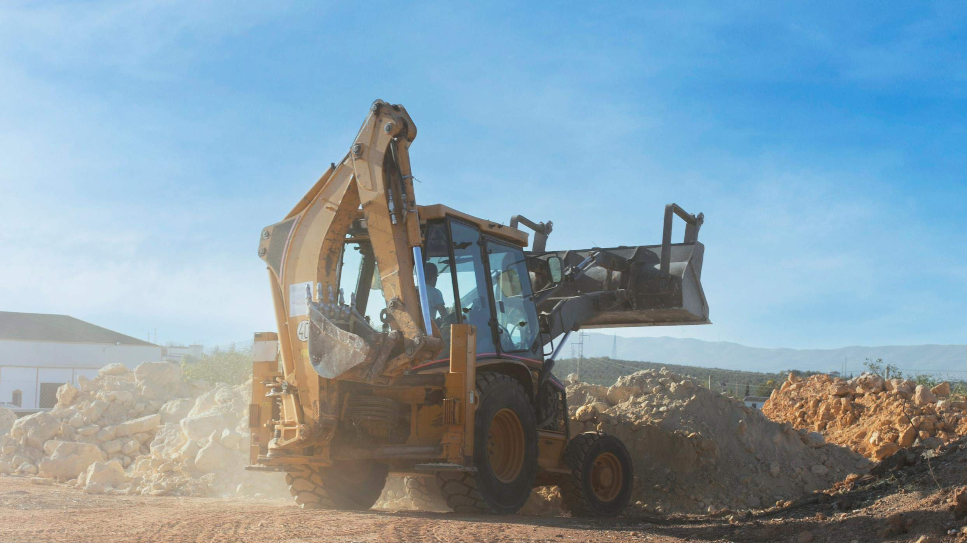
Introduction
Autonomous mining trucks are heavy equipment used by the mining industry to transport ore and other materials. These trucks are regularly large, weighing hundreds of metric tons. They are usually powered by diesel engines, while electric models are becoming more common.

Slide 3
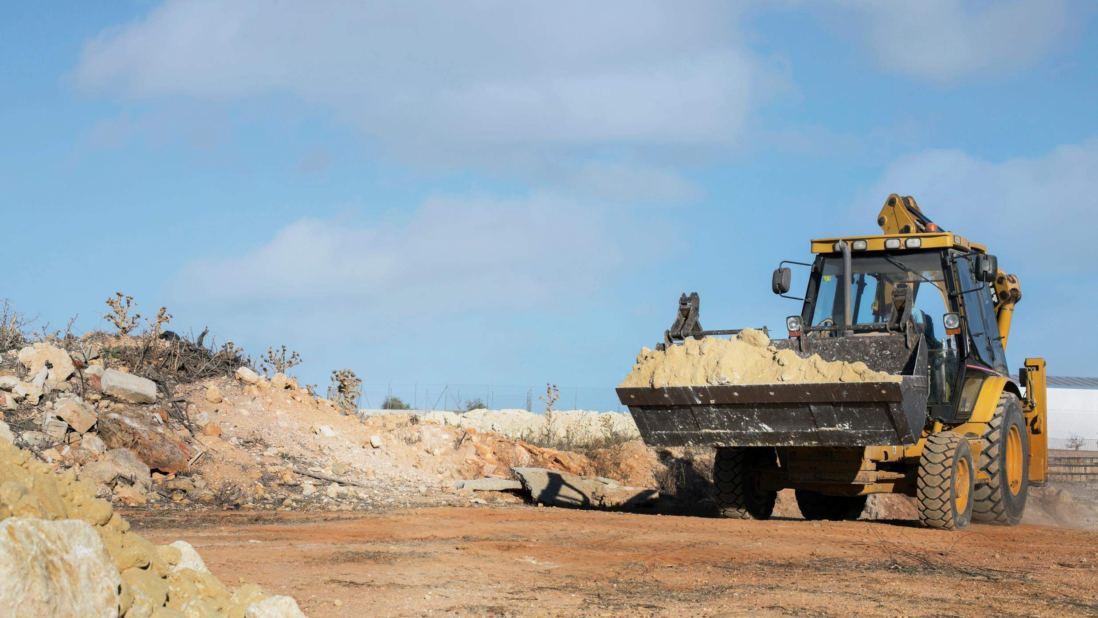

Key Insights
MARKET SIZE (2022)
6.8 BILLION
FORECAST (2030)
10.2 BILLION
CAGR (2023-2030)
24.2 %

Slide 4
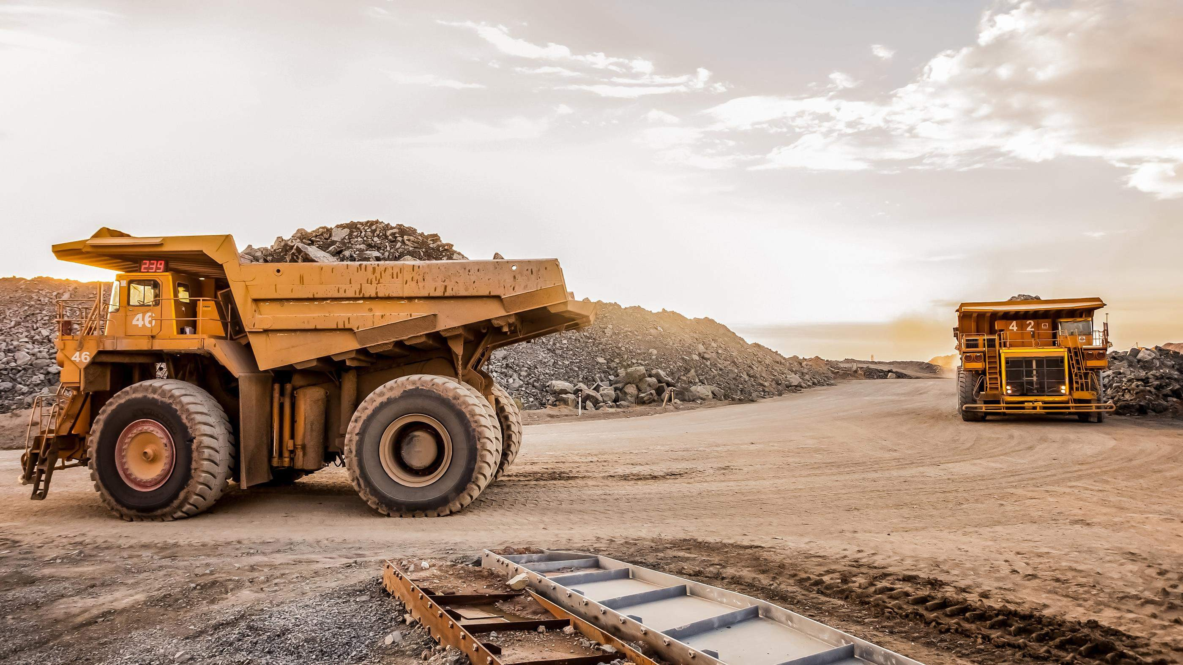
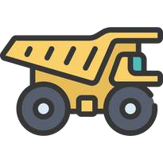
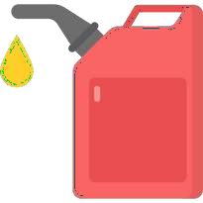
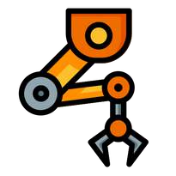
Revenue Market Share by Segments 2022
Size Large: 36.4%
Propulsion Diesel : 48.3%
Autonomy
level 1 and 2 :
58.2%
MARKET TYPE OEM : 64.2%

Slide 5
GLOBAL AUTONOMOUS MINING TRUCK MARKET REVENUE SHARE FOR 2022
North America:
38.4%

Slide 6
Drivers
Restraints
High initial costs associated with deploying trucks
Rising concerns over the safety and reliability of autonomous mining trucks
Rising demand for smart mining and technologically advanced mining equipment
Rising concerns about carbon emissions

Slide 7
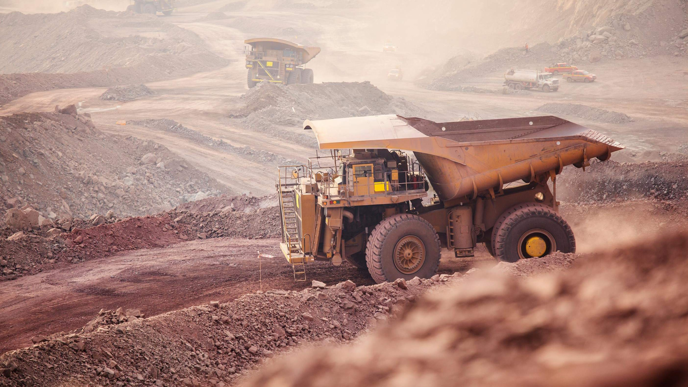
Author's Perspective
In propulsion, the market is segmented into electric and hybrid, and diesel. The electric and hybrid segment is expected to register the highest CAGR of 28.2% over the forecast period, owing to increasing development of autonomous electric mining trucks, enabling emission-free mining.
Autonomy market is divided into Levels 1 and 2, Level 3, and Levels 4 and 5. The level 1 and 2 segment is expected to register the largest share of 58.2% in the global market.
The market is segmented into small, medium, and large. Compared to other size segments, the large segment holds the highest revenue share at 36.4% and is expected to register a significant CAGR in the global market.

Slide 8
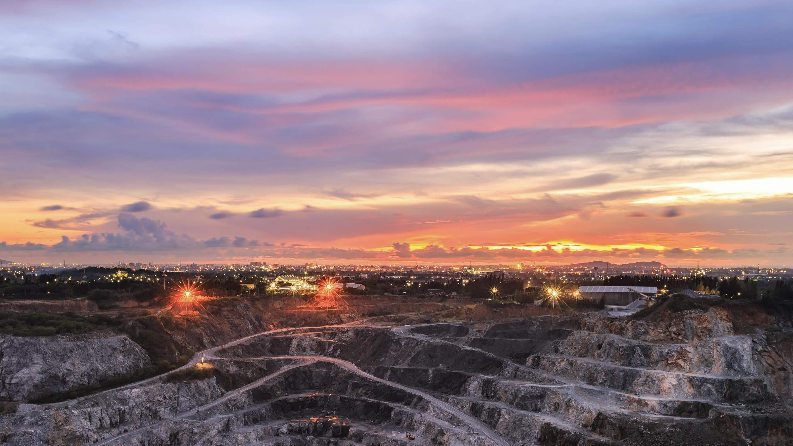
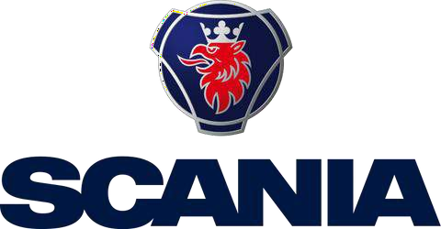





Key Players

Slide 9


Contact us
For Full Report
COGNITIVE MARKET RESEARCH
Tel: + 1 312 - 376 - 8303 | + 44 020 - 8123 - 0732
India: ( + 91 ) 983 - 496 - 8611
sales@ cognitivemarketresearch. com
Access the Full Report : http://tinyurl.com/4hc3tn23
Please visit our website:
https://www.cognitivemarketresearch.com

