Slide 1
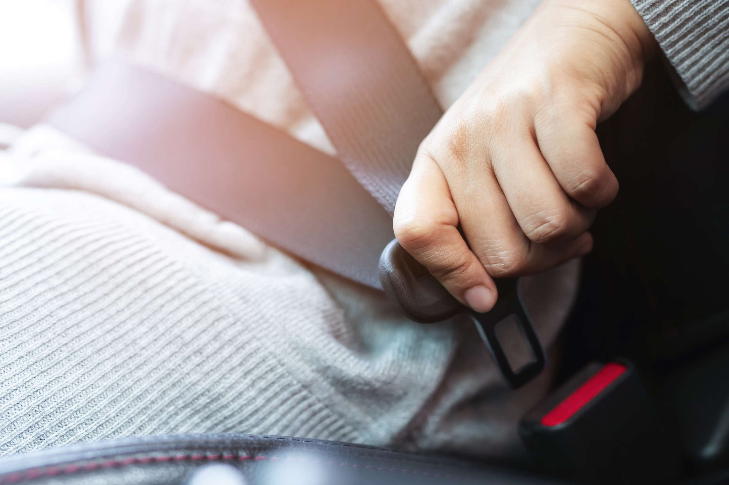
GLOBAL
AUTOMOTIVE BIOMETRIC SEAT
MARKET REPORT
2023
Global,Regional,CountryAnalysis

Slide 2

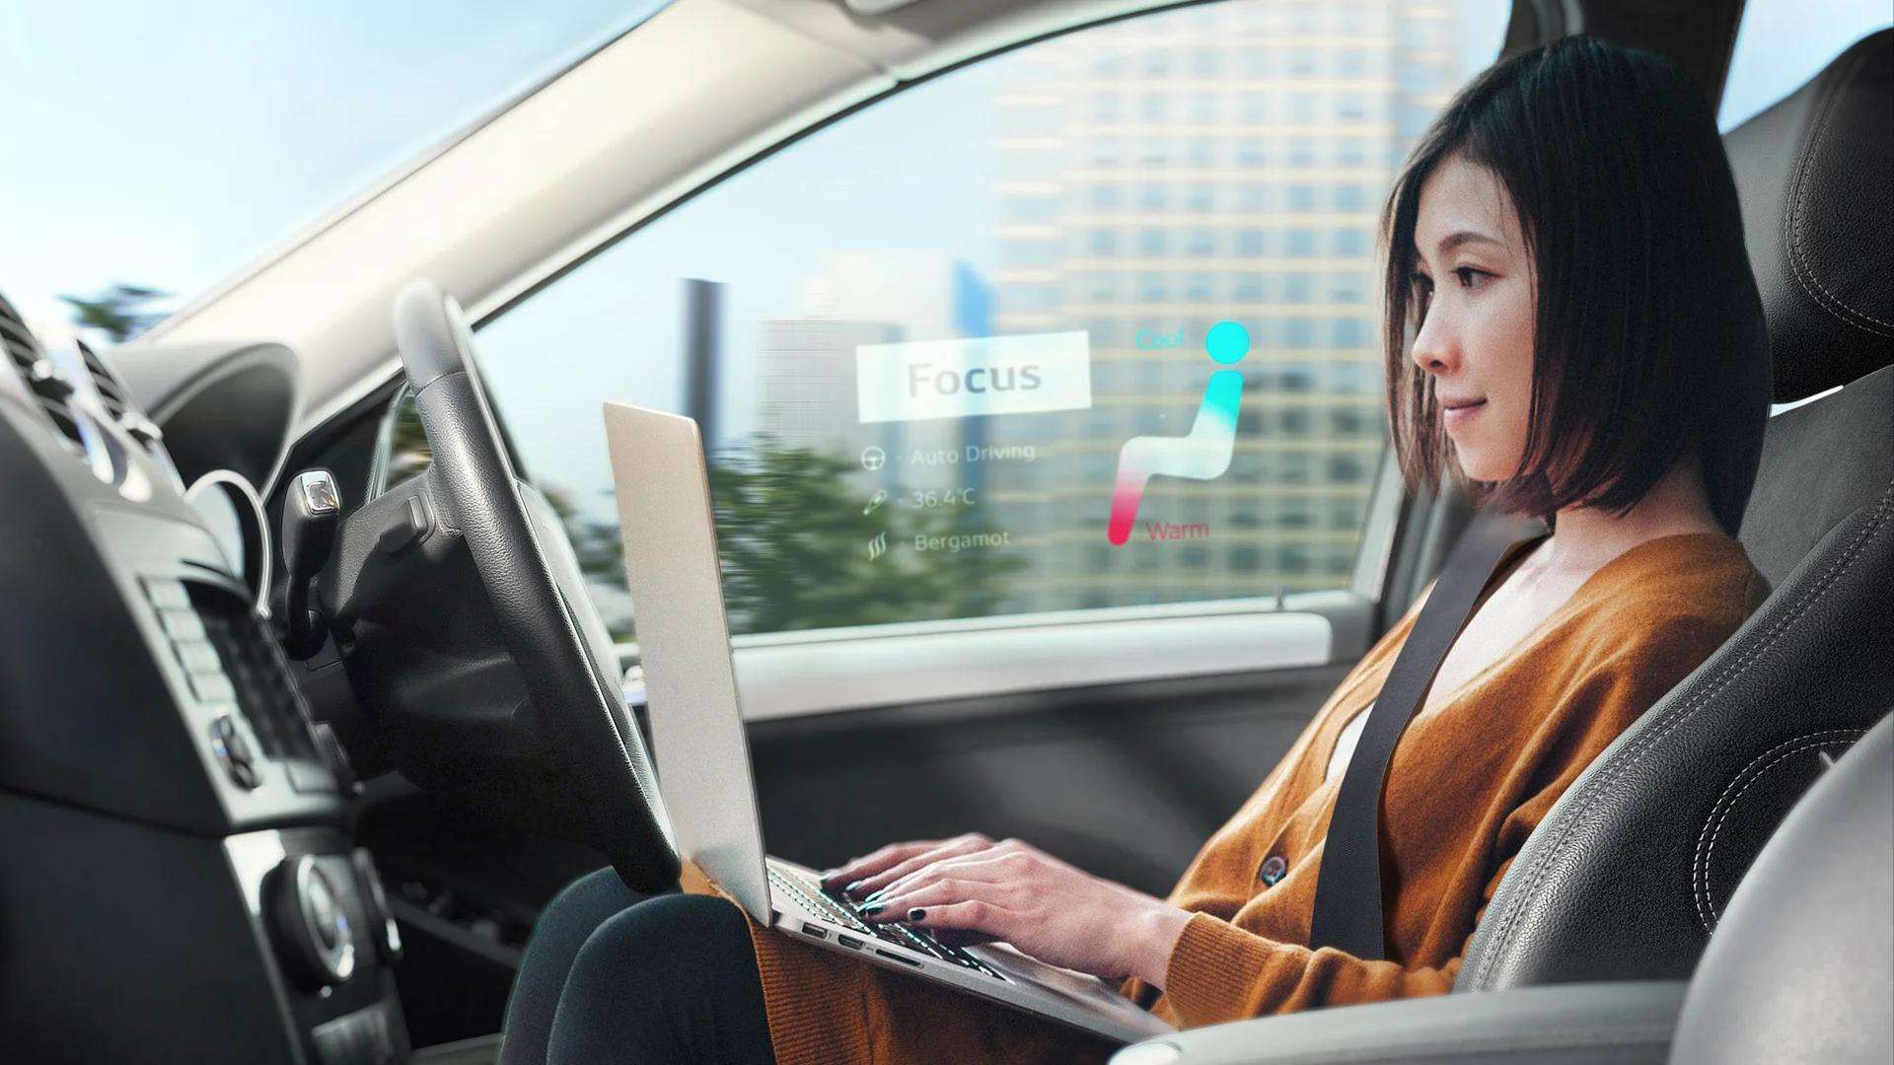
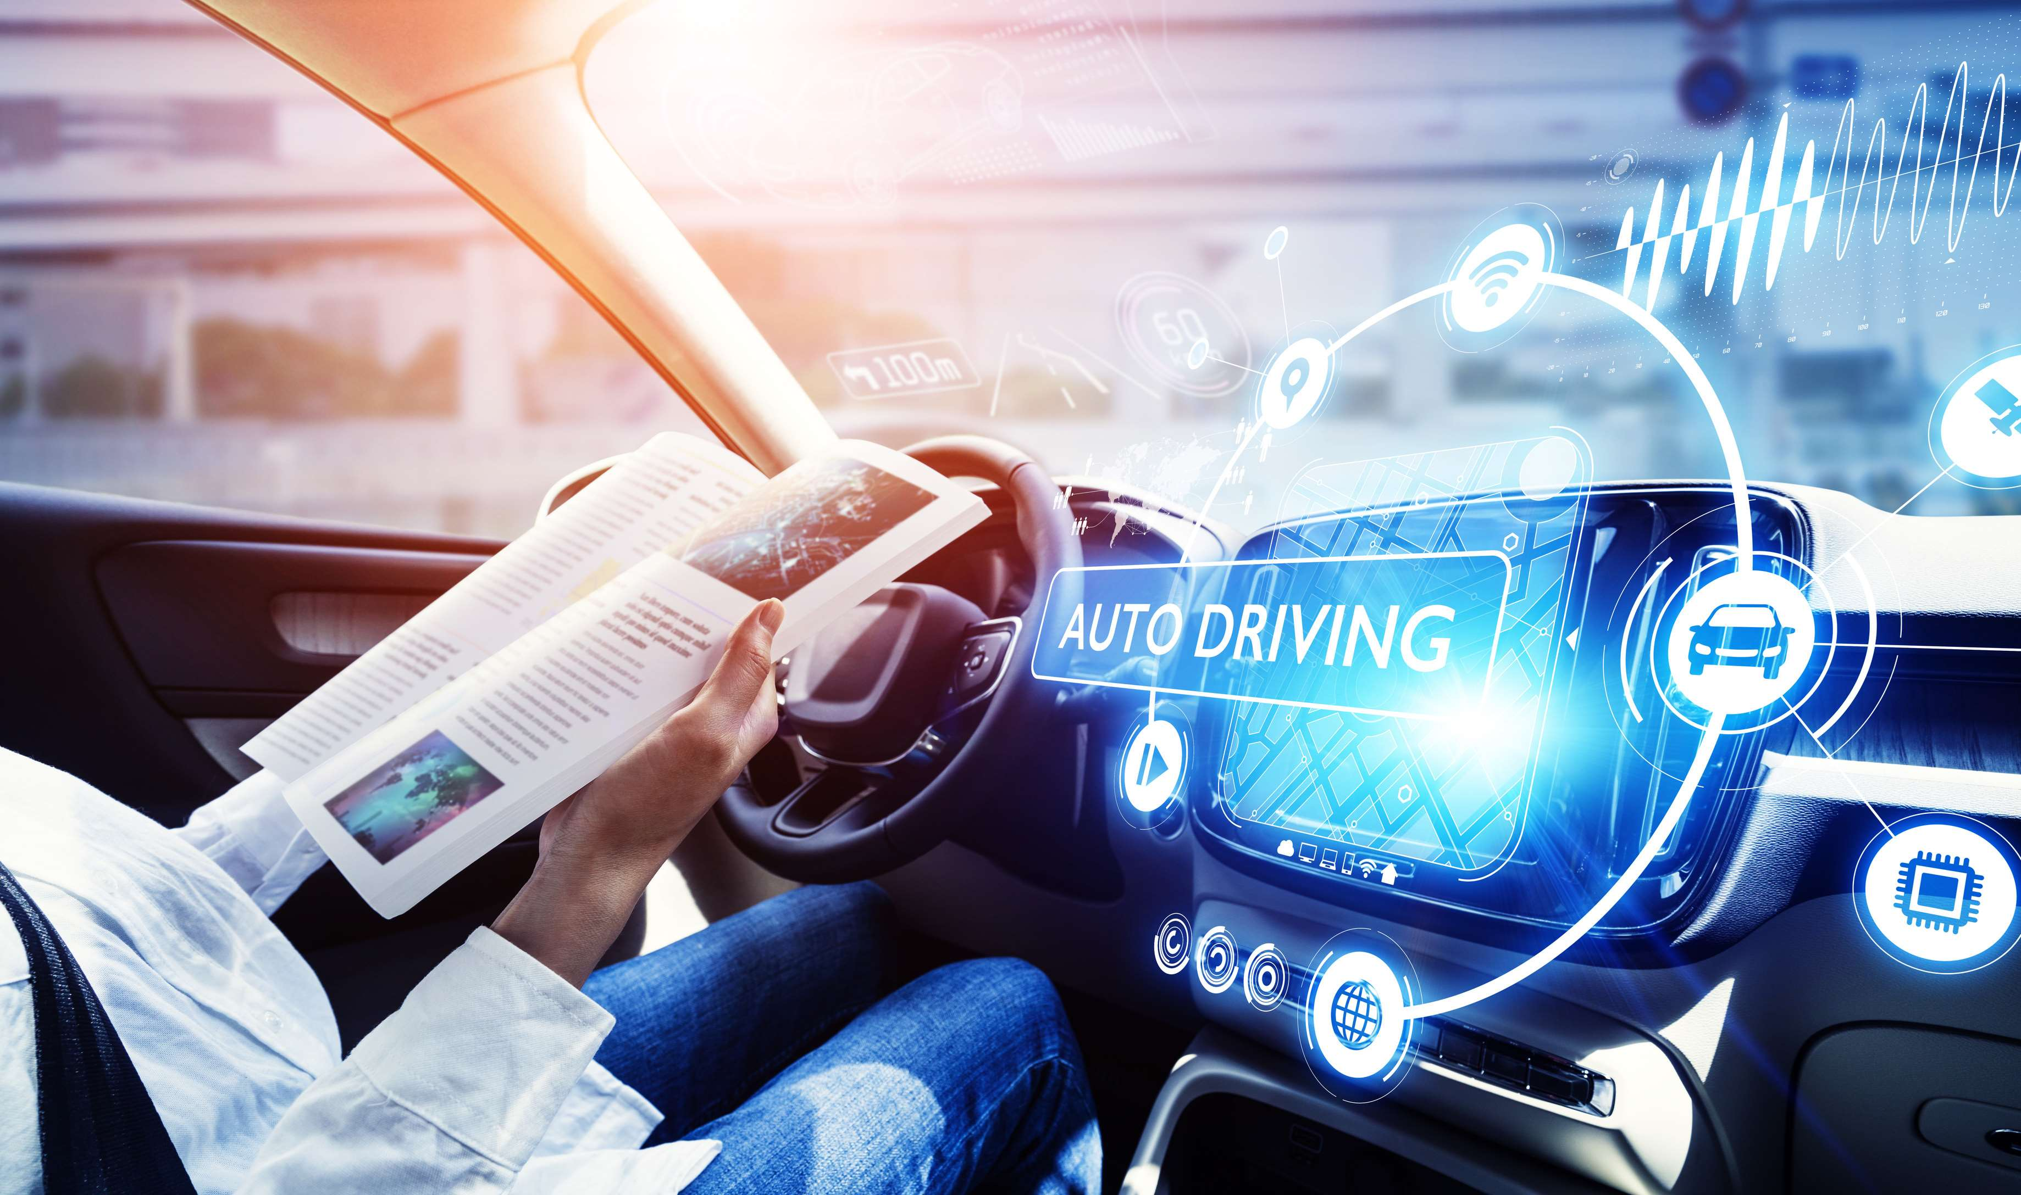
INTRODUCTION
Biometric seats are designed to monitor stress level of the driver while driving the vehicle. Biometric seats monitor the driver's heart rate and body temperature with the help of sensors.

Slide 3
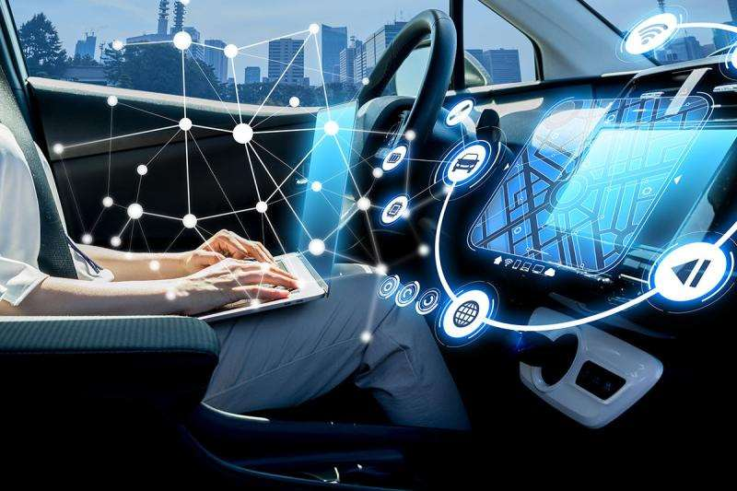

KEY INSIGHTS
MARKET SIZE
192.5 Million
2022
FORECAST
393.6 Million
2030
CAGR
9.3%
2030

Slide 4
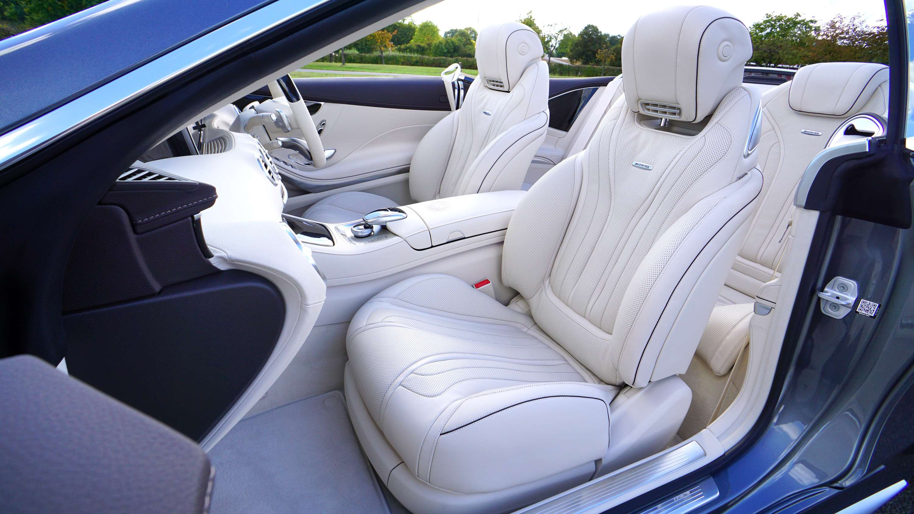




REVENUE MARKET SHARE BY SEGMENTS 2022
Component
Technology
Sensor:
48.2%
Infrared Technology:
51.2%
Vehicle Type
Channel
Passenger Vehicle: 60.2%
OEM:
65.2%

Slide 5

GLOBAL AUTOMOTIVE BIOMETRIC SEAT MARKET REVENUE SHARE FOR 2022
North America
36.4%

Slide 6
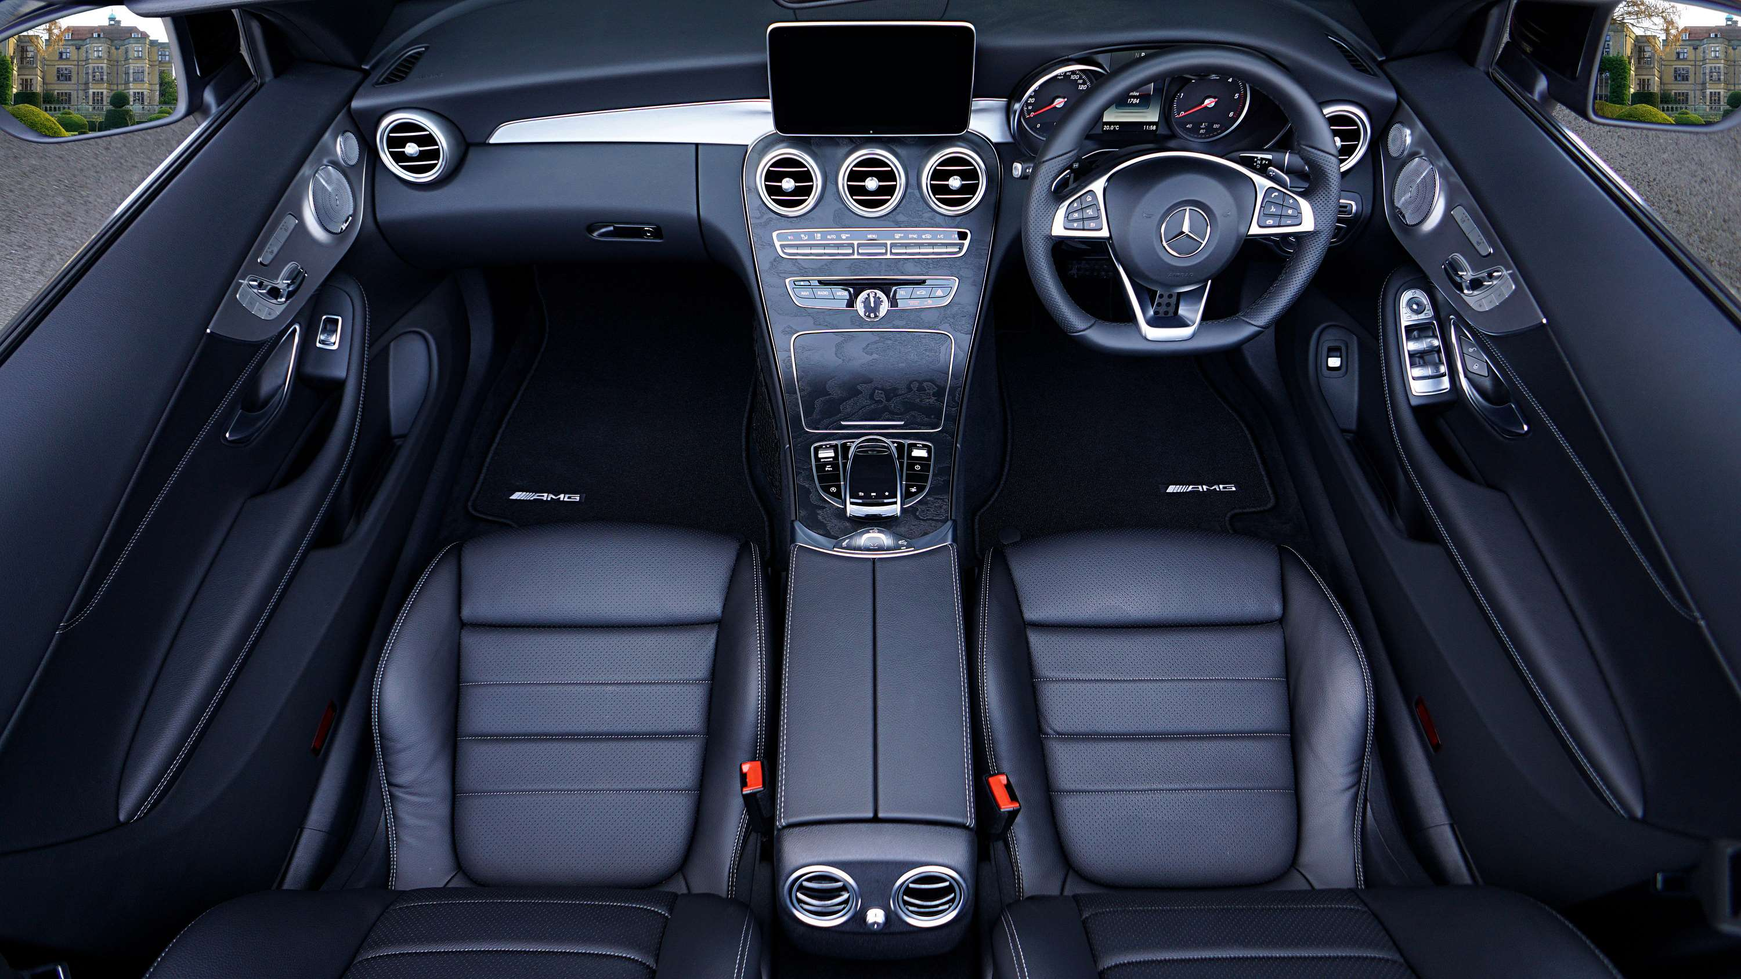
  The increasing adoption of artificial intelligence and the adoption of infotainment systems in vehicles.
  Increasing production of vehicles compliant with higher safety requirements
Drivers
Restraints
High cost of installing biometric seat

Slide 7
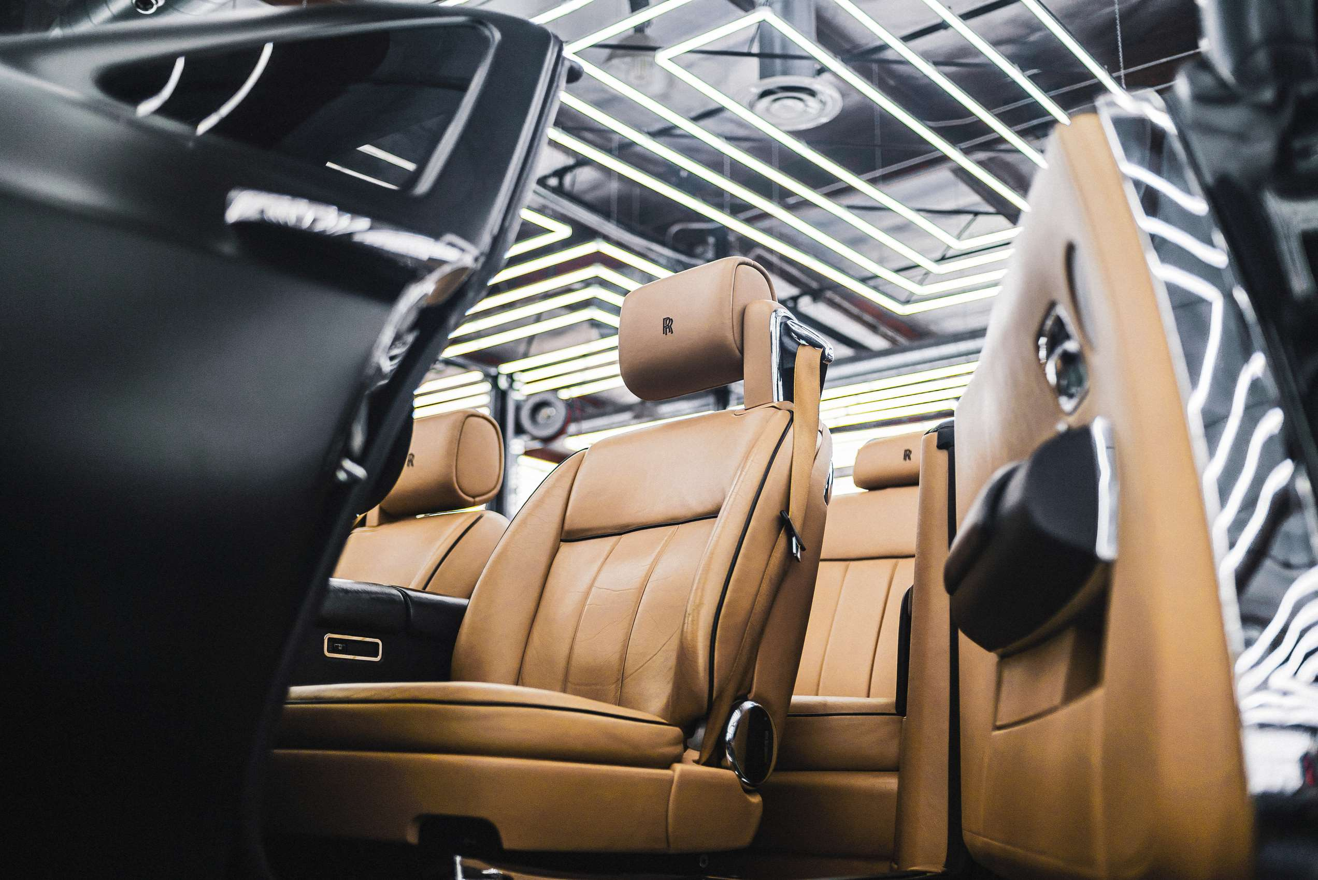
AUTHOR'S PERSPECTIVE
  With prospects in the markets for passenger cars, light commercial vehicles, and electric vehicles, the automotive biometric seat has a bright future.
  Growing worries about vehicle security and an increase in demand for luxury automobiles are the main factors driving the automotive biometric seat Market.

Slide 8









KEY PLAYERS

Slide 9


For Full Report
Contact us
COGNITIVE MARKET RESEARCH
Tel: +1 312-376-8303 | +44 020-8123-0732
India: (+91) 983-496-8611
sales@cognitivemarketresearch.com
Access the Full Report : https://shorturl.at/aVX57
Please visit our website:
https://www.cognitivemarketresearch.com

