Slide 1
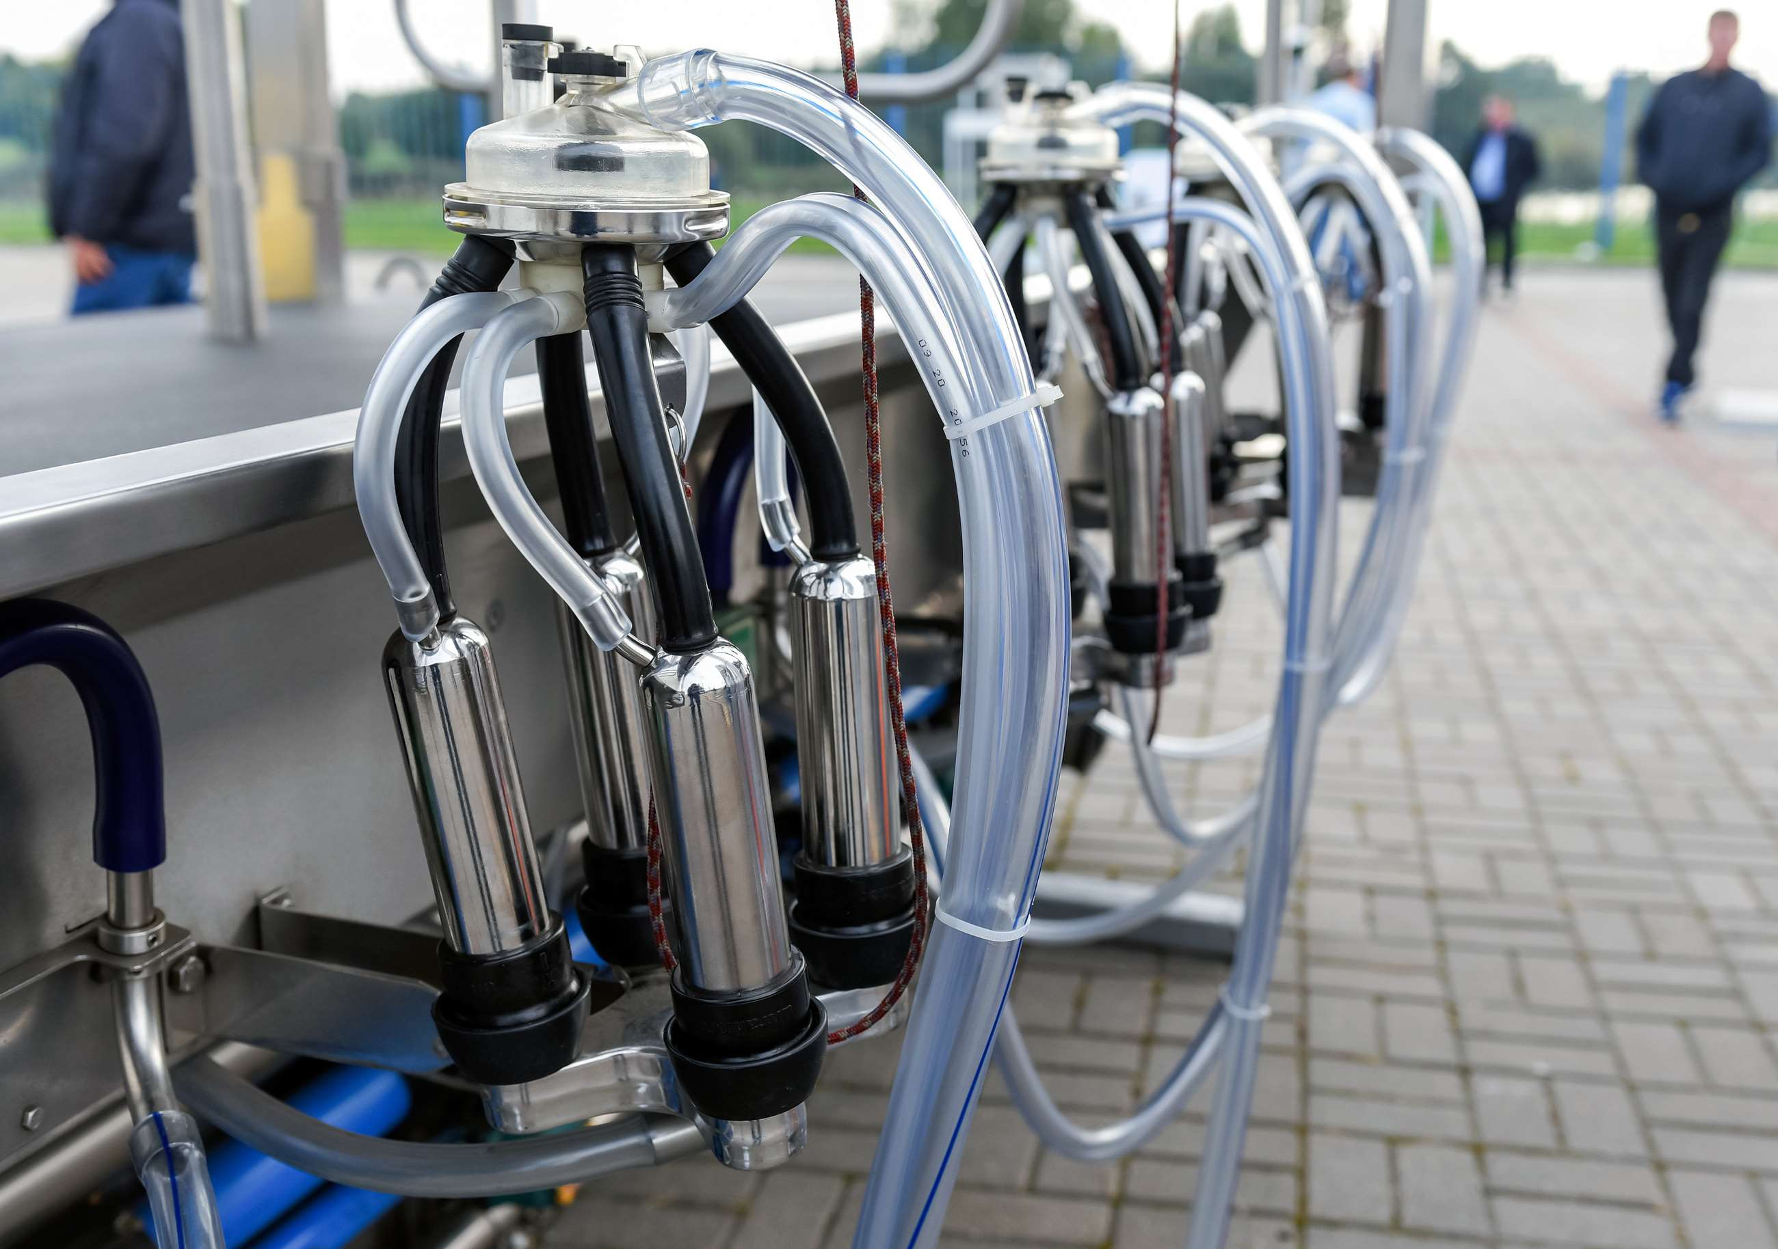
GLOBAL
AUTOMATIC TUBE CLEANING SYSTEM
MARKET REPORT 2024
Global,Regional,CountryAnalysis

Slide 2
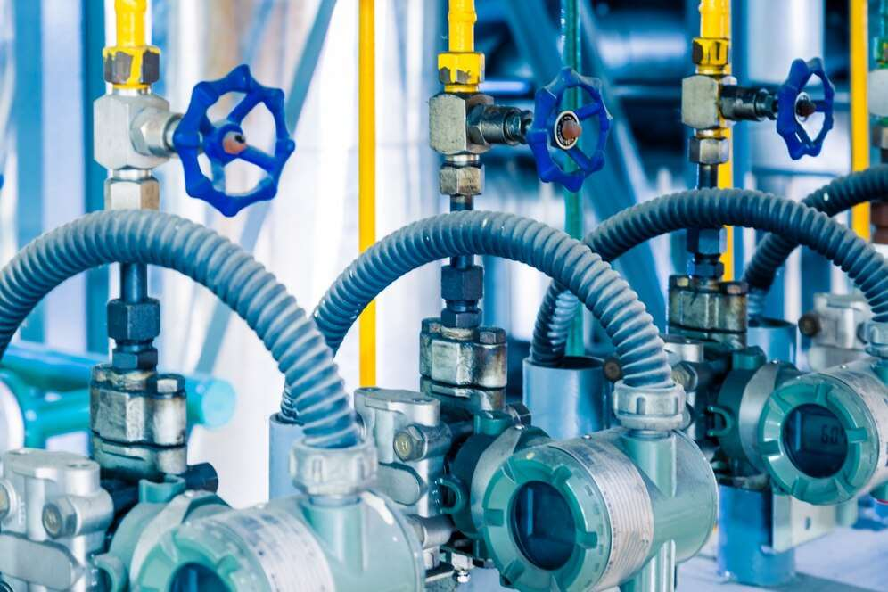
INTRODUCTION
An automatic tube cleaning system is used to prevent deposit formation in heat exchangers, and condenser tubes that are installed in industries such as power plants, refineries, hospitality, and commercial space.An automatic tube cleaning system is used to reduce the frequency of costly maintenance of machines and it helps in optimizing equipment function and saves energy on the equipment. There is an improvement in operational efficiency due to the use of an automatic tube cleaning system.

Slide 3
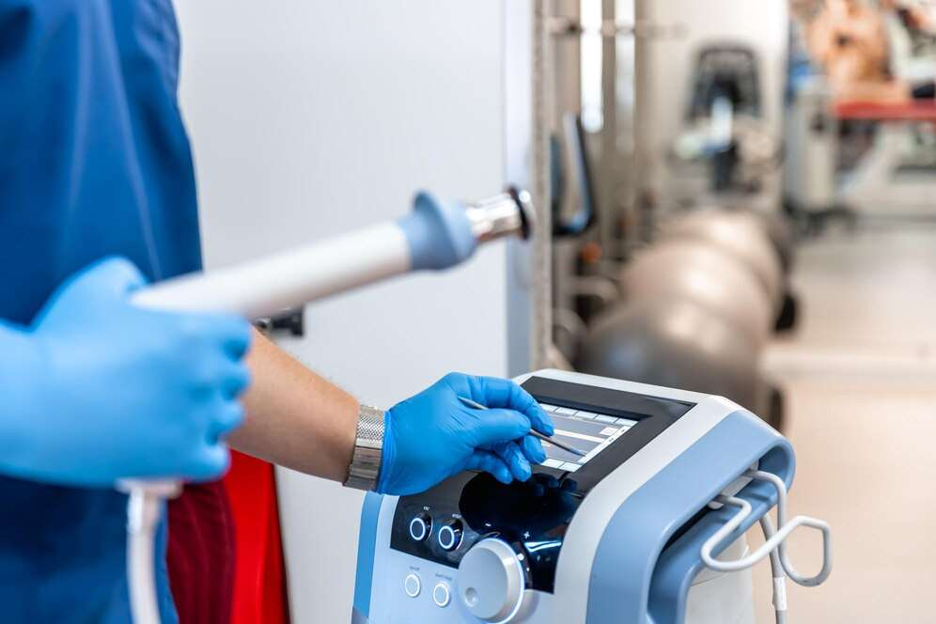

KEY INSIGHTS
FORECAST
$691.08 Million
2027
CAGR
5.73%
2023- 2030

Slide 4
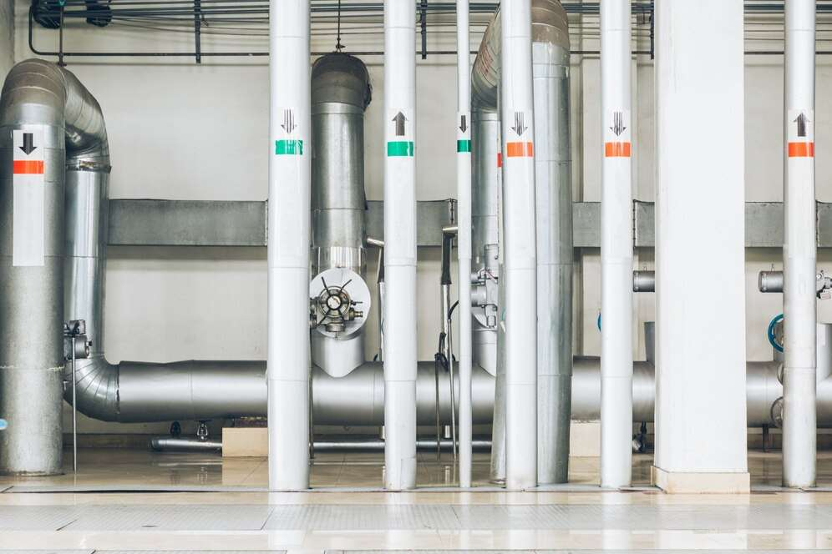
REVENUE MARKET SHARE BY SEGMENTS 2022
by Shape
Power Generation
USD 239.40 Million
Distribution Channel
  Offline
  Online

Slide 5

Global Automatic Tube Cleaning System Market Revenue share for 2022
North America
USD 222.04 Million

Slide 6
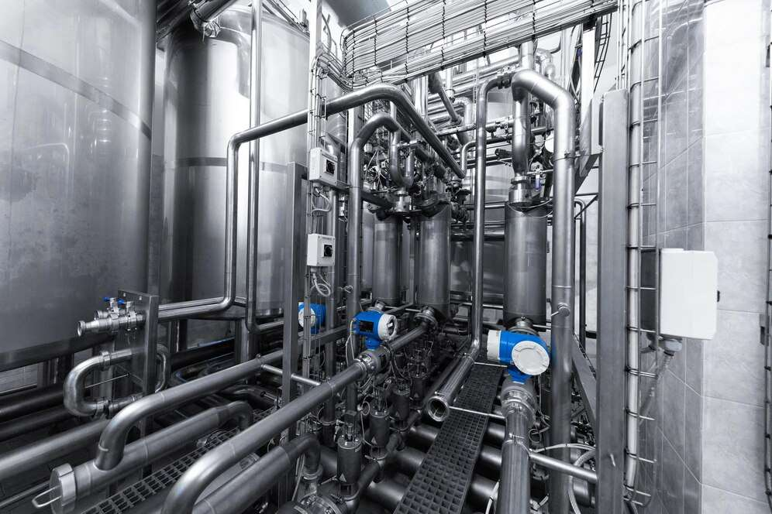
Rapid growth in Power plants
Drivers
Continuous changes in technologies
Restraints

Slide 7
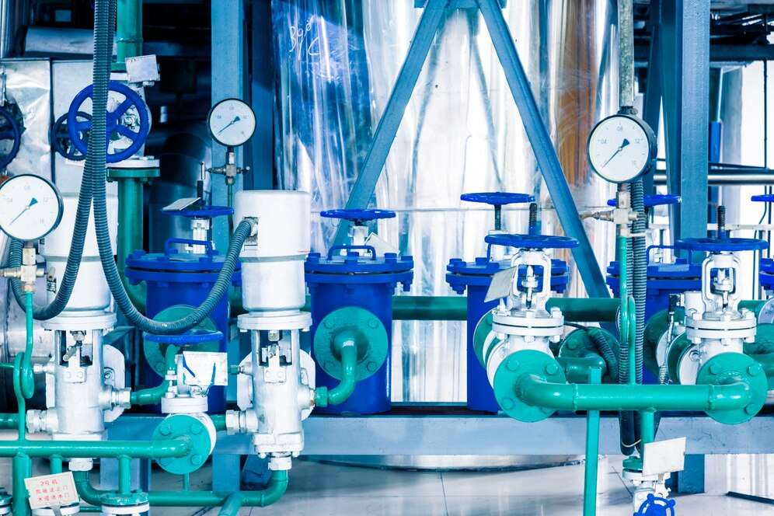
AUTHOR'S PERSPECTIVE
  The Global Automatic Tube Cleaning System Market is witnessing significant growth in the near future.
  In 2023, the Automatic Ball Tube Cleaning System segment accounted for noticeable share of global Automatic Tube Cleaning System Market and is projected to experience significant growth in the near future.
  The Power Generation segment is expected to expand at the significant CAGR retaining position throughout the forecast period.
  Some of the key companies TAPROGGE, Ovivo and others are focusing on its strategy building model to strengthen its product portfolio and expand its business in the global market.

Slide 8
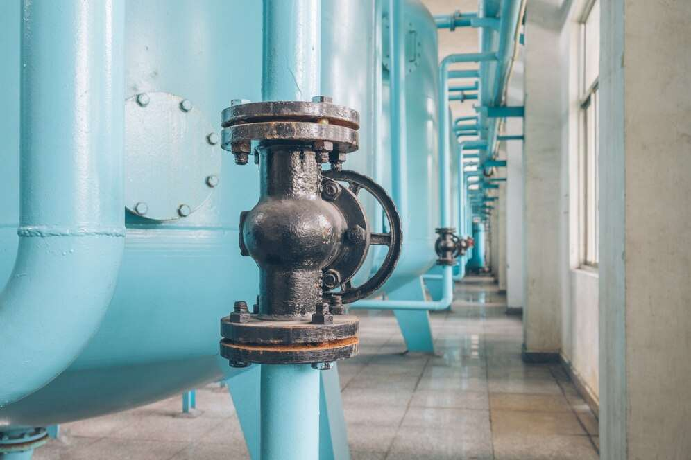






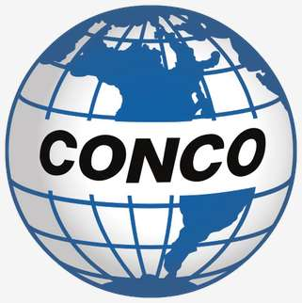
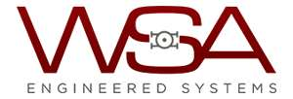

KEY PLAYERS

Slide 9


For Full Report
Contact us
COGNITIVE MARKET RESEARCH
Tel: +1 312-376-8303 | +44 020-8123-0732
India: (+91) 983-496-8611
sales@cognitivemarketresearch.com
Access the Full Report : https://tinyurl.com/zsawphcd
Please visit our website:
https://www.cognitivemarketresearch.com

