Slide 1
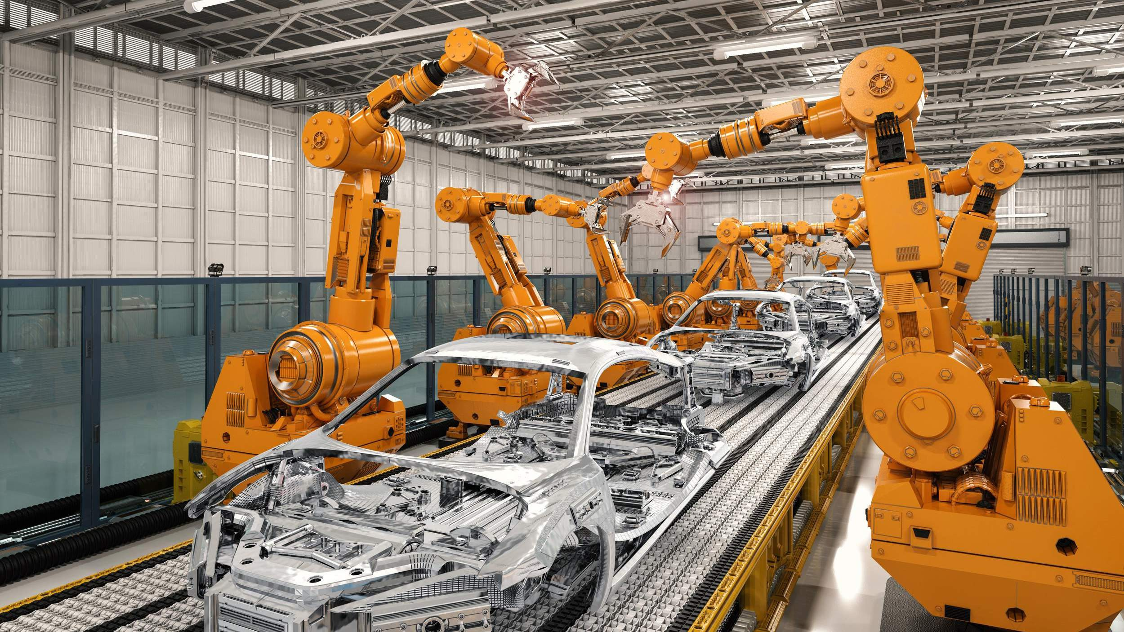
GLOBAL
ASSEMBLY LINE SOLUTIONS MARKET REPORT 2024
Global,Regional,CountryAnalysis

Slide 2
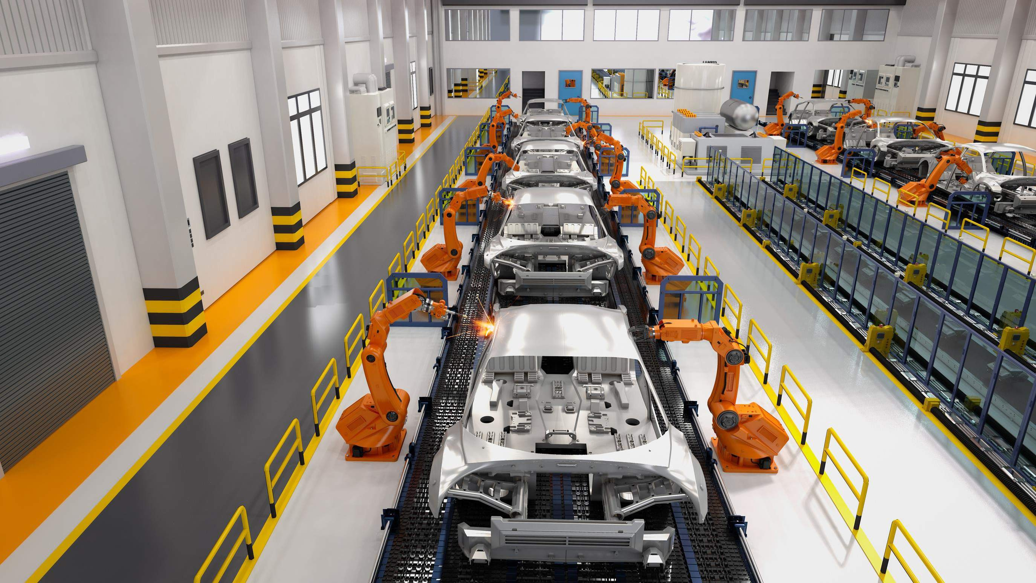
INTRODUCTION
An assembly line is a manufacturing method that divides the creation of a product into steps that must be performed in a specific order. The workers and machinery used to produce the item are stationary along the line and the product moves through the cycle, from start to finish.

Slide 3
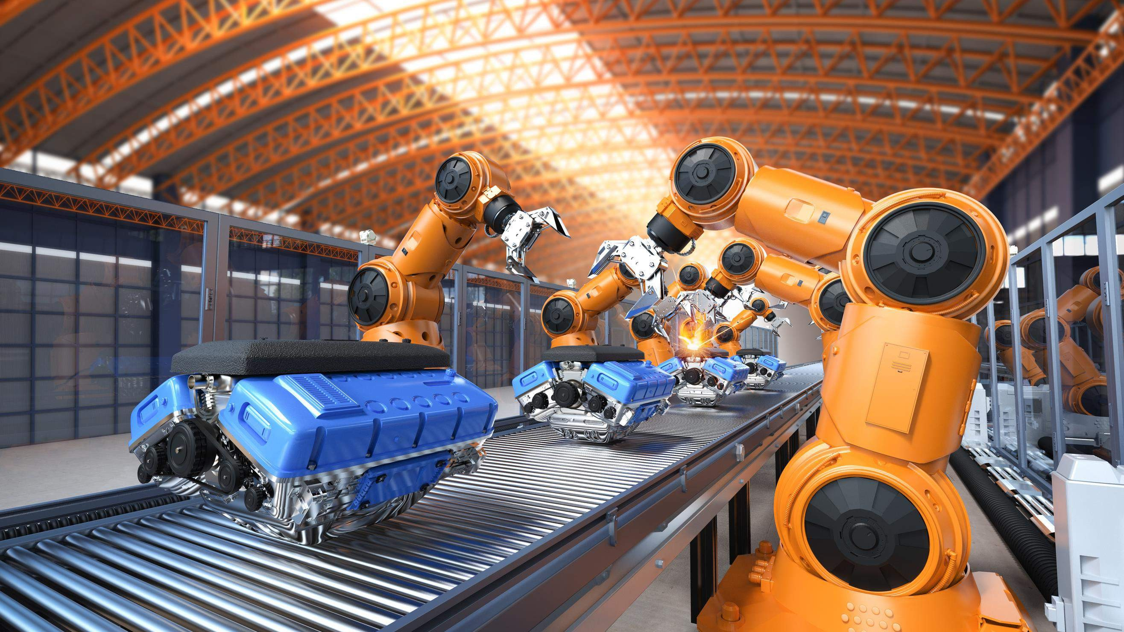

KEY INSIGHTS
MARKET SIZE
USD 1,722.18 Million
2016
FORECAST
USD 2,754.30 Million
2028
2023
CAGR 7.34%
-
2030

Slide 4
REVENUE MARKET SHARE BY SEGMENTS 2022
Manual Assembly Lines USD 602.87 Million
Automotive USD 990.30 Million
Type analysis
By application

Slide 5

Global Assembly Line Solutions Market Revenue share for 2022
Asia Pacific USD 1,413.23 Million

Slide 6
Growing demand in consumer electronic devices and connected devices
Inconsistent, high raw material prices and insufficient supply chain

Slide 7
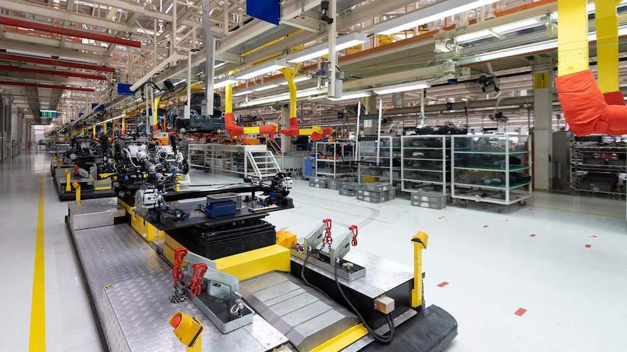
AUTHOR'S PERSPECTIVE
The Global Assembly Line Solutions Market revenue in 2016: USD 1,722.18 Million
Based on Type segment, the market is segmented into Manual
Assembly Lines, Semi-automated Assembly Lines, and Fully Automated Assembly Lines
Semi-automated Assembly Lines held for largest share of total revenue generated in 2019
Automotive held maximum share of Assembly Line Solutions market
in 2019

Slide 8
KEY PLAYERS

Slide 9


Contact us
For Full Report
COGNITIVE MARKET RESEARCH
Tel: + 1 312 - 376 - 8303 | + 44 020 - 8123 - 0732
India: ( + 91 ) 983 - 496 - 8611
sales@ cognitivemarketresearch. com
Access the Full Report : https://tinyurl.com/mw4fphdh
Please visit our website:
https://www.cognitivemarketresearch.com

