Slide 1

GLOBAL
ARTIFICIAL PLANT FLOWERS MARKET REPORT
2024
Global,Regional,CountryAnalysis

Slide 2

INTRODUCTION
The global Artificial Plants and flowers market has grown significantly, indicating changing consumer preferences and demand for practical and aesthetically pleasing decor options. This market's overview is characterized by a growing preference for artificial vegetation due to its low- maintenance nature and esthetic attractiveness. Home decor, commercial areas, and the hospitality industry have all adopted fake plants for indoor and outdoor use.
Factors such as urbanization, cultural influences, and the growing emphasis on sustainable and flexible decor options drive the industry. As consumers seek more durable and vibrant alternatives, the Artificial Plants and flowers market expands, providing various solutions to meet changing lifestyle tastes.

Slide 3
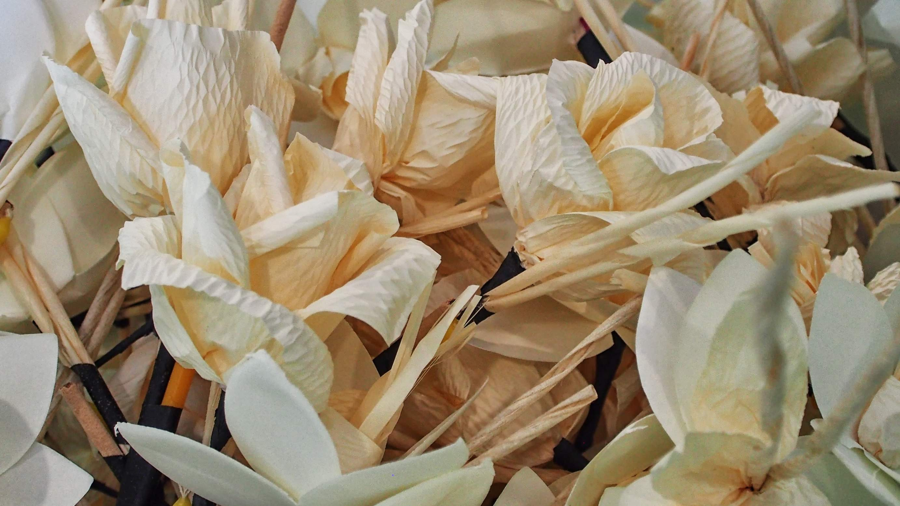

KEY INSIGHTS
MARKET SIZE
USD 1.3 billion
2023
CAGR 5.0%
20₋23
2030

Slide 4
REVENUE MARKET SHARE BY SEGMENTS 2022
Plastic Polyester Clay Cotton Nylon Silk
Material Segment
Wholesalers/Distributors Direct Sales
Online Retailers Independent Stores Specialty Stores Other Sales Channel
Sales Channel
Residential Commercial Hotels Offices Schools Hospitals Theme parks Airports
Cruise ships and others
Application Segment

Slide 5

Global Artificial Plant Flowers Market Revenue share for 2022
North America 38%

Slide 6

Increased Use of Fire- resistant and Water-resistant Artificial Plants and Flowers to Propel Market Growth
Drivers
Potential Health Concerns Related To Certain Ingredients to Restrict Market Growth
Restraints

Slide 7

AUTHOR'S PERSPECTIVE
The Global Artificial Plant Flowers Market is witnessing significant growth in the near future.
Polyester, widely used in producing artificial leaves and flowers, benefits the market by providing durability, colour retention, and design adaptability.
Hotels are helping to drive the growth of the fake Plants and flowers market by incorporating fake vegetation for interior decor and landscaping.
Manufacturers can promote their products, give unique customer experiences, and respond to changing preferences by engaging directly with consumers through various platforms, such as online marketplaces and dedicated retail venues.

Slide 8
KEY PLAYERS

Slide 9


Contact us
For Full Report
COGNITIVE MARKET RESEARCH
Tel: + 1 312 - 376 - 8303 | + 44 020 - 8123 - 0732
India: ( + 91 ) 983 - 496 - 8611
sales@ cognitivemarketresearch. com
Access the Full Report : http://tinyurl.com/4b2r4jfh
Please visit our website:
https://www.cognitivemarketresearch.com

