Slide 1
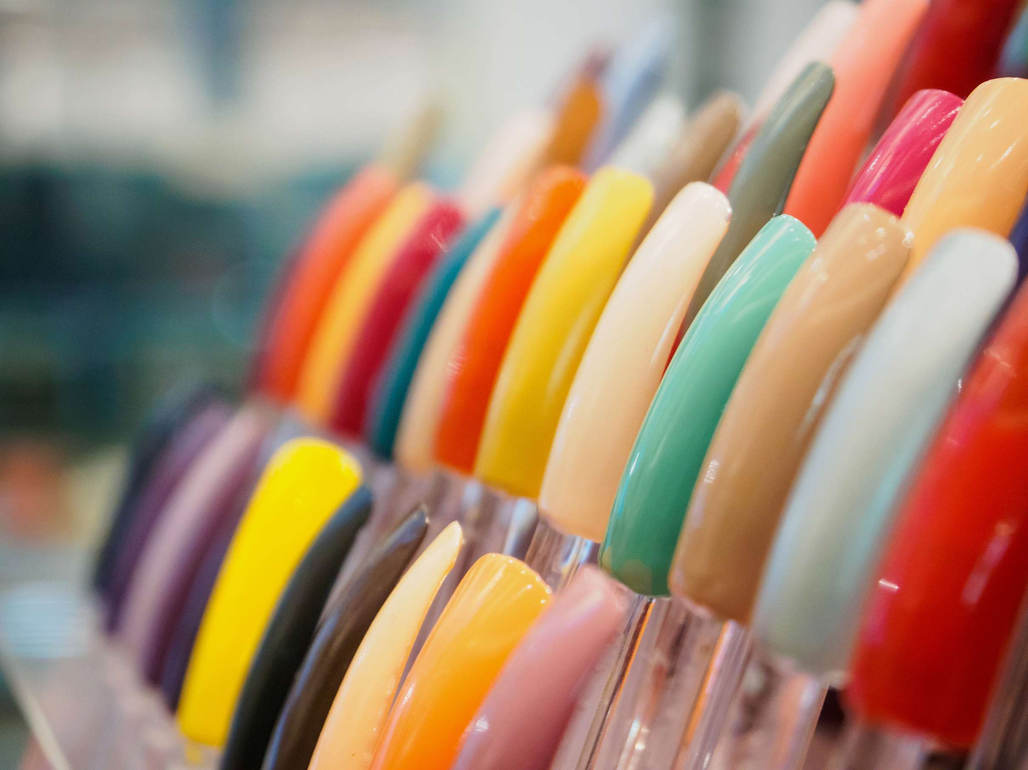
GLOBAL
ARTIFICIAL NAILS
MARKET REPORT
2024
Global,Regional,CountryAnalysis

Slide 2

INTRODUCTION
Artificial nails provide prosthetic coverings to natural nails to improve their appearance; made from materials like gel, acrylic, or dip powder can be applied in various forms. It offers numerous benefits, inclusive of strength, durability and ability to create customized nail designs. They can be shaped, painted and decorated according to personal preferences, allowing for creative expression and complementing different fashion and beauty trends. Growing demand from female consumers helps in market progress.

Slide 3
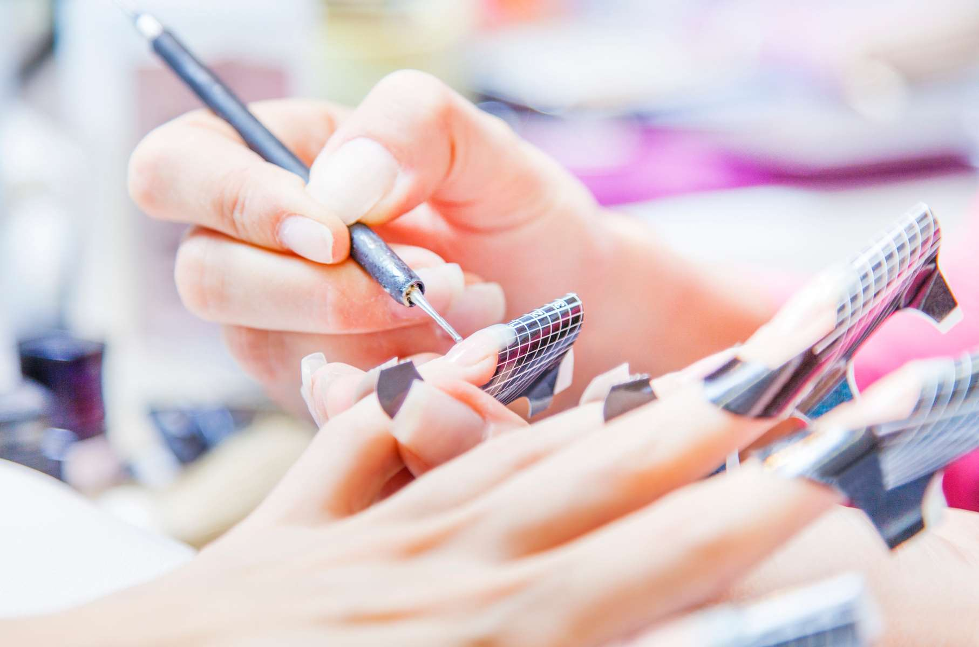

KEY INSIGHTS
MARKET SIZE
USD 0.248 billion
2022
CAGR
6.10%
2023- 2030

Slide 4
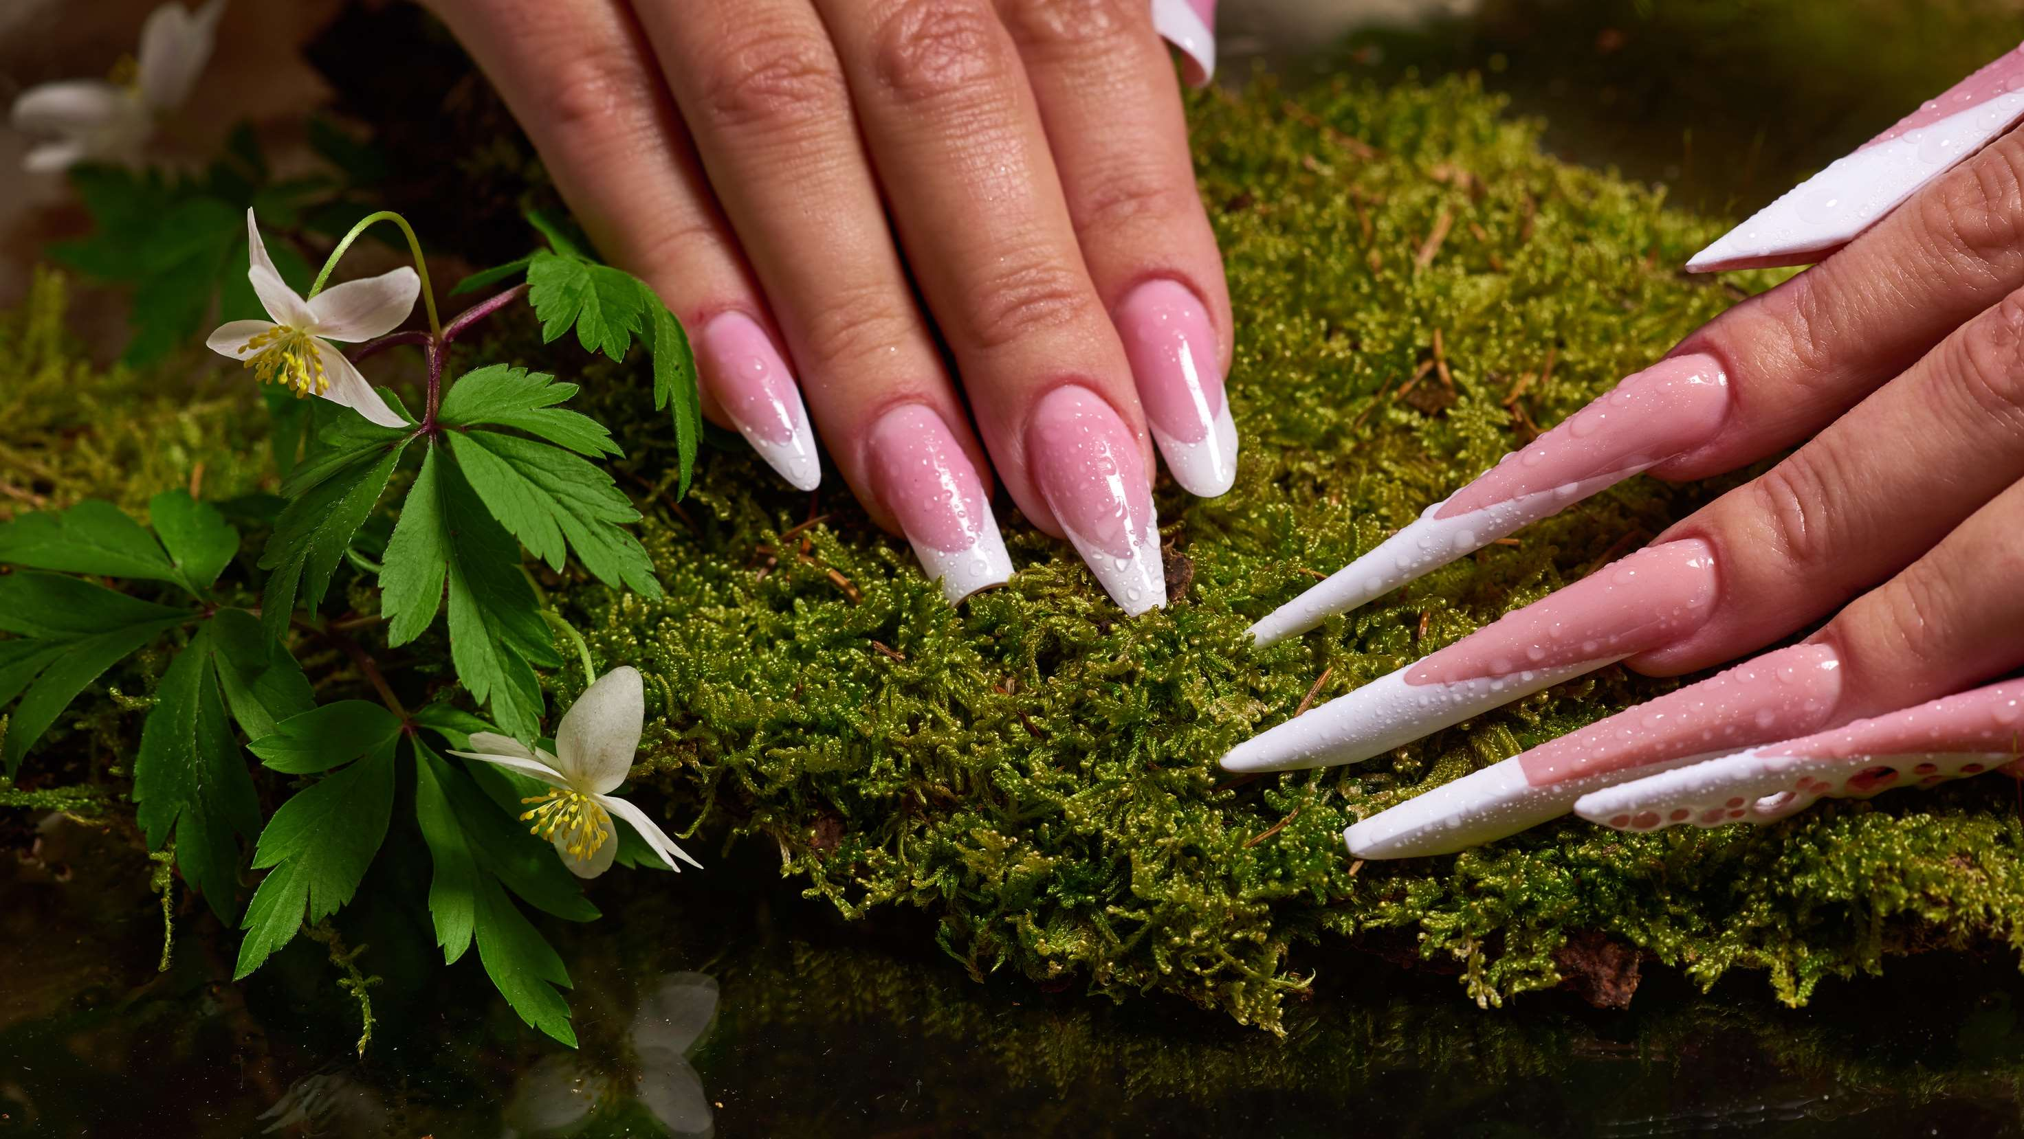
REVENUE MARKET SHARE BY SEGMENTS 2022
  Nail Tips
  Press-On Nails
  Transparent
  Solid
  Printed
Type Segment
Pattern Segment
  Acrylic
  Gel
  Dip Powder
  Plastic
  Low
  Medium
  High
Material Segment
Price Segment
  Glossy
  Matte
  Shimmery
  Glitter
  Online
  Offline
Finish Type Segment
Distribution Channel

Slide 5

Global Artificial Nails Market Revenue share for 2024
North America

Slide 6
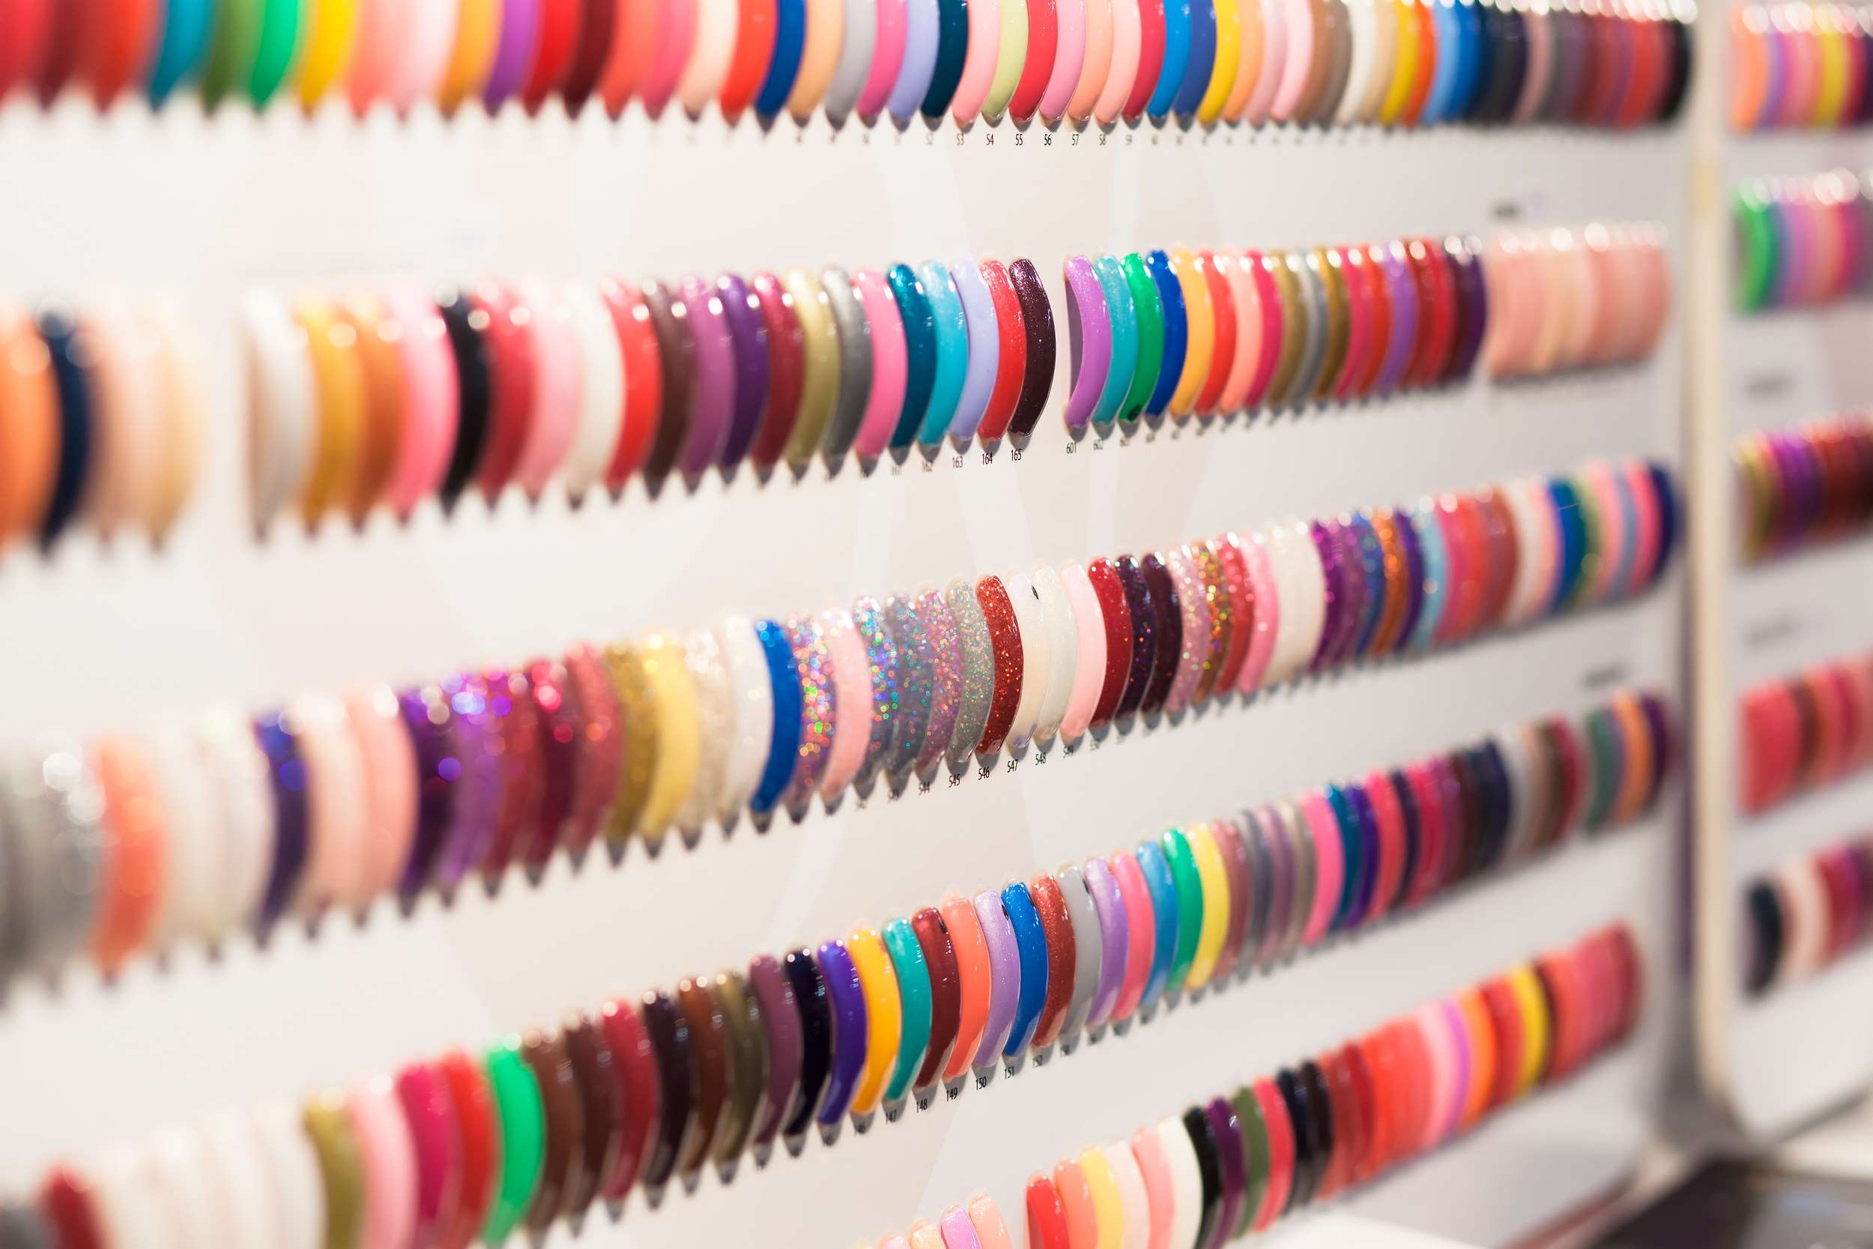
Fashion and Beauty Trends to Provide Viable Market Output
Drivers
Increasing Concern over the Potential Negative Effects on Natural Nail to Hinder Market Growth
Restraints

Slide 7

AUTHOR'S PERSPECTIVE
  The Global Artificial Nails Market is witnessing significant growth in the near future.
  Press-on nails have gained popularity in recent years due to their convenience and ease of use.
  Press-on nails have gained popularity in recent years due to their convenience and ease of use.
  Nail tips provide a more customized and long-lasting solution compared to press-on nails.
  Physical stores allow the customers to see and touch the products before purchasing, which can be particularly important for items like artificial nails that involve aesthetic preferences and sizing considerations.

Slide 8





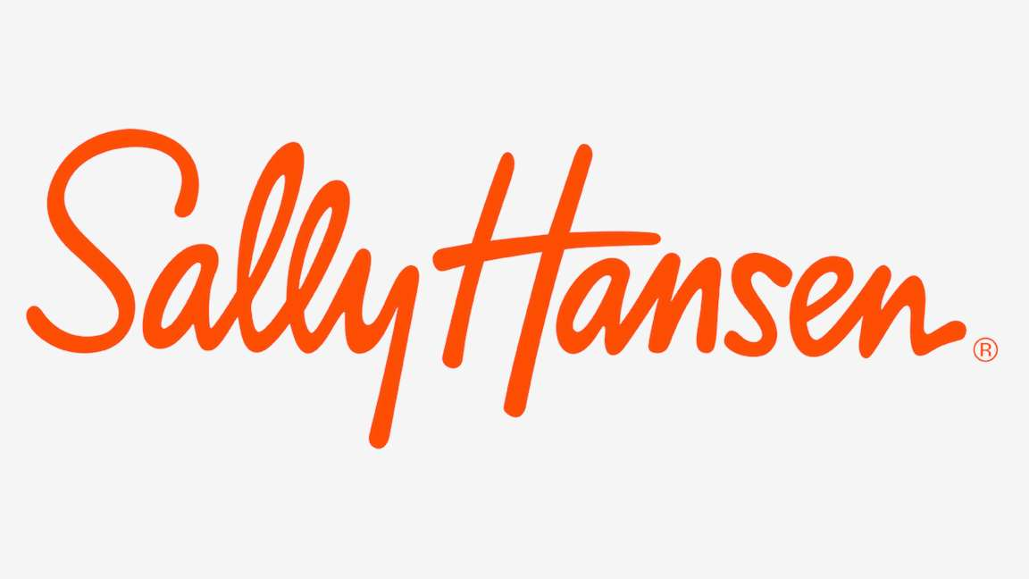
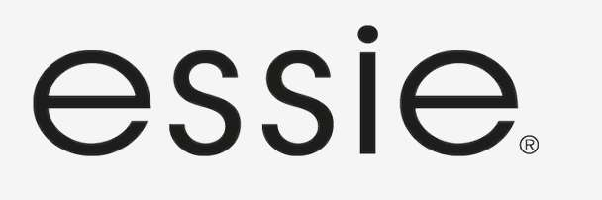




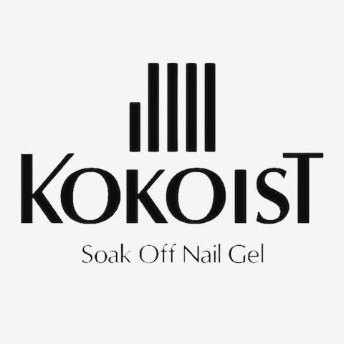

KEY PLAYERS

Slide 9


For Full Report
Contact us
COGNITIVE MARKET RESEARCH
Tel: +1 312-376-8303 | +44 020-8123-0732
India: (+91) 983-496-8611
sales@cognitivemarketresearch.com
Access the Full Report : https://tinyurl.com/4ux6kyxh
Please visit our website:
https://www.cognitivemarketresearch.com

