Slide 1
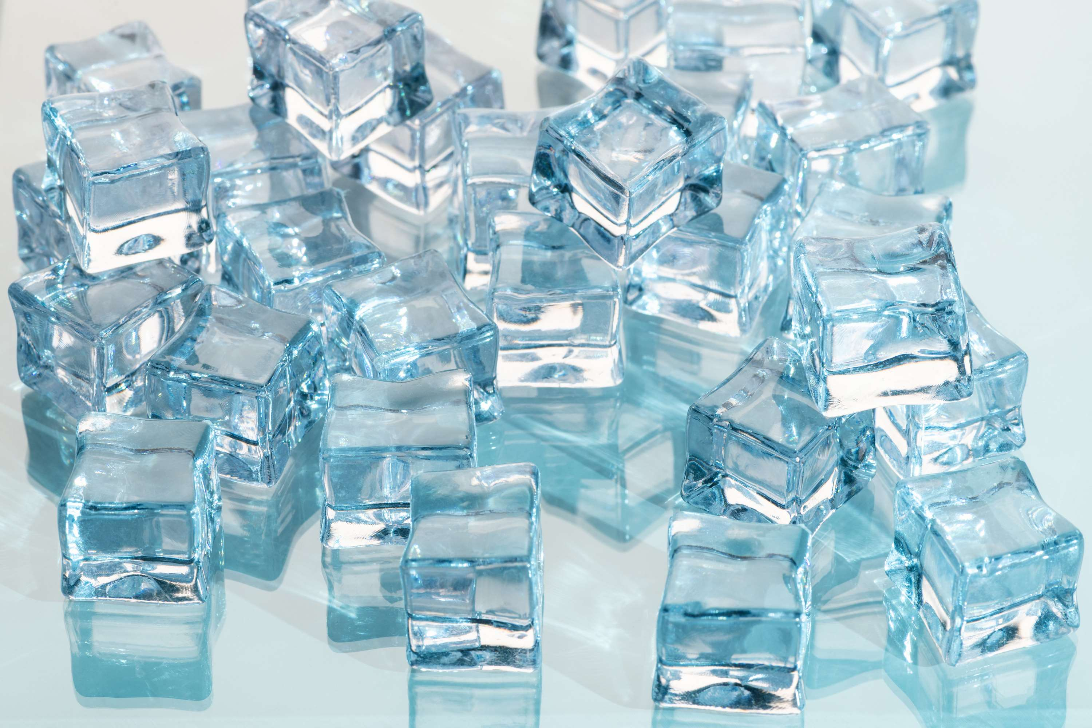
GLOBAL
ARTIFICIAL ICE
MARKET REPORT
2024
Global,Regional,CountryAnalysis

Slide 2
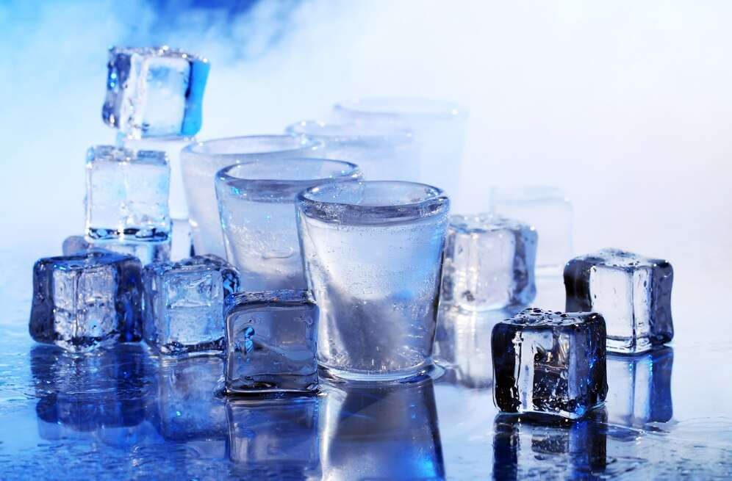
INTRODUCTION
The artificial ice market is the industry that deals with the production, sale, and distribution of artificial ice. Artificial ice is made from frozen water using various methods, including mechanical freezing, cryogenic freezing, and evaporative freezing. The increasing recognition of the advantages of skating, such as improved fitness and leisure, is projected to generate strong demand for ice rinks. As a result, this will drive the revenue growth of the artificial ice market. The increasing fame of the Internet and social media platforms has heightened fascination with winter sports such as ice hockey and figure skating. As a result, there is a rising demand for cost-effective substitutes for pricey traditional ice rinks. This gives significant prospects for prominent participants in the worldwide market.

Slide 3
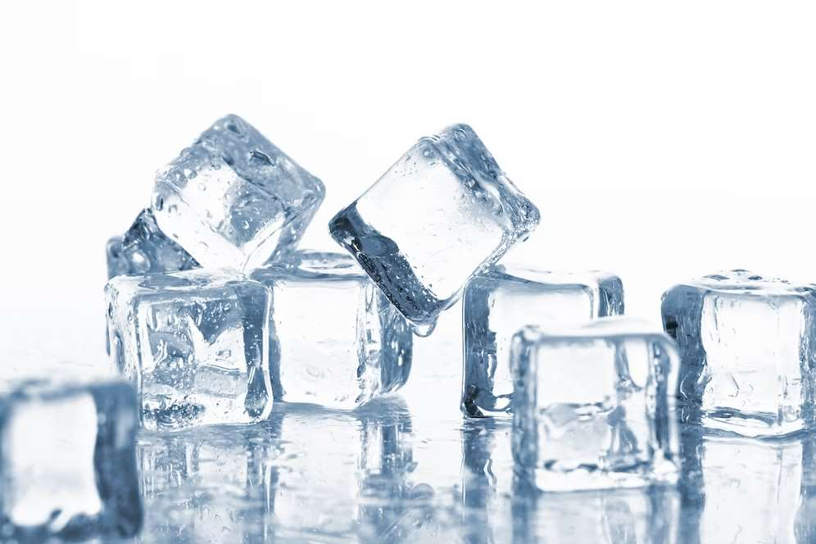

KEY INSIGHTS
CAGR
10.20%
2024- 2031

Slide 4
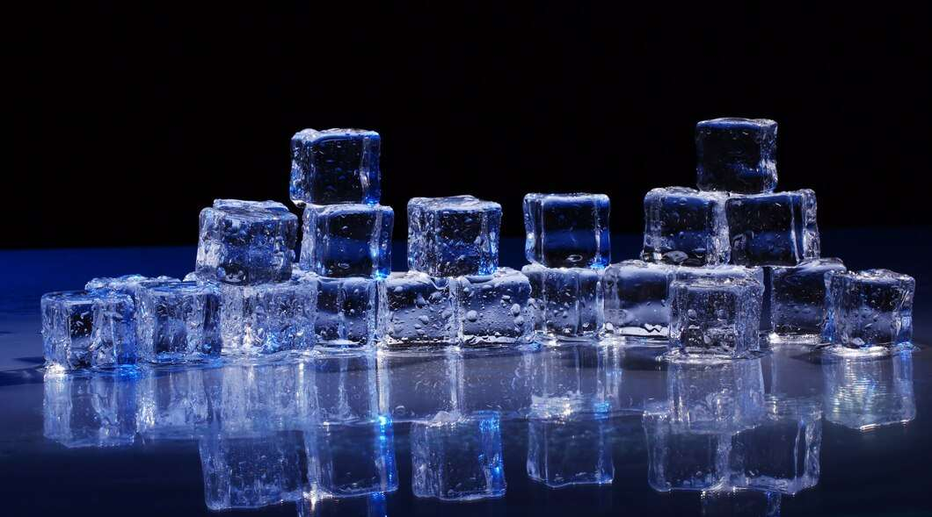
REVENUE MARKET SHARE BY SEGMENTS 2022
  Synthetic Ice
  White Ice
Type Segment
  Residential
  Amusement Parks
  Stadiums
Application Segment

Slide 5
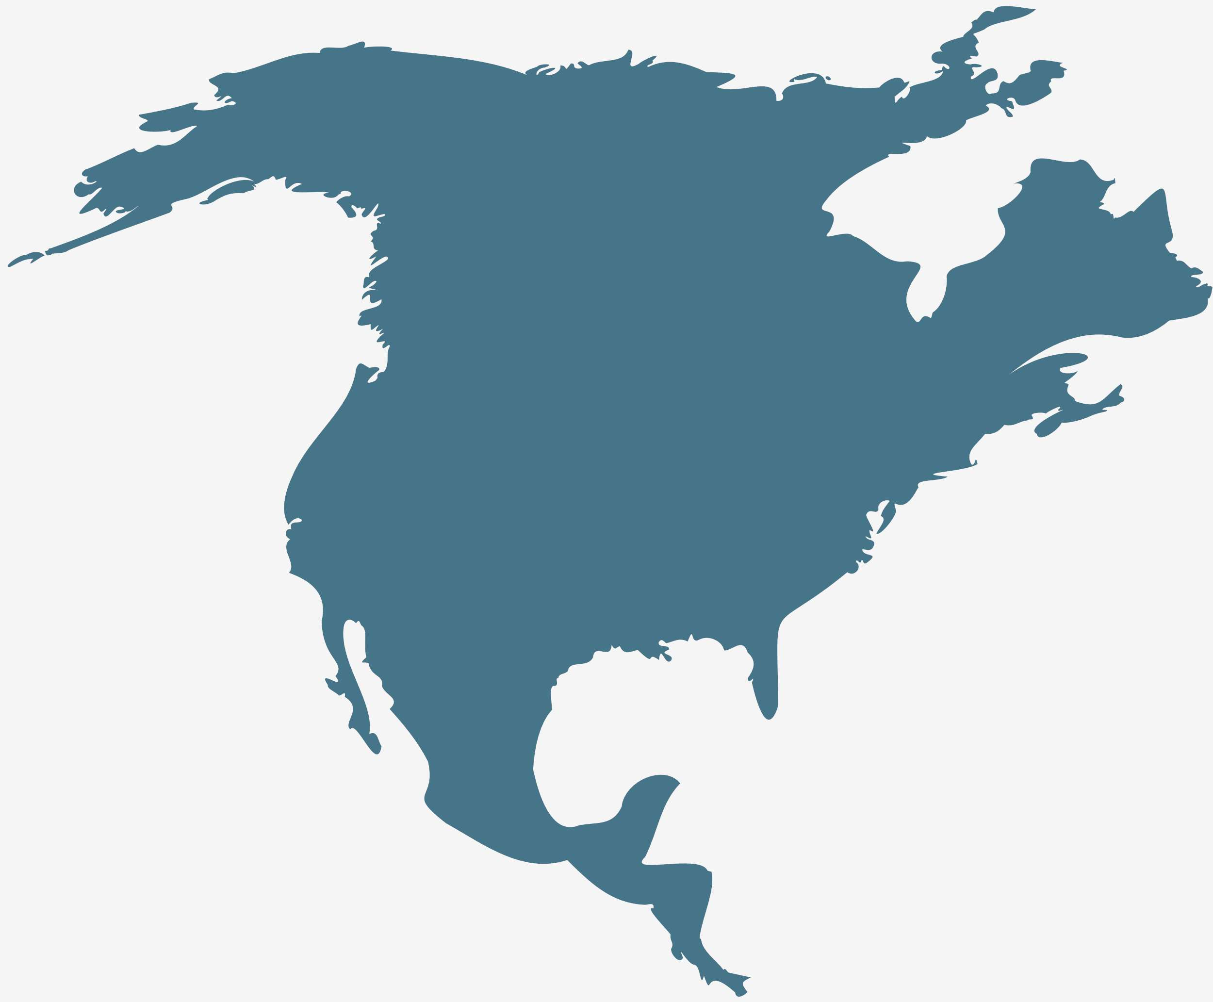
Global Artificial Ice Market Revenue share for 2024
North America

Slide 6
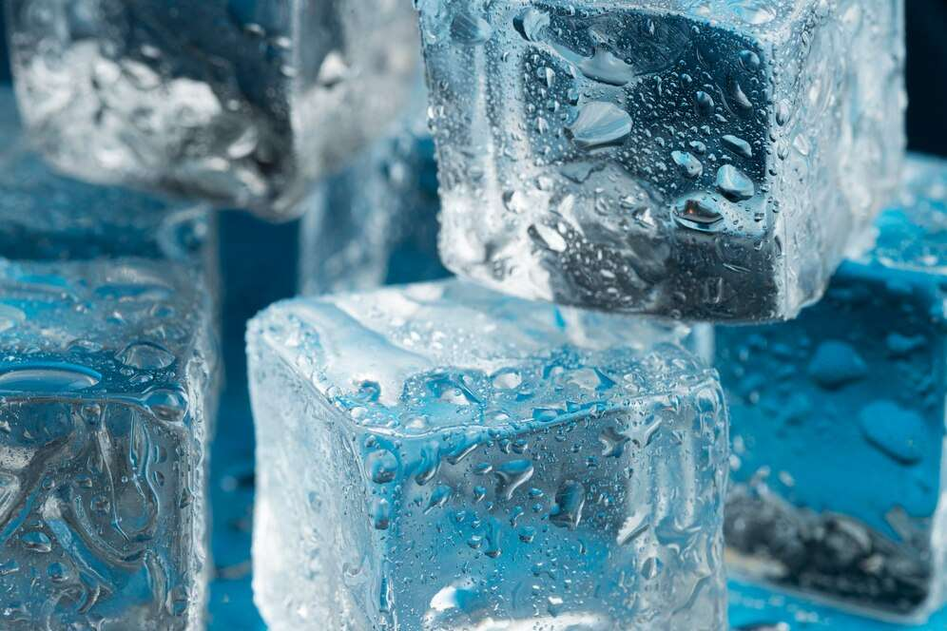
Synthetic Ice is an Ideal Alternative to Real Ice to Provide Viable Market Output
Drivers
High Cost of Maintenance to Hinder Market Growth
Restraints

Slide 7
AUTHOR'S PERSPECTIVE
  The Global Artificial Ice Market is witnessing significant growth in the near future.
  Ice cream is the largest segment in the ice cream industry.
  Consumers are becoming more and more aware of the benefits, convenience and safety of ice cream.
  The amusement park segment is the fastest-growing segment in the artificial ice. Ice cream creates a better understanding and real experience for tourists. For example, it is used to make ice cream and the like.
  Amusement parks increasingly use ice skating to create a wonderful and authentic visitor experience.

Slide 8
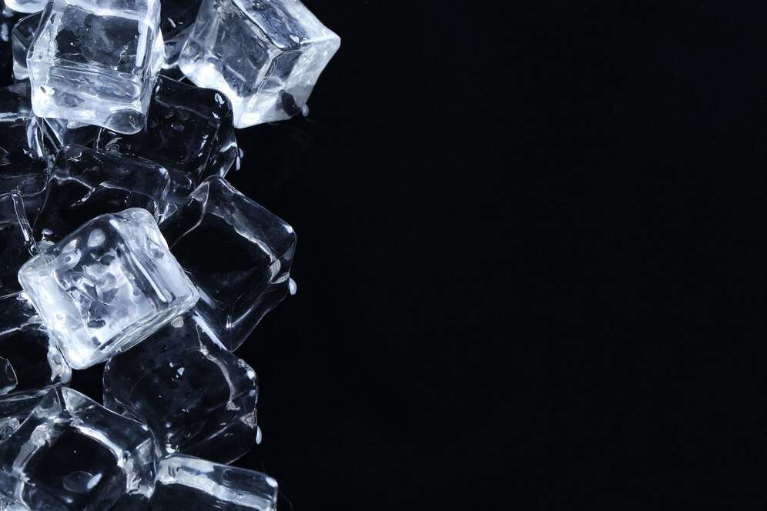







KEY PLAYERS

Slide 9


For Full Report
Contact us
COGNITIVE MARKET RESEARCH
Tel: +1 312-376-8303 | +44 020-8123-0732
India: (+91) 983-496-8611
sales@cognitivemarketresearch.com
Access the Full Report : https://tinyurl.com/3cxyhus2
Please visit our website:
https://www.cognitivemarketresearch.com

