Slide 1

GLOBAL
ARTIFICIAL FLOWERS
MARKET REPORT
2024
Global,Regional,CountryAnalysis

Slide 2

INTRODUCTION
The artificial flower market is the industry that produces, distributes, and sells fake or synthetic floral arrangements for decorative purposes. Typically composed of silk, plastic, or polyester, these artificial flowers are intended to mimic the appearance of real flowers. The market offers products, from single stems to intricate arrangements, to suit different consumer categories, including residential, commercial, and event planning sectors. Unlike fresh flowers, artificial flowers have several benefits, such as durability, low maintenance, and resistance to environmental factors. The artificial flower industry is growing globally due to rising urbanization, hectic lifestyles, and a focus on sustainability. It provides consumers with useful and aesthetically beautiful decoration solutions for homes, companies, and other spaces.

Slide 3
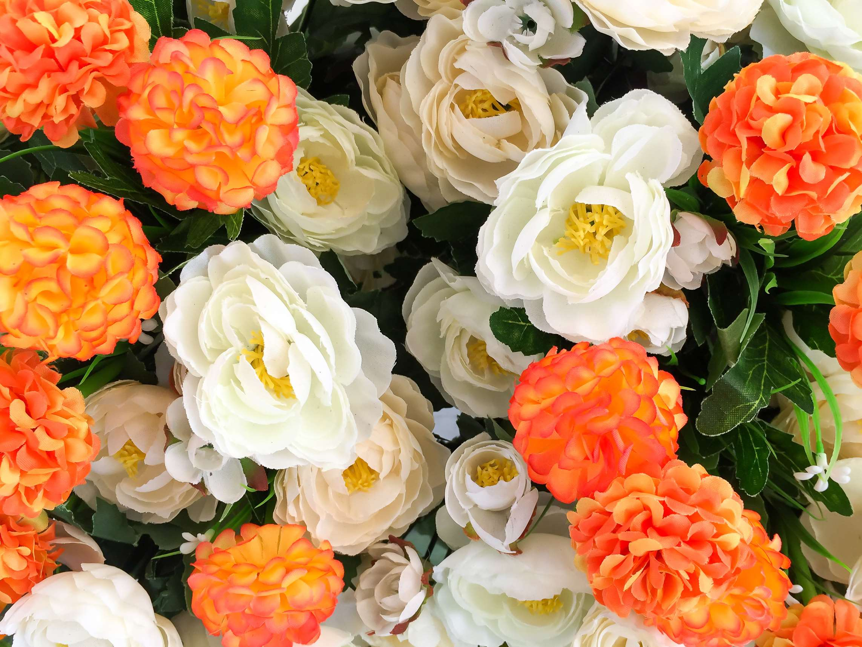

KEY INSIGHTS
MARKET SIZE
USD 1851.21 million
2024
CAGR
5.00%
2024- 2031

Slide 4
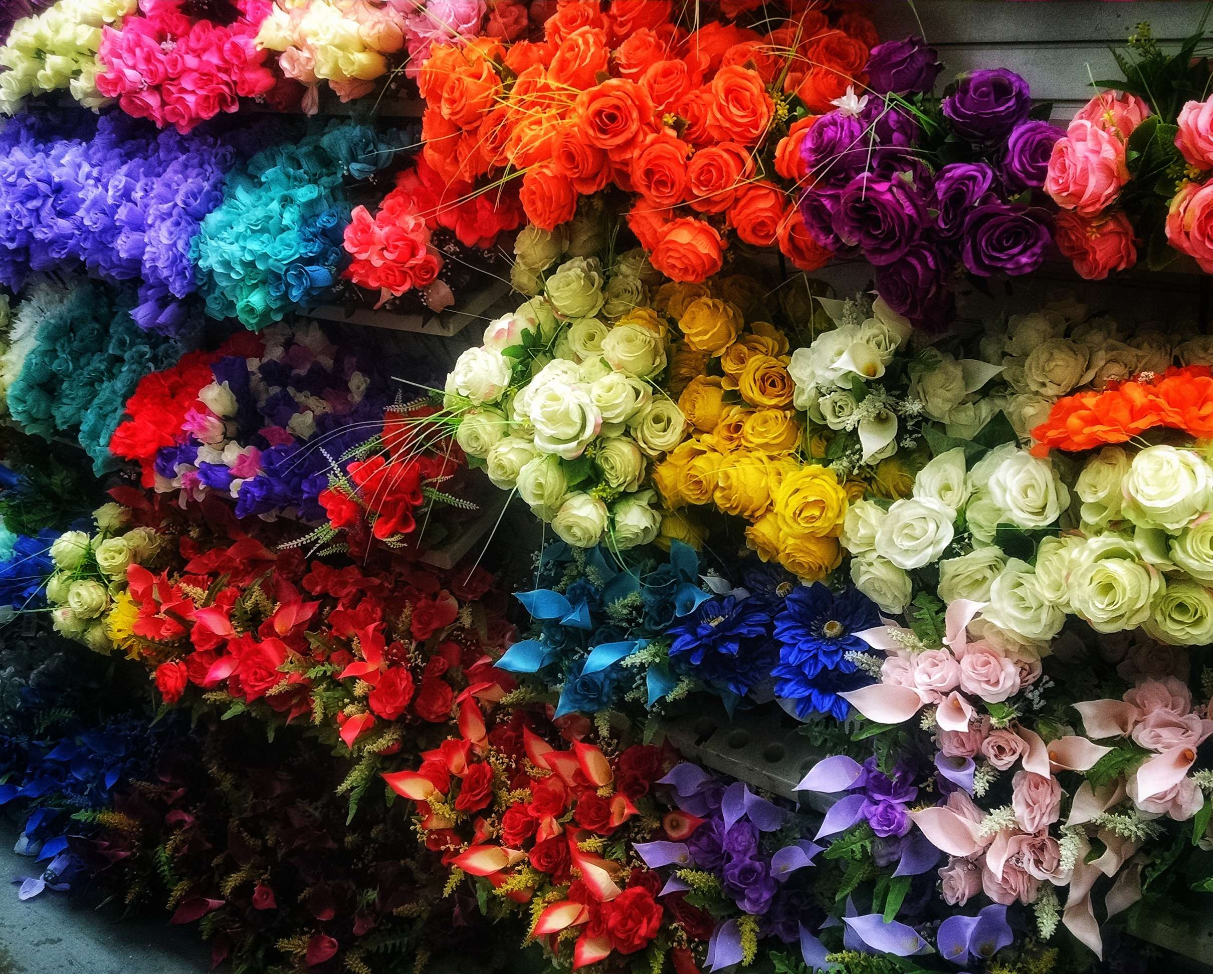
REVENUE MARKET SHARE BY SEGMENTS 2022
  Polyester
  Plastic
  Paper
  Nylon
  Silk
Material Segment
  Supermarkets & Hypermarkets
  Specialty Craft Stores
  Florists
Distribution Channel
  Residential
  Commercial
Application Segment

Slide 5

Global Artificial Flowers Market Revenue share for 2024
North America
40%

Slide 6
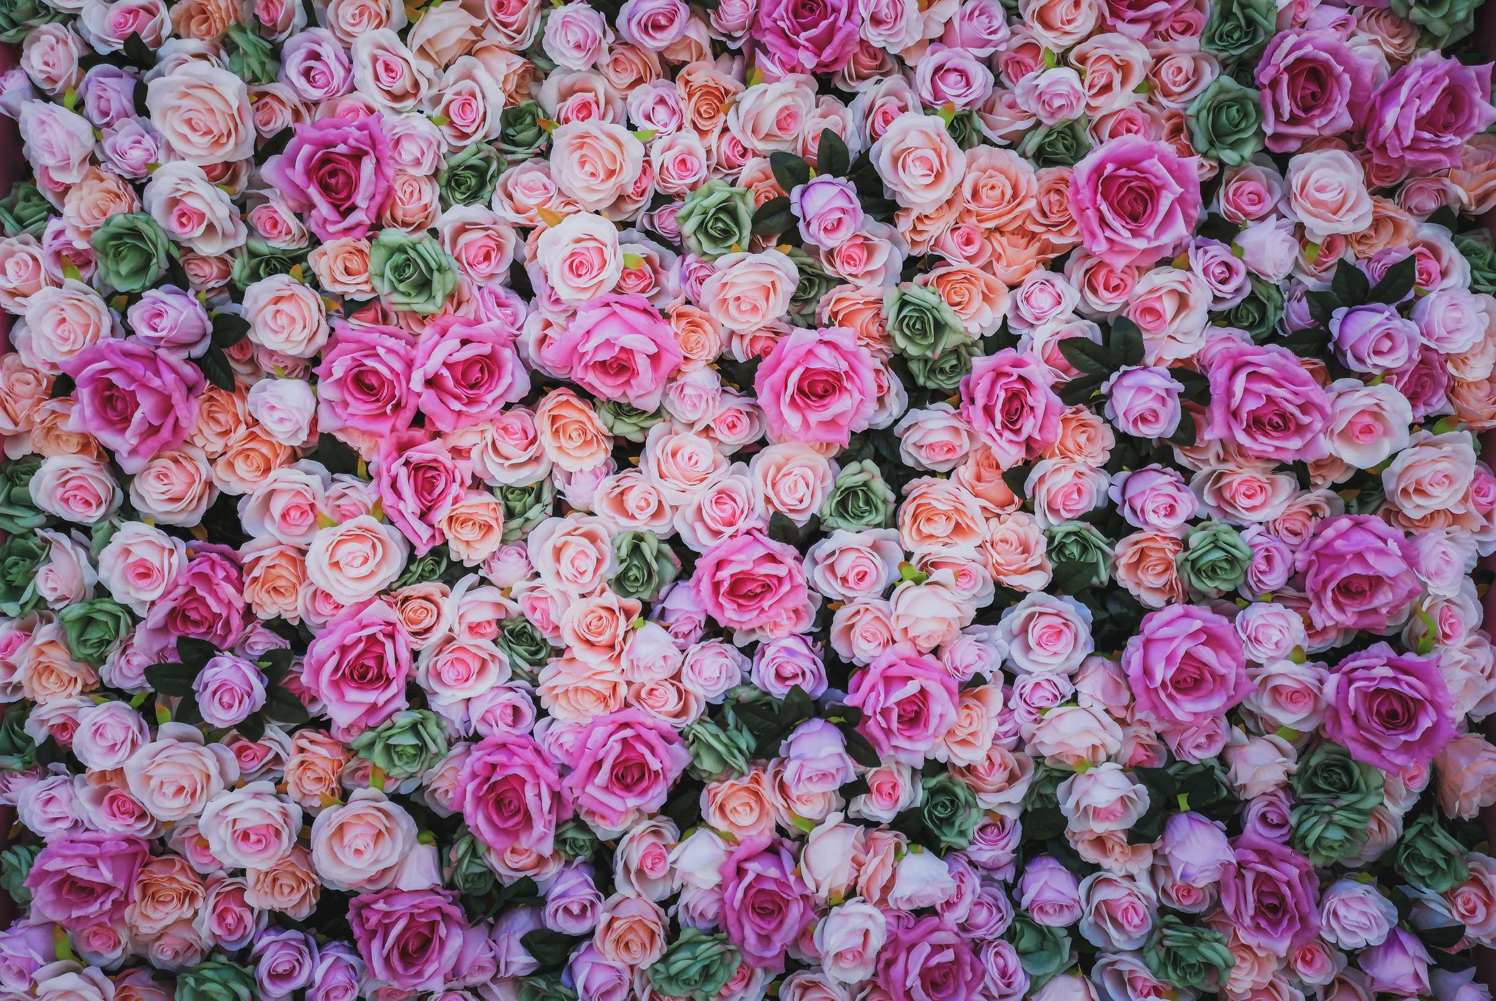
  Rising Disposable Incomes to Increase the Demand Globally
  Increased Urbanization and Busy Lifestyles to Propel Market Growth
Drivers
Perception of Inauthenticity to Limit the Sales
Restraints

Slide 7
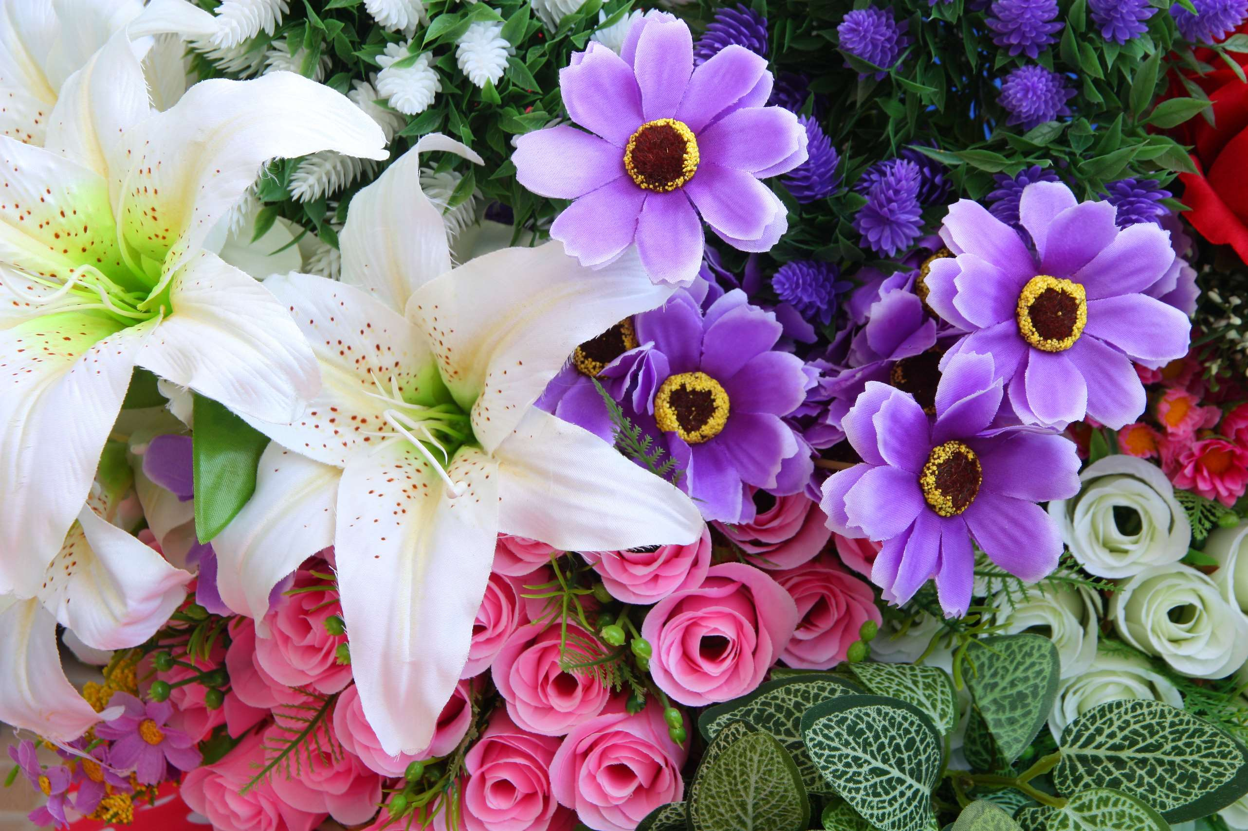
AUTHOR'S PERSPECTIVE
  The global Artificial Flowers Market will expand significantly by 5.00% CAGR between 2024 to 2031.
  Artificial flower purchases are now easier and more easy than ever thanks to the rising popularity of internet shopping, which is increasing accessibility and propelling market expansion.
  Because of worries about fresh flower shipping and water waste, some consumers opt for artificial flowers instead of fresh ones. Artificial flower production has an environmental impact of its own, but in some circumstances, it can have a smaller environmental impact.
  The Polyester held the highest Artificial Flowers market revenue share in 2024.

Slide 8
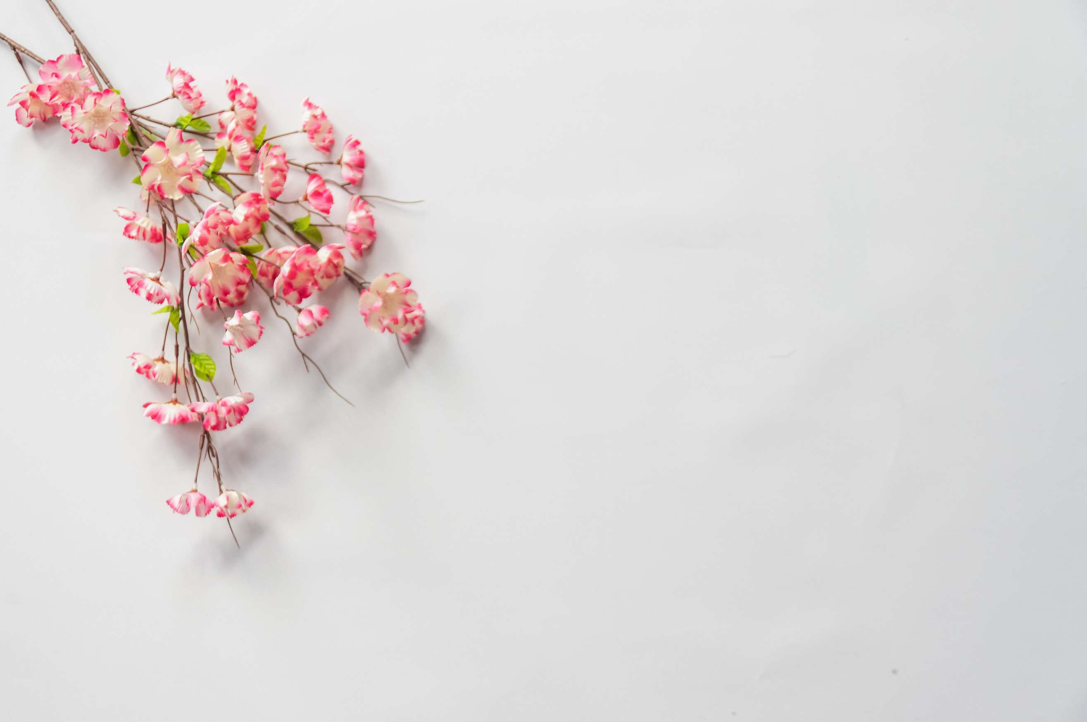
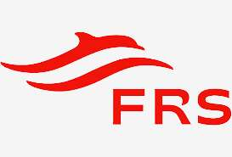



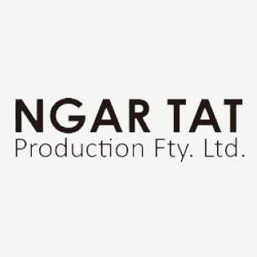
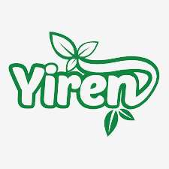
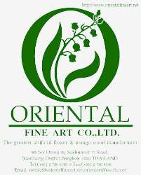
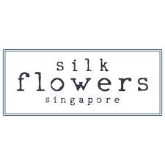
KEY PLAYERS

Slide 9


For Full Report
Contact us
COGNITIVE MARKET RESEARCH
Tel: +1 312-376-8303 | +44 020-8123-0732
India: (+91) 983-496-8611
sales@cognitivemarketresearch.com
Access the Full Report : https://tinyurl.com/2czxnu3n
Please visit our website:
https://www.cognitivemarketresearch.com

