Slide 1
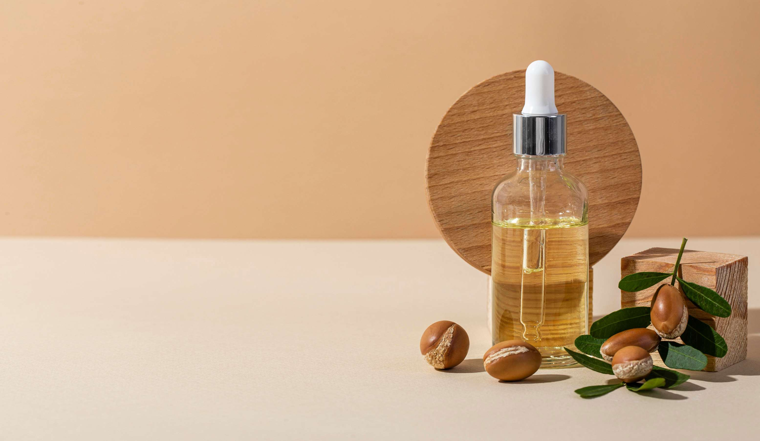
GLOBAL
ARGAN OIL
MARKET REPORT
2024
Global,Regional,CountryAnalysis

Slide 2
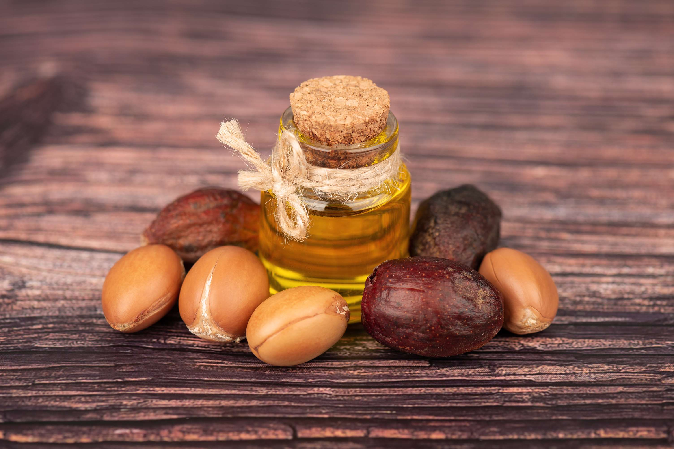
INTRODUCTION
Argan oil, derived from the kernels of the argan tree native to Morocco, is a versatile and highly prized natural oil renowned for its numerous health and cosmetic benefits. Rich in essential fatty acids, antioxidants, and vitamins E and A, it possesses moisturizing, anti-inflammatory, and anti-aging properties. Argan oil is commonly used in skincare products for its ability to hydrate and nourish the skin, reduce the appearance of wrinkles, and soothe irritation. It's also valued for its hair-strengthening qualities, promoting shine and manageability. Additionally, argan oil has culinary applications, adding a nutty flavour and nutritional boost to various dishes.

Slide 3
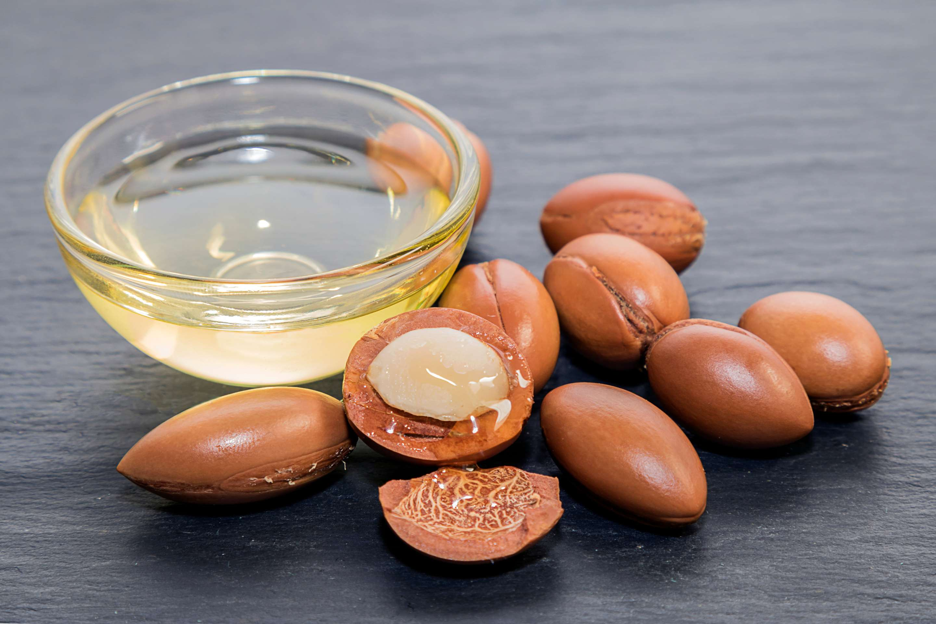

KEY INSIGHTS
MARKET SIZE
USD 268125.2 million
2024
CAGR
21.50%
2024- 2031

Slide 4
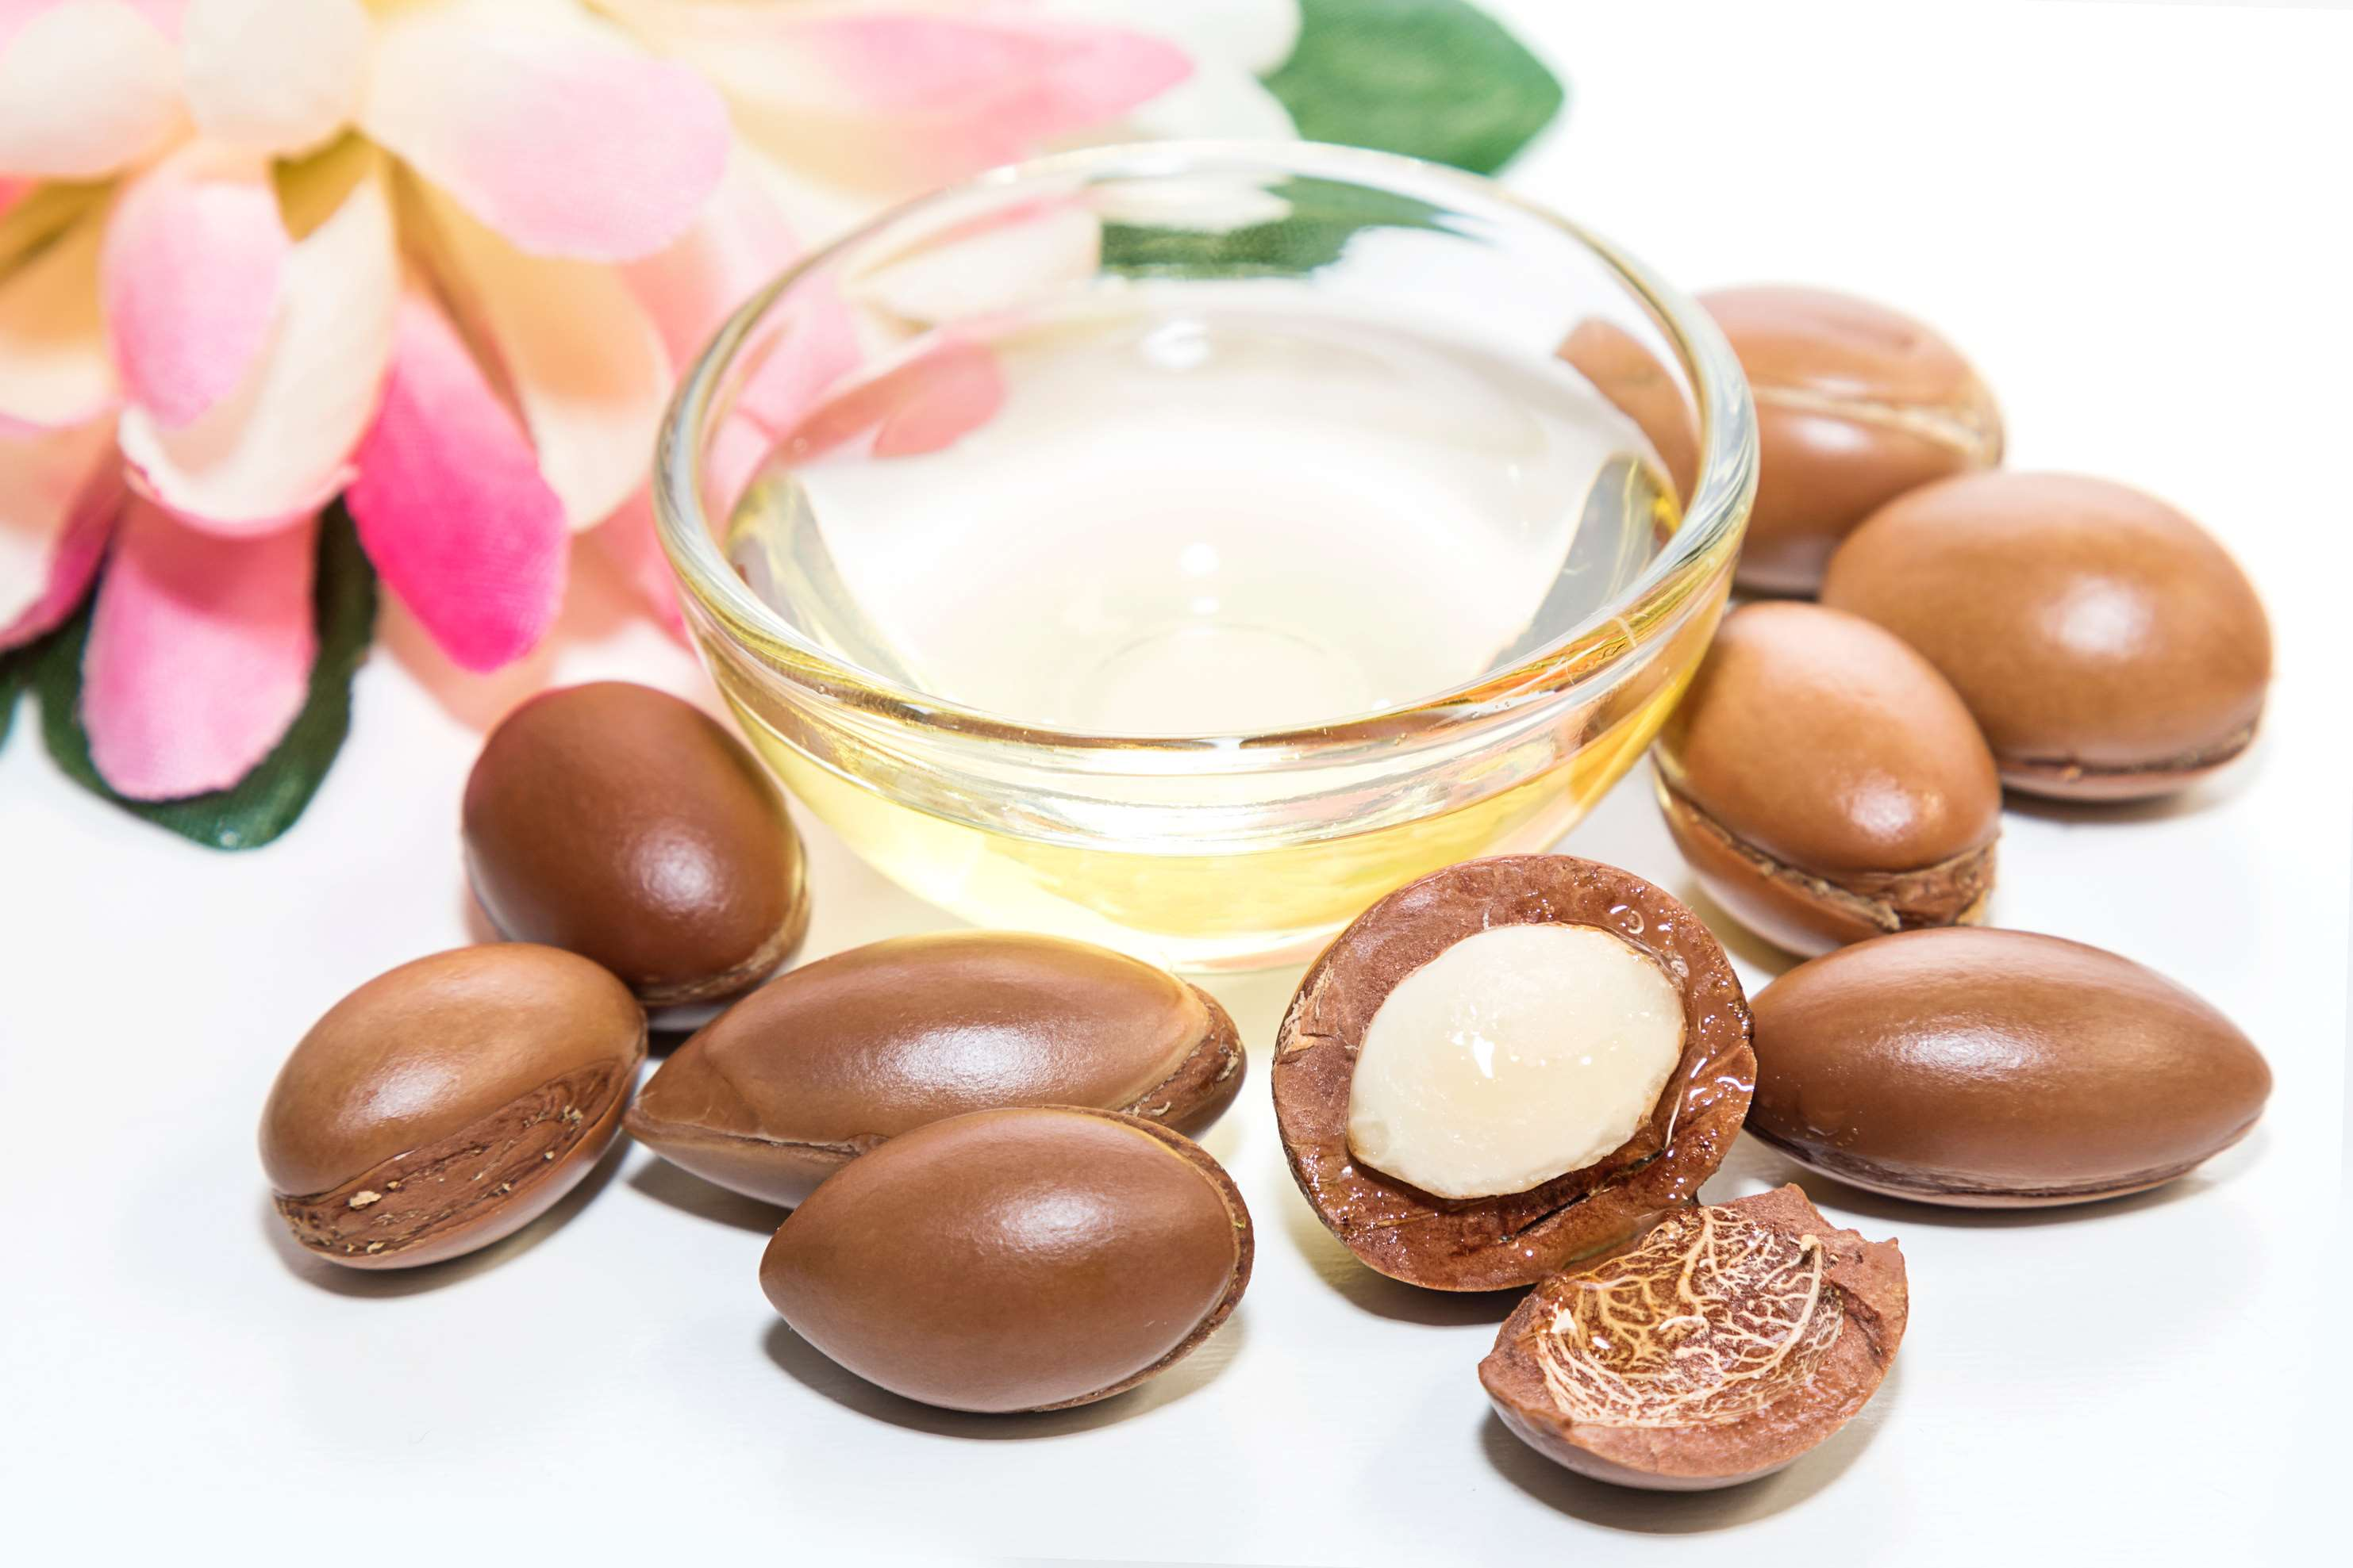
REVENUE MARKET SHARE BY SEGMENTS 2022
  Therapeutics Argan Oil
  Aromatherapy Argan Oil
  Food & Beverages Argan Oil
  Cosmetics& Personal Care Argan Oil
  Medical
Application Segment
  Absolute Argan Oil
  Concentrates Argan Oil
  Blends Argan Oil
Form Type Segment
  Natural Argan Oil
  Organic Argan Oil
Type Segment

Slide 5

Global Argan Oil Market Revenue share for 2024
North America
40%

Slide 6
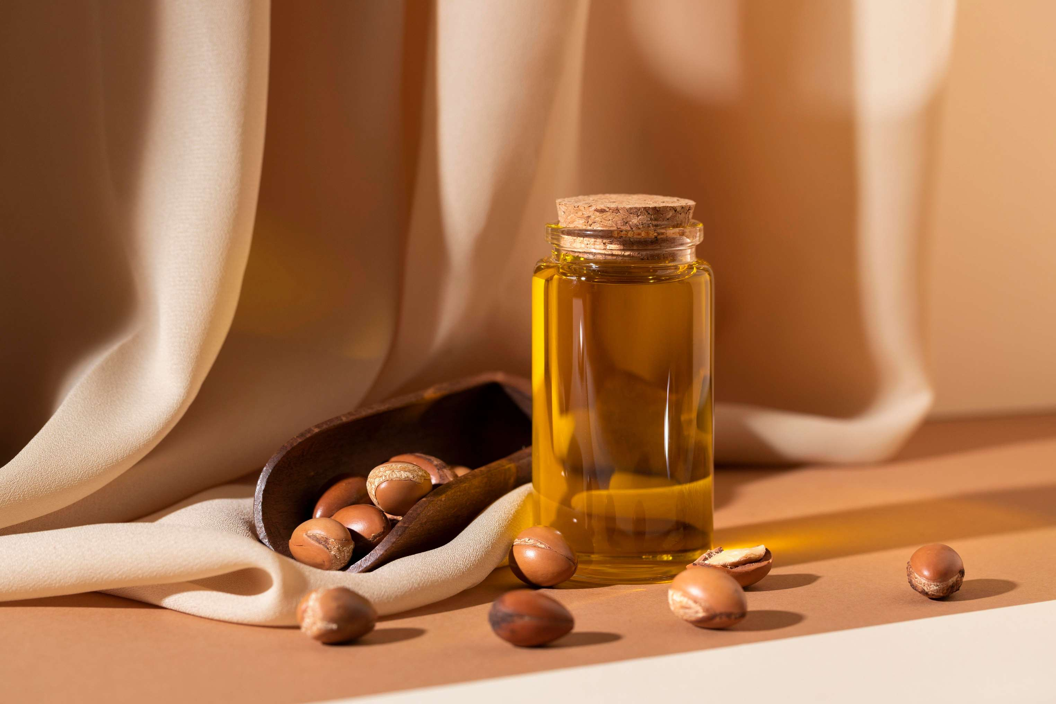
  Expansion of Cosmetic Industry to Increase Sales
  Growing Awareness of the Health and Beauty Benefits to Propel the Market
Drivers
Limited Geographic Distribution of the Argan Tree to Limit the Sales
Restraints

Slide 7

AUTHOR'S PERSPECTIVE
  The global argan oil market will expand significantly by 21.50% CAGR between 2024 to 2031.
  Its versatile applications in skincare, hair care, and culinary uses further contribute to sustained sales growth.
  Aromatherapy argan oil for use in diffusers, massage oils, and bath products expands its market appeal, contributing to its status as the fastest-growing segment.
  Concentrates argan oil is the fastest-growing category over the forecast period, owing to its potent formulations targeting specific skincare concerns.
  The sales of natural argan oil are poised to increase due to growing consumer preference for natural and sustainable beauty products, coupled with its diverse applications and proven health benefits.
  Sales of cosmetics & personal care argan oil are expected to rise due to its proven effectiveness in hydrating, nourishing, and rejuvenating the skin and hair, meeting the demand for natural beauty solutions.

Slide 8
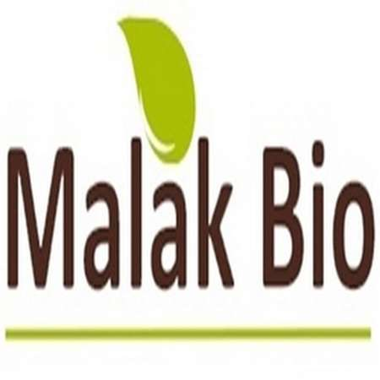
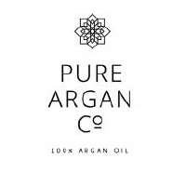
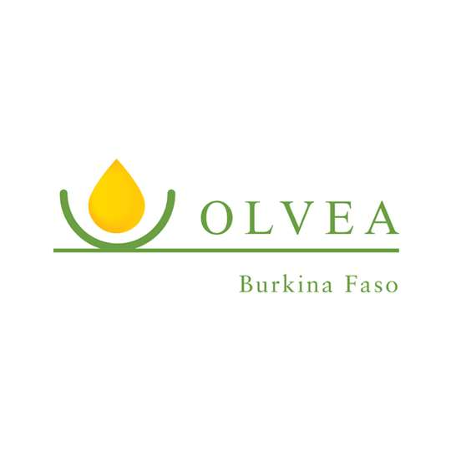
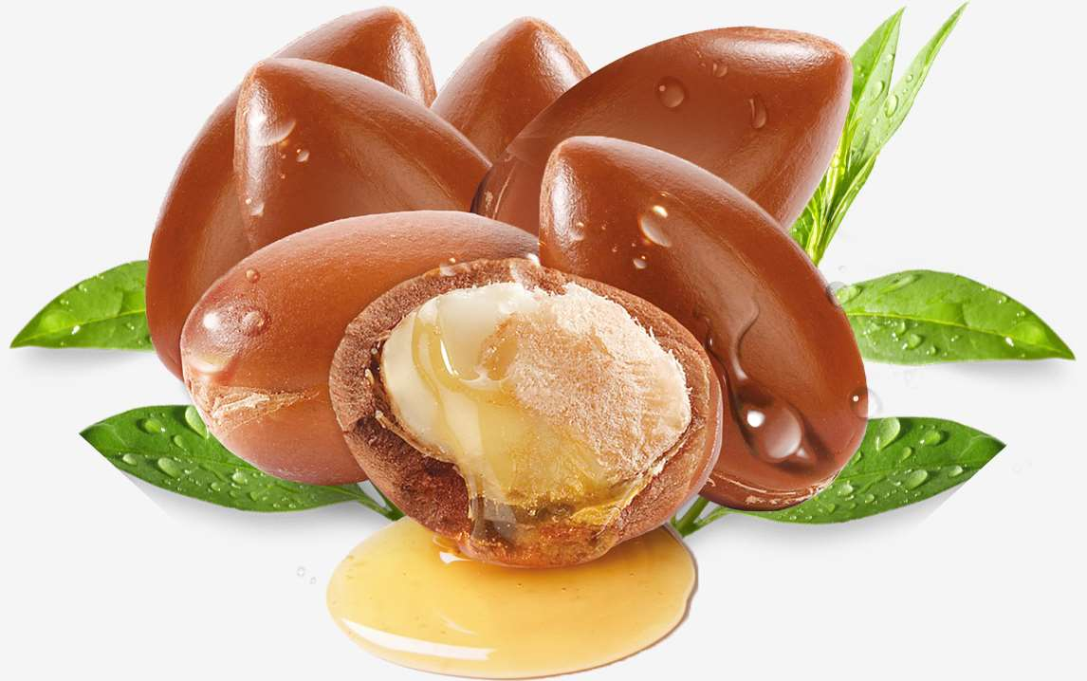

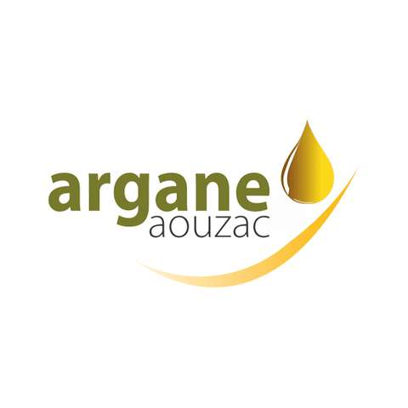
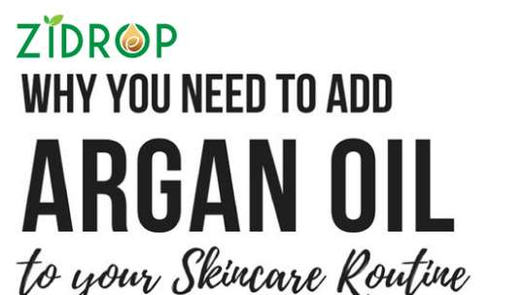
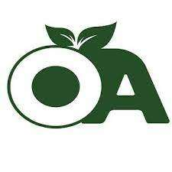
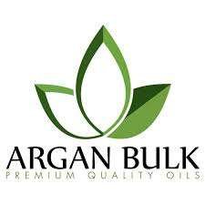
KEY PLAYERS

Slide 9


For Full Report
Contact us
COGNITIVE MARKET RESEARCH
Tel: +1 312-376-8303 | +44 020-8123-0732
India: (+91) 983-496-8611
sales@cognitivemarketresearch.com
Access the Full Report : https://tinyurl.com/2nu8c49t
Please visit our website:
https://www.cognitivemarketresearch.com

