Slide 1
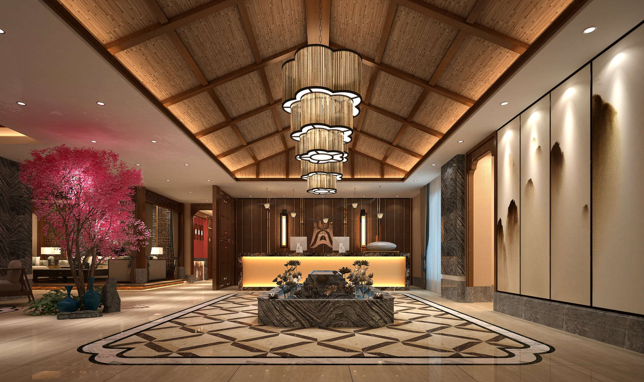
GLOBAL
APARTMENT HOTEL
MARKET REPORT
2024
Global,Regional,CountryAnalysis

Slide 2
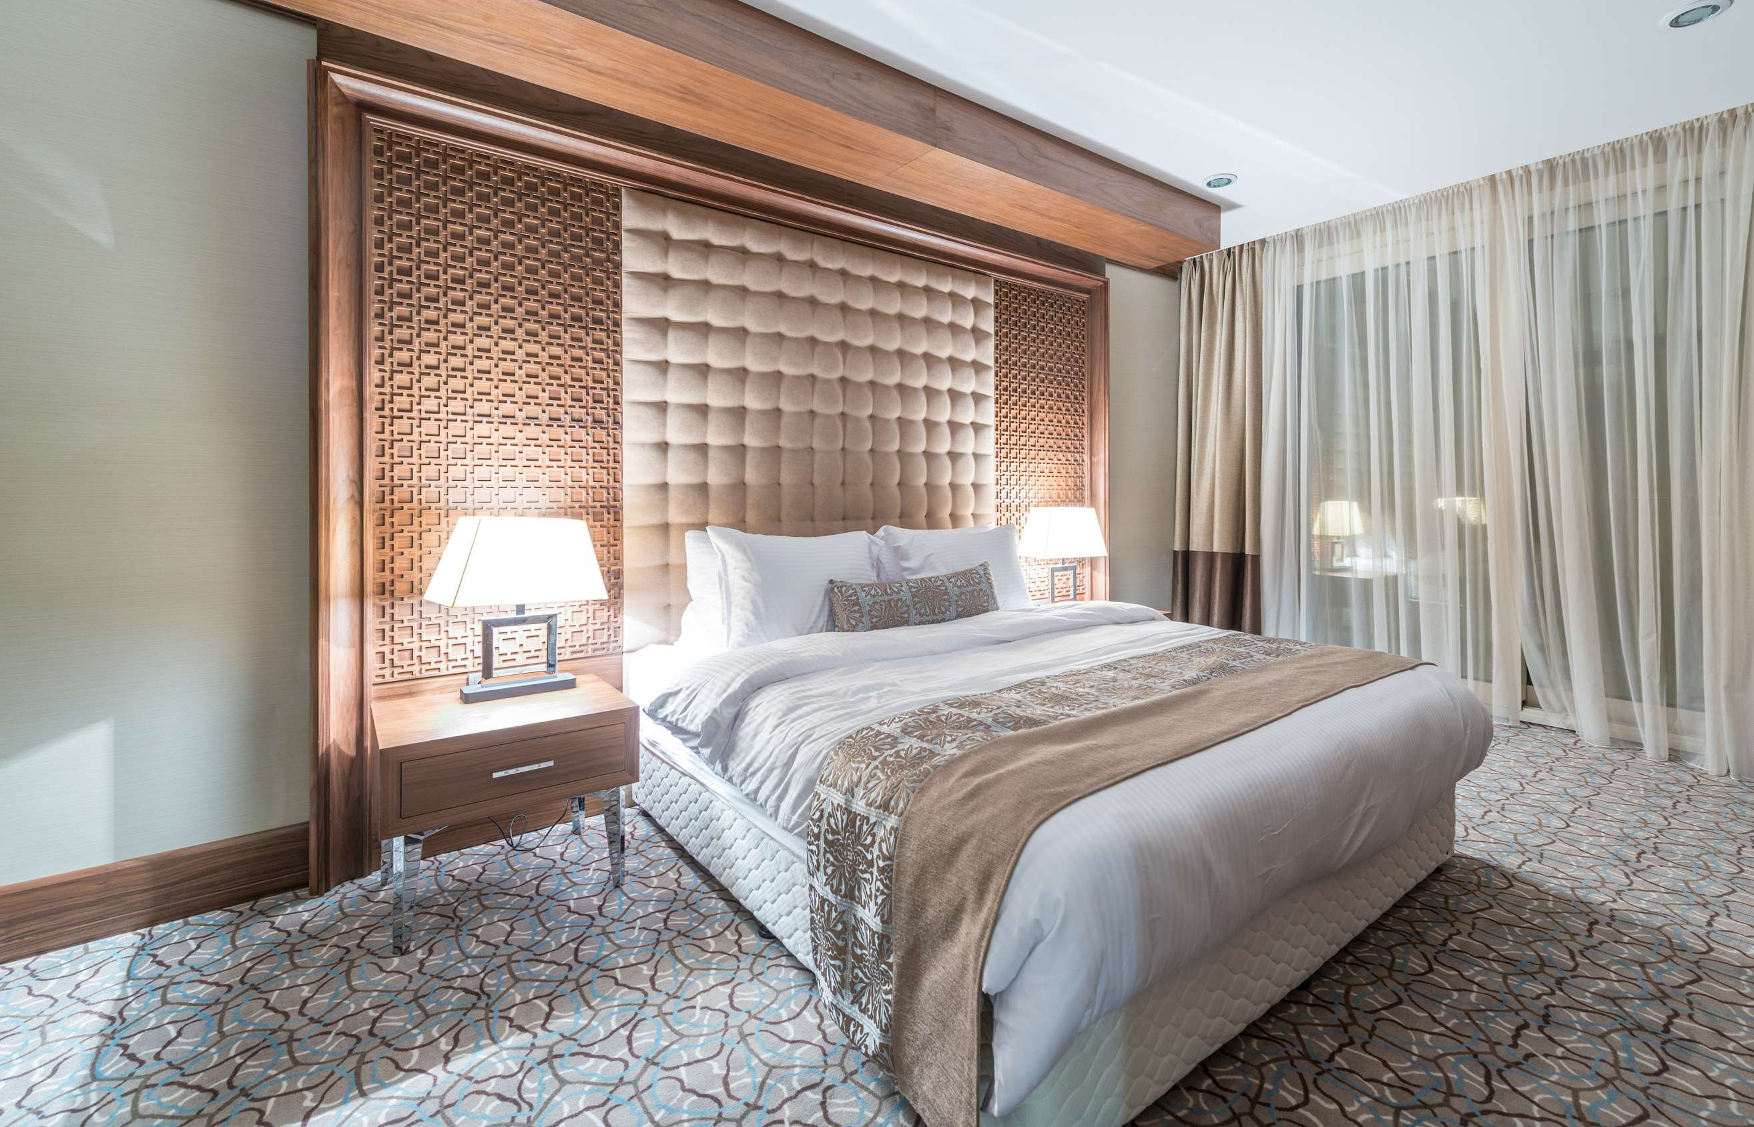
INTRODUCTION
An apartment hotel is a lodging option for travelers that shares similarities with hotels and serviced apartments, as it incorporates elements from both. Typically found in urban areas, these establishments offer fully furnished single-room apartments with everything needed for a comfortable stay. These apartments can be rented for varying durations, catering to the needs of both long-term and short-term guests, usually accommodating one or two individuals. The surge in demand for short-term lodging among business travelers, coupled with the rise in urbanization, the expanding number of leisure travelers, and evolving lifestyles, are contributing factors driving the growth of the apartment hotel market.

Slide 3


KEY INSIGHTS
CAGR
10.90%
2023- 2030

Slide 4

REVENUE MARKET SHARE BY SEGMENTS 2022
  Upscale Extended Stay Hotel
  Midscale Extended Stay Hotel
  Economy Extended Stay Hotel
Type Segment
  Travelers
  Business Customers
  Trainers and Trainees
  Government and Army Staff
Application
Segment

Slide 5

Global Apartment Hotel Market Revenue share for 2024
North America

Slide 6
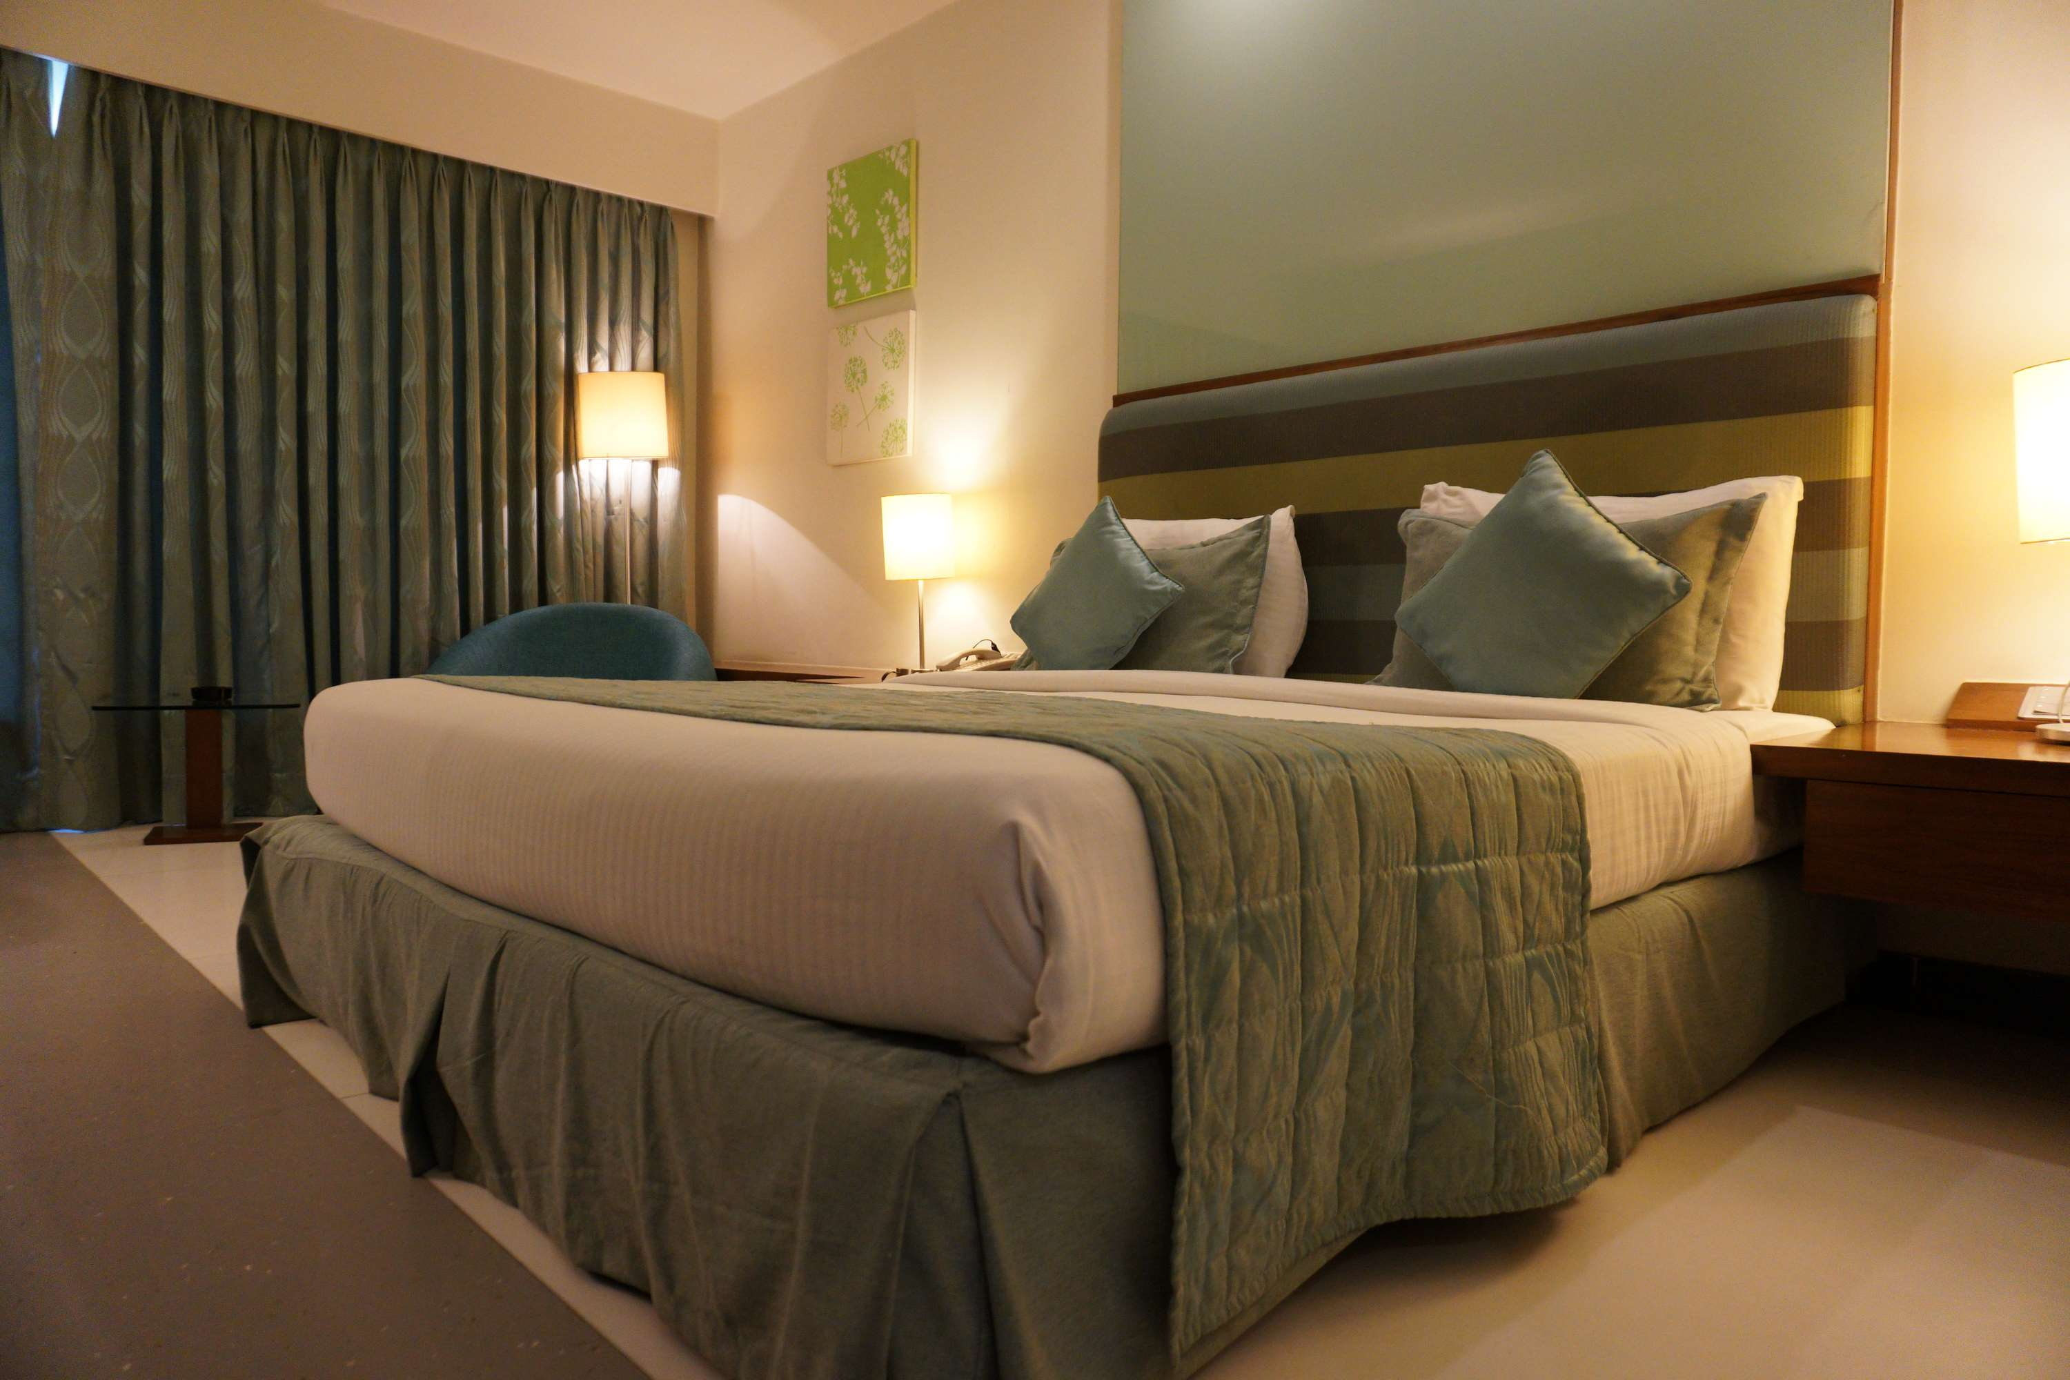
Changing Travel Preferences and Lifestyle Trends to Provide Viable Market Output
Drivers
Regulatory and Zoning Challenges to Hinder Market Growth
Restraints

Slide 7

AUTHOR'S PERSPECTIVE
  The Global Apartment Hotel Market is witnessing significant growth in the near future.
  Upscale extended-stay hotels blend premium amenities, spacious suites, and convenient locations, making them attractive options for business travelers, families, and tourists seeking an enhanced experience.
  Midscale extended-stay hotels balance affordability and essential amenities, making them attractive options for budget-conscious travelers, long-term business stays, and temporary relocations.
  Travelers, including families, couples, and solo adventurers, are opting for apartment hotels as they offer the flexibility of extended stays and home comforts.

Slide 8












KEY PLAYERS

Slide 9


For Full Report
Contact us
COGNITIVE MARKET RESEARCH
Tel: +1 312-376-8303 | +44 020-8123-0732
India: (+91) 983-496-8611
sales@cognitivemarketresearch.com
Access the Full Report : http://tinyurl.com/2byb3pjs
Please visit our website:
https://www.cognitivemarketresearch.com

