Slide 1

ANTI SPAM SOFTWARE MARKET REPORT

Slide 2

INTRODUCTION
Anti-spam is software that detects and blocks harmful emails from the user’s inboxes. Anti-spam software utilizes filters that only approve the known email addresses to the user inboxes. In case the email is unidentified as a legal email.

Slide 3

KEY INSIGHTS
MARKET SIZE
$ 4.62 Bn
2022
FORECAST
$22.03 Bn
2030
2023-
2030
CAGR 21.6%

Slide 4



REVENUE MARKET SHARE BY SEGMENTS 2022
ON-PREMISE DEPLOYMENT TYPE 56.8%
GOVERNMENT APPLICATION 33.5%

Slide 5
GLOBAL ANTI SPAM SOFTWARE MARKET REVENUE SHARE FOR 2022
North America- 34.2%

Slide 6

Increasing incidences of
Drivers
data breaches
Restraints
Lack of skilled professionals

Slide 7

AUTHOR'S PERSPECTIVE
In the past few years have seen rapid growth in email communication in emerging countries, due to the growth in the IT industry, there will be high adoption of anti-spam software in the upcoming years.

Slide 8

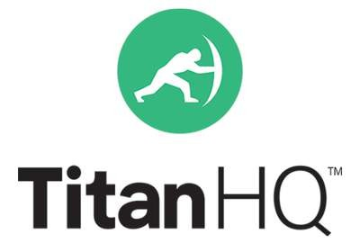




KEY PlAYERS

Slide 9


Contact us
For Full Report
COGNITIVE MARKET RESEARCH
Tel: +1 312-376-8303 | +44 020-8123-0732
India: (+91) 983-496-8611
sales@cognitivemarketresearch.com
Access the Full Report : https://shorturl.at/krsPS
Please visit our website: https://www.cognitivemarketresearch.com

